Slide 1
Introducing
Leadership

Slide 2
Today’s Objectives
To explain the meaning and importance of leadership in the workplace
To consider how it differs from management
To contrast the main approaches to leadership
To consider different leadership styles and how leaders behave
To evaluate transformational and inspirational leadership
To examine how leaders behave and how they exert power and influence
To assess what makes leaders effective and how they can be developed.

Slide 3
Some quotes....
‘Leadership means making people feel good’
(Jean Chretien, 1984)
‘The final test of a leader is that he leaves behind him in other men the conviction and the will to carry on.’ (Walter Lippman, 1945)
‘One realm, one people, one leader’
(Nazi slogan, 1930s)
Source: Oxford Dictionary of Quotations

Slide 4
Activity 1
Name 3 well-known leaders
What’s the difference between a manager and a leader?
Are all managers leaders?
Are all leaders managers?
Are leaders born or can they be made?
Notes:
Small group discussion please – 5 minutes

Slide 5

JFK: 1962
http://youtu.be/kwFvJog2dMw

Slide 6
The meaning of leadership
Leadership:
a relationship through which one person influences the behaviour or actions of other people.
It cannot be separated from groups and effective teambuilding.
Notes:
There are many possible definitions – here is one.

Slide 7
Leadership v Management
Leadership | Management
About behaviour | About processes
The way management methods and processes are used | The type of management methods and processes used
Sets a new direction and vision for others to follow | Controls/directs people and resources according to established principles/values
Relies on attitudinal qualities | Relies on management processes

Slide 8
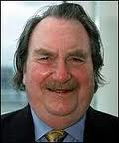
Close relationship between management and leadership
‘Increasingly, management and leadership are being seen as inextricably linked.
It is one thing for a leader to propound a grand vision, but this is redundant unless the vision is managed so it becomes real achievement.’
Sir John Harvey-Jones,
ex-Chair ICI and TV ‘Troubleshooter’
Notes:
This definition by the eminent late industrialist Sir John Harvey-Jones suggests that management is more about getting things done through other people to achieve organisational objectives.
-requires a structured organisation with prescribed roles.
Leadership is more about broader interpersonal behaviour and involves the willing and enthusiastic behaviour of followers.
Politicians are often referred to as ‘our leaders’ – the following isn’t always willing or enthusiastic but they don’t have managerial responsibility for us. Captains of sports teams are leaders – spurring them on
So leadership doesn’t have to take place within an organisational hierarchy – can operate at different levels in different ways – in some respects it can be formal or informal in nature.
Management passive towards goals / leaders personal active towards goals
Management co-ordinate and balance – compromises. Leader – create excitement and develops choices to images that excite people.
Managers – low level of emotional invoement with people; leaders empathise with others and look at what actions/events mean
Managers – conservators/regulators of existing order – preservers of the status quo ; leaders work in but don’t belong to the organisation – authority not derived from it so they seek out new opportunities for change – it’s a different mind set.

Slide 9
The importance of leadership
Management is changing:
- Less about getting results by close control of workers
- More about coaching, support and empowerment
Good leadership involves delegation and empowerment.
Leadership is a dynamic process.
The leader – follower relationship is two-way
Strong, positive relationship between leadership development and employee motivation and satisfaction.
Notes:
The world has changed. Remember those bureaucratic, Tayloristic organisations where people operated in their box and followed instructions? There are less of them around. Modern organisations are based more on these behaviours and approaches.
Delegation, empowerment, trust – recurring themes.
Leadership evolves – the leader influences the follower and the follower also influences the leader, it’s reciprocal.
It’s about motivation and interpersonal behaviour.

Slide 10
Management/Leadership
Management
  Getting things done through other people
  To achieve stated organisational objectives.
Leadership
  Broader emphasis on dealing with people
The willing and enthusiastic behaviour of followers

Slide 11
Leaders....
Create a vision
Communicate the vision
Energise, inspire and motivate others
Create the culture
Management = authority
Leadership = inspire and motivate

Slide 12
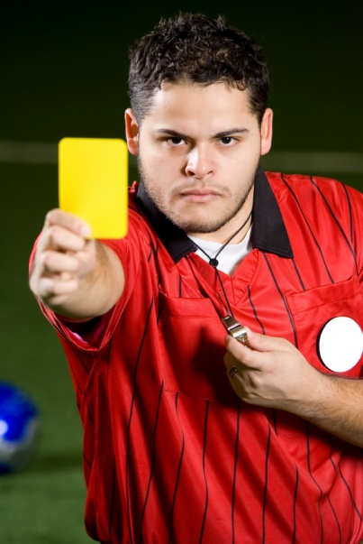
Or.....
Managers:
Do things right
Authority relationship
Create stability
Leaders:
Do the right things
Influence relationship
Create change

Slide 13
7 Ways of studying managerial leadership
Qualities or traits approach
The functional or group approach
Leadership behaviour
Styles of leadership
The situational approach and contingency models
Transformational leadership
Inspirational leadership
Notes:
Lots of ways of looking at this subject – these seven ‘approaches’ are one way.

Slide 14

1. Qualities/Traits approach
Assumes that leaders are born not made
The ‘Great Person’ theory
Focus is on the person who is leading
Inherited personality traits distinguish leaders from followers
Identifies some common traits, e.g.
  Self-confidence
  Initiative
  Intelligence
  Self belief
Notes:
Assumes leaders are born not made
Personality characteristics distinguish leaders – ‘Great Person’
Person not role focussed re leadership
Pick the right people for a leadership role not train them up – leaders are born not made according to this philosophy
Some general features or ‘traits’ re leaders but hard to generalise – doesn’t take account of a leadership situation or about the characteristics of those being led (‘followers’)
Problems: subjective judgement of ‘good’ or ‘successful’ These aren’t either or options – even natural talent needs to be developed, skills and techniques need to be learnt.

Slide 15
Leadership traits:
Cooper et al (2012: 128)
Old Traits (1981) | New Traits (more recent)
Tall | Integrity, maturity, energy
High socio-economic status | Business acumen
Good interpersonal skills | People acumen
Decisive | Organisational acumen
Intelligent | Curious, intellect, global mindset
Superior judgment | Superior judgment
Excellent verbal ability | Motivation to grow

Slide 16
4. Styles of Leadership
The way in which the functions of leadership are carried out
How the manager typically behaves towards members of the group.
Broad classifications of leadership style include:
Authoritarian (or autocratic) style - directive
Democratic style – participative
Laissez-faire (genuine) style – leave alone
Notes:
Our fourth approach – today manager’s can’t just throw their weight about to get things done.
Need to foster high morale, spirit of involvement and co-operation – to get people wanting and willing to work.
Examine the style of leadership adopted to do this.
Assumes if leaders behave in a certain way, subordinates are more likely to follow.
Would you agree? People have their own personal expectations and needs – increasingly resistant to purely autocratic leadership styles.
3 broad types:
Authoritarian/autocratic – power with the manager – the sole decision maker with authority for organising work
Democratic – power with group as a whole- shared leadership, manager part of team – input, involvement by members
Laissez-faire (genuine) – manager says group working well on its own – lets them have the power to do what they think’s best, not interfere, but help if needed. Can be confusing – may look as though manager doesn’t care and so detaches himself. Is this in fact leadership or abdication of managerial responsiblity?

Slide 17


Continuum of leadership behaviour
Tannenbaum and Schmidt , based on:
  The degree of authority used by the manager
  The area of freedom available to the non-manager
The four main styles are when a manager:
  Tells
  Sells
  Consults
  Joins
Notes:
Still with leadership style, there is a scale available to managers along which they can make decisions on possible leadership styles/behaviours = range of possible action available
Bit like theory X and Y (McGregor) – boss centred leadership (X); subordinate centred (Y)
4 main styles of managerial leadership result along the continuum:
Tells – manager does the lot
Sells – manager decides but seeks to persuade people to do it
Consults – manager presents problem to group, listens to advice and
Joins – manager defines problem and the limits within which the decision must be made, passes this to the group which makes the decision with the manager.
We have quite a diagram to show this:

Slide 18
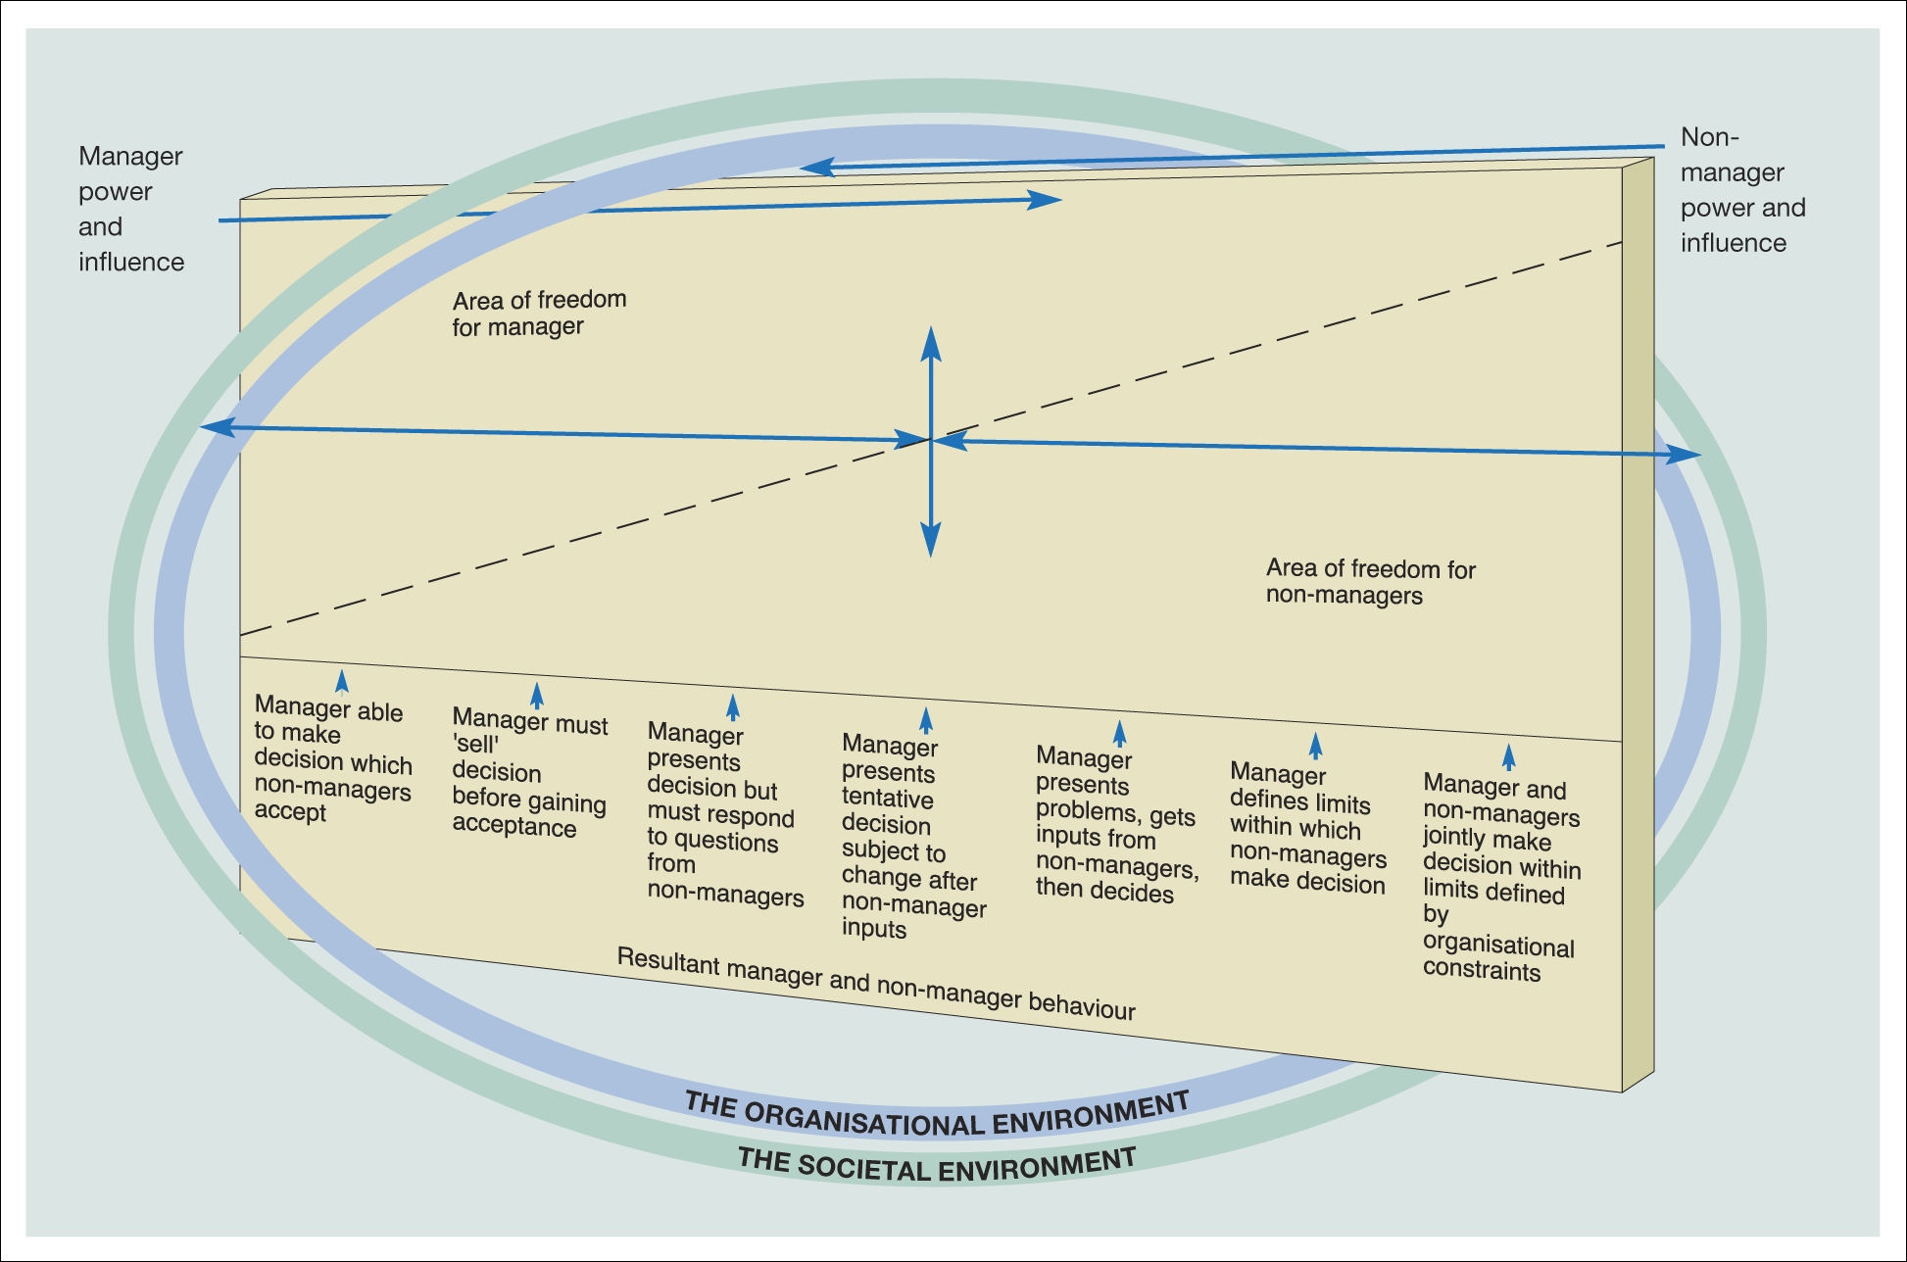
Continuum of manager to non-manager behaviour
Figure 10.4 Continuum of manager – non-manager behaviour
Source: Tannenbaum, R. and Schmidt, W. H., ‘How to choose a leadership pattern’, Harvard Business Review, May/June 1973, p. 167. Copyright © 1973 Harvard Business
School Publishing Corporation; all rights reserved. Reprinted by permission
Notes:
The line represents the degree of managerial control

Slide 19

Leadership style decisions
The choice of style is influenced by three main forces:
Forces in the manager
  Including personality, background and experience
Forces in the subordinate
  Including personality and expectations
Forces in the situation
  Including the specific situation and pressures
Notes:
These are the key influencers of management style:

Slide 20
Forces in the manager
Value systems
Confidence in subordinates
Leadership inclinations
Feelings of security in an uncertain situation

Slide 21
Forces in the subordinate
Strength of the need for independence
Readiness to assume responsibility for decision-making
Degree of tolerance for uncertainty
Interest in the problem and feelings as to its importance
Understanding and identification with the goals of the organisation
Necessary knowledge and experience to deal with the problem
The extent of learning to expect to share in
decision-making

Slide 22
Forces in the situation
Type of organisation
Group effectiveness
Nature of the problem
Pressure of time

Slide 23

Vroom and Yetton: five main decision styles
Autocratic
  A.I. Leader solves the problem alone.
  A.II. Leader obtains information then decides alone.
Consultative
  C.I. The problem is shared: the leader decides possibly reflecting influence of subordinates.
  C.II The problem is shared: the leader decides possibly reflecting the decision of subordinates.
Group
  G.II. The problem is shared: the leader chairs a group decision-making process.
Notes:
This model has since been revised by Vroom and Jago - more variables – Mullins 2010 p387 for more

Slide 24
Path – goal theory: House
Based on expectancy theories of motivation
Identifies four main types of leadership behaviour:
  Directive
  Supportive
  Participative
  Achievement-oriented
All four types of behaviour can be used by the same person at different times and in different situations.
Notes:
Third contingency theory by House and House and Dessler.
Assumes individual motivation dependent upon expectation increased effort to improve performance will be successful which gets positively rewarded, and avoids negative things.
Theory assumes performance of subordinates is affected by the extent to which the manager satisfies their expectations.
Workers see leadership as a motivator:
Need to perform effectively to meet their needs
Gets them the necessary direction, guidance and support they need
4 types of leadership behaviour as shown , similar to others we’ve been through.
The situation calls for different types of leadership to be adopted at different times.

Slide 25
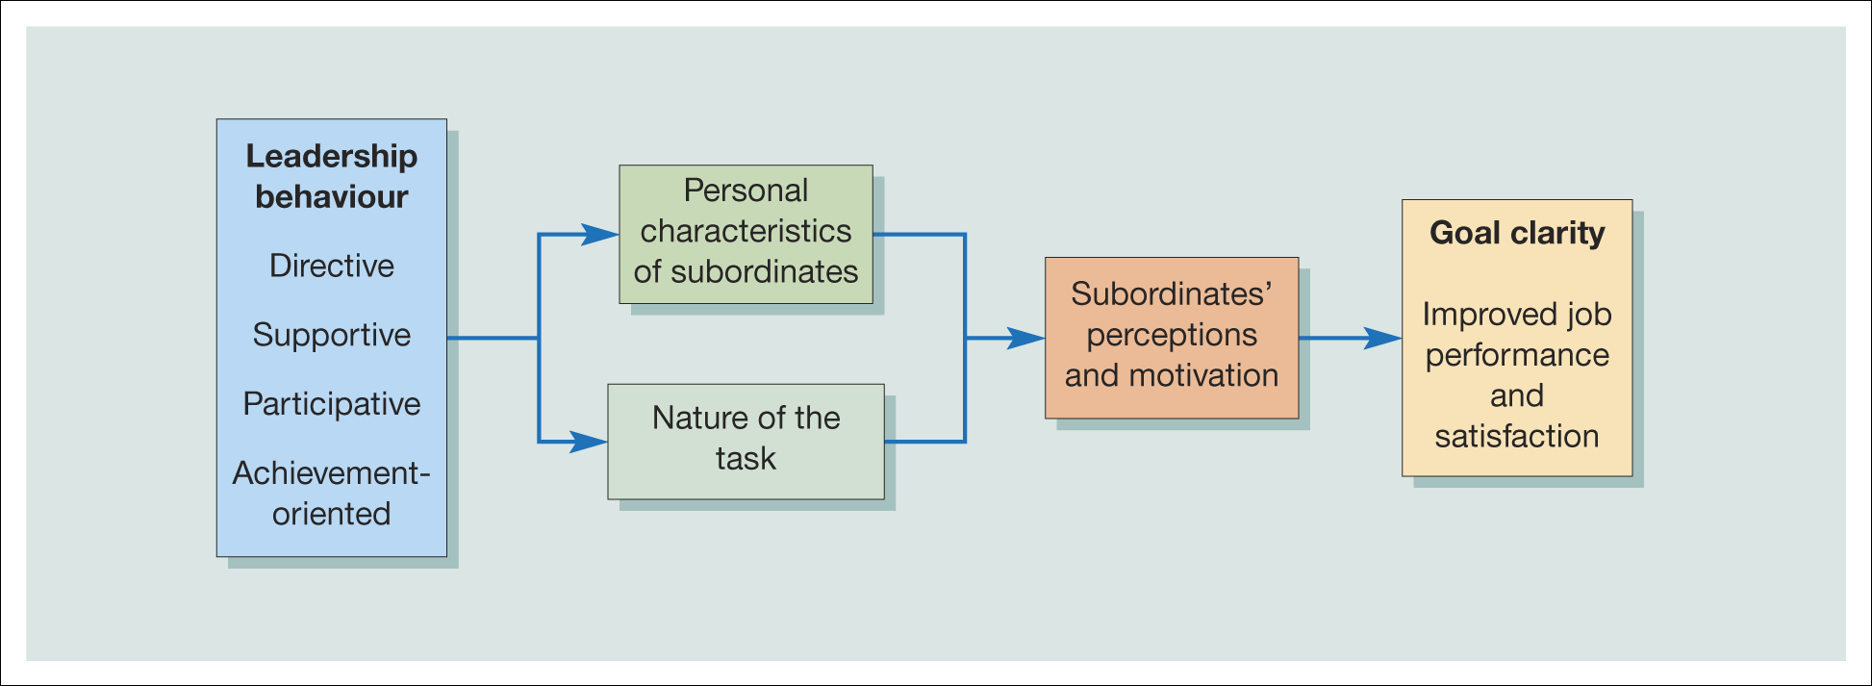
Representation of the path–goal theory of leadership
Figure 10.6 Representation of the path–goal theory of leadership
Notes:
This shows the ‘contingency’ or situational aspect of this theory at work
Personal characteristics of subordinates – how will they react to the leader’s behaviour? Does it help/hinder them?
Nature of the task: routine and structured (i.e. More straightforward) or non-routine, unstructured (more directive behaviour may be necessary to get things moving)
All about how can leaders best help to get the best out of their people and deliver the results required?

Slide 26

Transformational leadership
Transactional
Based on legitimate authority
Emphasis on the clarification of goals, tasks, outcomes and rewards
Appeals to the self interest of followers
Based on a relationship of mutual dependence and exchange
Transformational
A process of engendering high levels of motivation and commitment
Generating a vision for the organisation, an appeal to higher ideals of followers, creating a feeling of loyalty and trust
Is about transforming the performance or fortunes of a business
Notes:
There’s a growing trend away from transactional to transformational leadership, 2 main types
In what type of organisation would you expect to see transactional leadership?

Slide 27

Guidelines for transformational leadership: Yukl
Articulate a clear and appealing vision
Explain how the vision can be attained
Act confident and optimistic
Express confidence in followers
Provide opportunities for early success
Celebrate success
Use dramatic symbolic actions to emphasise key values
Lead by example
Empower people to achieve the vision
Notes:
How this can be done in practice:
Vision - Why are we here?
Attain vision – create link between vision and strategy for achieving it
Confident/optimistic – conviction, self-confidence, positivity, self and others
Be upbeat, go getting, inspirational
Know any leaders like that?

Slide 28
Inspirational, visionary or charismatic leadership
‘Charismatic leaders transform followers by creating changes in their goals, values, needs, beliefs and aspirations.
They accomplish this transformation by appealing to followers’ self-concepts – namely their values and personal identity.’
Kreitner et al.
Notes:
Often regarded as the same thing as transformational leadership
Here leaders create a strong vision, mission – people identify with him/her
The modern way – ‘inspirational ‘ – not really about leadership theory as we’ve just been discussing but more about the skills needed to motivate and inspire people.
It’s the vision thing. See the bigger picture, take the long term view - what are the ultimate objectives of the organisation and how can people work together to achieve them? - a touch of greatness perhaps?
- About increasing performance but also producing tangible results for people and bringing them increased satisfaction.
Are you born with charisma or can you learn it? Do you need more than that to be an inspirational leader?
Too much charisma can create dependence – Apple, Steve Jobs; Virgin – Branson; what happens when they’re not there anymore?
Is it as Adair suggests more about a ‘connection’ between the leader and followers – remember that Venn diagram intersecting?

Slide 29
The vision thing....
The ability to see the bigger picture
Taking a long-term view
Getting everyone to work together to achieve the organisation’s objectives
Create the right climate
Learn from mistakes not punish
More commitment from people, not just compliance (Whitehead, 2002)

Slide 30
Key quote
‘What sets great leaders apart is their ability to engage those around them in a shared vision of the future.
By making the right decisions, they demonstrate their commitment to turning their vision into reality;
And by doing so successfully, they instil in others the confidence to trust in their leadership’
Sir Brian Nicholson

Slide 31
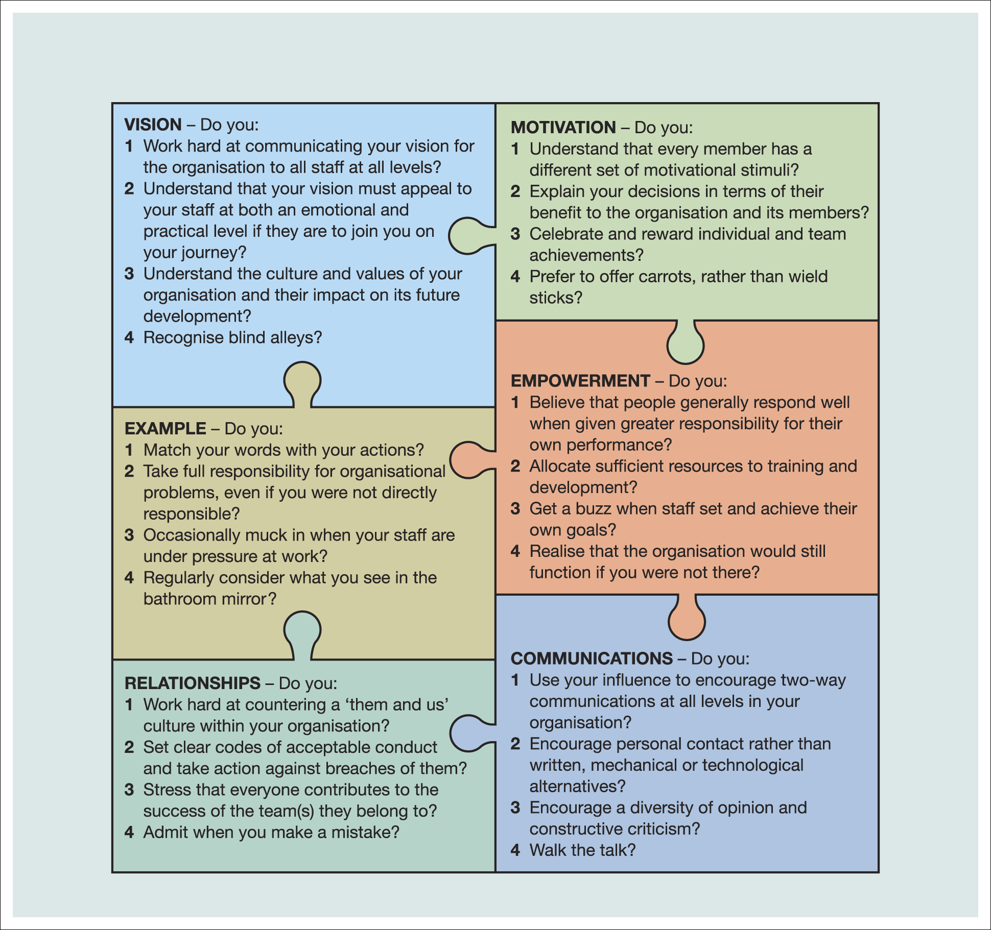
Figure 10.10 The leadership ‘jigsaw’
Source: Cutler, A. ‘A Good Fit Is Essential’, Professional Manager, vol. 15, no. 3, May 2005, p. 38. Reproduced with permission from Chartered Management Institute and Alan Cutler
Notes:
Cutler’s jigsaw of best practice – 6 pieces as shown all interlinking – aspiring leaders need all these things in his view.

Slide 32
New skills and competencies
The new leader understands and practises the power of appreciation says thanks
The new leader keeps reminding people of what is important stays focused
The new leader generates and sustains trust is fair
The new leader and the led are intimate allies team
Bennis
Notes:
‘the new leader must cast off the heavy burden of command and control, hierarchically based leadership.’ – it’s not about all that structure and bureaucratic authority any more.
There is, after all, no ‘I’ in ‘Team’.

Slide 33
Leading in changing times
Show energy and optimism
Be open to change
Communicate
Empower employees
Improve the organisation
Develop talent
Cooper et al, 2012

