Slide 1
BMHP6026-BIRM
Name: Patient Mohamed
Student number: 2332011
Digital transformation in health and care professions.
BMHP6026_BIRM
Lectures name: Zakiyyah Ahmed

Slide 2
Index:
What is DSCR system?
When and how DSCR system was implemented in the UK
Impact on Patient/ Service user
Impact on Service delivery
Conclusion
Reference list

Slide 3
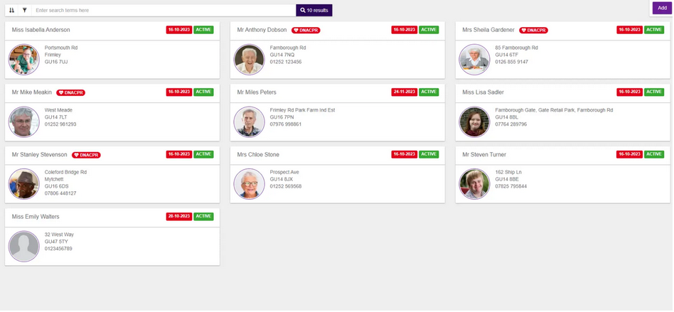
What is DSCR system?
Digital Social Care Record (DSCR) is a system used in most social care settings across the UK.
The system safely store records important info of the service users such as their name, medical history, care plans, their needs and up to date information and more (Skinner, 2023).
DSCR system replaces paper record and makes it digital, making it more accessible for professionals to access the patient's information easily reducing administrative time, medical errors and improving care services and communication(Gov.uk, 2025).
This image shows how the system looks like (Pass, 2024)

Slide 4
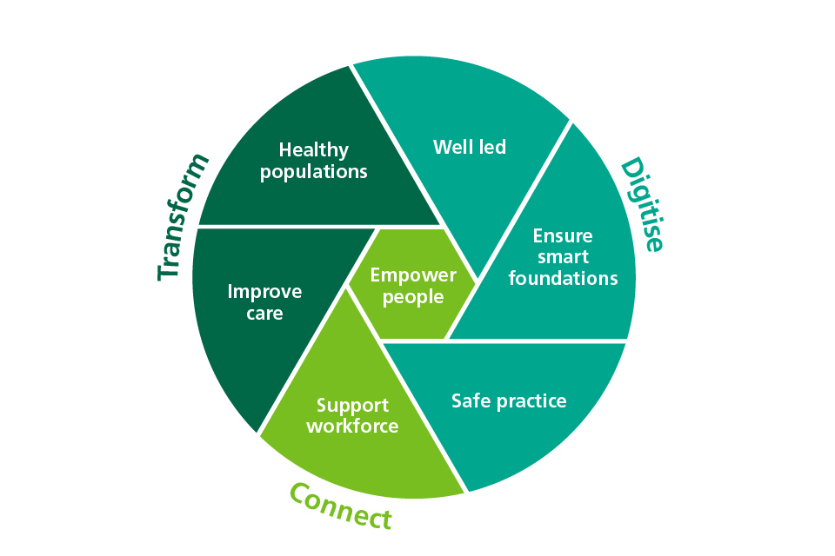
When and how DSCR system was implemented in the UK
DSCR system was implemented by the UK government in 2021(Ainsworth, 2023). Maley et al., (2026) noted that the government aim was that 80% of care providers registered in the Care Quality Commission (CQC) should be using the DSCR system by 2024, however that was extended to 2025. The government also provided financial support to help care homes change from recording on paper to recording digitally (Maley et al., 2026).
According to Sutton et al., (2023) the DSCR system was funded by the Department of Health and Social Care (DHSC) and supported by the NHS England, CQC was also involved and supported the innovation as they recognise that this system will be helpful for the professionals as it gives them quicker access to patient's information (Sutton et al., 2023).
What Good Looks Like (WGLL) framework policy provides guidance on how care providers should manage the patient personal data ensuring Patient's data security (Department of health & social care, 2023).
As you can see the image shows the 7 measures for digital working in adult social care for WGLL (Department of health & social care, 2023).

Slide 5

Impact on Patient/
Service user
DSCR system has changed service user experience by improving the care services, safety and communication. According to Brand et al., (2022) the system empowers patients, making them more involved when planning their care.
The service also allows families to be involved by accessing the portal, which contains the patient's personal data such as their medication history, care plan and more (Malley, 2025).
However, some patients may struggle with technology meaning that not every patient will be able to access the portal. This would make the patient less confident and more frustrated. This is a challenge as according to the Mental capacity act 2005 the patient has the right to be actively involved when creating their care plan (Whitfield, 2025).

Slide 6

Impact on Service delivery
The DSCR system has improved the service delivery benefiting the professionals, as it supports staff by reducing administrative hours and providing access to up-to-date patients' information and records, giving them more time to focus on following the care plan correctly (Abernethy et al., 2022).
However, Chambers et al. (2021) highlight that there are social care workers who lack IT skills. This could be a risk, as there could be an accidental breach of personally identifiable information (PII).
This suggests that there will be some challenges implementing the DSCR system in care homes where staff who have limited IT skills.

Slide 7

Conclusion
Overall, the Digital Social Care Record (DSCR) is a great innovation for social care settings as it securely registers the patients' up to date personal information, medication history and more.
The system also reduces administrative work for staff, giving them more time to provide care that follows the patients' preferences and empowering them following the Mental Capacity Act 2005, it also reduces medical errors as they have access to the patients' information.
However, the system faces challenges as there is a risk of data breaches. It is mandatory for social care workers to follow the 7 principles of GDPR and the Data Protection Act 2018 to secure the patients information.
There are ways to mitigate those challenges that the DSCR system faces. The government should increase the implementation fundings as this would help reduce the financial struggle of care homes. Digital training should me mandatory in every care home for staff to reduce the risk of data breach, this will protect the service users' personal data

Slide 8
Reference list:
Abernethy, A., Adams, L., Barrett, M., Bechtel, C., Brennan, P., Butte, A., Faulkner, J., Fontaine, E., Friedhoff, S., Halamka, J., Howell, M., Johnson, K., Long, P., McGraw, D., Miller, R., Lee, P., Perlin, J., Rucker,D., Sandy, L., Savage, L., Stump, L., Tang, P., Topol, E., Tuckson, R & Valdes, K. (2022) The promise of digital health: Then, now, and future. Nam perspective. Doi: 10.31478/202206e
Ainsworth, A. (2023) Digitising social care: reflections on progress. Available at: https://socialcare.blog.gov.uk/2023/11/09/digitising-social-care-reflections-on-progress/ (Accessed date: 27 June 2026)
Brands, M., Gouw, S., Beestrum, M., Cronin, R., Fijnvandraat, K & Badawy, S. (2022) Patient-Centered digital health records and their effects on health outcomes: Systematic review. Journal of medical internet research, 24(12). Doi: 10.2196/43086
Chambers, D., Cantrell, A & Booth, A. (2021) Raoid evidence review: challenges to implementing digital and data-driven technologies in health and social care. Available at: https://eprints.whiterose.ac.uk/id/eprint/175758/1/Digital%20challenges%20final%20report-for%20repository.pdf (Accessed date: 28 June 2026)
Department of Health and Social Care (2023) Digital working in adult social care: What good looks like. Available at: https://www.gov.uk/government/publications/digital-working-in-adult-social-care-what-good-looks-like/digital-working-in-adult-social-care-what-good-looks-like-for-local-authorities-and-care-providers (Accessed date: 26 June 2026)
Gov.uk (2025) Digital revolution in care saves millions of admin hours. Available at: https://www.gov.uk/government/news/digital-revolution-in-care-saves-millions-of-admin-hours (Accessed date: 26 June 2026)
Legislation. Gov. Uk (2026) Data Protection Act 2018. Available at: https://www.legislation.gov.uk/ukpga/2018/12/contents (Accessed date: 29 June 2026)
Legislation. Gov. Uk (2026) Mental capacity act 2005. Available at: https://www.legislation.gov.uk/ukpga/2005/9/contents (Accessed date: 28 June 2026)
Malley, J., Westwood, J., Snow, M., Farrelly, N., Steils, N., Handerson, C & Larkins, C. (2026) A rapid evaluation of the implementation of digital social care records in England. Health and social care delivery research, 14(16). doi: https://doi.org/10.3310/gjjw2821
Pass (2024) The complete guide to Digital Social Care Record. Available at: https://www.everylifetechnologies.com/content-hub/the-complete-guide-to-digital-social-care-records/ (Accessed date: 1 July 2026)

Slide 9
Reference list:
Skinner, P. (2023) Putting it on (digital) record. Available at: https://socialcare.blog.gov.uk/2023/08/10/putting-it-on-digital-record/ (Accessed date: 14 June 2026)
Sutton, M & Skinner, P. (2023) Digitisation is the power to improve care. Available at: https://socialcare.blog.gov.uk/2023/09/08/digitisation-is-the-power-to-improve-care/ (Accessed date: 26 June 2026)
Whitfield, G., Kispeter, E., Hamblin, K & Burns, D. (2025) How the care workforce navigates the digital ‘skill gap’: problems and opportunities from policy to practice. Frontiers in sociology, 10, 1552672. Available at: https://pmc.ncbi.nlm.nih.gov/articles/PMC12058752/

Slide 10

​

