Slide 1
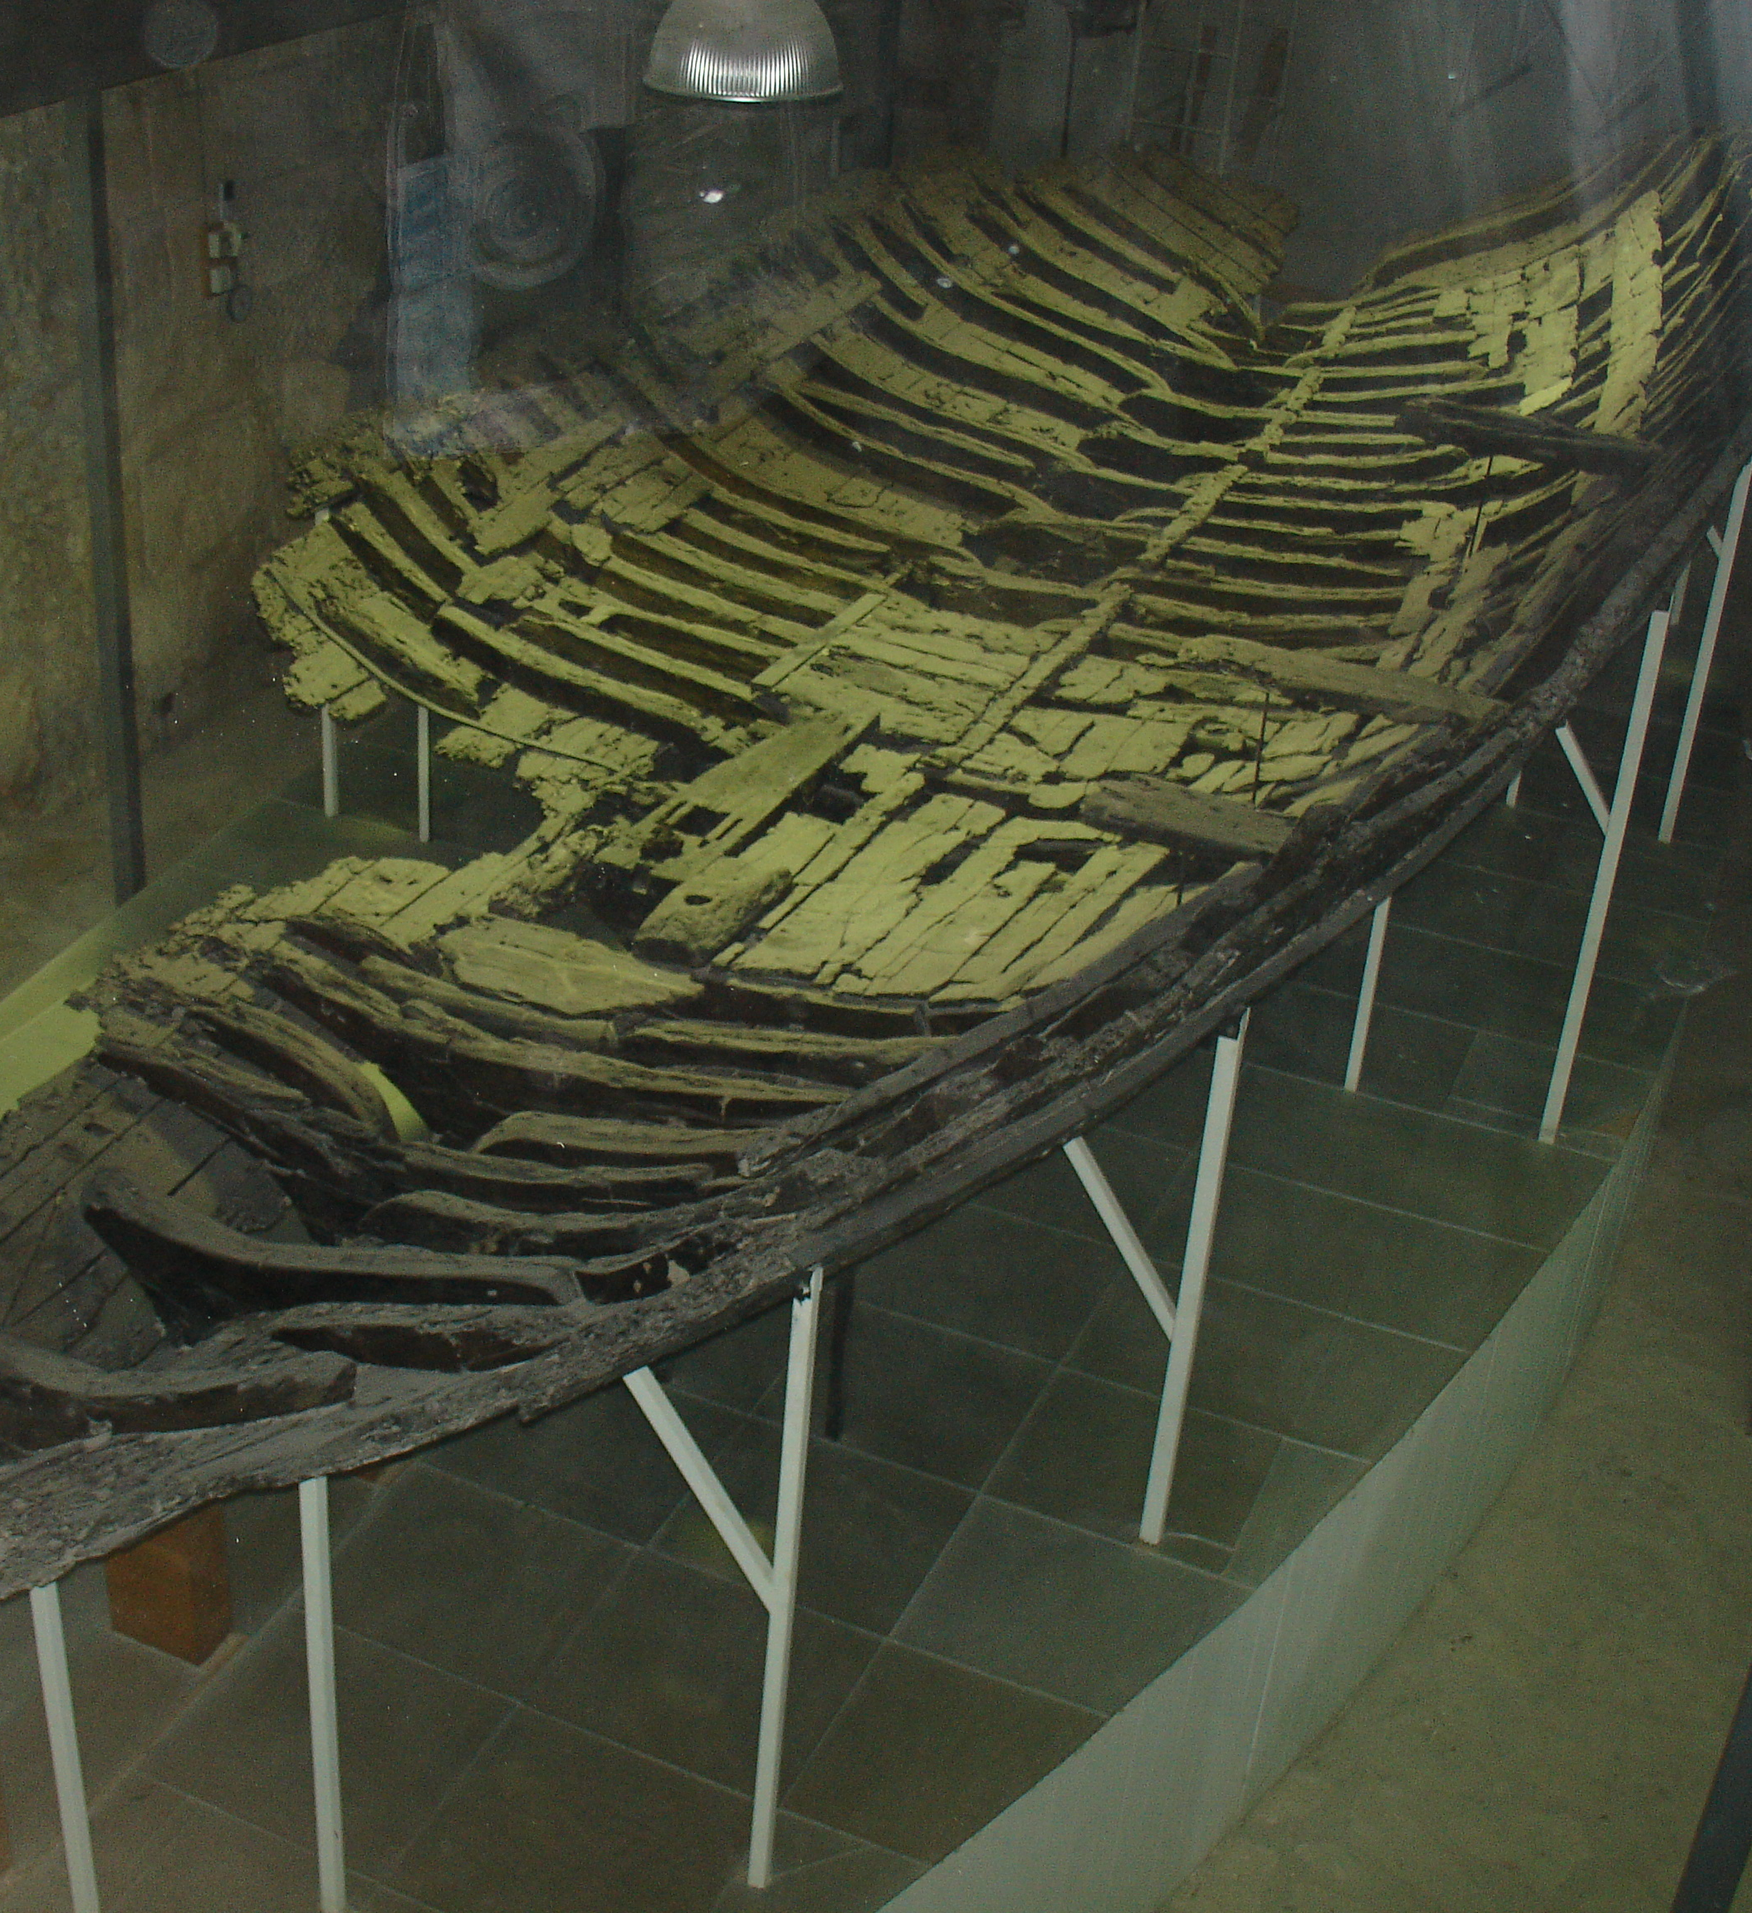
The wreck of the Kyrenia: An object biography perspective
By Carrina Tucker-Hughes

Slide 2
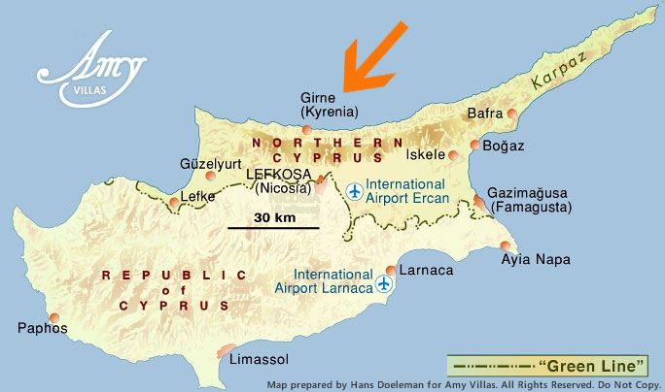
Topic and Objectives
I have chosen to do my dissertation on the Kyrenia shipwreck.
Using the perspective of cultural biography.
This dissertation allows the exploring of the Nautical side of Archaeology.
The wreck was found off the coast of the Cypriot city of Kyrenia, hence the name given.

Slide 3
Kopytoff: Biographical approach
Objects have value in different ways.
The value of the Kyrenia has changed through its life.
  Community value as a vessel
  Social value in the way it connected people and places in the 4th century.
  It is a priceless archaeological artefact
  Also has symbolic cultural value of modern Cypriot identity
Selective biographical aspects of the Kyrenia.
  Technical biography: repair record
  Social biography: place in society, life of the ship, including its cargos,, journeys and places.

Slide 4
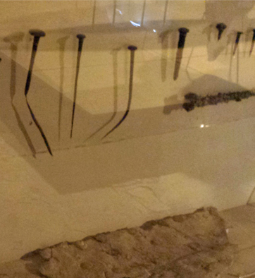
Section one: Construction
Built in the styles of ‘shell first’.
Used copper spikes to attach the ‘streaks’.
Merchant ships were built to be ‘broad and heavy’ with a ‘strong hull’ and ‘plenty of space’ for cargo (Bass, 1972. p41).
It was constructed from pine so that it could be left in the water more while not in use (Bass, 1972. p41).
Due to use it was repaired with lead sheathing (Bass, 1972. p49).

Slide 5
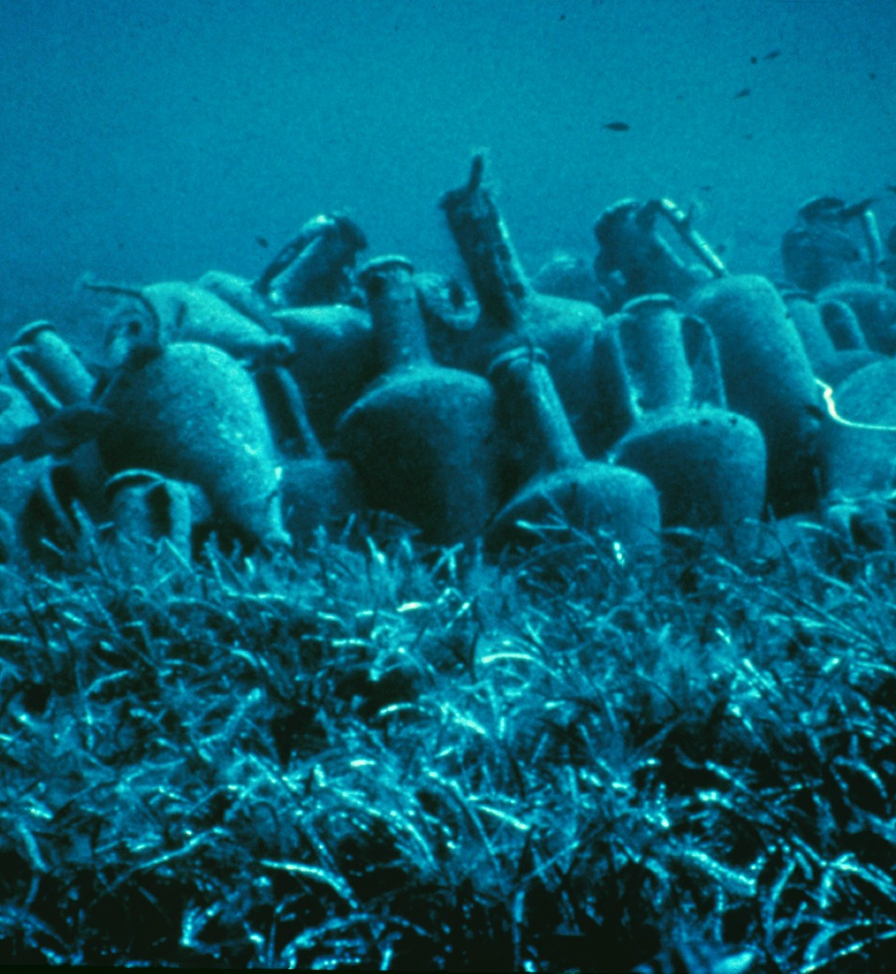
Section two: life at sea
The Kyrenia was a merchant ship that sailed around Mesopotamia during the time of Alexander the Great and his successors (Katzev, 2007).
Due to the repair work and carpentry it is surmised that the Kyrenia sailed as a merchant ship for 15-25 years (Katzev, 2007).
It was thought to be used to carried objects across the sea including amphora, which were found when its sunk.
The reason for its sinking is greatly debating with the first theory being it was taken by rough seas but now the theory of piracy is becoming for prominent (Katzev, 2007).

Slide 6
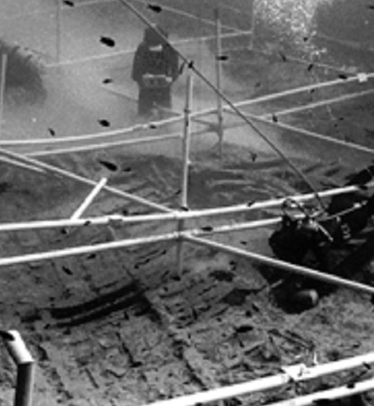
Section three: discovery and recovery
In 1967 during a dive a Cypriot diver came across the Kyrenia, off the coast of Cyprus (Bass, 1972. p50) .
In 1968 to 1969 the ship was then assessed by Michael Katzev and its contents was recorded.
Once all the objects had been recovered and recorded they carefully recovered the hull of the ship.
Conservation
Conserved between 1970 and 1974.
Then was finished being reassembled in 1976.

Slide 7
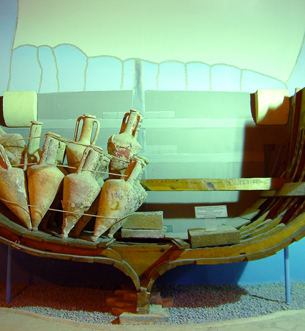
Conclusion
Potential conclusion for my dissertation is the changing biographical value of the Kyrenia during its life in the 4th century to present day.
So far in my research I have discovered the works of Kopytoff that is key piece of work for my dissertation. I have also researched the ship itself to give a basic understanding of its construction and life both at the time and its renewed life as archaeological evidence.
Further research will be done throughout the following months to increase details on the subject as well as hopefully establish where the ship was constructed and how the Kyrenia came to be sunk. Rough sea or Piracy?

Slide 8
Bibliography
Bass, G. F. (1974) A history of seafaring based on underwater archaeology. London: Omega.
Katzev, Susan Womer. “The Ancient Ship of Kyrenia, Beneath Cyprus Seas.” Great Moments in Greek Archaeology. Ed. Valavanēs and el. Oxford University press, 2007. p286-299.
Kopytoff, I. (1986) ‘The cultural iography of things: commoditization as process’, in The Social Life of Things: Commodities in Cultural Perspective. Cambridge ; United Kingdom: Cambridge University Press. pp. 64–91. [online]. Available from: https://books.google.co.uk/books?hl=en&lr=&id=6JqTcziwKTYC&oi=fnd&pg=PA64&dq=kopytoff+the+cultural+biography+of+things&ots=Xm8_2iTSo4&sig=B5XCwx-ssl3Ic2_0U6Nz_fpfRWg&redir_esc=y#v=onepage&q=kopytoff%20the%20cultural%20biography%20of%20things&f=false (Accessed 1 October 2019)
Images
Picture on slide one: https://en.wikipedia.org/wiki/Kyrenia_ship
Picture on slide two: https://www.amyvillas.co.uk/map.asp
Picture on slide four: https://northcyprusdiscovery.com/shipwreck-museum/
Picture on slide five: https://nauticalarch.org/projects/kyrenia-shipwreck-excavation/
Picture on slide six: https://nauticalarch.org/projects/kyrenia-shipwreck-excavation/
Picture on slide seven: http://www.northcyprusonline.com/North-Cyprus-Online-Sightseeing-Kyrenia-Shipwreck-Museum.php

