Slide 1
Work Breakdown Structure

Slide 2
Work Breakdown Structure
Learning Outcome
At the end of this lecture, students will be able to:
        Explain the principles and purpose of a Work Breakdown Structure (WBS) and Critical Path Method (CPM)
Engineering Project and Management

Slide 3
Work Breakdown Structure
Definition
A structured way of breaking down a project into smaller, manageable parts each part represents a deliverable or outcome that the team needs to produce to achieve the project's overall goals.

Slide 4
Work Breakdown Structure
Three reasons to use a WBS in your projects.
It helps more accurately and specifically define and organise the scope of the project
Helps with assigning responsibilities, resource allocation, monitoring the project, and controlling the project
Allows to double check all the deliverables specifics with the stakeholders and make sure there is nothing missing or overlapping

Slide 5
Work Breakdown Structure
The WBS makes the deliverables more precise and concrete so that the project team knows exactly what has to be accomplished within each deliverable?
This also allows for better estimating of cost, risk, and time because you can work from the smaller tasks back up to the level of the entire project

Slide 6
Work Breakdown Structure - Process
Inputs
The project scope statement
The project scope management plan
Organisational process assets
Approved change requests

Slide 7
Work Breakdown Structure - Process
WBS is the cornerstone of the detailed project plan.
It breaks down the project into manageable deliverables and tasks.
Start by assembling the project team.
Their knowledge, skills, and creative input are essential for breaking down each deliverable accurately.
Structure:
  Level 1: The Project Title.
  Level 2: The Main Deliverables, the key outputs required to achieve the project objectives.

Slide 8
Work Breakdown Structure -Process
After defining Level 1 (Project Title) and Level 2 (Main Deliverables), the next step is decomposition.
Level 3: Decomposition is the process of breaking down each deliverable into smaller, more manageable chunks of work.
Achieve a level of detail that can be:
  Realistically managed by the project manager
  Completed within a defined time frame by one or more team members
This level of detail is known as a Work Package.

Slide 9
Work Breakdown Structure - Process
What Is a Work Package?
A Work Package is the lowest level of a Work Breakdown Structure (WBS).
It consists of a specific task or deliverable assigned to one person or team.
This is the level where the Project Manager monitors all project work and performance.

Slide 10
Work Breakdown Structure - Process
Start with a Brainstorm
List all possible deliverables, don’t worry about order or structure at this stage.
Use Post-it Notes
Write each deliverable on a separate note and stick them to a whiteboard or wall.
Break It Down
Collaboratively decompose each deliverable into smaller components
and write each component on its own Post-it note.

Slide 11
Work Breakdown Structure
Build the Work Breakdown Structure (WBS) Tree
Visual Clarity:
Create a tree structure so everyone can quickly see progress and direction.
Flexible Layout:
Components can be easily rearranged for clarity or changes.
Quality Check:
Use the WBS to identify missing or overlapping tasks for each deliverable.
Reduced Rework:
Prevent change requests and duplicate efforts later in the project.

Slide 12
Work Breakdown Structure
1.0 Lighting Upgrade Project
├── 1.1 Planning
│ ├── 1.1.1 Site Survey
│ └── 1.1.2 Load Calculation
├── 1.2 Procurement
│ ├── 1.2.1 Select LED Fixtures
│ └── 1.2.2 Order Materials
├── 1.3 Installation
│ ├── 1.3.1 Wiring
│ ├── 1.3.2 Fixture Mounting
│ └── 1.3.3 Control Integration
└── 1.4 Testing and Handover
├── 1.4.1 System Testing
└── 1.4.2 Client Training

Slide 13
Pitfalls to Creating a WBS
Five common pitfalls
Inconsistent Work Package Detail
Focusing on activities Instead of Deliverables
Confusing WBS with a Schedule
Ignoring Change Control
Using organisational Structure as WBS

Slide 14
Critical Path
Knowing the critical path is essential for accurately determining the project delivery schedule.
To deliver on time or reduce the project duration, focus efforts and resources on tasks within the critical path.

Slide 15
Critical Path
Step 1: Estimate Tasks Individually
Create a task list before using a Gantt chart.
Focus purely on effort required, not the timeline.
Use independent judgment to estimate task durations accurately.
Step 2: Identify Task Dependencies
Recognise logical task order, some tasks must wait for others to finish.
Example: Can’t install a roof before building the walls.

Slide 16
Critical Path
Step 3: Create Your Gantt Chart
Use original task estimates from Step 1.
Apply dependencies from Step 2 to sequence tasks logically.
Avoid scheduling dependent tasks (e.g., walls and roof) in parallel.
Step 4: Identify the Critical Path(s)
Locate the longest chain of dependent tasks, this is your critical path.
Be aware:
  A project can have multiple critical paths.
  Not all tasks are on the critical path, but delays in critical tasks affect the overall timeline.

Slide 17
Critical Path Mapping
Activity Network Diagram: A Visual Tool for Time Management
An Activity Network Diagram (AND) displays the timelines of all sub-tasks in a project.
It helps calculate:
  Total project duration
  Earliest and latest start/finish times for each task
ANDs highlight:
  Which sub-tasks are critical to on-time completion
  Where to focus extra effort to accelerate the project with the maximum impact

Slide 18

A Network diagram
Events are linked by arrow – headed straight lines that denote activities (things that happen).
The expected time for the activity is written alongside the line. The total time to complete all the activities is 12 hours (5+2+4+1=12).
(1)

Slide 19
Network diagrams
Now suppose some of the activities are carried out at the same time. The network diagram becomes more complicated because there may be more than one line linking the activity circles.
The following figure shows a network for the manufacturer of an engineering product.
(1)

Slide 20
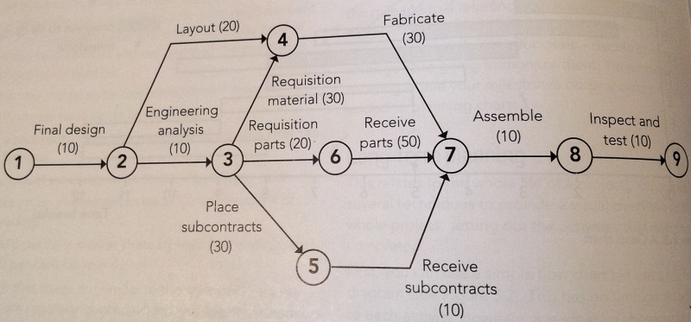
As you can see, some activities take place at the same time. For example, some elements of the product are being fabricated in the factory at the same time as other components are being requisitioned from suppliers and made by subcontractors:
Note: Another similar method is called ‘Fishbone diagrams’
(1)

Slide 21
Tables & Predecessors
In a complex network, some activities cannot start before others have finished.
For example, the parts cannot be received until they have been requisitioned and assembly cannot begin until parts have arrived.
When constructing any network diagram, you need to make sure that for each activity you take account of any activities on which it depends and, therefore, which need to have been completed first.
These preceding dependent activities are called predecessors.
One way to do this is to first list each activity in a table (see next slide), noting the time that the activity takes and any predecessors that must be completed before the activity can begin.
(1)

Slide 22
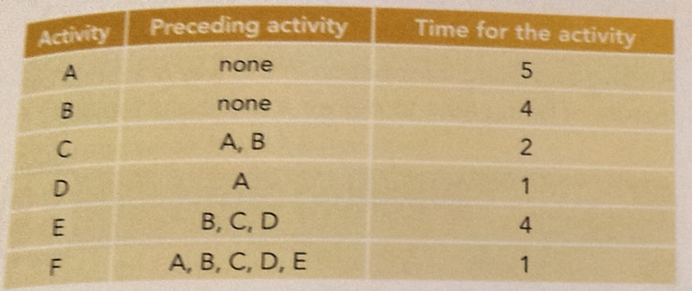
Activity Table
(1)

Slide 23
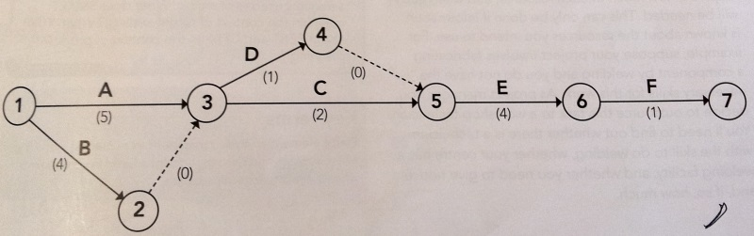
Then you can use the table to draw up the network diagram as shown below. Dummy activities where appropriate.
(1)

Slide 24
(1)

Slide 25
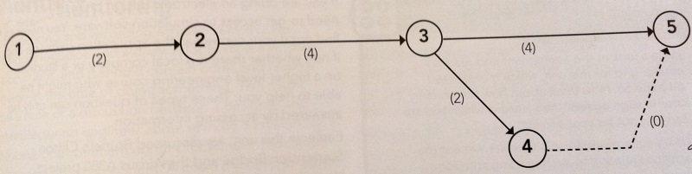
Dummy event
When two events run in parallel and one finishes before the other, a dummy event is added to the diagram. This is shown as a dashed line ---- in the figure below:
(1)

Slide 26
Critical Path Mapping
Slack time: - is defined as
‘Is the amount of time that a scheduled activity can be delayed without delaying the early start of any immediately following scheduled activities.’

Slide 27
Critical Path Mapping
Slack time
To calculate the slack time for any job or task, subtract the earliest start time from the latest start time
All of the jobs on the critical path, by definition, will have zero slack time

Slide 28
Critical Path Mapping
Slack time depends on the timing of preceding tasks.
If you consume slack early:
The remaining slack in that path shrinks.
This affects all subsequent tasks in that path.
You risk turning a non-critical path into a critical one.

Slide 29
Critical Path Mapping
Review the completed activity network diagram with the people who will be doing the work described by it.
Consider any feedback
Expand or modify the diagram as necessary to fit the actual situation.

Slide 30
Estimate time
Make sure you have allowed time for
Accidents and emergencies
Internal/external meetings
Holiday and sickness in key staff
Breakdowns in equipment
Missed deliveries by suppliers
Interruptions by customers, suppliers and contractors
Quality control rejections

Slide 31
Reference
[1] Meredith, J.R., Shafer, S.M. and Mantel, S.J. (2021) Project Management: A Managerial Approach, 11th edn. John Wiley & Sons. ISBN: 9781119803836.
[2] Kerzner, H. (2017) Project Management: A Systems Approach to Planning, Scheduling, and Controlling, 12th edn. John Wiley & Sons. ISBN: 9781119165354.

Slide 32
Thank You

