Slide 2
Plan for today
What are the Sustainable Development Goals
Historic View
The 2030 Agenda for Sustainable Development
Workshop
Assessment Guidance

Slide 3
What are the Sustainable Development Goals?
The 17 SDGs are an integrated, indivisible set of global priorities covering social, economic, and environmental dimensions. They aim to tackle urgent challenges such as poverty, inequality, climate change, environmental degradation, peace, and justice

Slide 4
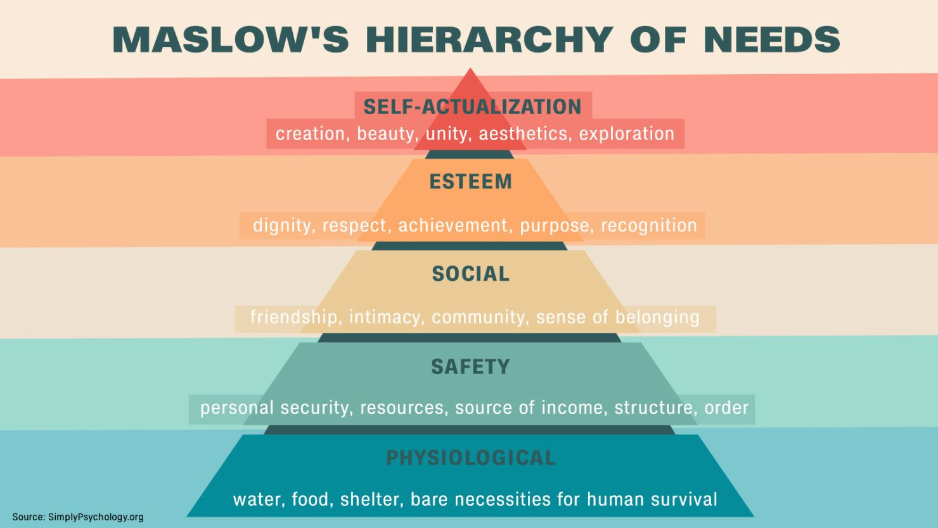
Maslow’s Hierarchy of Needs (1943)

Slide 5
Why do Sustainability Development Goals Matter?
Global inequality and environmental degradation threaten stability and wellbeing.
The SDGs provide a shared global framework—a roadmap for governments, communities, and industries.
They aim to address systemic challenges such as poverty, climate change, and social injustice through coordinated action

Slide 6
Sustainability Goals - History
1987 – Brundtland Report gave the first widely accept definition of sustainable development
1992 – Earth Summit (Rio de Janeiro), 172 plus countries adopted Agenda 21, promoting a global partnership for environmental stewardship and sustainable development
2015 – Adoption of the Sustainability Development Goals as part of the 2030 Agenda

Slide 7
The 2030 Agenda for Sustainable Development
End poverty and hunger in all forms
Protect the planet through sustainable resource use, climate action, and biodiversity preservation
Ensure prosperity and wellbeing for all people
Promote peace, justice, and strong institutions
Strengthen global partnerships to achieve sustainable development

Slide 8
Integrated and Interlinked Goals
One of the defining features of the Agenda is its emphasis on interdependence:
Progress on one goal affects progress on others.
Environmental, social, and economic systems must be addressed together, not in isolation
For example achieving Zero Hunger connects to climate action, water management, and economic growth.

Slide 9
‘Leave No One Behind’: A Core Principle
A central commitment of the 2030 Agenda is the pledge to “Leave No One Behind”. This means:
Prioritising those who experience the greatest disadvantage
Fast‑tracking progress for the most marginalised groups
Addressing structural inequalities that prevent people from accessing opportunities

Slide 10
A Blueprint for Peace and Prosperity
The Agenda is built around five pillars – known as the 5 Ps
People – ensuring all people live in dignity, free from poverty and hunger with access to health, education, and equality
Planet – protecting the environment through climate action, sustainable consumption and safeguarding natural resources
Prosperity – promoting prosperous, fulfilling lives, enabling technological and social progress in harmony with nature
Peace - Fostering peaceful, just, inclusive societies—acknowledging that there is no sustainable development without peace
Partnership - Strengthening global solidarity through partnerships between governments, civil society, academia, private sector, and citizens

Slide 11
Why the 2030 Agenda Matters
Addresses the root causes of global challenges, not just the symptoms
Provides a shared language and vision for governments, educators, businesses, and communities
Encourages long-term thinking and collaboration
Recognises the need for systemic change to achieve a sustainable future

Slide 12
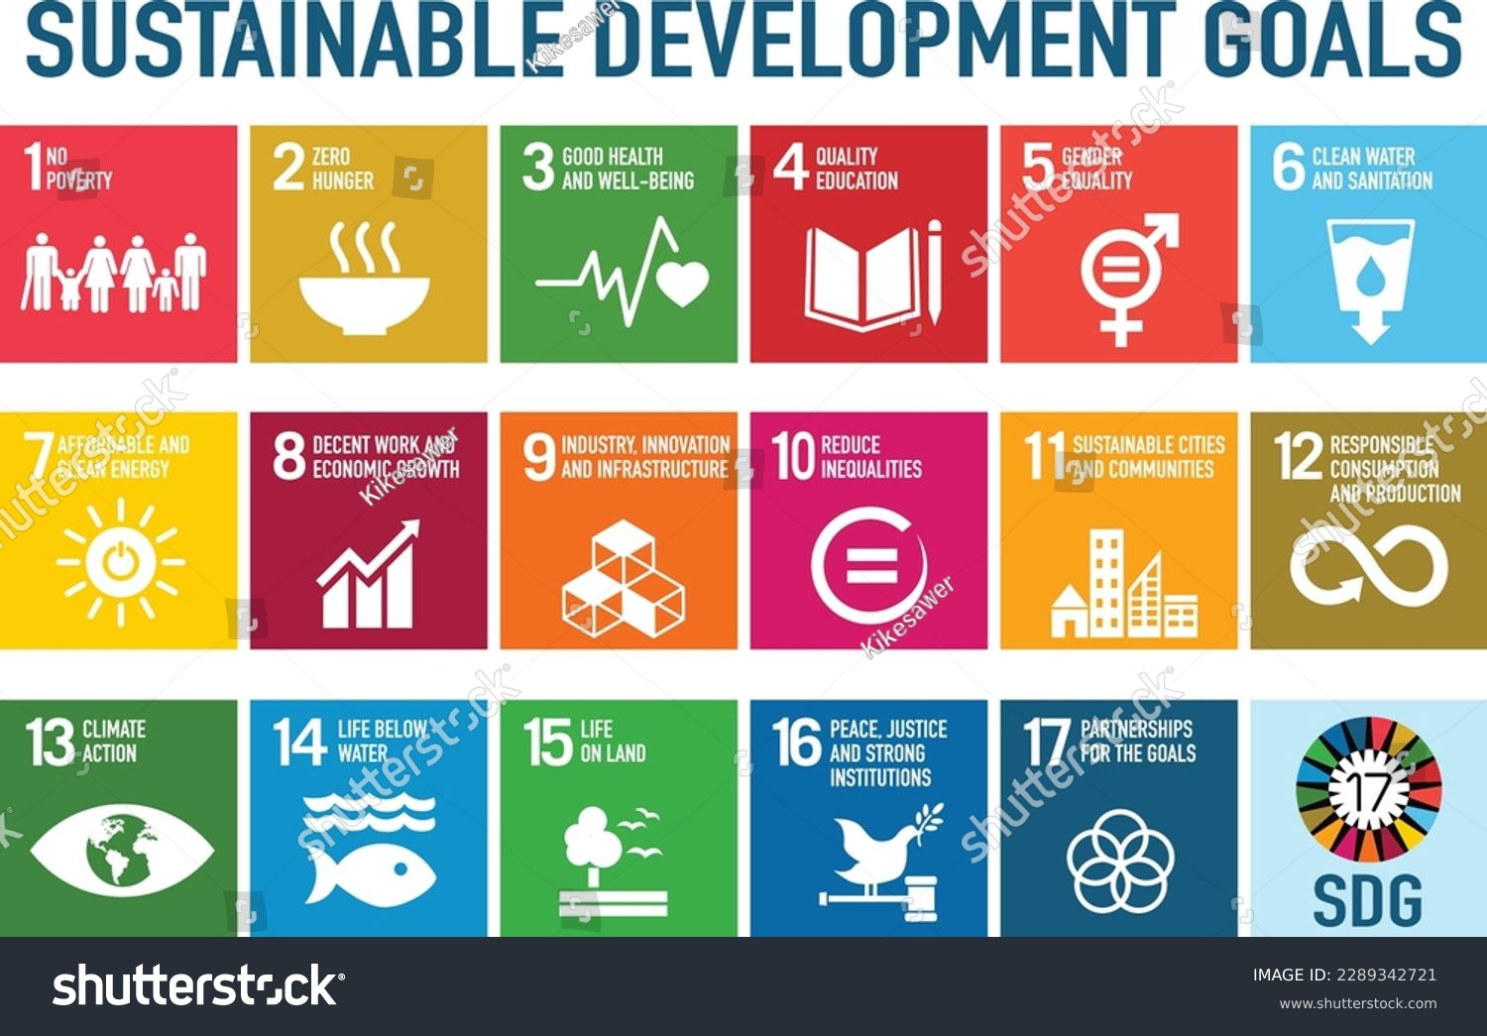
The 17 Sustainability Development Goals

Slide 13
Class Exercise
In your groups chose an issue from the list on the following slide
Conduct research to answer the following:
Which SDG’s are the most relevant to your chosen issue and why?
How do the goals interact?
What barriers exist to achieving these SDG’s in relation to your chosen issue?
What evidence-based interventions or policies could improve the situation?

Slide 14
Choose an issue from the list below:
Digital exclusion and healthcare access
Women’s health inequalities
Climate‑related health risks
Poverty and chronic illness
Urban air quality and respiratory health
Youth mental health and online environments

Slide 15
Assessment Guidance
3) Evaluation: Students must build upon the cause-and-effect diagram to evaluate the chosen issue, suggesting potential solutions. These must be linked to at least one of the 17 Sustainable Development Goals. (1400-word equivalent)
  Identify and define the issue, giving some scope to the issue on a contemporary level.
  Discuss the main causes of this issue, linking to literature in the field of study and evaluate the links between the causes and the main effect(s).
  Give context to the Sustainable Development Goals and link it to the chosen issue, discussing what Wales and the United Kingdom are putting in place to address the issue and justify why

Slide 16
Structure
Written assignments should include:
An introduction
A discussion
A conclusion

Slide 17
A Good Introduction
An introduction should seek to:​
Grasp the reader's attention​
Explain what the issue you are covering is and why this is important (Rationale)​
A rationale should include evidence to support your choice

Slide 18
Discussion/Analysis
Evaluate the main findings of your fishbone diagram
Discuss causes and impact of your issue
Consider any links between your findings
Ensure that you can substantiate your points with credible literature
Link to SDG’s where possible
Include what the United Kingdom and Wales have/will implement to address your i
Avoid opinion!

Slide 19
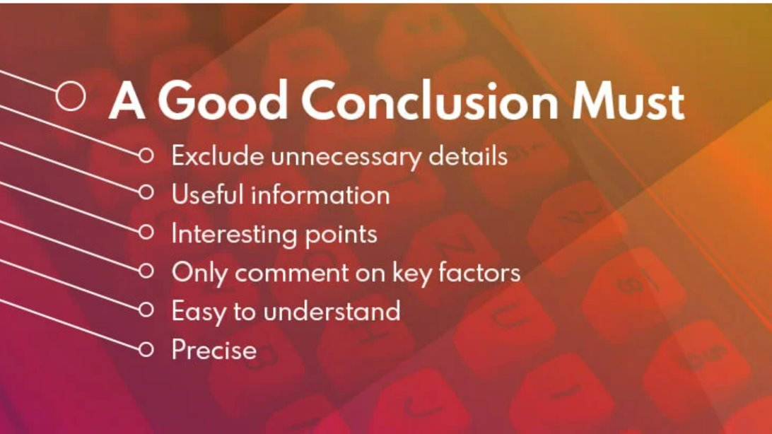
Conclusion

Slide 20
Next Week - Drafts
Drafts to be sent before the session on Monday​
Drafts to be sent via email​
Individual, verbal feedback given via a drop in session​
One draft only will be read​
Ensure you come prepared for your feedback session​ (pen, paper)
The draft can contain as much or as little as you like – the more you submit, the more detailed the feedback​

