Slide 1
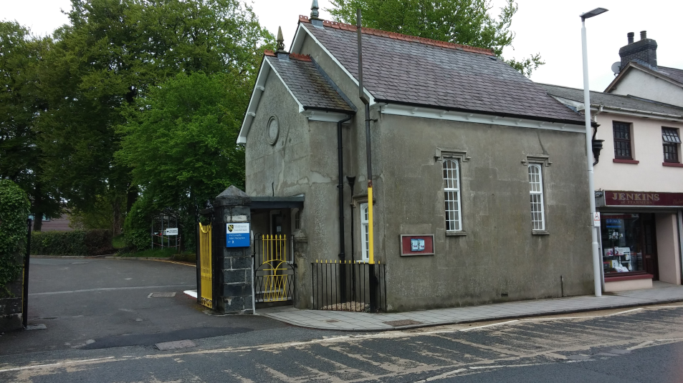
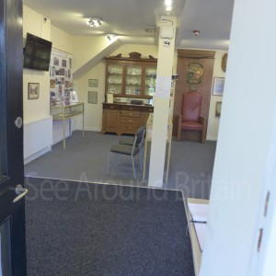
SWOT analysis of
Lampeter Museum
By Abigail McKeeman

Slide 2
Strengths
One of the major strengths is the volunteers they add so much to the museum due to being so knowledgeable and friendly
Good relationship with the University who owns the building they are in (means little to no rent)
It is offers something different to the county museum as it is very much focused on the history of the local area.
They have a website which is quite easy to use and understand

Slide 3
Weaknesses
Many people don’t actually know where it is therefore the footfall is not as high as it could be
According to the visitor book statistics numbers are actually dropping (see statistics below)
Small space so no room for expansion
Previous Annual Totals
2014 1059
2015 1086
2016 1086
2017 926

Slide 4
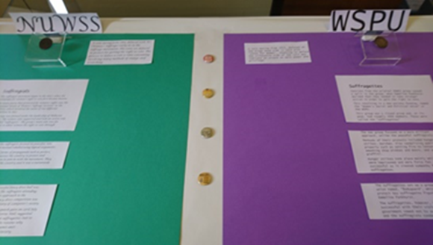
Opportunities
Possibly developing a relationship with the B&B’s in Lampeter to promote the museum
The museum becoming an official tourist information centre as this could then possibly help with footfall and boost income if they then sell items

Slide 5
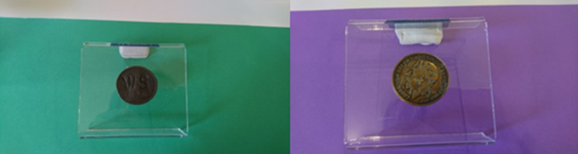
Threats
The potential of the university closing down
The visitor numbers continue to fall therefore forcing the museum to decide whether or not it is worth staying open

Slide 6

Conclusion
This is a wonderful local museum that offers something different than the big county museum. However the museum needs to be able to stop its visitor numbers falling and then to increase them otherwise its future could be in danger.

