Slide 1

Writing your Dissertation Proposal
JJC/AMS

Slide 2
Why is a proposal useful?
Ensures that the research is viable
Provides a focus
Opportunity for feedback and refinement
Sets clear objectives and timescales
It demonstrates you have a good knowledge of existing work and debates
Helps to identify academic tutor to supervise

Slide 3
‘a 4 ‘Ps’ view (Punch 2006)
The research proposal
  A phase of the overall process
  A process planning, designing and setting up
  A product – a formal document
  A plan for carrying out the research

Slide 4
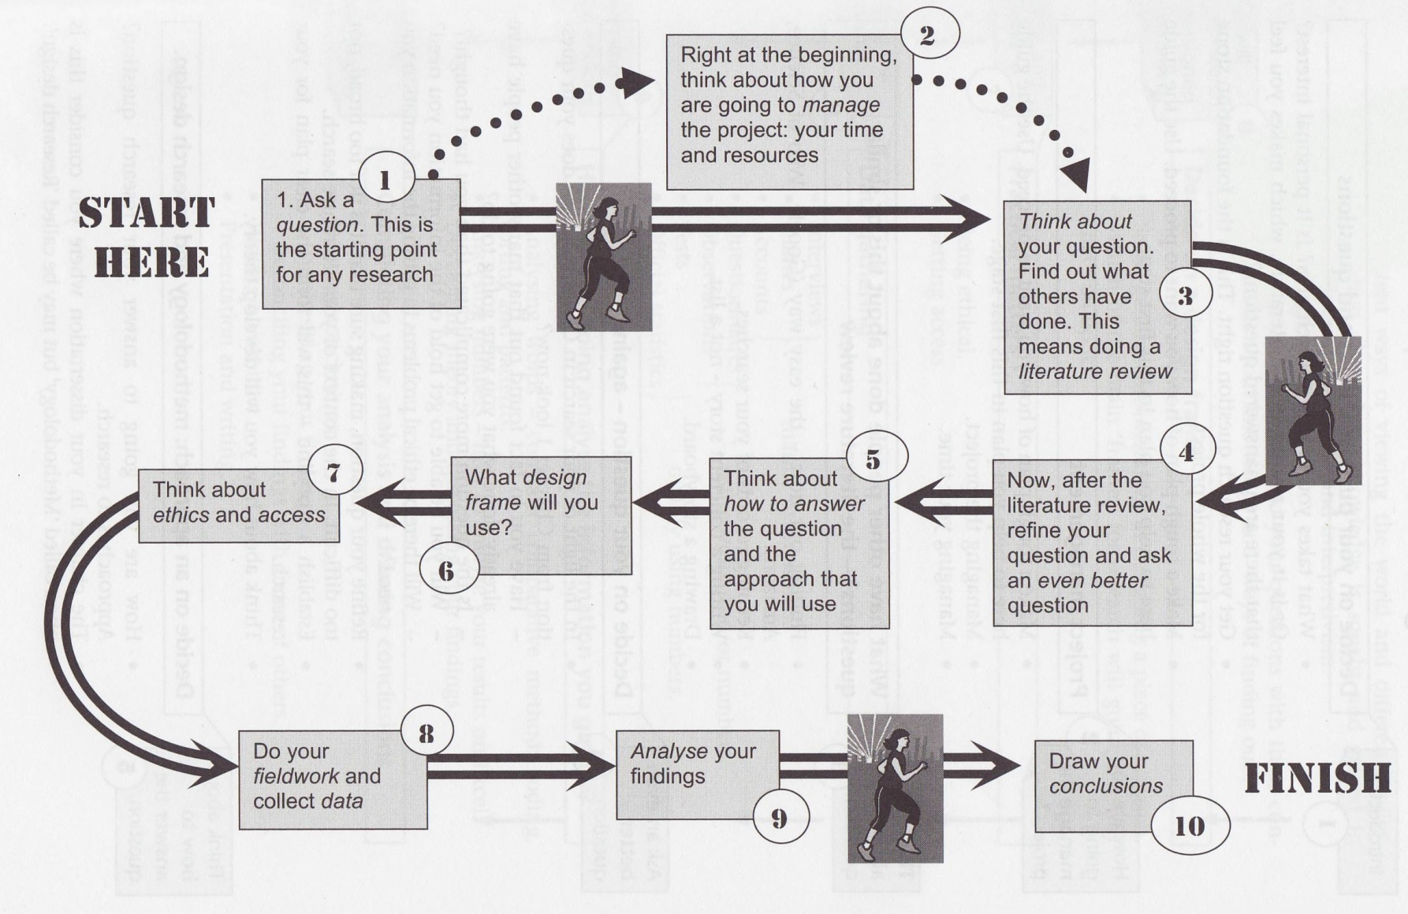
Road Map

Slide 5
Exploring your ideas
Question
Ethical considerations
Timescale
Methods
Challenges

Slide 6
Key questions
What
  What is my research about?
  What is its purpose?
  What is it trying to find out or achieve?
  **What questions is it trying to answer
How
  How will my research answer its questions?
Why
  Why is this research worth doing?

Slide 7
MA Dissertation Proposal Form
Provisional Dissertation Topic or Title
Main Research Question
Outline of study, including proposed research methods (Design/approach, participants, measures, procedures, data analysis):
Information regarding initial bibliography, titles, articles, other sources and references etc:
Any practical and ethical considerations:

Slide 8
1. Title
Should be short, but attention grabbing
Should be specific without being over specific
Should communicate the purpose of the study
Preferably less than 20 words
Choose keywords from your research questions and try to incorporate these
Keep title tightly focused
Don’t make it cute or play on words (keep it academic)

Slide 9
2. Research question
Aims and purpose – a statement of the research issue/problem
  “A problem might be defined as the issue that exists in the literature, theory, or practice that leads to a need for the study” (Creswell, 1994, p. 50).
  It is important in a proposal that the problem stand out—that the reader can easily recognize it. Sometimes, obscure and poorly formulated problems are masked in an extended discussion. In such cases, reviewers will have difficulty recognizing the problem.
Context and rationale for research
What specific questions will you be asking?

Slide 10
From general to specific
Research Area
  Ex: Children’s Rights
Research topic [the topic falls within the area]
  The implementation of children’s rights in the Early Years
  Children’s understanding of their rights
Research question
  How do Early Years Practitioners ensure that children’s rights are part of their everyday practice?
  Do young children aged 4-6 years old understand the notion of rights?

Slide 11
Literature Review
“The review of the literature provides the background and context for the research problem. It should establish the need for the research and indicate that the writer is knowledgeable about the area” (Wiersma, 1995, p. 406).
The literature review accomplishes several important things:
It shares with the reader the results of other studies that are closely related to the study being reported.
It relates a study to the larger, ongoing dialogue in the literature about a topic, filling in gaps and extending prior studies.
It provides a framework for establishing the importance of the study, as well as a benchmark for comparing the results of a study with other findings.
It “frames” the problem earlier identified.

Slide 12
Literature review (ctd)
Delineate the “jumping-off place” for your study. How will your study refine, revise, or extend what is now known? Does it address a gap in knowledge, or extend on a piece of work already done?
In a proposal, the literature review is generally brief and to the point. Be judicious in your choice of exemplars—focus on key studies that are pertinent and relevant to your research question(s).

Slide 13
3. Outline of Study
Think about:
  when, where, who, how, what, when, why?
When will the study be undertaken?
Where will the study be conducted?
Who will be studied?
How will they be recruited?
What will they be asked to do?
How will the data be collected, recorded, and analysed?
Why has the approach been chosen?

Slide 14
Elements of the methodology section
Design – qualitative or quantitative, with brief justification, and description of specific research type (e.g. case study, survey, action research, etc.)
Sample – who is taking part, and their relevant characteristics
Instruments – description of questionnaire, interview schedule, etc..
Procedure – How you intend to carry out the research? (access? Gatekeepers?)
Pilot study? How this might inform the main study
Analysis – How you propose to analyse the collected data

Slide 15
5. Ethical & practical Issues
This section should demonstrate your knowledge and understanding of ethical procedure in research (protocols/guidelines) as well as the different ethical issues or problems you may anticipate
Proposal should discuss all relevant ethical issues associated with your study:
  Sensitive issues?
  Power dynamics?
  Access
  Consent
  Children and young people?
You cannot simply assume that people in your school will take part, appropriate consent must be gained, both for staff and pupils

Slide 16
Time & feasibility: Try to Identify any potential delays or problems (e.g. holidays, other issues which may interrupt your opportunities to do research)
Conflict of interests? (Researcher/practitioner roles)

Slide 17
A good proposal
Direct and straightforward – clarity of thought and expression
Intentions are well communicated – does not make assumptions of knowledge
Well organised – clear structure, use of sub-headings

Slide 18
A not so good proposal...
Omits key information, ignores word limit
No relationship between title and objectives;
Stated methods mismatch to objectives
Vague research focus
Unexplained design and methodology
Too brief or too long-winded/repetitive
Makes strong assumptions about the anticipated findings
Absence of any theoretical or conceptual framework

Slide 19
Research proposal
Completed in time
Adequately resourced
Lends itself to being researched
Worth researching
No serious constraints
Sufficiently challenging
Viable

Slide 20
Common Mistakes in Proposals
1. Failure to provide the proper context to frame the research question.
2. Failure to clearly the boundary conditions for your research. (e.g. research question is too vague or unclear)
3. Failure to cite landmark studies.
4. Failure to accurately present the theoretical and empirical contributions by other researchers.
5. Failure to stay focused on the research question.
6. Failure to develop a coherent and persuasive argument for the proposed research.
7. Too much detail on minor issues, but not enough detail on major issues.
8. Too much rambling -- going "all over the map" without a clear sense of direction. (The best proposals move forward with ease and grace like a seamless river.)
9. Too many citation lapses and incorrect references.
10. Too long or too short.
11. Sloppy writing.

Slide 21
Mapping out your ideas…
Title
Research question (and aims)
Context, participants
Methods
Ethical & practical issues

Slide 22
Ethical Approval
Before you can collect data you must receive ethical approval from the College Ethics Committee. You will need to submit:
  *Dissertation Proposal Form
  *Ethics Declaration (signed by you and supervisor)
  Draft copies of:
    Research Information sheet
    Consent form
    Interview/Observation schedule/Questionnaire

Slide 23
References and suggested readings
Bell, J. (2005) Doing your research project: Chapter 2 – ‘planning the project’.
Cryer, P. (2006) The Research student’s guide to success: Chapter 4 – producing the research proposal.
Punch, K. (2006) Developing Effective Research Proposals, 2nd edition, London: Sage
Thomas, G. (2009) How to do your research project, London: Sage

