Slide 1
Contemporary Themes in the Hotel and Hospitality Sector
BMIH6001
Personalization – Greeting guests by name upon arrival and providing customized room settings – Case Studies : Accor
Student’s Name:Cristian Andrei Fazecas
Student’s ID: 2107706
Lecturer’s Name: Natalie Brailsford

Slide 2


Introduction
- Customization makes customers happier and more loyal in the hospitality business by letting staff know each guest's name and making rooms fit their needs (Revfine, 2022).
- Travelers want more personalized experiences, and technology like CRM systems helps hotels meet these needs by letting them customize greets and room settings (Mews, 2019).
- Personalization strategies used by hotels make guests happier, get them to come back, and get good reviews online, which is very important in this digital age (Mews, 2019).
- The hotel business is moving towards more services that are focused on the guest through data-driven personalization. This makes operations more efficient and makes guests happier (Altexoft, 2020).
- Personalized service is important for keeping customers coming back to high-end hotels and improving the brand's image (Altexoft, 2020).

Slide 3
Hotels Overview
Hilton Hotels
- Hilton is a global leader in the hospitality industry, with a portfolio that includes 23 world-class brands, spanning over 7,600 properties and nearly 1.2 million rooms across 126 countries and territories
- The company was founded by Conrad Hilton in 1919 and has a long history of innovation in hospitality, including being the first to introduce televisions in guest rooms and air-conditioning in public areas
- Hilton prioritizes digital innovation to enhance the guest experience, with initiatives like the Digital Key technology and confirmed connecting rooms, which streamline and personalize the guest experience
Accor Hotels
- Accor Hotels is a leading French multinational hospitality company, operating 5,584 properties across over 110 countries, with a diverse portfolio including luxury, premium, midscale, and economy brands.
- The company has embraced a digital transformation strategy, leveraging technology to enhance guest experiences across its global network.
- Accor continues to expand its global footprint, focusing on sustainable growth and innovation in the hospitality sector.
Marriott Hotels
- Marriott Hotels is a leading international lodging company with properties in numerous countries, offering a wide range of accommodations.
- The company operates various brands catering to different market segments, including luxury brands like Ritz-Carlton and budget options like Courtyard by Marriott.
- Marriott Bonvoy, the loyalty program, offers members benefits like room upgrades, free nights, and points redeemable for travel experiences.

Slide 4

Literature Overview
- Adjusting room attributes like temperature and lighting based on guest preferences creates extra comfort (Phocuswire, 2021).
- Smart room technologies increase guest satisfaction ratings by 15% through mobile device control of amenities (WebRezPro, 2023).
- Personalized room setups boost guest loyalty; clients more likely to return when preferences are remembered by the hotel (EHL Hospitality Insights, 2022).
- Personalization creates familiarity, encouraging positive word-of-mouth and building a loyal customer base (EHL Hospitality Insights, 2022).
- Customization leads to increased revenue per available room (RevPAR) (Hospitality Net, 2024).
- Customized marketing strategies boost hotel profitability by promoting additional personalized services (Hospitality Net, 2024).

Slide 5

Literature Overview
- Automated room settings enhance operational efficiency (Canary Technologies, 2021).
- Reduced operating expenses boost service focus (Canary Technologies, 2021).
- Personalization requires careful data privacy balance (GuestCentric Blog, 2023).
- Effective privacy policies build guest trust (GuestCentric Blog, 2023).
- Customized settings improve guest satisfaction (StayApp, 2020).
- Ethical data management is crucial (StayApp, 2020).
- Technology should respect guest privacy preferences (StayApp, 2020).

Slide 6
PESTEL Framework
- Political: GDPR requires strict data management in the EU to protect guest privacy (AxisRooms, 2019).
- Economical: High initial tech costs but potential for increased revenue through enhanced guest experiences (Ciobanu et al., 2023).
- Social: Younger generations value personalized services, boosting hotel reputations and loyalty (Userguest, 2021).
- Technological: Advancements in IoT, AI, and machine learning are crucial for personalized room settings (Oaky, 2019).
- Environmental: Personalized tech integrates sustainable practices, appealing to eco-conscious guests (Hotel Management, 2022).
- Legal: Adhering to privacy laws is critical for maintaining guest trust and avoiding legal issues (Qloapps, 2020).

Slide 7
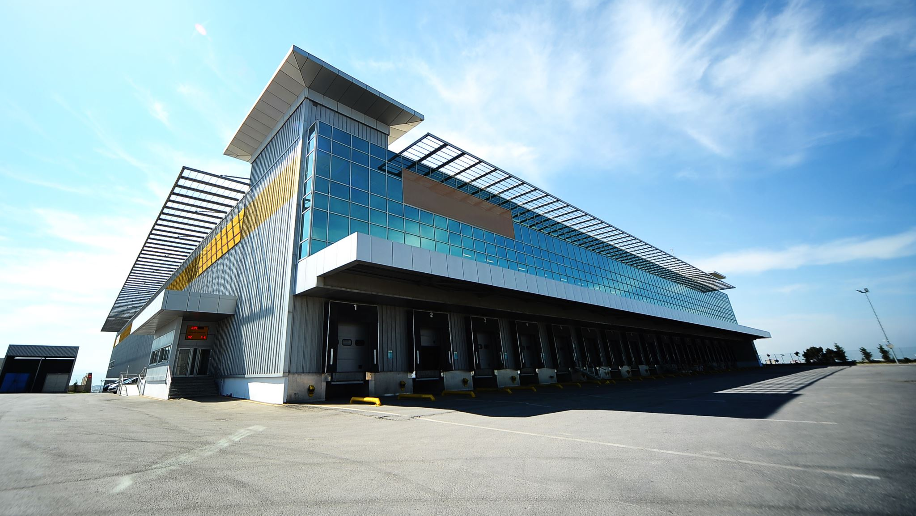
Hotel Industry Responses (Marriott & Hilton)
- Marriott customizes room settings using guest data to enhance satisfaction and loyalty, but faces high costs in technology and training (Moco360 Media, 2017).
- Hilton offers digital keys and room selection via their app, improving guest convenience and operational efficiency (Skift, 2023).
- Both Marriott and Hilton's personalized services require substantial investment in technology (Moco360 Media, 2017; Skift, 2023).
- Hilton's use of digital technology highlights the need for robust cybersecurity to protect guest information (Skift, 2023).
- The technologies implemented by both hotel chains add operational complexity and increase financial challenges (Moco360 Media, 2017; Skift, 2023).

Slide 8

Hotel Industry Responses (Hyatt, Ritz-Carlton, Accor)
- Hyatt uses data analytics for personalized marketing, offering tailored incentives and experiences that increase direct bookings (AVIXA, 2021).
- Hyatt's digital-focused approach risks reducing the traditional personal connection in hospitality, potentially deterring customers who prefer in-person interactions (AVIXA, 2021).
- Ritz-Carlton enhances guest loyalty with personalized greetings and room setups, significantly boosting brand reputation (CRM.org, 2020).
- Ritz-Carlton's high level of personalization requires extensive resources, leading to higher operational costs and growth challenges (CRM.org, 2020).
- Accor Hotels merges sustainability with personalization, offering eco-friendly room customization options to guests (Accor Group, 2023).
- This approach enhances guest satisfaction and reinforces Accor's environmental commitment (Accor Group, 2023).
- However, Accor faces increased costs from sustainable technologies and materials, potentially impacting profitability (Accor Group, 2023).

Slide 9

Future Policy and Management Solutions
- Enhance guest experiences by adopting personalized room setups to stay competitive and meet evolving guest demands (Hotel Technology News, 2024).
- Implement robust data security measures like end-to-end encryption and regular security audits to protect guest data and comply with regulations like GDPR (Turneo, 2023).
- Maintain transparency in how visitor data is used and protected to build trust and ensure guests feel secure (Bastenburgh Capital, 2022).
- Integrate sustainable technologies such as occupancy sensors and smart thermostats into personalization efforts to reduce environmental impact and operational costs (Smart Pricing, 2019).
- Ensure that personalization efforts balance guest satisfaction with strong data protection to foster long-term loyalty and trust.

Slide 10

Future Policy and Management Solutions
- Adopt AI and IoT technologies to enhance real-time data analysis and personalization in guest experiences, ensuring smooth integration into operations (Hospitality Net, 2023).
- Continuously train hotel staff in using new technologies to maintain a personalized human touch in guest services (Phocuswire, 2021).
- Invest in ongoing training programs for employees to ethically use visitor data and create customized experiences that respect guest privacy (Mews, 2019).
- Implement effective feedback mechanisms to gather guest input through various channels, using insights to improve services and personalize guest experiences further (Hospitality Net, 2024).
- Regularly update personalization techniques and policies to adapt to changes in consumer behavior, technology advancements, and legal requirements, ensuring relevance and effectiveness in personalization efforts.

Slide 11
Conclusion
- Personalized room arrangements boost guest satisfaction and loyalty through advanced data management, yet require careful attention to data privacy, security, and sustainability to meet expectations and regulations.
- Customized services present scalability and cost challenges; ongoing investment in technology, staff training, and adaptable management practices are crucial for maintaining a competitive edge in the hospitality industry.

Slide 12
References
Accor Group (2023) 'Digital power of personalization'. Available at: https://group.accor.com/en/Actualites/2023/11/digital-power-of-personalization (Accessed: 12 May 2024).
Altexsoft (2020) Personalization in hospitality. Available at: https://www.altexsoft.com/blog/personalization-hospitality/ (Accessed: 12 May 2024).
AVIXA (2021) 'Hyatt Hotels making each stay a personalized experience'. Available at: https://www.avixa.org/av-topics/articles/hyatt-hotels-making-each-stay-a-personalized-experience (Accessed: 12 May 2024).
AxisRooms (2019) Personalization in hotels: How it helps improve guest experience. Available at: https://blog.axisrooms.com/personalization-hotels-how-helps-improve-guest-experience/ (Accessed: 12 May 2024).
Bastenburgh Capital (2022) Personalized experiences in travel and hospitality. Available at: https://bastenburghcapital.com/personalized-experiences-travel-hospitality/ (Accessed: 12 May 2024).
Canary Technologies (2021) Personalize the hotel guest experience. Available at: https://www.canarytechnologies.com/post/personalize-hotel-guest-experience (Accessed: 12 May 2024).
Ciobanu, O., Dabija, D.C. and Bărbuţă-Mişu, N. (2023) 'The role of technology in enhancing hotel service personalization: A structural equation model approach', Tourism Management Perspectives, 45. Available at: https://www.sciencedirect.com/science/article/pii/S0261517723001000 (Accessed: 12 May 2024).
CRM.org (2020) 'Ritz-Carlton gold standards'. Available at: https://crm.org/articles/ritz-carlton-gold-standards (Accessed: 12 May 2024).
EHL Hospitality Insights (2022) Personalization in hotels. Available at: https://hospitalityinsights.ehl.edu/personalization-in-hotels?hs_amp=true (Accessed: 12 May 2024).
GuestCentric Blog (2023) Personalization vs. privacy: What do hotel guests prefer? Available at: https://blog.guestcentric.com/personalization-vs-privacy-what-do-hotel-guests-prefer/ (Accessed: 12 May 2024).
Hospitality Net (2023) Personalization in the hospitality industry: An overview. Available at: https://www.hospitalitynet.org/opinion/4113278.html (Accessed: 12 May 2024).
Hospitality Net (2024) Personalization in the hospitality industry. Available at: https://www.hospitalitynet.org/opinion/4120349.html (Accessed: 12 May 2024).
Hotel Management (2022) 61% of consumers will spend more for personalized experiences. Available at: https://www.hotelmanagement.net/data-trends/61-consumers-will-spend-more-personalized-experiences (Accessed: 12 May 2024).
Hotel Technology News (2024) How to create a personalization strategy for your hotel. Available at: https://hoteltechnologynews.com/2024/01/how-to-create-a-personalization-strategy-for-your-hotel/ (Accessed: 12 May 2024).
Medallia (2022) 'Understanding personalization efforts in the hospitality and retail industries'. Available at: https://www.medallia.com/wp-content/uploads/pdf/resources/Medallia-Understanding-Personalization-Efforts-in-the-Hospitality-and-Retail-Industries-Report.pdf (Accessed: 12 May 2024).
Mews (2019) Personalization in hospitality. Available at: https://www.mews.com/en/blog/personalization-in-hospitality (Accessed: 12 May 2024).
Moco360 Media (2017) 'Marriott unveils smart hotel room prototypes with personalized presets and voice control'. Available at: https://moco360.media/2017/11/14/marriott-unveils-smart-hotel-room-prototypes-with-personalized-presets-and-voice-control/ (Accessed: 12 May 2024).
NFCI Hospitality (2020) 'Personalization in the hospitality industry'. Available at: https://nfcihospitality.com/personalization-in-the-hospitality-industry/ (Accessed: 12 May 2024).
Oaky (2019) Personalisation in the hospitality industry. Available at: https://oaky.com/en/blog/personalisation-in-hospitality-industry (Accessed: 12 May 2024).
Phocuswire (2021) Amadeus: 5 tried & true strategies for effective hotel guest personalization. Available at: https://www.phocuswire.com/amadeus-5-tried-true-strategies-effective-hotel-guest-personalization (Accessed: 12 May 2024).
PressReader Blog (2019) 'Customization and personalization in hospitality'. Available at: https://blog.pressreader.com/hotels/customization-and-personalization-in-hospitality?hs_amp=true (Accessed: 12 May 2024).
Qloapps (2020) Personalization and customization in hotels. Available at: https://qloapps.com/personalization-and-customization-in-hotels/ (Accessed: 12 May 2024).
Revfine (2022) Personalization in hotel marketing. Available at: https://www.revfine.com/personalization-in-hotel-marketing/#:~:text=Personalization%20has%20increased%20guest%20loyalty,offerings%20and%20exceptional%20guest%20experiences (Accessed: 12 May 2024).
Skift (2023) 'Hilton tests new ways to increasingly personalize guest bookings'. Available at: https://skift.com/2023/03/29/hilton-tests-new-ways-to-increasingly-personalize-guest-bookings/amp/ (Accessed: 12 May 2024).
Smart Pricing (2019) Personalization for hotels and how to do it. Available at: https://www.smartpricing.it/en/blog/personalization-for-hotels-and-how-to-do-it (Accessed: 12 May 2024).
StayApp (2020) Personalization in the hotel industry. Available at: https://www.stay-app.com/blog/personalization-hotel-industry?hs_amp=true (Accessed: 12 May 2024).
Turneo, H. (2023) 'Hotel personalization: Bringing your trusted expertise to modern-day travelers', Medium. Available at: https://medium.com/@hello_turneo/hotel-personalization-bringing-your-trusted-expertise-to-modern-day-travelers-c70bdf6feff4 (Accessed: 12 May 2024).
Userguest (2021) Hyper-personalization in the hotel industry using technology to meet customer expectations. Available at: https://userguest.com/hyper-personalization-in-the-hotel-industry-using-technology-to-meet-customer-expectations/ (Accessed: 12 May 2024).
WebRezPro (2023) 7 simple ways independent hotels can personalize the guest experience. Available at: https://webrezpro.com/7-simple-ways-independent-hotels-can-personalize-the-guest-experience/ (Accessed: 12 May 2024).

Slide 13

Thank you for watching!

