Slide 1
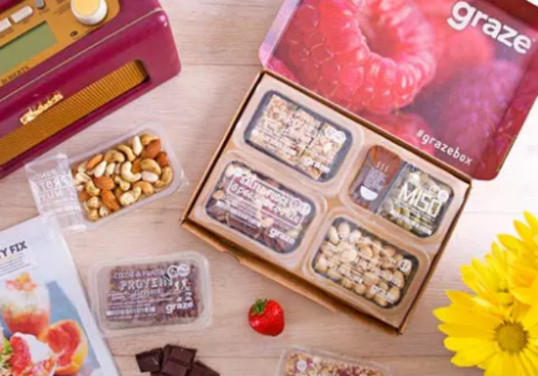
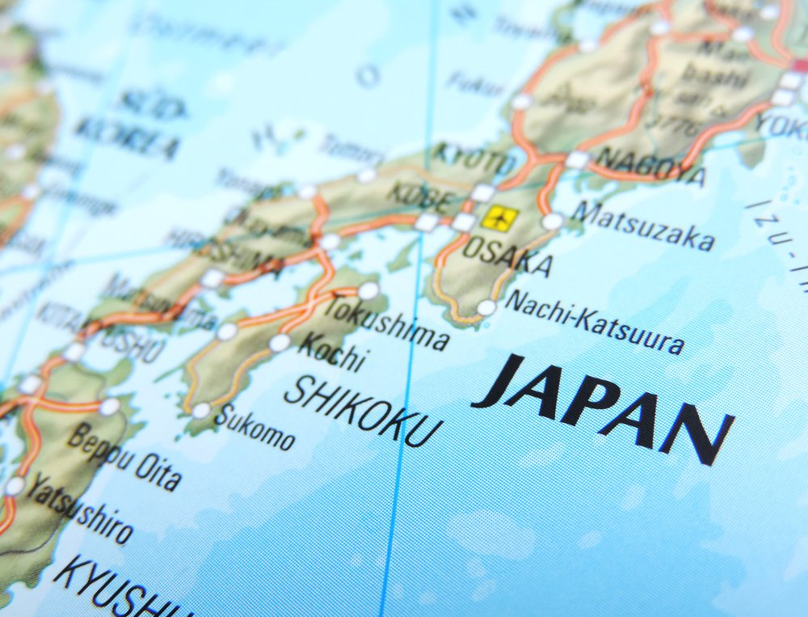
graze and Japan
Market information and risk assessment

Slide 2
PEST analysis Political environment
A stable country for business with the government implementing economic stimulus plans and an enhanced monetary policy
With a strong business culture and an increasingly globalised perspective, Japan may provide a strategic springboard for other Asian markets (GOV.UK, 2015)
Government also gradually opening up nation to foreign investment through deregulation whilst ensuring robust intellectual property protection

Slide 3
Economic environment
Large and well-educated consumer market based mainly in urban areas Reputation for being early adopters of new products and services
Relatively high levels of disposable income, especially amongst older people and young singles living at home (GOV.UK, 2015)
Savoury snacks market Yen1249b.(£8.61b) in 2017 (50% crisps and rice snacks) Local potato crop damage affected sales, with growth in alternatives to rice snacks
Sweet biscuits/snack bars/fruit snacks Yen564b (£3.89b.) in 2017 Volume growth in snack bars and fruit only
1% value CAGR for both categories expected over next few years driven by rise of busy, health-conscious consumers, looking for convenience (Euromonitor, 2017a, 2017b)

Slide 4
Economic environment: competitive arena
Snack sector dominated by Japanese global companies such as Calbee Foods & Ezaki Glico Co, but sales mainly in standard range of crisps/rice snacks/sweet biscuits
Many producers are developing more high value-added products,
often targeting adult customers (Euromonitor, 2017a, 2017b)
Determined local companies develop strategies to compete hard against newcomers (JAPANSTRATEGY, n.d.)
Relaxed regulations for “Food with Functions Claims”: NPD increase in related health food category could enhance but also compete with healthy snack market
Price competition from widening dependence on mass market retailers and increasing private labels (Scattergood, 2018)

Slide 5
Economic environment: conducting business in Japan
Patient, strategic approach required for Japan: long-term commitment, develop and maintain relationships through regular visits and communication
Majority of overseas SMEs use support of local partners to understand / access Japanese market Helpful to translate some documents into Japanese if possible
Good understanding of Japanese business law necessary – can be very different from UK Use English-speaking Japanese lawyers (GOV.UK, 2015)
Licences/permits/certificates to be obtained from authorised bodies partly to safeguard the fundamental and established food industry (Jones, 2018a)
Expectation of detailed preparation & planning plus knowledge of “high context” Japanese business etiquette (JAPANSTRATEGY, n.d.)

Slide 6
Social environment: an ageing population with highest life expectancy (World Population Review, 2018)
Population of Japan
126.59m.
(Statistics Japan, n.d.)
Current graze markets:
UK = 63.7m.
US = 318.9m.
(OECD, n.d.)
Japan population by age group,
January 1 2018
5-19 = 16.66m
20-34 = 19.54m
35-49 = 26.70m *
50-64 = 23.56m
65-79 = 24.40m
(Statistics Japan, n.d.)

Slide 7
Social environment: drivers of the Japanese healthy snack market
An ageing society will support demand for more healthy food and snacks Single elderly will tend to eat/snack alone: products personalised / individualised
Growing requirement for convenience and ready-to-eat products, as women now encouraged to join workforce (Scattergood, 2018)
Consumption of standard sweet/savoury snacks reducing: adult awareness of food safety issues and interest in ethical ingredients, with younger people dieting (Euromonitor, 2017a)
Many consumers expect diverse and innovative products: they have enjoyed new flavours but healthy snack varieties now likely to appeal (Culliney, 2014)

Slide 8
Technological environment
Japan has an excellent postal system (Japan Today, 2013)
with a universal, and in many areas, a 7-day delivery service (Ward, 2017)
It has a world-leading internet infrastructure (Fitzpatrick, 2015)
103.89m. internet users in 2017
91% accessed it every day and 6% at least once a week
75.32m used mobile phone for access (Statista, 2018a, 2018b, 2018c)
iPads have proved a popular buy with senior Japanese
Japan Post is donating a further 5m. to this age group by 2020 (Ossola, 2015)

Slide 9
TOWS analysis
Threats • Food industry is competitive, particularly with new/non-Japanese entrants • Rising NPD in associated health food sector, with target groups in common • Price competition from increased consumer purchase of supermarket own brands • Residual protectionism in the food industry through a necessity for documentation • Demanding business environment in terms of conventions
Opportunities • Government policy gradually welcoming foreign investment, with good IP protection • Large potential snack market with growing interest in alternative, healthy snacks • Affluent, urban, “internet savvy” society prepared to experience new products • Demographics indicate a requirement for convenient, customised portions of snacks • Japan has excellent networks for online marketing/ordering and also delivery
(Euromonitor, 2017a, 2017b), (GOV.UK, 2015), (JAPANSTRATEGY, n.d.), (Scattergood, 2018), (Statista, 2018a, 2018b, 2018c), (Ward, 2017)

Slide 10
TOWS analysis continued
Weaknesses • Lack of familiarity with Japanese marketplace • Limited knowledge of Japanese language, business norms and management style • Non-Japanese entrant to food industry (although a local partnership is advisable)
Strengths • Experience in expansion outside UK, useful knowledge gained from home and overseas market • Speedy, innovative and flexible organisation ready to defend against competition • Direct-to-consumer, online subscription and network marketing strategies • Extensive range of snacks fulfils consumer demand for variety, convenience and suitability • In-house algorithms collect vast amounts of data affording insight into customers and the market • Ethical approach to sourcing, production and packaging, appealing to discerning consumers
(Bord Bia, 2016), (Dunsby, 2015), (Gibbons, 2010), (GOV.UK, 2015), (Graze, 2018), (Khalil, 2012), (Pendrous, 2016)

Slide 11
Five Forces analysis (Porter, 1979)
Existing rivals A competitive industry but current reliance on traditional snacks & standard methods of distribution via grocery stores & supermarkets, however increasing NPD in healthy ranges (Euromonitor, 2017a, 2017b), (Scattergood, 2018)
Buyers Prepared to try out and pay a small premium for value-added products such as nutritious and novel snacks (Euromonitor, 2017a, 2017b)
Suppliers graze can source 200 ingredients from 70 countries, although some country-specific preferences may need to come from within Japan (graze, 2018) (Pendrous, 2016)
New entrants Innovative, consumer-direct, online offerings have more potential to succeed against the reputation, size and alliances of incumbents than conventional products and distribution methods (AAC, 2015)
Substitute products/services graze has a “First Mover Advantage”: a decade of refining in-house developed systems to gain customer/market feedback & optimise product offering; where possible seek IP protection against competitors (Jones, 2018b) (Bearne, 2017)

Slide 12
Key success factors
Selection of most appropriate partner for a positive relationship (EXPORT TO JAPAN, n.d.)
Understanding and adapting to language, cultural and business differences (Jones, 2018c)
Determination and flexibility to overcome unfamiliar competitive and bureaucratic challenges Time & financial investments needed – but rewards for success in Japan can be substantial (JAPANSTRATEGY, n.d.)

Slide 13
References
AAC (2015) Modern Grocery Retailing in Japan Agriculture and Agri-food Canada, June 2015 Available online at: http://www5.agr.gc.ca/resources/prod/Internet-Internet/MISB-DGSIM/ATS-SEA/PDF/6626-eng.pdf [Accessed 23rd F2bruary 2018]
Bearne, S. (2017) The snacks boss with an appetite for success 12th June 2017 BBC Business News Available online at: http://www.bbc.com/news/business-40199167 [Accessed 24th February 2018]
Bord Bia (2016) Understanding the consumer: lessons from brand forum 11th November 2016 Available online at: https://www.bordbia.ie/industry/manufacturers/insight/alerts/pages/understandingtheconsumer%E2%80%93lessonsfrombrandforum.aspx [Accessed 23rd February 2018]
Culliney, K. (2014) Japan’s $10.6 billion snack market is an R&D playground: Euromonitor 17th January 2014 Bakery and snacks.com Available online at: https://www.bakeryandsnacks.com/Article/2014/01/15/Japan-10.6bn-snack-sector-good-for-R-D-Euromonitor [Accessed 14th February 2018]
Dunsby, M. (2015) The secrets behind graze.com´s amazing growth 5th November 2015 startups Available online at: https://startups.co.uk/the-secrets-to-graze-coms-success/ [Accessed on 23rd February 2018]
Euromonitor (2017a) Savoury snacks in Japan July 2017 Euromonitor Int. Available online at: http://www.euromonitor.com/savoury-snacks-in-japan/report [Accessed 14th February 2018]
Euromonitor (2017b) Sweet biscuits, Snack bars and Fruit Snacks in Japan July 2017 Euromonitor Int. Available online at: http://www.euromonitor.com/sweet-biscuits-snack-bars-and-fruit-snacks-in-japan/report [Accessed 14th February 2018]
EXPORT TO JAPAN, (n.d.) Finding the best route to market in Japan EXPORT TO JAPAN Available online at: http://www.exporttojapan.co.uk/doing-business-in-japan/finding-best-route-market-japan [Accessed 17th February 2018]
Fitzpatrick, M. (2015) Why is hi-tech Japan using cassette tapes and faxes? 3rd November 2015 BBC Business News Available online at: http://www.bbc.com/news/business-34667380 [Accessed 15th February 2018]
Gibbons, K. (2010) Graze: a model for network marketing success 3rd November 2010 Econsultancy Available online at: https://econsultancy.com/blog/6784-graze-a-model-for-network-marketing-success [Accessed 23rd February 2018]
GOV.UK (2015) Doing business in Japan 21st May 2015 Department for International Trade Available online at: https://www.gov.uk/government/publications/exporting-to-japan/exporting-to-japan [Accessed 14th February 2018]
Graze (2018) Graze Available online at: https://www.graze.com/uk/ [Accessed 23rd February 2018]
JAPANSTRATEGY (n.d.) Japan market entry: why can business in Japan be difficult? JAPANSTRATEGY Available online at: http://www.japanstrategy.com/business-in-japan/ [Accessed 16th February 2018]
Japan Today (2013) The secret of Japan Post: unbeatable service 29th July 2013 Japan Today Business Available online at: https://japantoday.com/category/business/the-secret-of-japan-post-unbeatable-service [Accessed 15th February 2018]
Jones, B. (2018a) Protectionism Curatr entry Step 2.6 10th February 2018 Available online at: https://uniwales.curatr3.com/courses/emba-international-business-copy-6338/home#object/221675 [Accessed 22nd February 2018]

Slide 14
Jones, B. (2018b) New Trade Theory Curatr entry Step 3.4 21st February 2018 Available online at: https://uniwales.curatr3.com/courses/emba-international-business-copy-6338/home#object/221681 [Accessed 24th February 2018]
Jones, B. (2018c) International Business Curatr entry Step 2.1 5th February 2018 Available online at: https://uniwales.curatr3.com/courses/emba-international-business-copy-6338/home#object/221670 [Accessed 24th February 2018]
Khalil, S.P. (2012) Graze: sharing their story through ethics 23rd October 2012 rmtheorytopractice Available online at: https://rmtheory2practice.wordpress.com/2012/10/23/graze-sharing-their-story-through-ethics/ [Accessed 23rd February 2018]
Lanson, N. (2012) Graze anatomy: the tech behind graze.com’s ultra-customised snacks 11th May 2012 WIRED Available online at: http://www.wired.co.uk/article/graze-anatomy [Accessed 23rd February 2018]
OECD, (n.d.) Data OECD Available online at: https://data.oecd.org/ [Accessed 14th February 2018]
Ossola, A. (2015) Japan is giving away iPads to millions of elderly people 30th April 2015 Popular Science Available online at: https://www.popsci.com/bringing-ipads-and-custom-apps-japans-elderly [Accessed 15th February 2018]
Pendrous, R. (2016) Graze has global expansion snack plans 21st March 2016 FOOD manufacture Available online at: https://www.foodmanufacture.co.uk/Article/2016/03/21/Graze-to-start-selling-in-US-stores-this-summer [Accessed 23rd Feb 2018]
Porter, M. (1979) How competitive forces shape strategy Harvard Business Review, March-April, 2-10 Available online at: https://hbr.org/1979/03/how-competitive-forces-shape-strategy [Accessed 23rd February 2018]
Scattergood, G. (2018) The top 10 Japanese health & consumer trends every food & nutrition business needs to know 22nd Jan 2018 William Reed Business Media Available online at: https://www.nutraingredients-asia.com/Article/2016/10/17/The-top-10-Japanese-health-and-consumer-trends-every-food-and-nutrition-business-needs-to-know [Accessed 14th February 2018]
Statista (2018a) Number of internet users in Japan from 2015 to 2022 Statista Available online at: https://www.statista.com/statistics/266376/internet-users-japan/ [Accessed 15th February 2018]
Statista, (2018b) Frequency of internet usage as of January 2018 Statista Available online at: https://www.statista.com/statistics/683622/japan-internet-usage-frequency/ [Accessed 15th February 2018]
Statista, (2018c) Internet usage in Japan Statista Available online at: https://www.statista.com/topics/2361/internet-usage-in-japan/ [Accessed 15th February 2018]
Statistics Japan (n.d.) Population estimates Ministry of Internal Affairs & Communication, Japan Available online at: http://www.stat.go.jp/english/data/jinsui/tsuki/index.htm [Accessed 14th February 2018]
Ward, R. (2017) Japan Post 5th September 2017 Bloomberg Quick Take Available online at: https://www.bloomberg.com/quicktake/japan-post [Accessed 15th February 2018]
World Population Review (2018) Japan Population 2018 24th January 2018, WPR Available online at: http://worldpopulationreview.com/countries/japan-population/ [Accessed 14th February 2018]

