Slide 1

Introduction to Research
BMSW4003_BIRM Digital Skills and Research Methods
Week 1

Slide 2
During this session we will…
Analyse what makes a good
research project
Define the term research
Identify the types of research
.
.
.

Slide 3

What is Research?
You begin a research study by identifying a topic of study- typically an issue or problem that needs to be resolved or understood.
When a research problem has been identified, we need to justify why it is important or relevant to spend time (and often money) researching it.
Research then uses a method of data collection to find out about the problem, this information is then analyzed and discussed.
Conclusion are made according to what was found and then recommendations can be made regarding how to solve the issue being researched. (Cresswell, 2014)

Slide 4
Types of Research
There are two main forms of research:
  Primary – original research that has been carried out by the author (i.e. the research has never been done before).
  Secondary – research that already exists.
These types can be divided further into:
  Qualitative – the focus is on opinion and feelings e.g. interviews
  Quantitative - the focus is on research that can be measured i.e. data.
Notes:
Outline each term
Share any research that you have been involved in.

Slide 5

Why do we have different types of research method?
https://www.youtube.com/watch?v=RZcfmA1l6cE
This video explores the difference between different research methods
Notes:
Watch the video as a group. You may need to pause the video to answer any questions and explain any terms used.

Slide 6
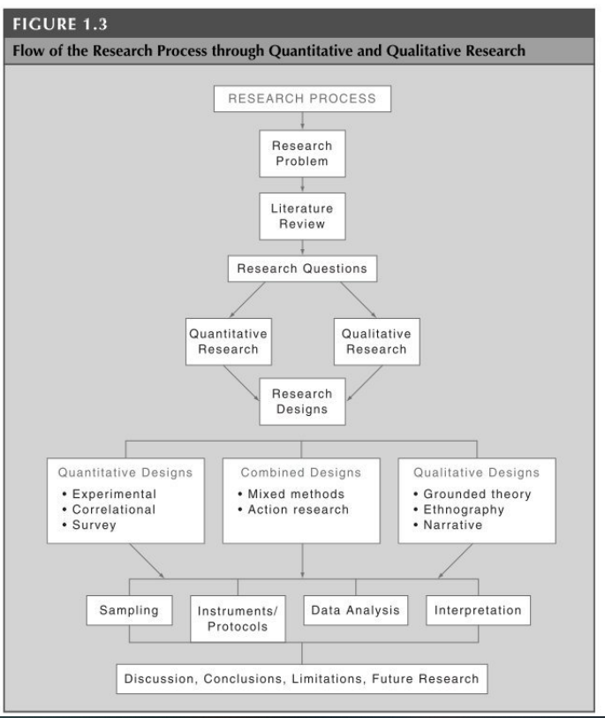
The Research Process
This diagram from Cresswell (2013, p29) shows the steps and sequence of the research process.
Notes:
Clarify the vocabulary at each stage, take each step one at a time. Highlight the ‘future research’ at the end

Slide 7
The Attributes of Good Research Projects
Jankowicz (2004) lists six concepts that apply to research in general.
Originality
Generality
Pragmatism
Ethical issues
Quality of evidence used
Balance
Notes:
Originality – Does the research investigate something that has not been look at before? Or does it research something well known but in a new way?
Generality – Do the findings of the research have relevance beyond the research study? Can the be used to be generalised statements?
Pragmatism – Do the projects follow a clear structured method of research that could be replicated by others? Do the arguments made in the research make sense according to the results found?
Ethical Issues – Are ethical challenges acknowledged and have adjustments been made? Has the research been conducted in an ethical way?
Quality of evidence used – Have participants been recruited in an organised way? Has a big enough sample been used? Has any secondary data been verified?
Balance – Have all arguments been considered? Has the research been conducted objectively?

Slide 8
Activity
Complete the Introduction to Research Quiz on Moodle in Week 1

Slide 9
Summary
Today we have:
- Introduced the module content for the term.
- Discovered and used Outlook and the OneDrive
Begun to understand key research terms.
Next session:
- We will be using a range of tools in MS Word
- We will be finding sources of information and learning how to navigate articles.

Slide 10
References
Cresswell, J. W., (2013) Educational research: Planning, conducting and evaluating Quantitative and Qualitative Research, London: Pearson
Jankowicz, A. D., (2004) Business Rearch Projects, 4th Ed, Andover: Cengage Learning EMEA
USU Libraries, 2018, Empirical Studies: Qualitative vs Quantitative, [video] Available at https://www.youtube.com/watch?v=RZcfmA1l6cE [accessed 10/01/2022]

