Slide 1
Evaluating information for credibility and reliability
Stephanie John

Slide 2
Explain what makes information credible and reliable.
Use the CRAAP test to evaluate information. distinguish between academic and popular sources.
Recognise common forms of misinformation and disinformation.
Apply evaluation skills to health and social care information.
Locate, retrieve and communicate useful information.
Explain why you have chosen one source over another.
Learning outcomes

Slide 3
Imagine you are supporting a service user who asks:
"I saw on TikTok that drinking lemon water every morning can prevent diabetes. Is that true?"
What would you do?
A. Tell them it is probably true because lots of people say it.
B. Search Google and use the first result.
C. Check where the information came from and look for reliable evidence.
D. Tell them everything on social media is false.
Which answer would you choose?
What would you check?
What could happen if the information was wrong?

Slide 4
Key message:
In health and social care, poor-quality information can affect decisions, behaviour, wellbeing and safety.

Slide 5
When selecting sources, these questions can help you decide on their suitability:
Question | Evaluating sources
Who? | Is there an identifiable author / organisation? Do they have academic / official credibility?
What? | How relevant is the subject content to your research questions?
Where? | How does the context relate to your research area? (e.g. your assignment is about UK G.P. clinics; you find a report about US hospitals)
When? | How current is the source? (in general: the newer, the better)
Why? | Is the motivation for publishing the source clear? (e.g. is it to inform or persuade? Is there possible bias?)

Slide 6
a. A peer-reviewed journal article about loneliness and older adults. b. A tiktok video by an influencer claiming that “social media causes depression”. c. A BBC news article reporting on new research. d. An NHS webpage explaining symptoms of depression. e. A website selling a supplement that claims to “cure anxiety naturally”.
Rank these from 1 (most trustworthy) to 5 (least trustworthy).

Slide 7
REcap
What made you put your top source first?
Does a professional-looking website automatically mean it's reliable?
Can a source be accurate but unsuitable for an assignment?
Can a source be popular but unreliable?
Does something being published online make it less trustworthy?

Slide 8
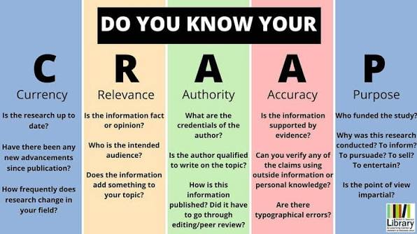
CRAAP test — deeper exploration

Slide 9
A source doesn't have to score highly on every CRAAP criterion to be useful.
For example, a historical source may be old but still highly relevant when studying the history of social care

Slide 10
Academic vs popular sources
Academic sources
Written by researchers/subject specialists.
Published in academic journals or books.
Often peer reviewed.
Include references.
Explain methodology/evidence.
Use specialist academic language.
Intended primarily to contribute to knowledge.
Popular sources
Examples include:
Newspapers.
Magazines.
Blogs.
Social media.
General-interest websites.
Online articles.
These aren't automatically bad.
Popular doesn't mean unreliable, and academic doesn't mean automatically correct.”
Evaluate the evidence, author, purpose and context.

Slide 11
Fake news and misinformation
Misinformation
False or inaccurate information that is shared without necessarily intending to cause harm.
Disinformation
False information deliberately created or shared to deceive or manipulate.
Fake news
A broad, everyday term for fabricated or misleading content presented in a news-like format.

Slide 12

Fake news: Red flags 🚩
Sensational headline: “Doctors hate this….”
No identifiable author.
No references or evidence.
Anonymous experts.
Claims that sound too good to be true.
Excessive use of capital letters/ exclamation marks.
Strong emotional language.
Cherry-picked statistics.
Old information presented as new
One person’s experience presented as scientific evidence.
Commercial links or products being promoted “they don’t want you to know…”
No information about who owns the website

Slide 13

Quiz
What does the first A in CRAAP stand for?
What is the difference between authority and accuracy?
Why might an old source still be relevant?
Give two signs that an online source may be unreliable.
What is peer review?
What is the difference between misinformation and disinformation?

Slide 14
The take-away:
Stop
Check
Compare
Decide

Slide 15

Summary
Good academic practice is not about finding sources that agree with your opinion. It is about evaluating evidence critically and selecting the most credible information available.
One thing I have learnt from this session that I consider important…….
Name three things to check before using information in your assignment…

Slide 16

Next week we will be CRAAP detectives!

