Slide 1
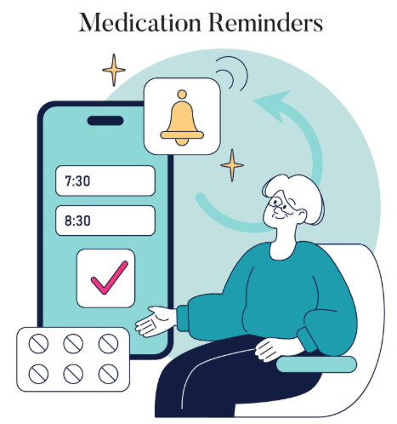
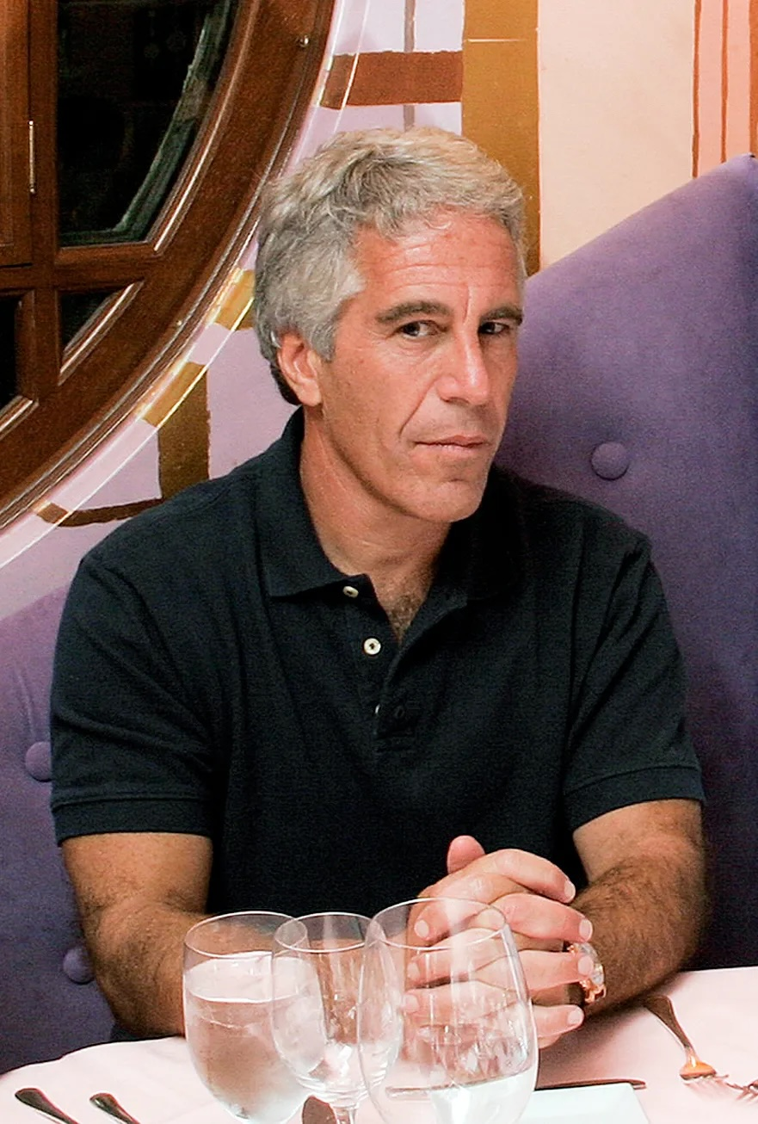
Extenuating Circum-Systems
Smart Medication Management Application
[1]
ACCB6019 – Emerging Trends

Slide 2
Introduction
Team Introduction
Proposal Idea
Research
Next Steps
References
Questions

Slide 3
Team Introduction
Ryan Hopkins – Project Lead: Ensuring everything runs smoothly, and everyone stays on task.
Jamie Richards - Developer Programmer
Max Jones – Developer Programmer
Jacob James-Machin – Developer Programmer
Sharise Jonathan – Developer Program designer and Tester
Serena Jonathan – Research Lead: Finding the gap in the market, what we can use to give us an advantage
Communication via WhatsApp
Meeting Weekly
Using the AGILE methodology

Slide 4
Proposal idea
Gamify a medication reminder app with the aim to increase user retention
Key Features:
• Gamification encourages consistent behaviour with rewarding positive habits – I.E daily log in
• Smart notifications with confirmation tracking
• Automatic low stock alerts
• Automatic Reorder
• Medication tracking history
• Caregiver / Family notifications for missed doses
• Customizable medication reminders

Slide 5

Research

Slide 6
"44% of men and 51% of women had taken at least one prescribed medicine in the last week, and 24% of men and 25% of women had taken at least three types of medicine" [2]
The book Gamification for Product Excellence written by M Hyzy and B Wardle explains that gamification can enhance user engagement and retention by appealing to people's motivation, it highlights points such as badges, progress tracking and challenges to create a sense of achievement.[3]
Mobile medication apps show promise in improving adherence but evaluation is inconsistent and long term retention outcomes are unclear [4]

Slide 7
What problem are we aiming to solve?
People often forget to take medication
Difficulty in tracking what doses if there is multiple medications
Struggles with reordering prescription
Mitigate any health risks from doubling or missing doses

Slide 8
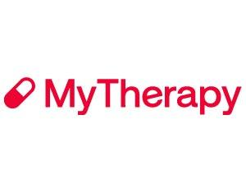
Existing Applications (1/3)
MyTherapy
Purpose:
A medication reminder and health tracking app designed to help users manage prescriptions.
Strengths:
All-in-one health tracking
User-friendly interface
Trusted and widely used
Limitations:
Interface can feel cluttered
Many advanced features locked behind premium
Can be overwhelming for simple use cases
[5]

Slide 9

Existing Applications (2/3)
Medisafe
Purpose:
A smart medication management app that helps users stay on schedule.
Strengths:
Clean design
Strong reminder system
Safety features (interaction warnings)
Limitations:
Premium subscription required for full features
Can be complex for elderly users
Limited customisation in free version
[6]

Slide 10

Existing Application (3/3)
NHS App
Purpose:
A healthcare app that allows patients to access NHS services digitally.
Strengths:
Direct integration with NHS services
Secure and government-supported
Centralised access to medical information
Limitations:
No advanced medication reminder system
Limited personal health tracking features
Focused on services rather than daily medication management
[7]

Slide 11



The Problems with existing application
Premium paywalls restrict important features
Underwhelming interface for younger users
Complex interfaces for elderly users
Limited personalization
Lack of simple, focused daily medication management
No accessibility friendly features for the visually impaired or hard of hearing
What are the users saying about these existing applications?
Colin
Stuart Poole
Raeli Kyllonen
Used this for years but didn't pay for the extra features. Now they are inaffect forcing you to pay to use. £5 a month! There are free alternatives that use ads and I am happy to pay for them to be removed in one off payment. Not paying every month to use an app. It's a shame as it's been useful but not in any way worth a monthly payment. Uninstalled.
Others said recently they can't login and you are directing them to the help.login.nhs.uk site. Despite your comment, my problem is not one of the six listed errors on the site. Version 5.4.0. Just recently, it gets into an authentication loop. The login screen doesn't give me a chance to do anything. It immediately throws up a "We were unable to authenticate you" message before I even try to login. I choose an option and it immediately throws the same error. I can log into the web version fine.
Used to heavily rely on this app, enjoyed you could paused medication reminders and adjust urgency. However, the new updates are aggravating. Takes up entire screen instead of usual push notification, doesnt register the "30 minutes later" input anymore, have to stop everything im doing to make the window go away or risk pushing the big "Confirm" button on accident and missing my medication entirely. Keeps throwing ads and "Please Review Us" windows in my face. Used to be a simple app.
Medisafe
NHS App
MyTherapy Pill

Slide 12
Gamification inside the application
The application target audience is young adults, as this is the case we require something that appeals to younger people.
The idea the team produced is replacing the prescription with birds, as the user can watch their bird grow up with the number of times they return to the application. Users can differentiate prescriptions by type of bird.

Slide 13
Next Steps
Further research
Create a Gantt chart
UI and software design
Prototype development
Testing and Security

Slide 14

Questions

Slide 15
References
[1] Anonymous "Health Gamification. Flat Illustration," Available: https://www.vecteezy.com/vector-art/47805684-health-gamification-flat-illustration.
[2] Anonymous . Prescribed medicines. Available: https://digital.nhs.uk/data-and-information/publications/statistical/health-survey-england-additional-analyses/ethnicity-and-health-2011-2019-experimental-statistics/prescribed-medicines.
[3] M. Hyzy and B. Wardle, Gamification for Product Excellence: Make Your Product Stand Out with Higher User Engagement, Retention, and Innovation. 2023.
[4] H. Saul, "Apps to help patients take medication on time need to be evaluated in a consistent way," 2020. Available: https://evidence.nihr.ac.uk/alert/apps-to-help-patients-take-medication-on-time-need-to-be-evaluated-in-a-consistent-way/.
[5] Anonymous“MyTherapy Medication Reminder and Pill Tracker App - MS Fitness Challenge,” MS Fitness Challenge, 2025. https://www.msfitnesschallenge.org/partners/mytherapy/ (accessed Feb. 12, 2026).
[6] Anonymous “Medisafe Expands Business Solutions with New Software as a Medical Device (SaMD) | Medisafe,” Medisafe, Jan. 04, 2023. https://www.medisafe.com/medisafe-expands-business-solutions-with-new-software-as-a-medical-device-samd/
[7] NHS Wales, “About Us,” NHS Wales, 2023. https://www.nhsapp.service.nhs.uk/login

