Slide 1

BREATHE BETTER,
DRINK SMARTER
A life-course local council campaign to reduce smoking and alcohol harm
Presentation details
Module: LCHS7000 Social Epidemiology and Public Health Development
Assignment: Component 1 Group Presentation
Target: All ages in the local community
Focus: Smoking and alcohol consumption
Student name(s): __Amreen Akhtar______________________________
Student ID : _2214675__________________________________
Lecturer: _Junaid Shaikh_______________________________________
Professional practice intervention | 30-minute group presentation
Notes:
This presentation will introduce a unique local council health promotion campaign which aims to promote drinking water and improve respiratory health: Breathe Better, Drink Smarter. The campaign focuses on smoking and alcohol use as both are still significant modifiable risk factors for disease, premature death and health inequalities in the UK. The presentation is aimed at all ages, but takes a life course approach to ensure the activities are relevant to young people, working age adults, parents/carers and older people. The emphasis is on prevention for young people: not taking on habits that will become normal if they want to resist social pressure and understand the risk before it becomes normal. Brief advice, reduction, and quitting support and referral are the focus for adults. Medication safety, falls risk, loneliness and support to minimise harm are the focus for older people.

Slide 2
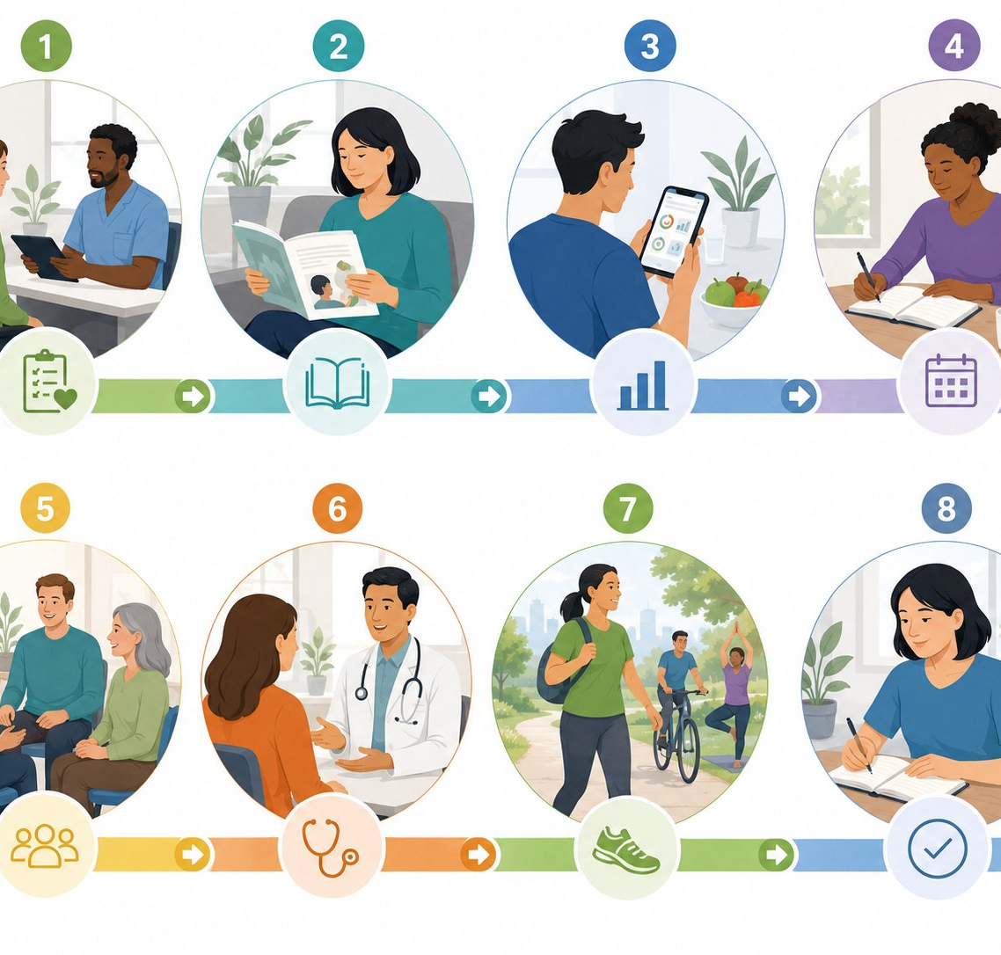
Campaign overview: 8-week practice intervention
02
Campaign format
Commissioned by a local council to promote positive health behaviour.
All-age community access with life-stage segmentation.
Weekly 60–75 minute sessions in venues and online.
Brief advice, education, peer support and referral.
Outcome focus: awareness, service engagement and behaviour change.
8-week flow
1 Screen
2 Learn
4 Plan
3 Track
5 Support
6 Refer
7 Act
8 Review
Campaign design informed by local health promotion guidance and NICE tobacco recommendations (NICE, 2025).
02
Notes:
The campaign is NOT a one-off awareness event; it is an eight-week practice intervention. This is important as smoking and alcohol behaviours are learned, are influenced by social context, stress and access to support, and a poster is not enough. The elements targeted include screening questions, referrals, individual action plans and signposting to local alcohol support services, pharmacies, GPs and NHS stop smoking services. The eight-week flow is split into four phases: baseline screening and awareness, tracking and planning, social support and referrals, review and follow-up. This aids the group to demonstrate practical application, rather than theory, with clear aims for each activity and measurable outcomes.

Slide 3
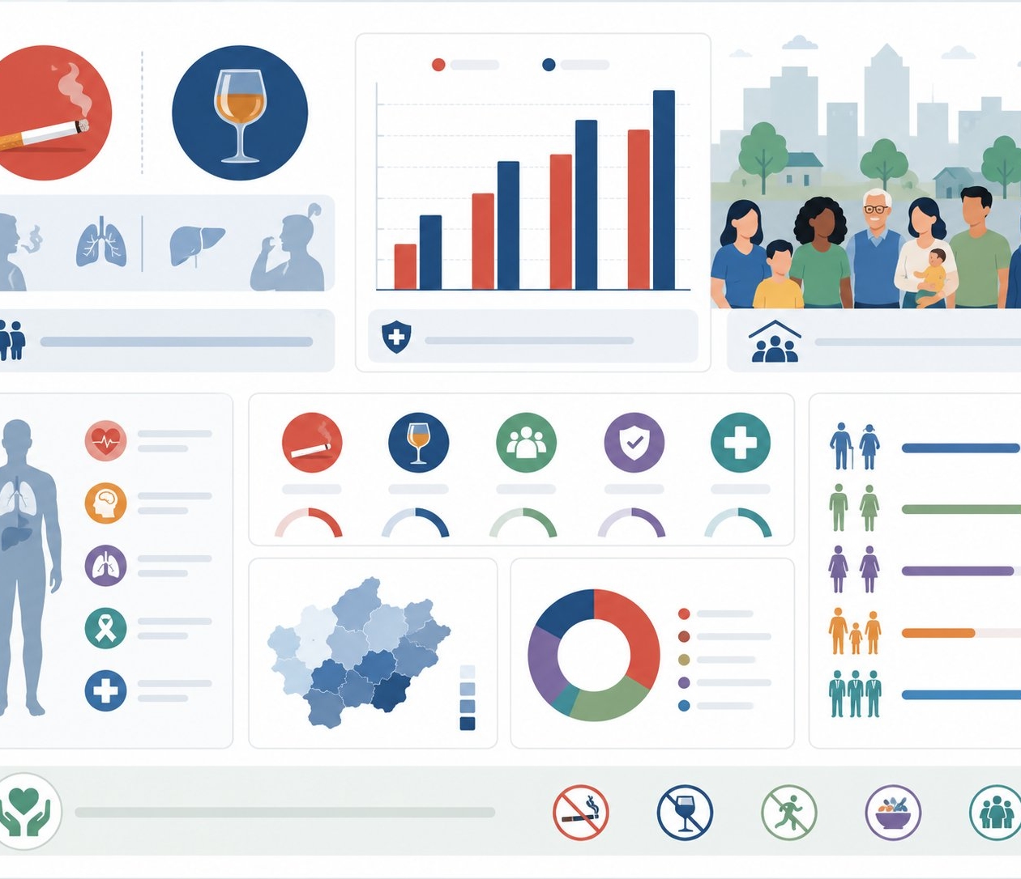
Rationale: why smoking and alcohol are priorities
Task 1: Rationale
03
10.6%
5.3m
21%
8,274
UK adults smoked cigarettes in 2024
People aged 18+ smoked in the UK
Adults drank above 14 units/week in 2024
Alcohol-specific deaths in England in 2023
ONS, 2025
ONS, 2025
HOC Library, 2026
DHSC/OHID, 2025a
Public health logic
Critical issue
Council relevance
Both are modifiable risk factors.
Harms begin before visible illness.
Risks accumulate across the life course.
Prevention reduces future NHS and social care demand.
Disadvantaged groups still carry higher harm.
Alcohol risk can appear socially normal.
Combined messaging reduces stigma by discussing everyday habits.
Community venues reach people before a crisis.
Partners can support prevention and referral.
Outcomes can be monitored locally.
Data sources: ONS (2025), House of Commons Library (2026), DHSC/OHID (2025a), WHO (2024).
03
Notes:
This campaign is based on the premise that smoking and drinking alcohol are preventable, common and socially patterned risk factors for poor health. The latest ONS estimate is that 10.6 per cent of all UK adults, or some 5.3 million people, were smoking cigarettes in 2024, the lowest proportion since records began. Alcohol continues to be an issue: 21 per cent of adults in England consumed more than 14 units a week of alcohol in 2024. In England, 8,274 alcohol-specific deaths were reported on the alcohol profile in 2023. They also have a cost to the family, the employer, councils and the NHS. In areas where the council can have an impact before the illness occurs, the council can raise awareness and normalise help-seeking and connect people to evidence-based help.

Slide 4
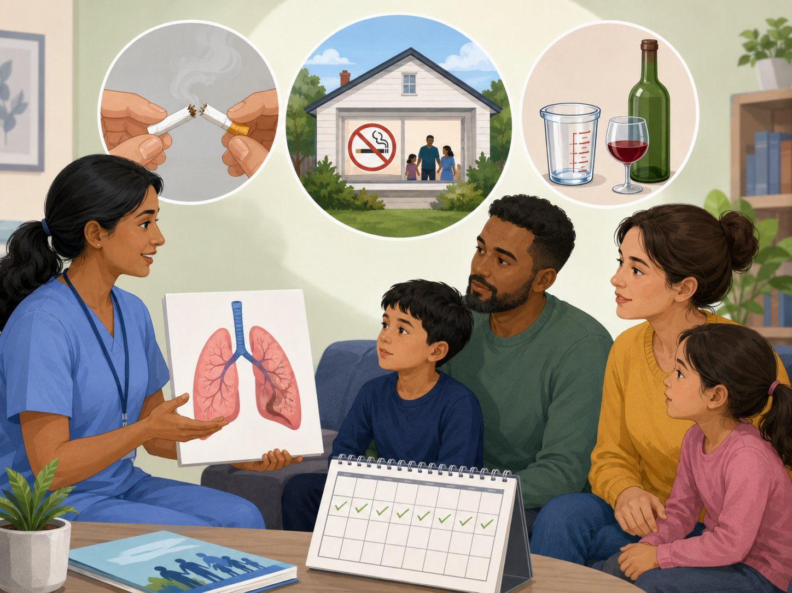
National guidelines: what should the campaign promote?
Task 1: Rationale
04
Smoking and tobacco
Alcohol consumption
Best message: do not smoke; if smoking, access quit support.
NICE NG209 supports helping to stop smoking from age 12+ and prevention for under-24s.
Campaign translation: youth prevention, adult quit attempts and smoke-free home pledges.
Adults should not regularly drink more than 14 units weekly.
Spread units across 3+ days and include drink-free days.
Children and young people: an alcohol-free childhood is the healthiest and safest option.
Life-course approach
Guidelines: NICE NG209 (2025); Department of Health (2016); GOV.UK alcohol prevention toolkit (2025).
04
Notes:
The campaign should be based on national guidance and not on personal opinion. The smoking message is simple: Don't smoke. If someone already has a habit of smoking, then there should be a path in the campaign that leads them to support. NICE NG209 advises support to help people stop smoking from age 12, and prevention to be offered to children, young people and young adults (aged 12-24 years). The Chief Medical Officers for the UK have recommended that adults should not consume more than 14 units of alcohol a week and should try to spread these units out over three or more days. The best way to protect children and young people is to keep them alcohol-free. This implies the campaign has to be age sensitive – not suggesting that youth should drink at the adult level, rather it needs to encourage youth prevention, delay and family awareness.

Slide 5
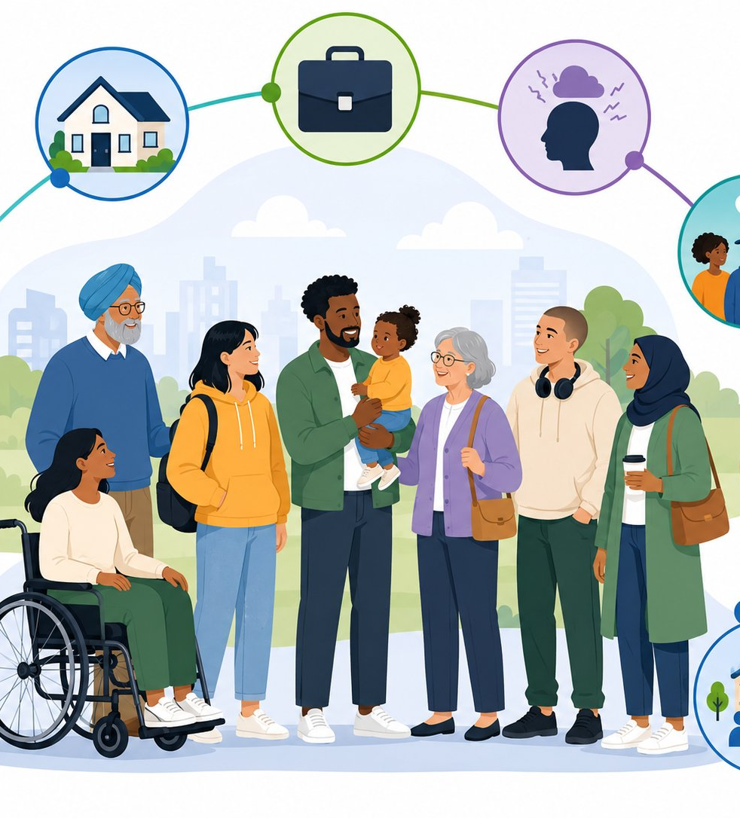
Needs assessment: social determinants and inequalities
Task 1: Rationale
05
Behaviour is shaped by environment, not only personal choice
Deprivation & cost of living
Stress, trauma & mental health
Peer norms & family habits
Marketing, availability & licensing
Access to GP, pharmacy & support
Housing, work & social isolation
Campaign implication
Combine information, motivation, practical skills and referral. Otherwise, the intervention risks blaming individuals for structurally patterned behaviours.
Conceptual basis: social determinants of health and UK inequality evidence (DHSC/OHID, 2025b; WHO, 2024).
05
Notes:
A good needs assessment should not consider smoking and drinking alcohol to be just an issue of willpower. Social determinants have a strong influence on these behaviours. Smoking or drinking can be caused by stress, anxiety, trauma, loneliness, family dynamics, stress on finances, or stress on peers. Inequality is significant due to the increased stress exposure and reduced protective factors that people in disadvantaged communities might have. Hence, the campaign can't cast blame and must provide solutions. This involves free local venues, accessible language, culturally sensitive materials, family inclusive activities, referral to NHS and voluntary sector services and follow-up opportunities. The thinking in the campaign is social epidemiological – it is more likely to happen when individual motivation is reinforced by enabling environments.

Slide 6

Consequences of poor habits: short-term and long-term harm
Task 1: Rationale
06
Short-term: daily life
Long-term: future health
Hangovers, poor sleep and low energy.
Breathlessness and reduced exercise tolerance.
Mood change, irritability and cravings.
Accidents, injuries and unsafe decisions.
Family conflict and financial pressure.
Cancer, COPD and cardiovascular disease.
Liver disease, pancreatitis and dependency.
Worsening mental health and isolation.
Second-hand smoke harms children.
Premature mortality and inequalities.
Campaign message: benefits of change begin early, while prevention reduces future disease and inequality.
Health harms: WHO Europe (2025), NHS Better Health (2024a), NHS England Digital (2024), NHS Inform (2025)
06
Notes:
The consequences must be communicated in both short-term and long-term terms as different audiences respond to different forms of risks. These messages can be more relevant for them, such as the ones about breathlessness, hangovers, sleep, concentration, mood, money and family relationships. Smoking causes almost every organ of the body to be harmed, and is associated with lung cancer, respiratory disease, cardiovascular disease and second-hand smoke. In the short-term, alcohol misuse is associated with an increased risk of accidents and injuries, and in the longer-term, liver disease, cancer, stroke, heart disease and dependency. The harms also impact family and community, including through caregiving pressure, financial burden, in-work absence and the need for health and social care provision. It highlights that preventing damage from smoking and alcohol can benefit people's daily lives and also help to prevent further illness.

Slide 7

Three measurable campaign aims
Task 1: Rationale
07
1. Increase awareness
2. Increase help-seeking
3. Support behaviour change
By week 8, at least 80% improve their knowledge of smoking harms, alcohol units and support routes.
Benefit: informed decisions and stronger risk perception.
At least 40% of smokers or risky drinkers accept signposting, referral or brief support conversation.
Benefit: earlier contact with evidence-based services.
At least 30% report a quit attempt, reduced smoking, alcohol-free days or a smoke-free home pledge.
Benefit: measurable risk reduction.
Primary data tool: pre/post form + attendance/referral log
Aim design aligns with process, impact and outcome evaluation principles and local public health practice.
07
Notes:
There are three measurable aims for the campaign, as it is short on broad intentions, and the assessment brief specifies that the aims need to be measurable. It will be assessed against the completion of a brief pre- and post-session questionnaire to identify: the adult alcohol guideline, risk of second-hand smoke, quit support options and signs of higher risk drinking. Two of the aims are help-seeking aims: It acknowledges that knowledge alone is insufficient if people don't know where to turn to and are not confident that they can seek assistance. The number of participants taking signposting, AUDIT-C or smoking status screen, talking to a trained adviser and taking a signposting card will be used to measure this aim. Aim 3 is a behaviour-change aim. Rather, it is based on early changes like a quit attempt, decrease in cigarettes, pledge to keep home smoke-free, decrease in number of alcohol units, fewer alcohol-free days or a personal action plan.

Slide 8
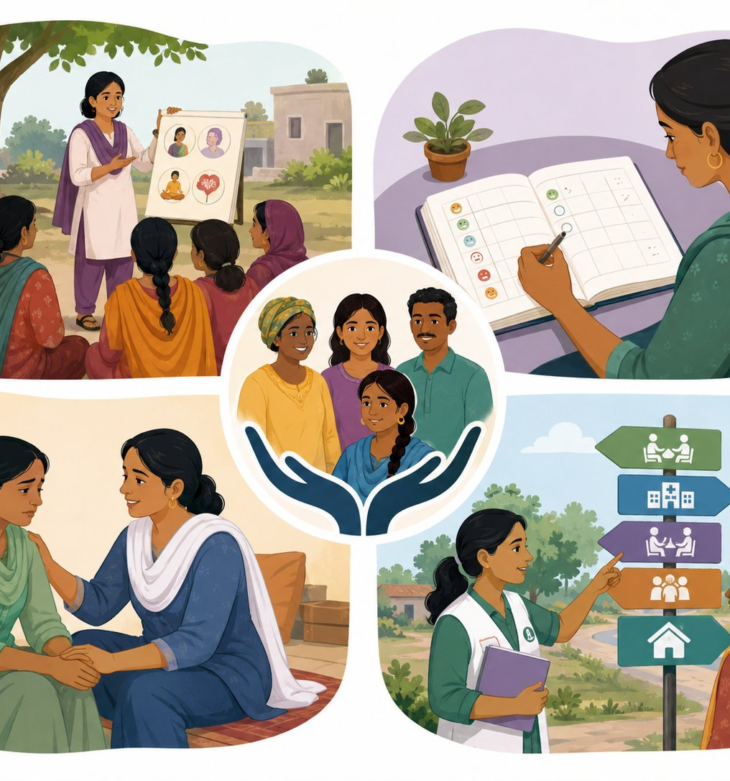
Campaign design: prevention, support and referral
Task 2: Campaign
08
Breathe Better, Drink Smarter
A community campaign that turns health guidance into everyday action
EDUCATE
TRACK
Risks, units, second-hand smoke and myths
Cigarettes, cravings, triggers and weekly alcohol units
SUPPORT
REFER
Peer groups, family pledges and motivational conversations
NHS stop smoking, GP, pharmacy and alcohol support
Theory-informed: Capability improves knowledge and skills | Opportunity provides free access | Motivation uses personalised goals and social encouragement
Intervention components draw on NICE (2025), NHS (2021), NHS Better Health (2024a; 2024b) and COM-B evidence (Gilbert et al., 2023).
08
Notes:
Design of the campaign incorporates prevention and support/referral. It's not just a warning campaign, as it should be an evidence-based health promotion, which should enable people to act on information. Participants are informed about the harmful effects of smoking, how many alcohol units are in their drink, the harmful effects of second-hand smoke, alcohol free childhood and the difference between low-risk advice and no-risk myths. Cigarettes, Cravings, Triggers, Alcohol Units and Alcohol free days are recorded by people. There is no judgment in tracking, and it aids people in identifying patterns. This encompasses peer discussion, family pledges, culturally sensitive conversations and motivational interviewing-type questions. Those who require additional assistance are referred to NHS stop smoking services, pharmacies, GPs, community alcohol services and/or mental health services.

Slide 9

Activity plan: 6–8 weekly sessions
Task 2: Campaign
09
Week
Session theme
Aim and content
1
Launch + baseline
Smoking status, AUDIT-C, quiz, goals
2
Smoke-free living
Nicotine dependence, quit options
3
Alcohol units
14-unit guideline, diary, alcohol-free days
4
Triggers + cravings
Stress, peer pressure, coping alternatives
5
Family + community
Smoke-free homes and support buddies
6
Local help pathway
NHS, pharmacy, GP, alcohol support referral
7
Action planning
SMART goals and relapse planning
8
Review + sustain
Post-measures and follow-up
All sessions include signposting, safeguarding awareness and referral where risk is identified.
Session content informed by NHS stop smoking services and Better Health resources (NHS, 2021; NHS, 2024a; NHS, 2024b).
09
Notes:
This slide illustrates how the intervention is put into practice. Week two covers second-hand smoke, nicotine dependence, and how to find quit support, in addition to introducing the campaign and gathering baseline data with a short knowledge quiz and alcohol screening (AUDIT-C). In week three, alcohol units and an adult 14-unit guideline are explained, as well as completing a drink diary activity. In week four, we will be examining triggers and cravings as stress and social habits and routines can trigger behaviour. The scope of Week 5 broadens to cover family and community, such as smoke-free homes, safe socialising and support buddies. The local help pathway in week 6 brings participants together with stop smoking services, pharmacies, GPs and alcohol support services. Week seven is about learning to create SMART action plans. This sequence meets the short-term goals since it is 6-8 weeks long and offers definite goals and activity content.

Slide 10

Campaign poster concept
Task 2: Campaign
10
Poster requirements covered
BREATHE BETTER
DRINK SMARTER
Title and memorable slogan; focus on smoking and alcohol reduction; weekly activities; benefits; QR/phone/in-person call to action.
A free 8-week community campaign
STOP SMOKING • DRINK LESS
Accessibility note
Use large text, plain UK English, translated versions where required and a non-digital booking option for people without smartphones.
SCAN • JOIN • TALK • TRACK • CHANGE
poster content aligns with NHS Better Health messages and local council health promotion principles (NHS, 2024a; NHS, 2024b).
10
Notes:
It is important to note that the title Breathe Better, Drink Smarter does not include shaming language. Smoking and alcohol are portrayed as behaviours that can be modified with help. The poster contains the campaign title, focus, the frequency of the activities, the main benefits and an explicit call to action. There should be a QR code area (which may point to a local council booking page) and a telephone number and in-person booking option, for those who don’t use smartphones. For an all-age campaign, it is important to be accessible. The final poster must be in large fonts, in plain English, translated into other languages as necessary, and contain pictures depicting a variety of ages and communities. The poster underpins the wider intervention and is not a standalone. It's there to grab people's attention, to sensitise them to the stigma associated with the issue and to get them to engage with the weekly sessions where more in-depth support for behaviour change can occur.

Slide 11

Partners, organisations and reusable resources
Task 2: Campaign
11
Local council Public Health
NHS stop smoking services
Commissioning, venues, local data, safeguarding
Quit support, NRT advice, follow-up, CO monitoring
GPs + pharmacies
Schools, colleges + youth services
Brief advice, referral, medicines and health checks
Prevention, peer norms and family engagement
Community and faith groups
Alcohol services + charities
Trusted spaces, inclusion and social support
AUDIT-C, brief intervention and recovery pathways
Reusable resources: NHS Better Health leaflets • alcohol unit tracker • AUDIT-C screen • CO monitor • smoke-free home pledge • referral card • text reminder template • local support directory
poster content aligns with NHS Better Health messages and local council health promotion principles (NHS, 2024a; NHS, 2024b).
11
Notes:
The assessment brief asks for potential partners and organisations, including local and national resources. The local council public health team are key as they can supply venues, local needs assessment information, safeguarding procedures and assessment oversight. NHS stop smoking services play a critical role in supporting people to quit smoking, advising on nicotine replacement products, ensuring carbon monoxide monitoring and providing follow-up after quitting. Brief advice, medication advice and referral can be given by GP practices or pharmacies. Schools, colleges and youth services can support prevention messages for young people and engage parents/carers. Community and faith groups are important since they are trusted local places and can access people who are not going to formal health services. For individuals with risky or dependent drinking levels, alcohol support services and charities can offer tools from AUDIT-C, a brief intervention, alcohol recovery pathways, and information about recovery. The campaign is realistic and cost-effective because of the reusable resources.

Slide 12
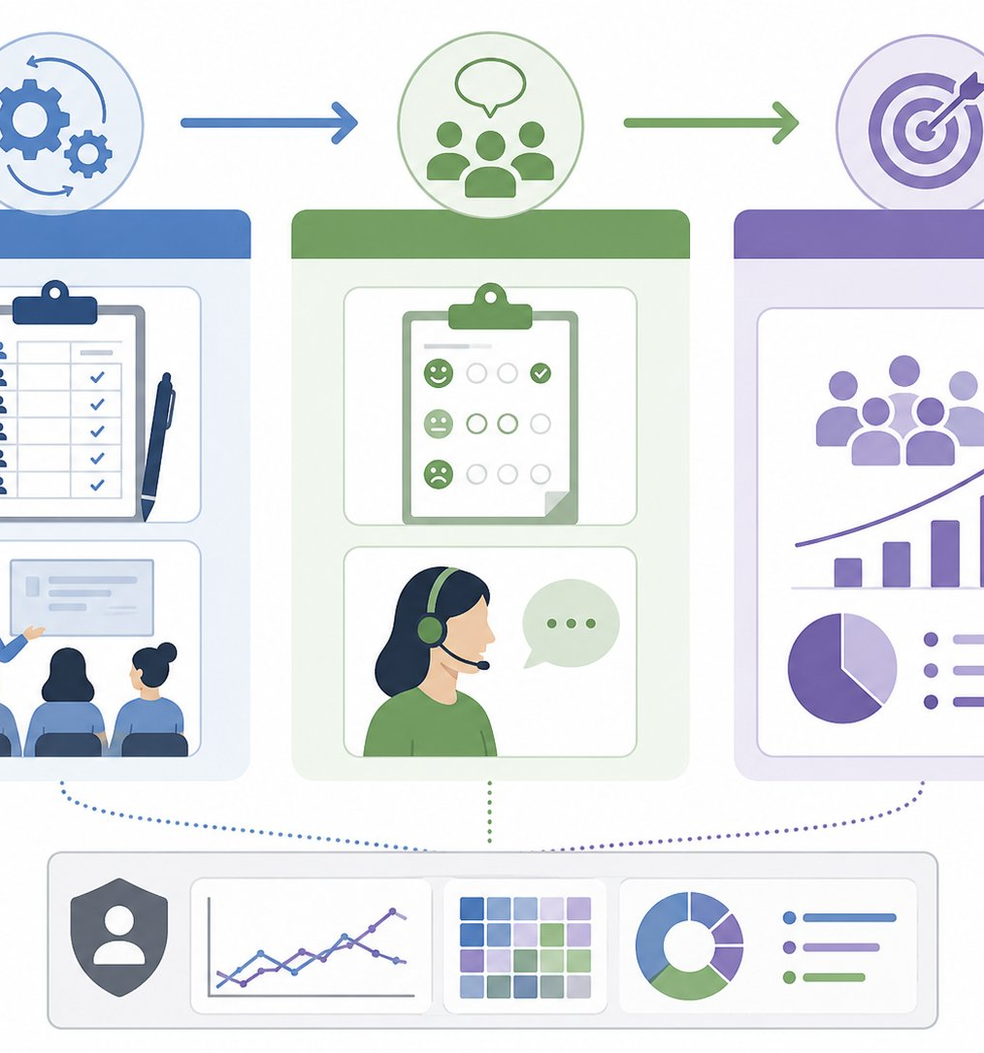
Evaluation plan: how success will be measured
Task 2: Campaign
12
PROCESS
IMPACT
OUTCOME
Was it delivered?
• Attendance by week
• Reach across ages/communities
• Referral conversations logged
• Partner involvement
Tool: monitoring log
Did knowledge or intention change?
• Pre/post knowledge quiz
• Confidence rating
• Alcohol unit awareness
• Quit readiness and smoke-free pledge
Tool: short questionnaire
Did behaviour change begin?
• Quit attempt or reduced cigarettes
• Fewer weekly alcohol units
• Alcohol-free days
• 4–8 week follow-up
Tool: self-report + service data
Ethical practice: anonymous group data, consent for follow-up, and safe referral when dependency or safeguarding risk is identified.
Evaluation indicators use service monitoring principles and NHS stop smoking 4-week quit definitions (NHS Digital, 2024; NICE, 2025).
.
12
Notes:
Process evaluation addresses the question of "did the campaign get to those intended?" Attendance, age mix, engagement with a partner, number of referral conversations and delivery of sessions as planned are all included. The question in impact evaluation is: "Did there change in knowledge, confidence and intention? This can be assessed by a brief questionnaire prior to and following the campaign, including levels of awareness about alcohol units, smoke-free homes, second-hand smoke, quit support and confidence to quit. Outcome evaluation is a question as to whether early behaviour change has begun. Should document quit attempts, fewer cigarettes, smoke-free commitments, fewer alcohol units per week, alcohol-free days and follow-up commitment, after 4 to 8 weeks. Data should be anonymous at the group level, consent should be sought for follow-up contact, and anyone with a dependency on alcohol, a mental health crisis, or safeguarding issues should be directed promptly to appropriate services.

Slide 13

Benefits of changing smoking and alcohol behaviours
Task 3: Benefits and challenges
13
Physiological benefits
Psychological benefits
Sociological benefits
Better breathing and stamina
Lower cancer, COPD and CVD risks
Improved liver, sleep and blood pressure health
Reduced second-hand smoke exposure
Greater self-efficacy and control
Improved mood and energy
Reduced guilt, worry and dependency cycles
Better concentration and sleep routine
Healthier family routines
Less financial pressure
Safer social occasions and fewer injuries
Greater community connection and support
Behaviour change pathway: small step → reduced exposure → better daily wellbeing → lower future risk
Health benefits: NHS Better Health (2024a; 2024b), WHO Europe (2025), WHO (2024).
13
Notes:
On the physiologic level, quitting smoking has a beneficial effect on respiration, decreases exposure to carbon monoxide, and decreases the risk of cancer, COPD and cardiovascular disease in the long-term. Limiting alcohol use can help improve sleep, energy, weight, blood pressure, liver function, and lessen the risk of injury. Behaviour change can have psychological benefits, such as helping to boost confidence, self-efficacy and mood, as individuals feel more in control of their routines and expenditure. The advantages are not just to the person; they are also social. Smoke-free homes keep kids and pregnant women safe from secondhand smoke. Less drinking can help to reduce family conflict, enhance relationships, decrease financial pressures and risky situations in social settings. The campaign message is small steps make a difference: Taking the first step of one alcohol-free day, one quit attempt, one conversation about support or one smoke-free home pledge can start a journey to improve one’s wellbeing in the day and reduce risk in the future.

Slide 14
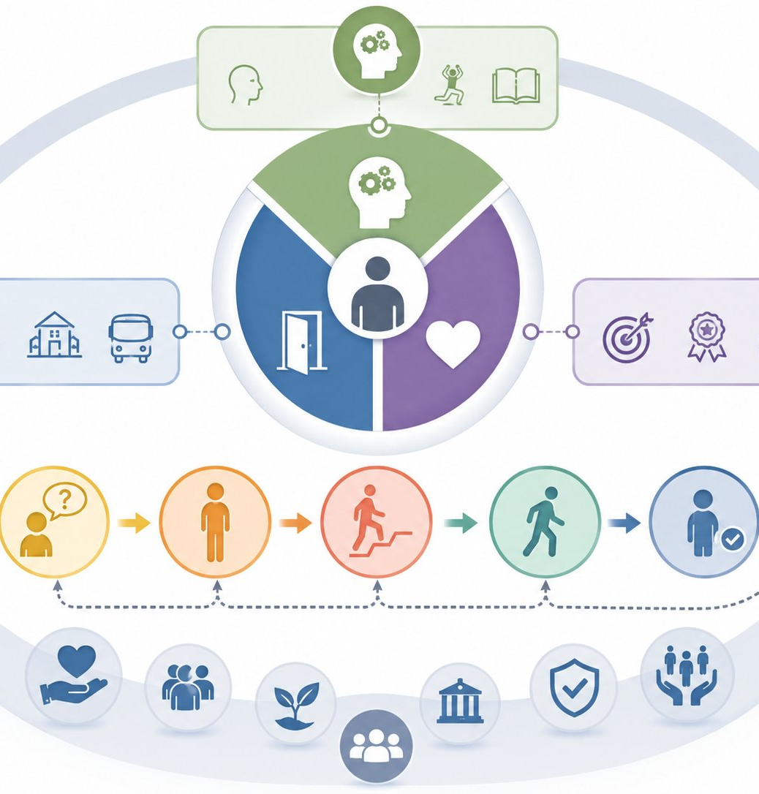
Challenges, behaviour-change theory and campaign solutions
Task 3: Benefits and challenges
14
COM-B
HBM
TTM
Capability • Opportunity • Motivation
Risk, benefits, barriers, cues
Stages of change
Key barriers
Campaign solutions
Nicotine dependence, cravings and withdrawal.
Alcohol as a social norm or coping strategy.
Low perceived risk: “I only drink/smoke socially”.
Stigma, fear of judgment, and low confidence.
Limited time, digital exclusion or poor access.
Capability: plain information and action plans.
Opportunity: free venues, referral cards and partner access.
Motivation: confidence scaling, goals and peer support.
Stages: awareness, preparation, action and relapse planning.
Equity: translated resources and culturally sensitive delivery.
Critical point: education alone is insufficient; change requires capability, opportunity, motivation, services and social support.
Models and evidence: Gilbert et al. (2023), Alyafei and Easton-Carr (2024), Park et al. (2024), NICE (2025)
14
Notes:
The campaign needs to define problems and relate the solutions to behaviour change theory. COM-B is a theory which states that behaviour is influenced by the people’s capability, opportunity and motivation. Individuals who do not comprehend what an alcohol unit is lack psychological ability. If they consider cigarettes or alcohol as the only way to relieve stress, they may have mixed feelings about it. The Health Belief Model is helpful to understand why some people don't act when risks are present. They might not feel vulnerable, might minimise the seriousness, might think that advantages will be long-term away, or might face problems like lack of trust, cost and fear of failure. The Transtheoretical Model is a reminder to us that people are in different stages – some of them are not ready, some are thinking, some are preparing, and some are actually acting. As a result, the campaign is support stage-matched. Rather, it provides awareness, motivating discussions, coping skills, peer support, referral, planning for action and relapse prevention. The key message is the education is not enough without any support provided practically and socially.

Slide 15
References: Harvard style
15
Action on Smoking and Health (ASH) (2025) Smoking and respiratory disease. Available at: https://ash.org.uk/resources/view/smoking-and-respiratory-disease (Accessed: 6 June 2026).
Alcohol Change UK (2026) Alcohol statistics. Available at: https://alcoholchange.org.uk/alcohol-facts/fact-sheets/alcohol-statistics (Accessed: 6 June 2026).
Alyafei, A. and Easton-Carr, R. (2024) The Health Belief Model of Behavior Change. StatPearls. Available at: https://www.ncbi.nlm.nih.gov/books/NBK606120/ (Accessed: 6 June 2026).
Department of Health (2016) Alcohol consumption: advice on low risk drinking. Available at: https://www.gov.uk/government/publications/alcohol-consumption-advice-on-low-risk-drinking (Accessed: 7 June 2026).
Department of Health and Social Care and Office for Health Improvement and Disparities (2025a) Alcohol profile: short statistical commentary, February 2025. Available at: https://www.gov.uk/government/statistics/alcohol-profile-february-2025-update/alcohol-profile-short-statistical-commentary-february-2025 (Accessed: 7 June 2026).
. Department of Health and Social Care and Office for Health Improvement and Disparities (2025b) Smoking profile: statistical commentary, November 2025. Available at: https://www.gov.uk/government/statistics/smoking-profile-november-2025-update/smoking-profile-statistical-commentary-november-2025 (Accessed: 7 June 2026).
Gilbert, E. et al. (2023) Using the COM-B model to identify barriers and facilitators in smoking behaviour. Tobacco Prevention & Cessation. Available at: https://www.tobaccopreventioncessation.com/Using-the-COM-B-model-to-identify-barriers-and-facilitators-in-smoking-behaviour%2C162897%2C0%2C2.html (Accessed: 7 June 2026).
House of Commons Library (2026) Statistics on alcohol: England. Available at: https://commonslibrary.parliament.uk/research-briefings/cbp-7626/ (Accessed: 7 June 2026).
. NHS (2021) NHS stop smoking services help you quit. Available at: https://www.nhs.uk/live-well/quit-smoking/nhs-stop-smoking-services-help-you-quit/ (Accessed: 8 June 2026)
NHS (2024a) Understanding the true impact of smoking. Available at: https://www.nhs.uk/better-health/quit-smoking/why-quit-smoking/understanding-the-true-impact-of-smoking/ (Accessed: 8 June 2026).
NHS (2024b) Drink less alcohol. Better Health. Available at: https://www.nhs.uk/better-health/drink-less/ (Accessed: 8 June 2026).
15

Slide 16
References: Harvard style
16
NHS England Digital (2026) Health Survey for England, 2024: adults health-related behaviours. Available at: https://digital.nhs.uk/data-and-information/publications/statistical/health-survey-for-england/2024/adults-health-related-behaviours (Accessed: 9 June 2026).
. National Institute for Health and Care Excellence (NICE) (2025) Tobacco: preventing uptake, promoting quitting and treating dependence (NG209). Available at: https://www.nice.org.uk/guidance/ng209 (Accessed: 9 June 2026).
. Office for National Statistics (2025) Adult smoking habits in the UK: 2024. Available at: https://www.ons.gov.uk/peoplepopulationandcommunity/healthandsocialcare/healthandlifeexpectancies/bulletins/adultsmokinghabitsingreatbritain/2024 (Accessed: 9 June 2026).
. Park, M.H. et al. (2024) Transtheoretical model to predict stages of change in smoking cessation behaviour among adolescent smokers. Frontiers in Public Health, 12. Available at: https://www.frontiersin.org/journals/public-health/articles/10.3389/fpubh.2024.1399478/full (Accessed: 10 June 2026).
. World Health Organization (2024) Alcohol. Available at: https://www.who.int/news-room/fact-sheets/detail/alcohol (Accessed: 10 June 2026).
. World Health Organization Europe (2025) Effects of tobacco on health. Available at: https://www.who.int/europe/news-room/fact-sheets/item/effects-of-tobacco-on-health (Accessed: 10 June 2026).
.
16

