Slide 1
The Who’s Who: A Parody Trading Card Game
Individual Business Plan Presentation
Student: Mohammed Abu Hurayra Razzaque
Student Number: 2126598
Module: LCLM4006 – Enterprise & Entrepreneurship
Lecturer: Fouziya Farheen

Slide 2
Overview of the Business Idea
The Who’s Who TCG is a parody-driven collectible card game that celebrates pop culture, politics, and global personalities through wit and design — not combat. Players collect, trade, and showcase cards featuring humorous takes on public figures, uncovering rare and exclusive editions along the way. Designed for collectors and social players alike, the game blends satire, strategy, and discovery, turning every deck into a snapshot of modern culture. With themed expansions, digital collection tools, and limited-edition drops, The Who’s Who TCG delivers a fresh, laughter-filled twist on the traditional trading card experience.
The projected figures on the TCG industry are currently:
$5.6 billion in 2025
$12 billion by 2034

Slide 3

Product and Service Offering
Base Starter Deck & Booster Packs
Kick off the fun with the Base Starter Deck — the perfect introduction to The Who’s Who TCG. Expansion Booster Packs keep gameplay fresh, offering new parody cards in varying rarities to collect, trade, and compete with.
Limited Themed Editions
Exclusive Themed Editions like Internet Icons and Global Leaders spotlight fan-favorite personalities through collectible parody sets. These limited runs drive excitement, exclusivity, and repeat purchases.
Digital Companion App
The companion app enhances the experience with digital deck-building, collection tracking, and online play — connecting players anytime, anywhere.
Multi-Channel Distribution
Available through major retailers, specialty game stores, and online platforms, The Who’s Who TCG is designed for easy access and broad market reach.
Multi-Channel Distribution
Available through major retailers, specialty game stores, and online platforms, The Who’s Who TCG is designed for easy access and broad market reach.

Slide 4
Management Structure
Role | Responsibilities
Managing Director & Founder | Leads overall business strategy, creative direction, and legal compliance. In the early stages, the Founder will also act as Lead Designer and Operations Manager, overseeing product development, supplier coordination, logistics, and distribution through local courier partners.
Marketing & Community Lead | Manages brand promotion, social media strategy, player engagement, and event coordination to build and sustain the player community.
Accountant / Finance Manager | Oversees budgeting, financial reporting, and Corporation Tax compliance, ensuring financial transparency and regulatory adherence.
At launch, the company will operate with a lean core team, supported by freelance and project-based specialists such as illustrators, card designers, and app developers. This flexible model allows for creative agility and cost efficiency during the startup phase.

Slide 5
Legal Format
The Who’s Who TCG will be registered as a Limited Company (Ltd) in the United Kingdom.
This structure ensures:
Intellectual Property Protection – Safeguards parody content, artwork, and brand assets.
Limited Liability – Protects the founder’s personal assets from business risks.
Tax Efficiency – Provides access to Corporation Tax structures and creative industry incentives.
Professional Credibility – Builds trust with retailers, distributors, and investors.
This framework supports accountability, legal compliance, and scalable growth, establishing a strong foundation for launching and expanding a parody-based collectible card game in the UK market.

Slide 6
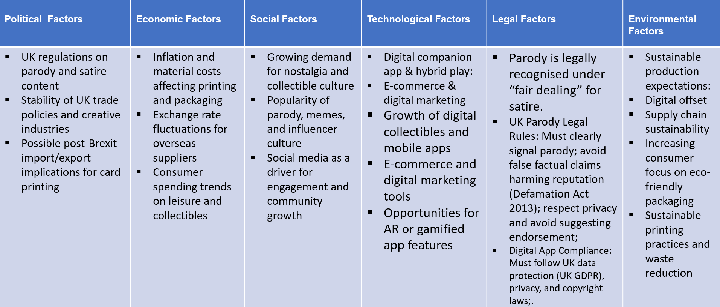
PESTEL ANALYSES

Slide 7
Funding required and allocation
We will require £120,000 to cover product development, digital infrastructure, of the initial startup costs and it’s allocations:marketing, production, and operations for the first 12–18 months.Below is a breakdown of allocation of funds.
Product Development (40% – £48,000)
  Card design & artwork: £30,000
  Rulebook creation & prototyping: £18,000
Digital Infrastructure (25% – £30,000)
  Website development & hosting: £12,000
  Companion app development (iOS & Android): £18,000
Marketing & Promotion (20% – £24,000)
  Influencer collaborations & social media ads: £15,000
  Content creation & community engagement: £9,000
Physical Production & Distribution (10% – £12,000)
  Printing initial card sets (e.g., 5,000–10,000 packs): £8,000
  Packaging & shipping: £4,000
Operational & Miscellaneous Costs (5% – £6,000)
  Office setup, legal fees, insurance, and contingencies: £6,000

Slide 8
Marketing
1. Influencer Marketing
Partner with gaming, comedy, and pop-culture influencers on TikTok, Instagram, X, and YouTube to showcase rare cards, humorous reveals, and parody content.
Serves as the primary promotional channel to drive viral engagement, brand awareness, and community growth.
2. Digital & Online Marketing
Website: Parody-themed hub for products, rulebooks, rare card highlights, and online purchases.
Social Media: Short, shareable parody clips complement influencer campaigns.
Companion App: Deck tracking, digital pack openings, rarity tracking, and card trading boost retention.
Community Marketing: Newsletters and Discord/Reddit maintain engagement and announce rare card drops.
3. Branding Approach
Tone: Humorous, satirical style differentiates from traditional TCGs.
Shareability: Pop-culture relevance and influencer-driven content drive organic viral promotion.

