Slide 1

BMSW-4004
Task-1
Certificate of Higher Education in Skills for the Workplace:
Problem Solving and Decision Making
Bestie Jose
Submitted by:- Saima Faser - 2108665

Slide 2

Introduction
This presentation is based on Mid Cheshire Hospitals NHS Foundation Trust (MCHT), which are facing a wide range of issue in managing staff absentees. This company is facing issues with a high turnover and absenteeism in their company for manage target of analysing 4.51%
This presentation includes different measures taken by company to control absenteeism.

Slide 3

  Nature of problem on employees and organisations
Employee’s absenteeism is defined by managing frequent absence of the employee from their workplace.
Mid Cheshire Hospitals NHS Foundation Trust’s employees are facing the major impact of this problem in the company, this is due to facing issue with pay checks, losing their values and having the fear of losing their jobs in some unidentified factors.
Every organisations have their own protocols to manage the resources and make functions to handle the crises including the issue of employee’s absentees in their company.

Slide 4
Impact of problem on employees and organisations
At the same time, employers and the company also faced the worst impact of employee’s absenteeism due to being understaffed, increased liabilities and additional labour costs to manage and cover up the process and missed the work hours in an effective and applicable way (Dodokh, 2022). This issue is further being associated to manage common reasons and make the growth in employee’s absences which are totally justified and collect the data in an effective and applicable way.

Slide 5

Swot analysis
Strength:
They provide the formal mental health and wellbeing support as long as the employee of the company needed.
Weaknesses:
Employees may feel trust losses in the company while working with business environment.
Threats:
Higher rate of employee’s absenteeism is the major threat for the company
Opportunities:
They also provide some major experiencing the growth in the respective company and provide systematic resources for getting successful in the health sectors.

Slide 6
Pestle analysis
With the help of macro environment for managing the factors which help to contributing the respective problems in an effective way. There are other resourceful ways to gather information and manage wider range of impact on pestle analysis.
Political: These are the factors which are associated to tax, employment laws and introduction to the new laws and manage business policies.
Economic: These are associated to some wider terms with high national and international approaches. This is very important to stay connected with the costs, tax and revenue amount of the company and get benefit to the employees also for manage the resources.

Slide 7

Continue
Environmental: These are concerned with high business impact on the environment and its ecological footprint (Ford et.al., 2022).
Social: It task the amount of consideration which are associated to different attitudes and evolving the views and make the need for manage company’s people. After the impact of Covid-19 many of the businesses affect and their employees get demotivated.

Slide 8
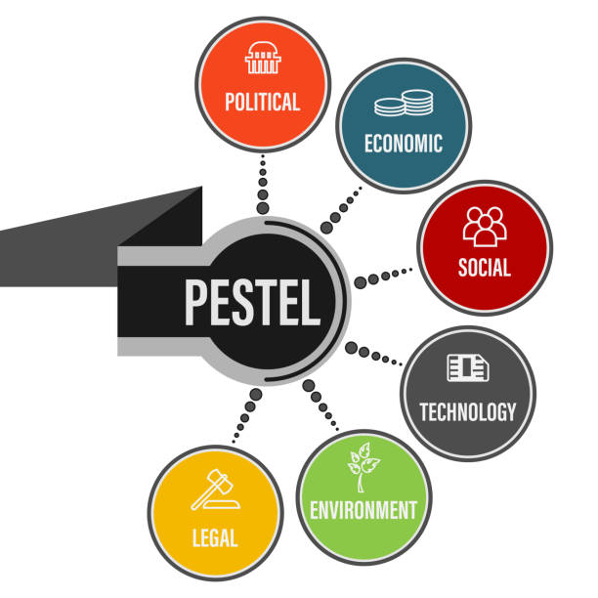
Continue
Technological: Many of the businesses are using high range of profit which are associated to make growth and embracing the technology. That will provide the high competitive advantage to the company and generate the values for the business functions in the company.
Legal: Employment laws and other processing factors are associated to manage over time and HR practitioners to understand the changes that affect the company policies.

Slide 9
Fish bone diagram

Slide 10
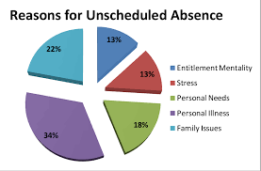
  Cause-and-effect analysis of the complex problem
There are some factors that’s need to be considered in absenteeism such as workplace harassment, family related issues and job hunting at large platform (Hastuti and Timming, 2022).
There are different reason which the companies are facing issues of absenteeism are related to burnout the management, stress and low morale of the employees.

Slide 11
  PMI Tool Table
Plus | Minus | Interesting
Learn about the company’s objective (8) Increase the change by getting promotion in the same or different company. (8) | Minimise the get together of social evening with the colleagues or friends. (5) Minimize the Cost of extra expenses (8) | Make new friends (10) Join online courses (-8) Improve confidence (5)
Total 16 | Total (-13) | Total 7

Slide 12

  Alternative solutions
In the respective Mid Cheshire Hospitals NHS Foundation Trust Company, the HR of the company should appoint some management practices to reduce their high employee’s absenteeism in the organisation. These can be related to clear attendance policies, providing rewards with good attendance system and also they can improve their employee’s well-being process to the company.

Slide 13

Conclusion
From the above report, it has been analysed to complete the working and manage the issues of the company in an appropriate way. With the help of proper research it has been identified that employee’s absenteeism is becoming one of the major issues for the company.

Slide 14
References
Darban, G., Karatepe, O.M. and Rezapouraghdam, H., 2022. Does work engagement mediate the impact of green human resource management on absenteeism and green recovery performance?. Employee Relations: The International Journal.
Dodokh, A.M.I., 2022. Examining the Impact of Personal Social Media Use at Work on Workplace Outcomes (Doctoral dissertation, University of Plymouth).
Ford, K., Hughes, K., Bellis, M.A. and Sharp, C., 2022. Impacts of a workplace physical activity intervention on employee physical activity & mental health for NHS staff in Wales: an evaluation of the pilot Time to Move initiative. International Journal of Population Data Science, 7(2).

Slide 15


