Slide 1
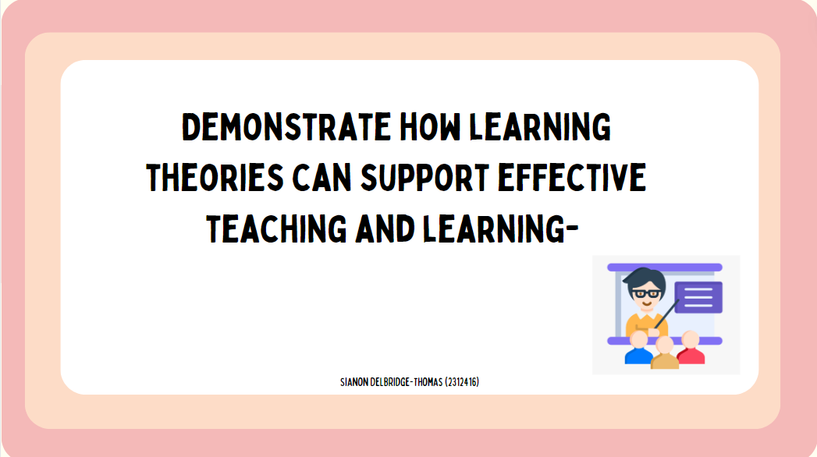
https://www.canva.com/design/DAF9UnVHGa4/x1SHwFb7W9AqzOVa8mrQKQ/view?utm_content=DAF9UnVHGa4&utm_campaign=designshare&utm_medium=link&utm_source=recording_view

Slide 2
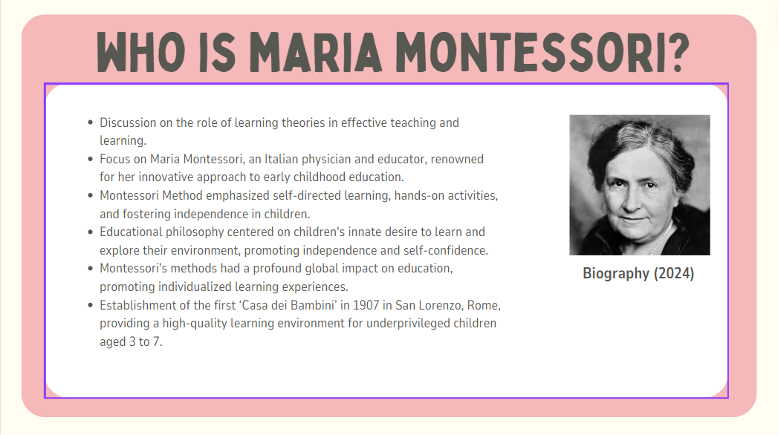

Slide 3
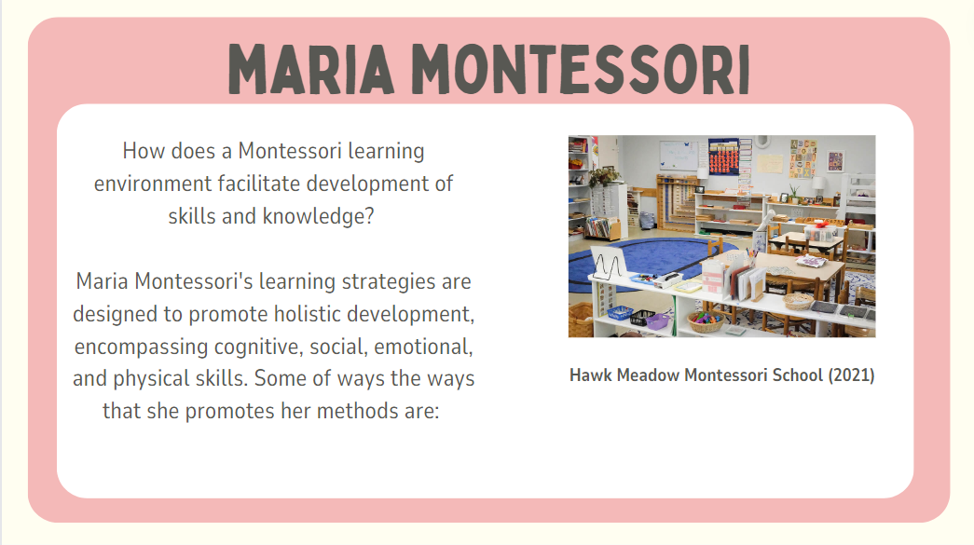

Slide 4
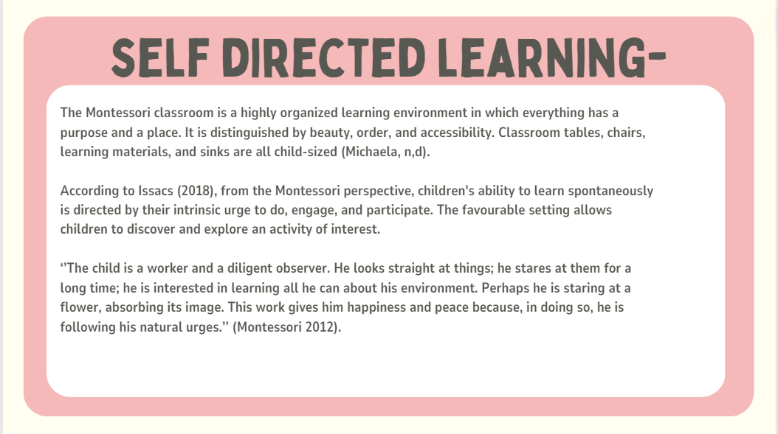

Slide 5
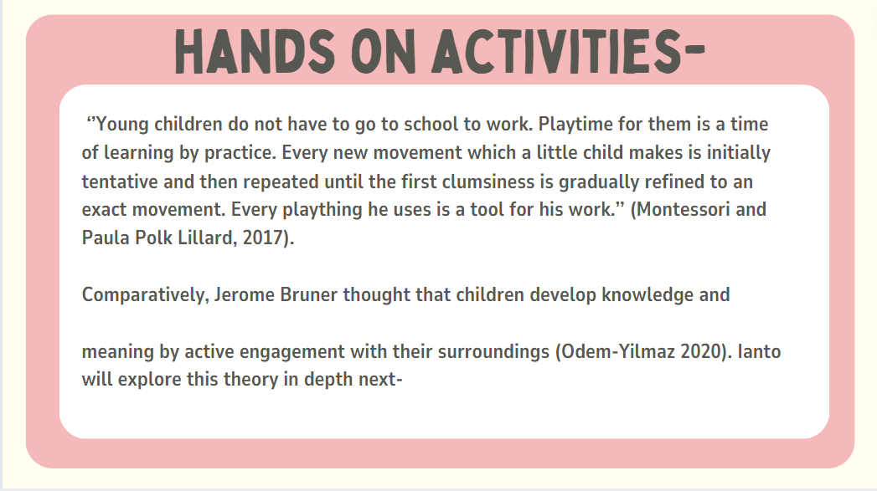

Slide 6
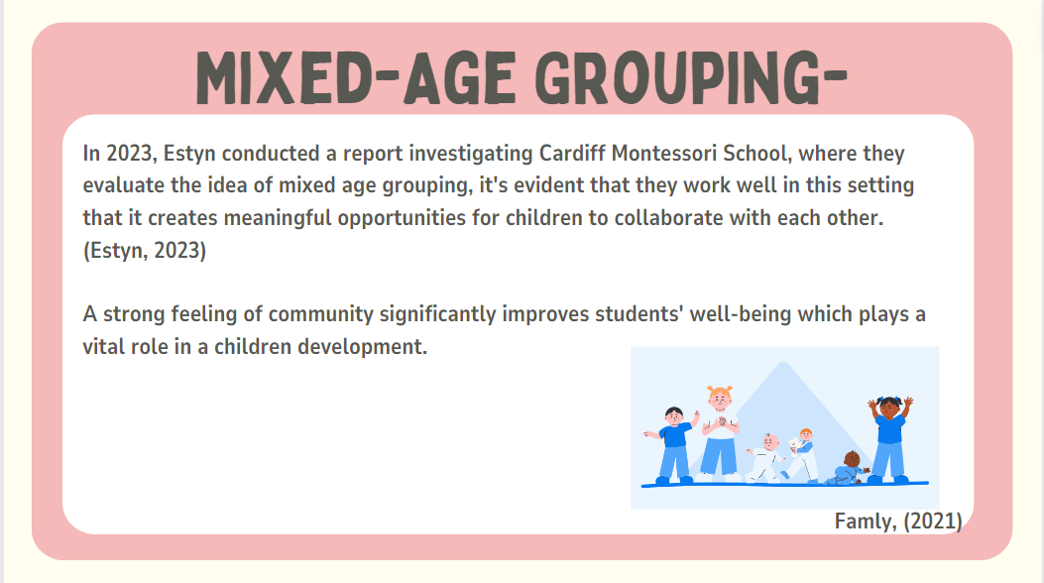

Slide 7
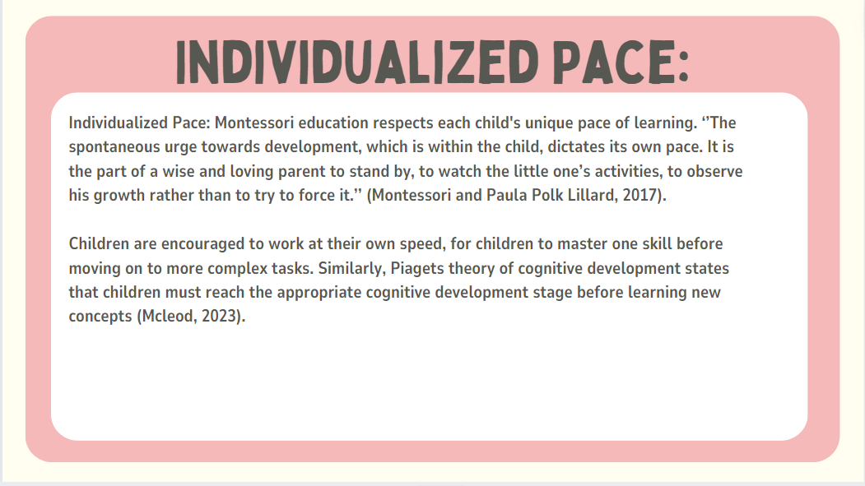

Slide 8
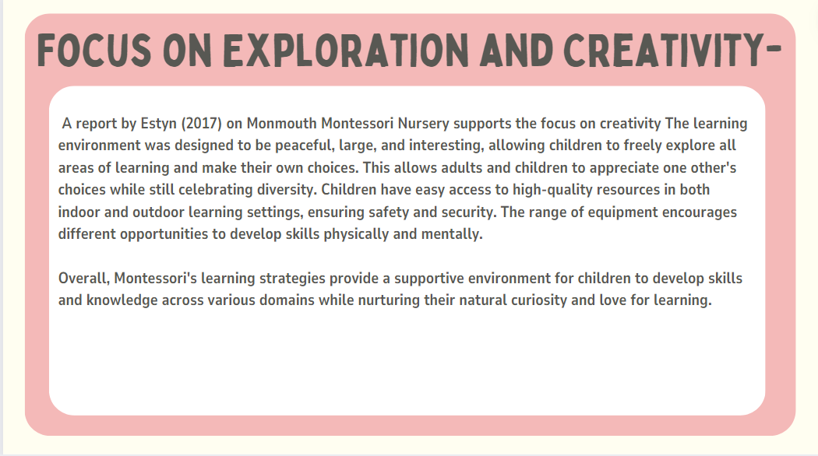

Slide 9
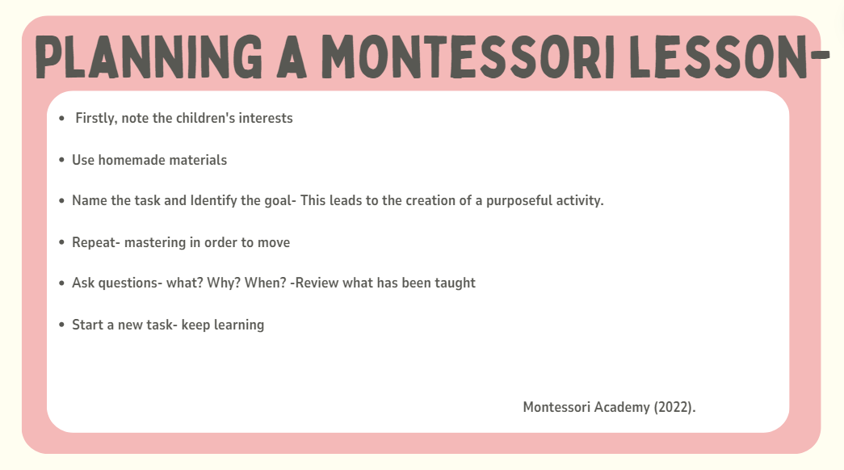

Slide 10
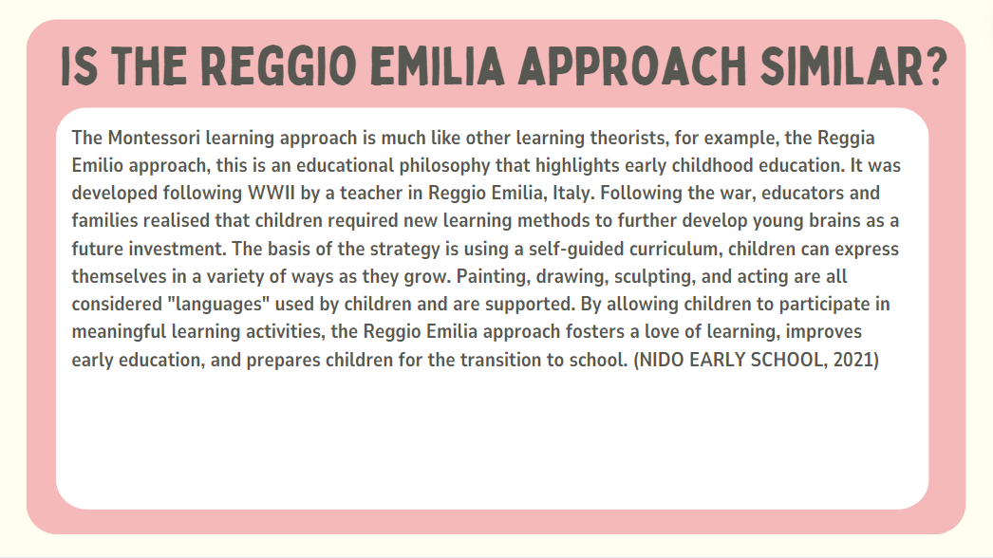

Slide 11
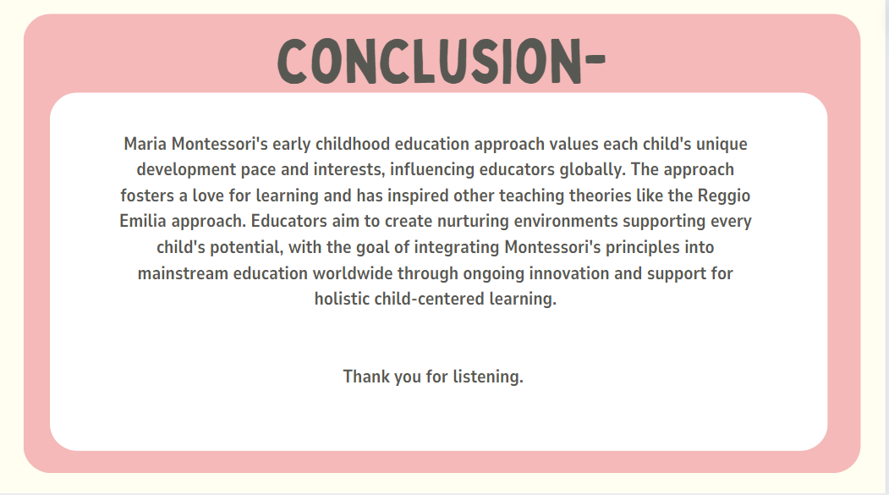

Slide 12
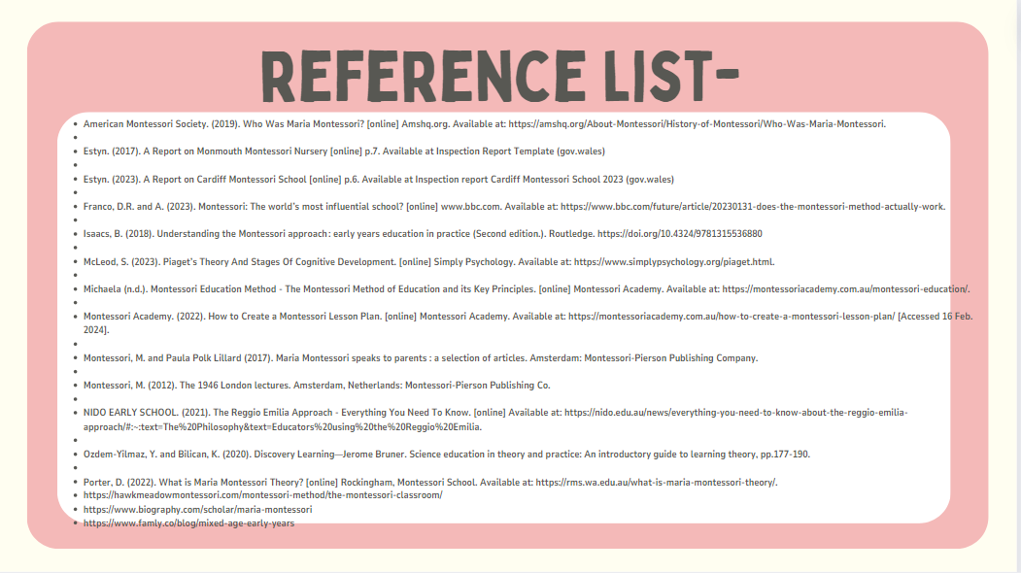

Slide 13
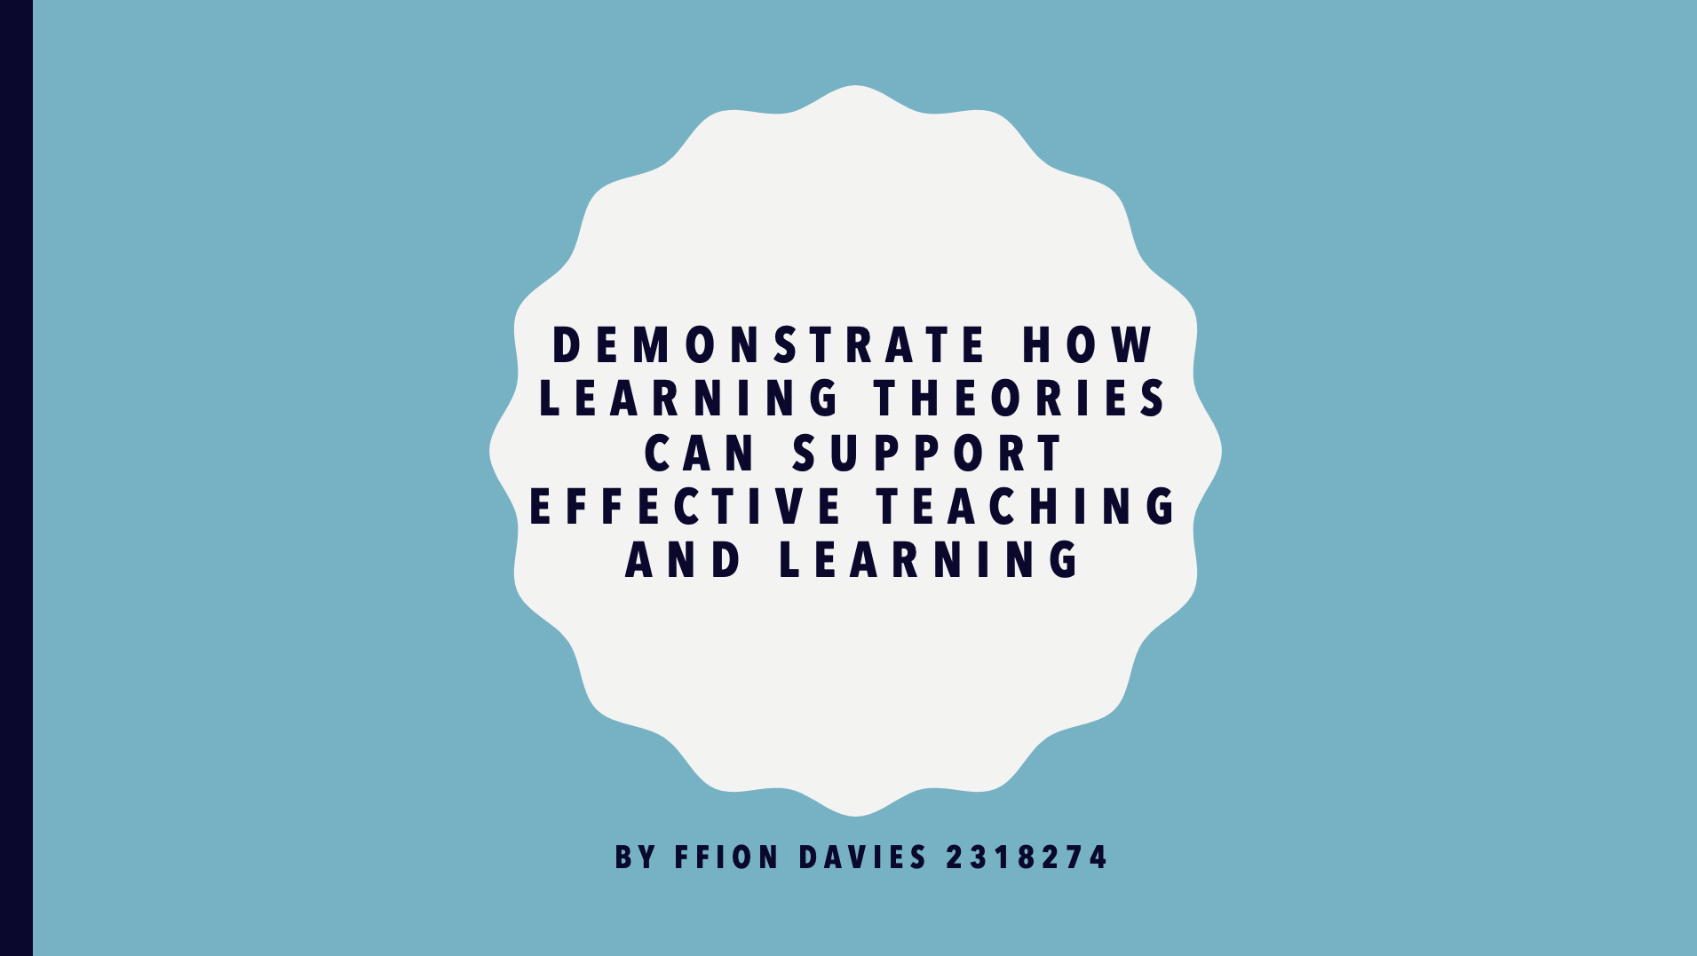
Notes:
Ffion Davies 2318274

Slide 14
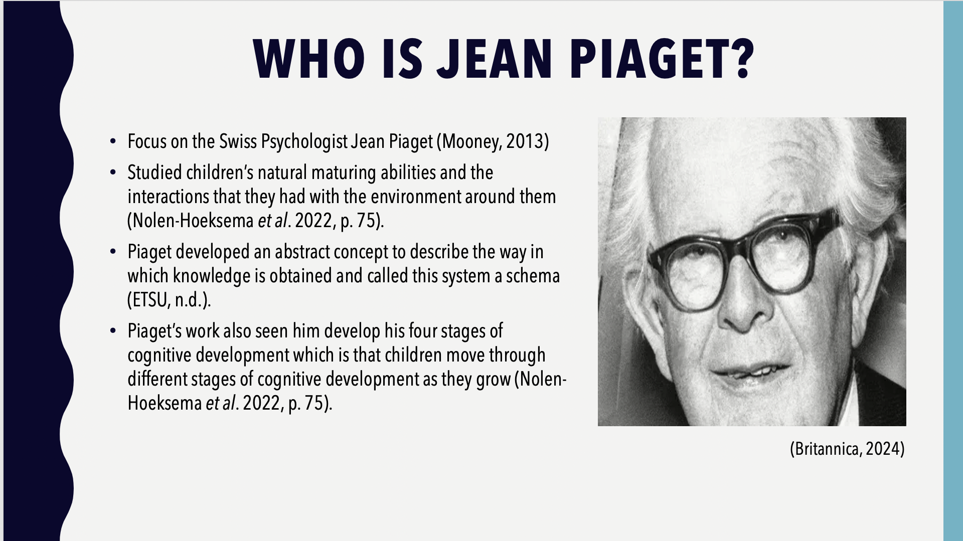
Notes:
Ffion Davies 2318274

Slide 15
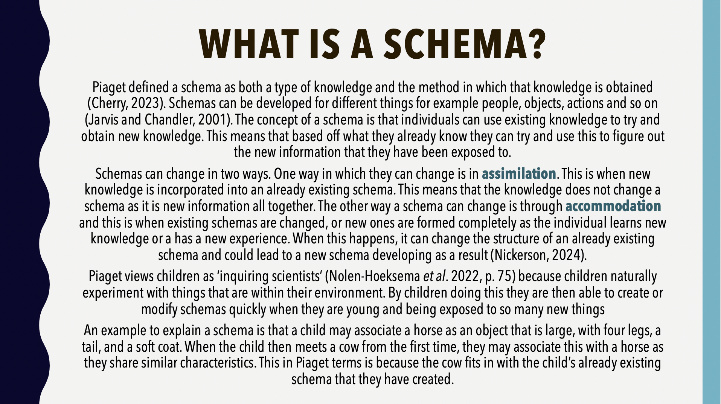
Notes:
Ffion Davies 2318274

Slide 16
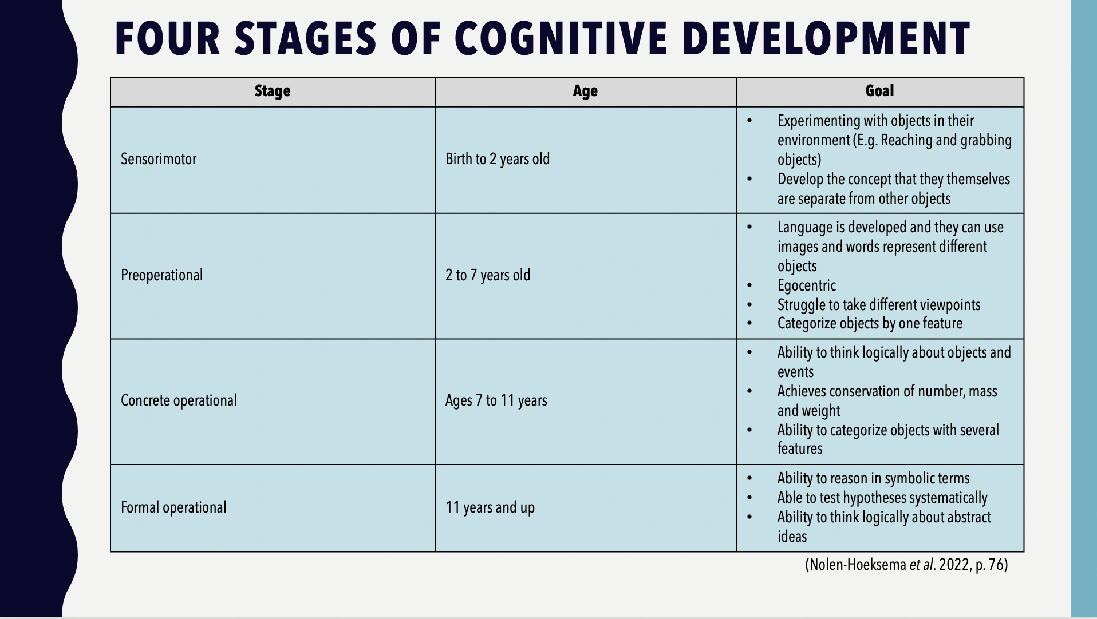
Notes:
Ffion Davies 2318274

Slide 17
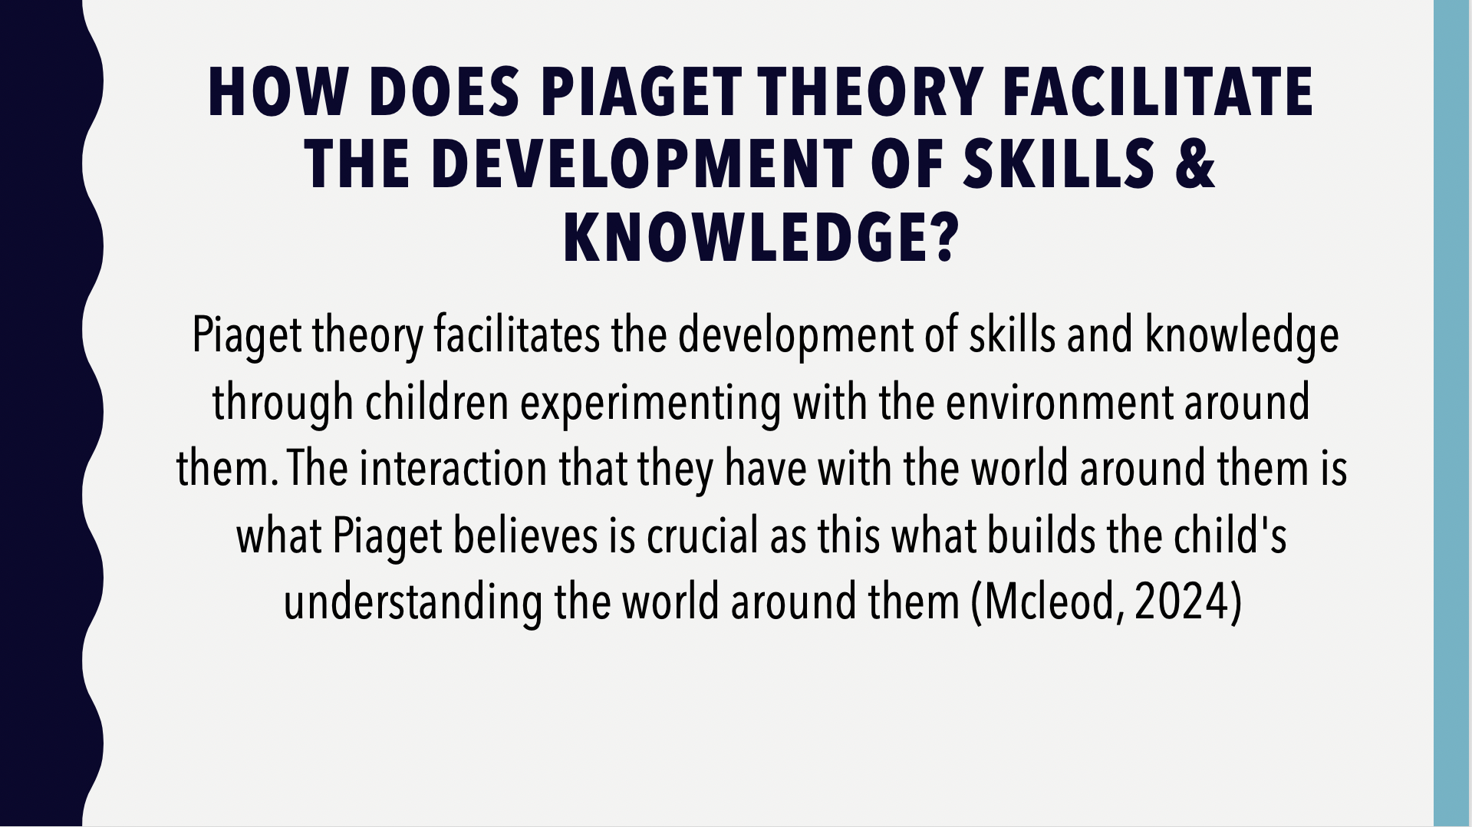
Notes:
Ffion Davies 2318274

Slide 18
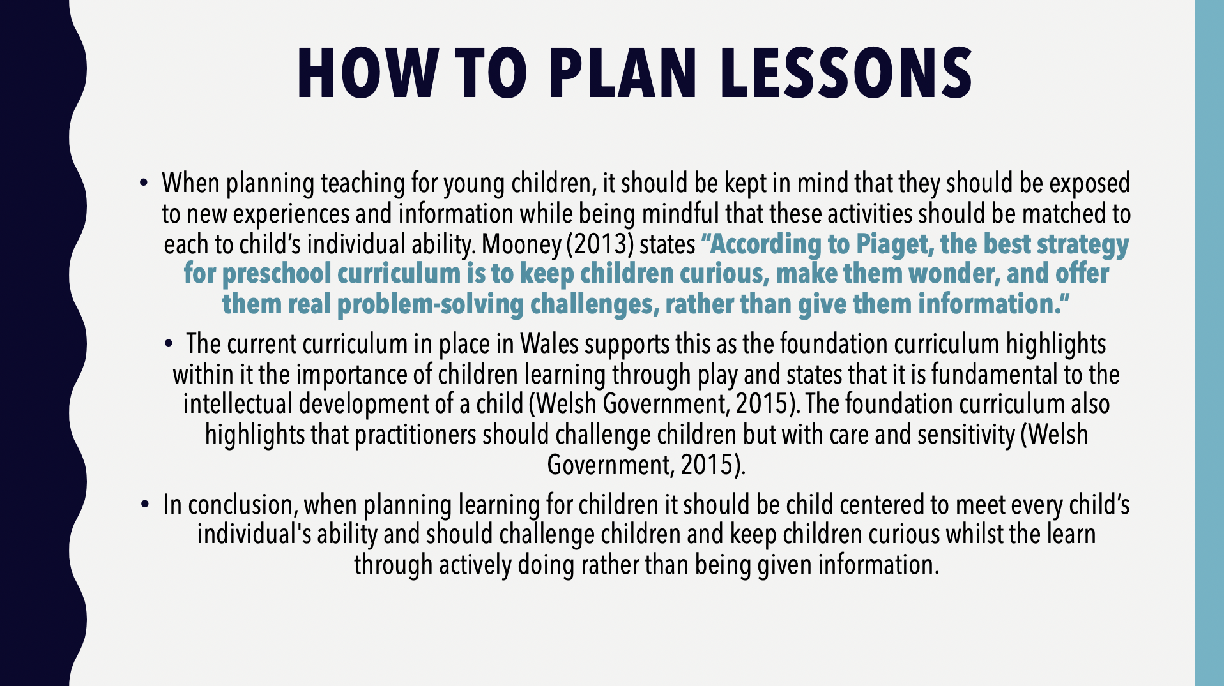
Notes:
Ffion Davies 2318274

Slide 19
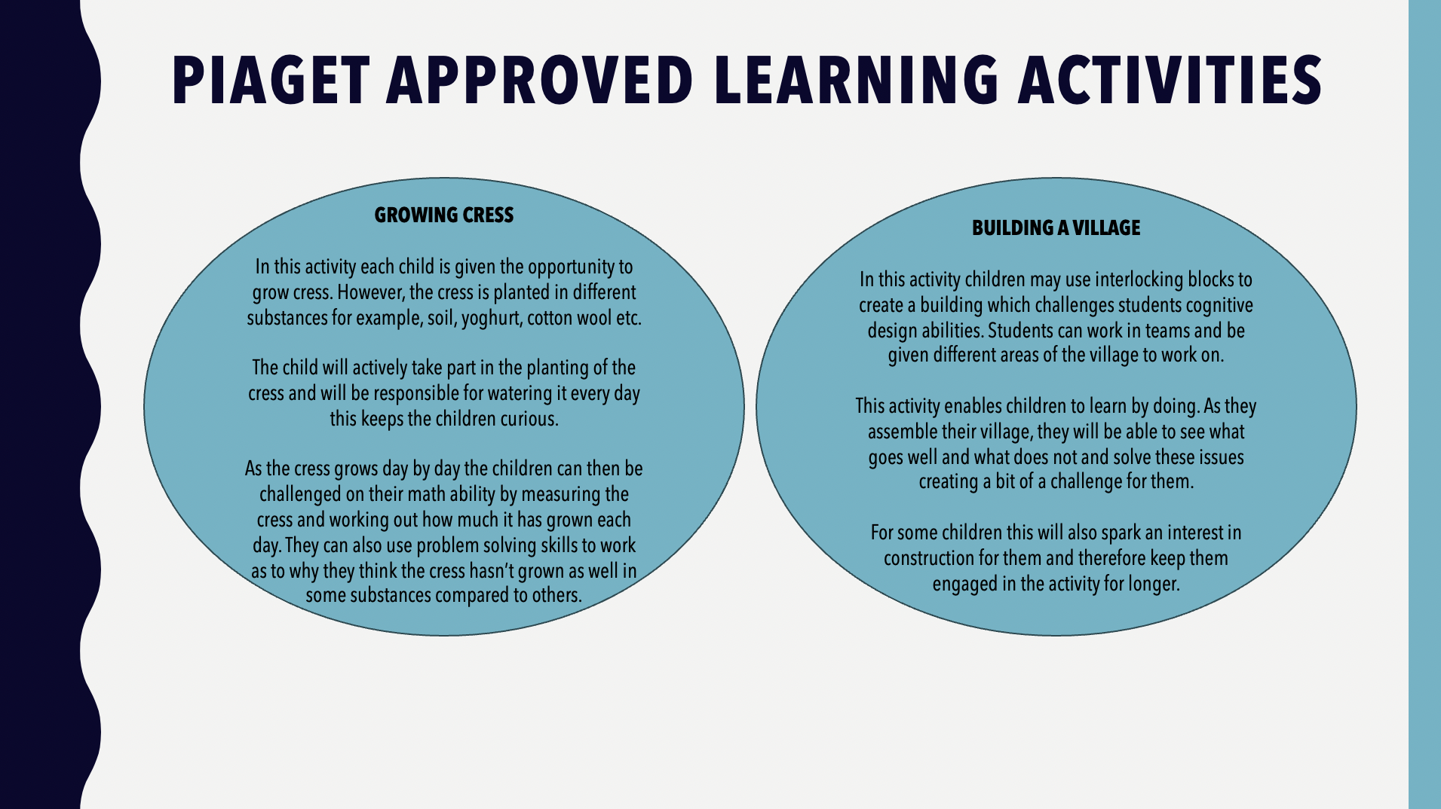
Notes:
Ffion Davies 2318274

Slide 20
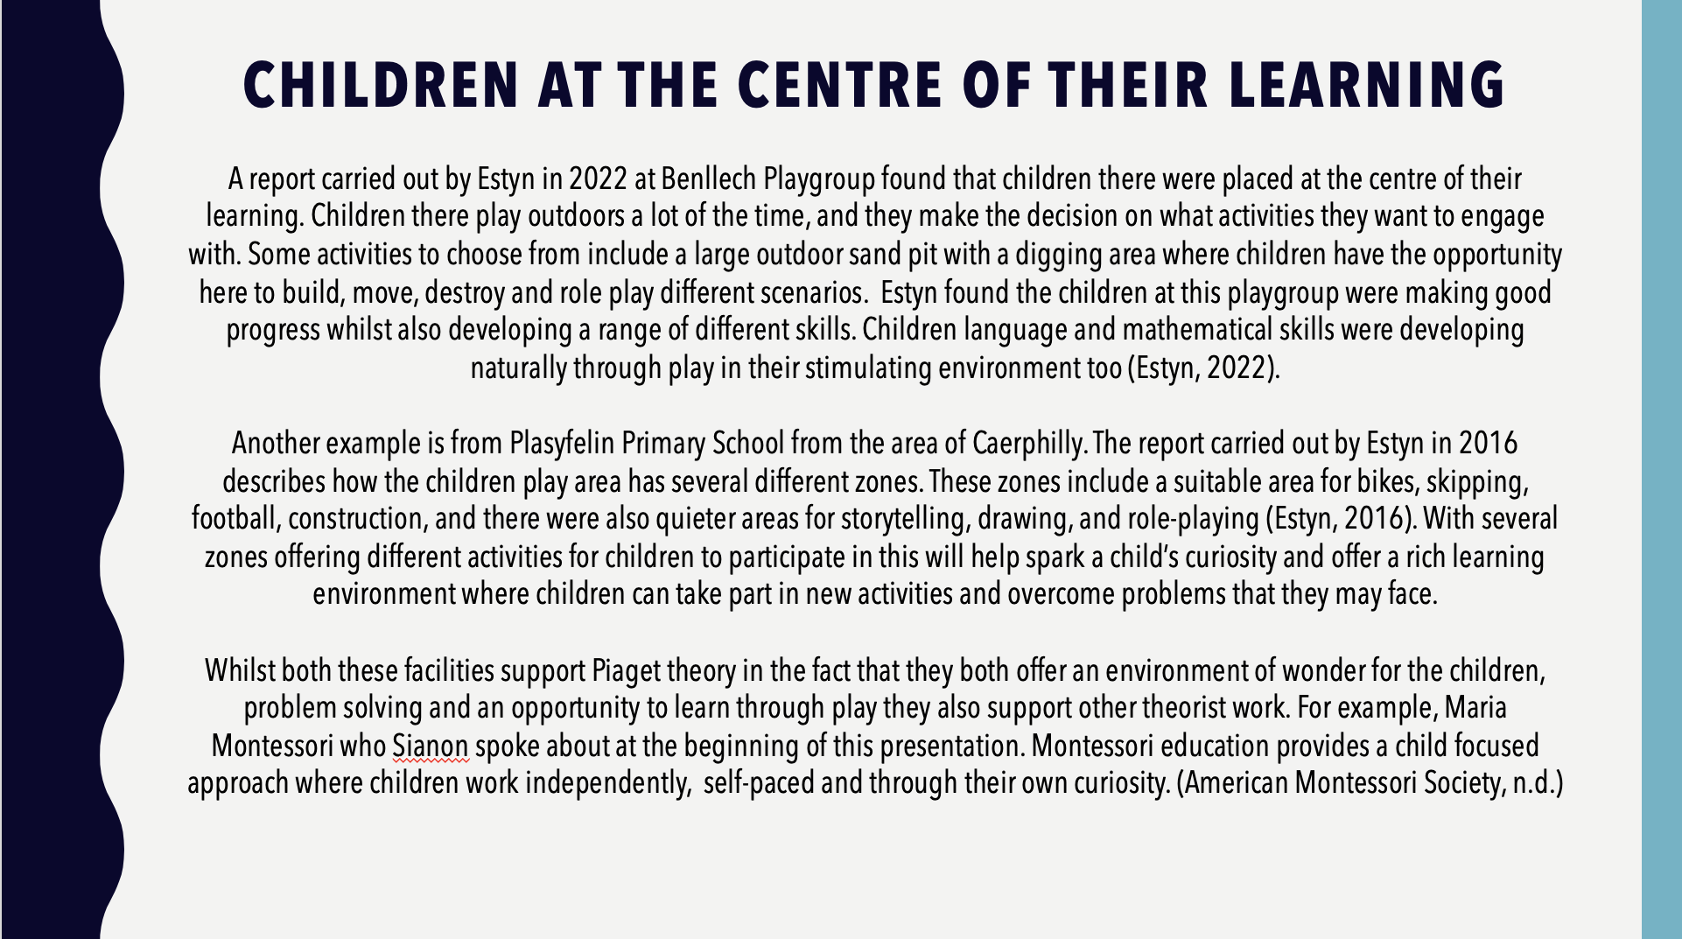
Notes:
Ffion Davies 2318274

Slide 21
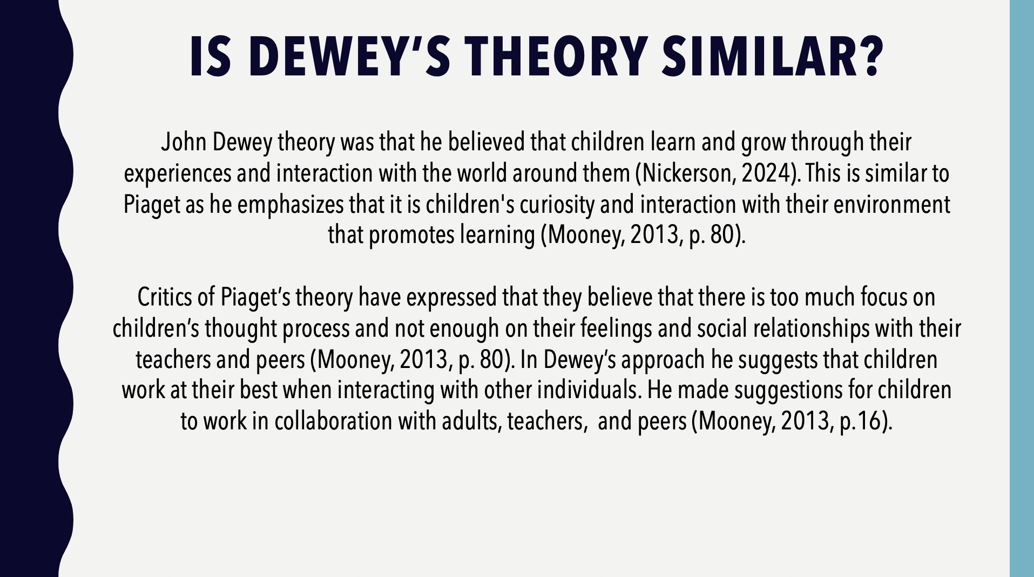
Notes:
Ffion Davies 2318274

Slide 22
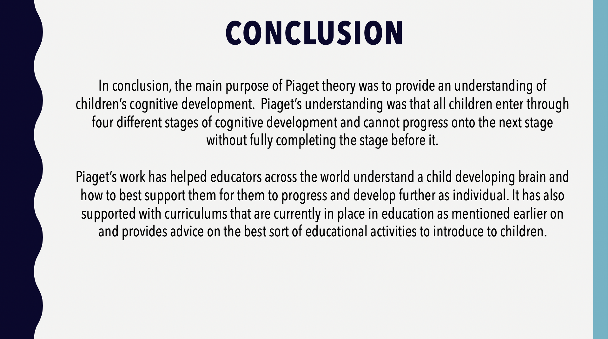
Notes:
Ffion Davies 2318274

Slide 23
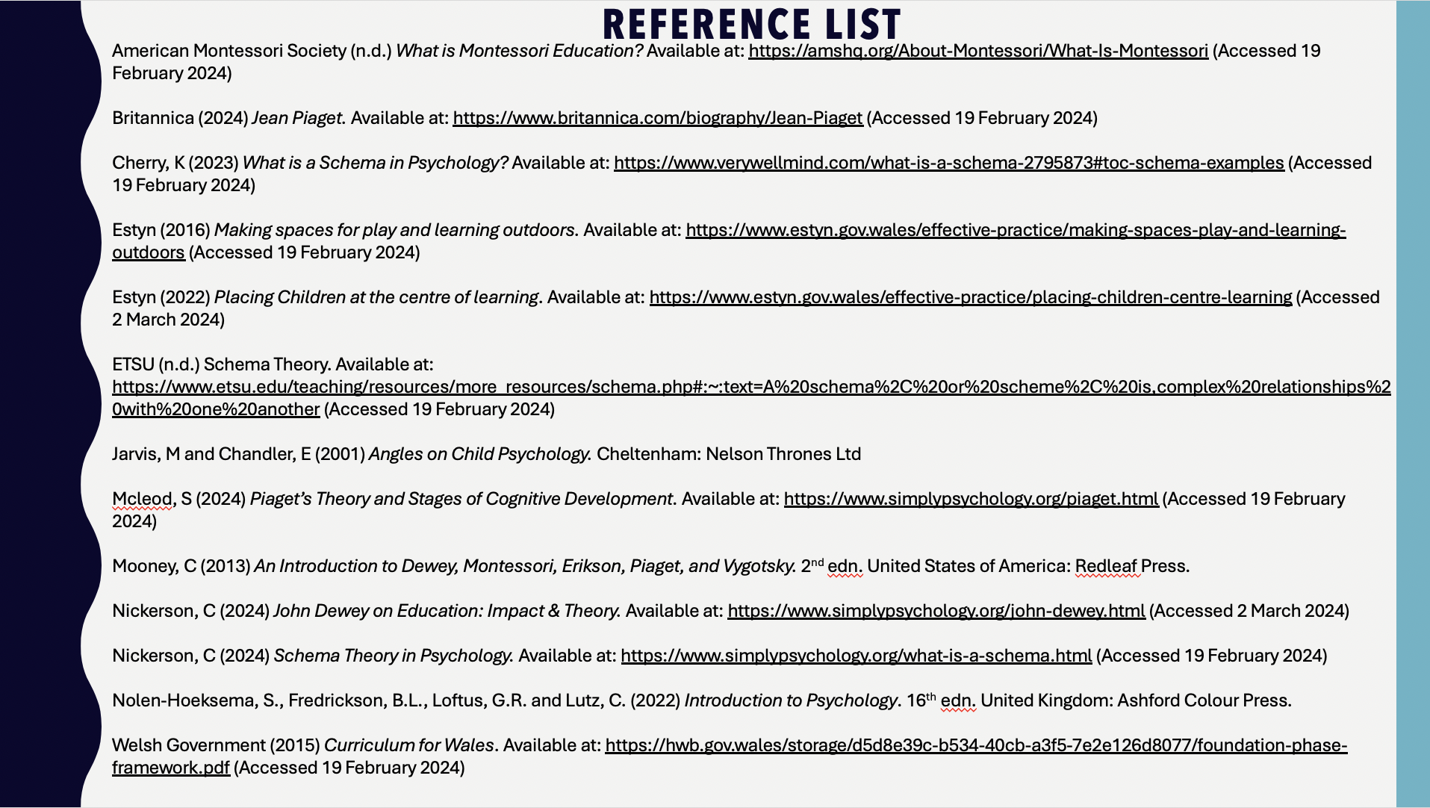
Notes:
Ffion Davies 2318274

Slide 24
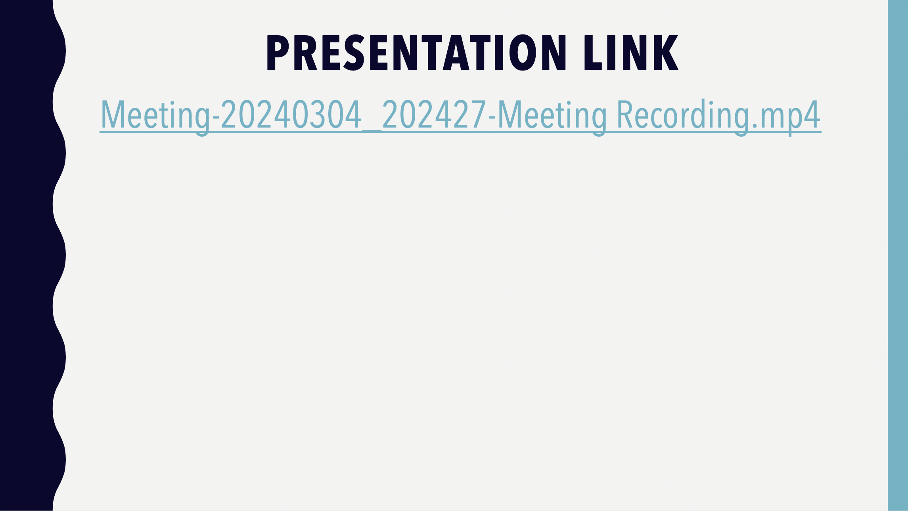
Notes:
Meeting-20240304_202427-Meeting Recording.mp4
Ffion Davies 2318274

Slide 25
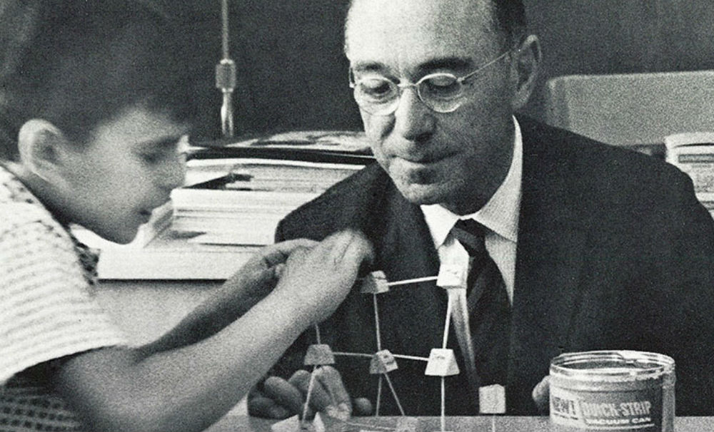
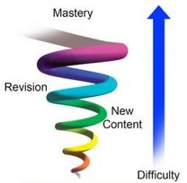

Jerome Bruner's spiral curriculum Theory
Ianto Davies (2317125)

Slide 26
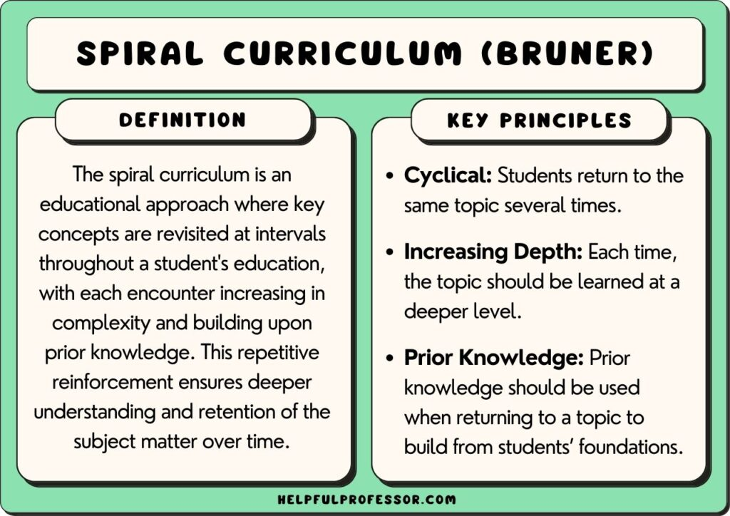
Introducing Jerome Bruner's Theory
This theory implies that teaching and learning revisit key concepts such as mathematics and many other topics that are revisited over time.
Increasing depth after being introduced to a new topic and increasing the complexity further down the line.
Mathematics is a good example of how to describe his work.
Ianto Davies (2317125)

Slide 27
Examples of his Theories
Children may start with simple mathematic skills such as adding and subtraction in early education. These ideas would be covered again in later years of education, but with an increased level of complexity when students were introduced to algebra, fractions, multiplication, and division.
"Curriculum should be thought of not as a static list of subjects to be learned, but as sequences of experience through which the learner gradually comes to grasp the structure of the subject matter." (Bruner, 1960, p. 28)
Bruner believed that children learn through structure and not through a “list of subjects to be learned”
Ianto Davies (2317125)

Slide 28
My Educated opinion of Bruner's Theory
I personally agree with elements of Jerome Bruner's theory of a spiral curriculum as his theory promotes teachers and educators to scaffold teach to pupils by being able to come back to work covered previously and further build on the skills pupils have already gained at a lower level of complexity.
I personally believe this also fosters and develops critical thinking skills and helps pupils to apply previous knowledge and understanding into new work.
Bruner thought it was important to expand on the prior knowledge and experiences of students. He states, "The curriculum should be designed to spiral in increasing depth and sophistication over the years, always building upon the child's earlier experiences and understandings" (Bruner, 1960, p. 34).
Ianto Davies (2317125)

Slide 29
Comparison to other Theorists
I personally think, Maria Montessori and Jerome Bruner have two very unique approaches to their teaching and learning, but also hold a few similarities throughout their theories.
She wrote, "The greatest sign of success for a teacher... is to be able to say, 'The children are now working as if I did not exist'" (Montessori, 1967, P. 88).
Bruner believed that students learn best when they are actively engaged in the learning process and encouraged to explore and make connections between ideas. According to Bruner, a teacher should act as a guide or facilitator to help students on their educational journey. He said (Bruner, 1977, p. 56) "Teaching is the canny art of intellectual temptation".
She stated, "The teacher's task is not to talk, but to prepare and arrange a series of motives for cultural activity in a special environment made for the child" (Montessori, 1967, p. 239).
Ianto Davies (2317125)

Slide 30
How can the Spiral Curriculum be used in classrooms
Bruner believed that the spiral curriculum could be effectively used in classrooms to help promote learning efficiently, Bruner thought it was important to expand on the prior knowledge and experiences of students.
"The curriculum should be designed to spiral in increasing depth and sophistication over the years, always building upon the child's earlier experiences and understandings" (Bruner, 1960, p. 34).
By adding hands-on activities individually or as a group this would boost engagement and learning amongst pupils. He has also stated, "We begin with the hypothesis that any subject can be taught effectively in some intellectually honest form to any child at any stage of development" (Bruner, 1960, p. 9).
Ianto Davies (2317125)

Slide 31
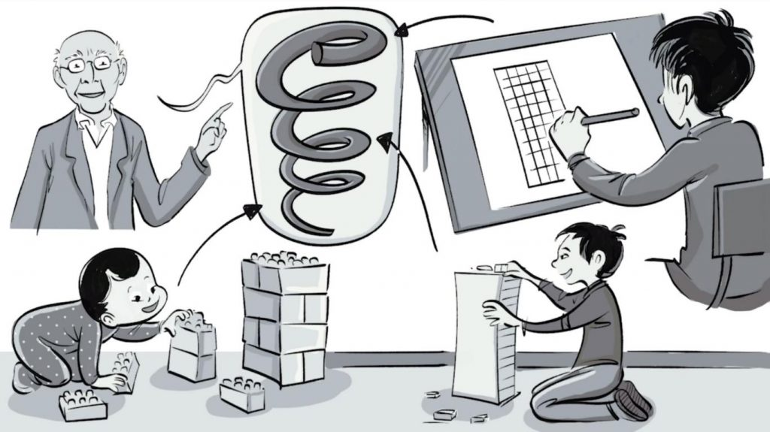
Contested issues of Bruners theories
"We should not expect simple tests to probe the complex achievements of growing minds" (Bruner, 1966, p. 75).
Critics also point to the potential mismatch between the spiral curriculum and the diverse learning needs of students. Some learners may require more time or support to grasp certain concepts, while others may progress more quickly.
"Any subject can be taught effectively in some intellectually honest form to any child at any stage of development" (Bruner, 1960, p. 9).
Theorists theories will always be contested as it is a theory and not everyone works the same way, I believe every pupil and child are totally different and can't always all learn the same, because of this I sit on the fence and cannot lean one way or the other.
Ianto Davies (2317125)

Slide 32
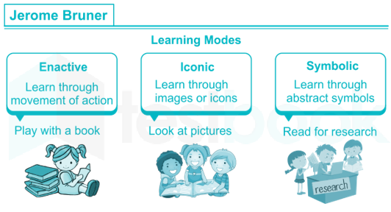
Future implications of Burner’s spiral curriculum
"teaching is the cunning art of intellectual temptation." Bruner (1977, p. 56) According to Bruner's idea, it is important to instill a love of learning in children and provide them the resources they require to become self sufficient learners.
According to Bruner (1966, p. 17), "To understand is to invent" Students are encouraged to use higher thinking abilities including analysis and evaluation through the spiral curriculum. By following Bruner’s spiral curriculum theory, he believes a wider range of thinking skills can be obtained by following his theory.
Ianto Davies (2317125)

Slide 33
Reference list
Bruner, J. S. (1960). The Process of Education. Harvard University Press.
Bruner, J. S. (1960). The Process of Education. Harvard University Press.
Bruner, J. S. (1966). Toward a Theory of Instruction. Harvard University Press.
Bruner, J. S. (1973). Beyond the Information Given: Studies in the Psychology of Knowing. W. W. Norton & Company.
Bruner, J. S. (1977). The Process of Education. Harvard University Press.
Montessori, M. (1967). The Absorbent Mind. Henry Holt and Company.
https://www.google.com/search?q=jerome+bruner%27s+spiral+curriculum+theory&tbm=isch&ved=2ahUKEwjZ1s6O8bmEAxX-pf0HHeekDYAQ2-cCegQIABAA&oq=jerome+bruner%27s+spira&gs_lp=EgNpbWciFWplcm9tZSBicnVuZXIncyBzcGlyYSoCCAAyBBAjGCcyBBAAGB4yBBAAGB4yBBAAGB4yBhAAGAgYHkiuJFAAWMcOcAB4AJABAJgBV6AB3gOqAQE2uAEByAEA-AEBigILZ3dzLXdpei1pbWfCAgUQABiABIgGAQ&sclient=img&ei=Q5bUZZmpD_7L9u8P58m2gAg&bih=730&biw=768&rlz=1CAGZLV_enGB940#imgrc=7YoLznWHzGRepM
https://www.google.com/search?sca_esv=9dfa76d4a9091c2b&rlz=1CAGZLV_enGB940&sxsrf=ACQVn09hKbpJLvcTMV9pGPrwc4hUEPKJFw:1708431001661&q=america&tbm=isch&source=lnms&sa=X&ved=2ahUKEwjirOi38bmEAxV9xAIHHejWCS4Q0pQJegQIDhAB&biw=768&bih=730&dpr=1.25
https://www.google.com/search?sca_esv=9dfa76d4a9091c2b&rlz=1CAGZLV_enGB940&sxsrf=ACQVn08zSVsjkx97R4LAHddf5CqolQUH9g:1708433431807&q=jerome+bruner%27s+spiral+curriculum+theory&tbm=isch&source=lnms&sa=X&sqi=2&ved=2ahUKEwiWysy--rmEAxVB-QIHHX2iCT0Q0pQJegQIEBAB&biw=768&bih=730&dpr=1.25#imgrc=8Uw2wrX5y_S4gM&imgdii=Q-v5UqT3OLsn9M
https://www.google.com/search?sca_esv=6df0982588bcee2b&rlz=1CAGZLV_enGB940&sxsrf=ACQVn09ZdyqEH-JsXJlCKOU_Gc2BUdoy1w:1708433672355&q=jerome+bruner+theorist&tbm=isch&source=lnms&sa=X&ved=2ahUKEwi8xqax-7mEAxXc1wIHHcn_CjEQ0pQJegQIDxAB&biw=768&bih=730&dpr=1.25#imgrc=aPlLVDn4HxQEQM
Ianto Davies (2317125)

Slide 34
Ianto Davies' Presentation and notes link
https://uowtsd-my.sharepoint.com/personal/2317125_student_uwtsd_ac_uk/Documents/Recordings/ianto%20Davies%20PP-20240221_125646-Meeting%20Recording.mp4?web=1&referrer=Teams.TEAMS-WEB&referrerScenario=MeetingChicletGetLink.view.view
Jerome Bruner’s spiral curriculum theory.docx

Slide 35

Vygotsky
Learning Theory
Lottie shute
2307996

Slide 36
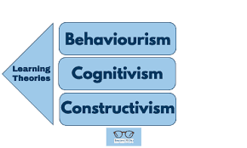
Demonstrate how leanring theories can support effective teaching and learning
Understanding learning theories support teachers' interactions with a range of students. Teachers can adapt their lesson plans to the needs and abilities of their students by focusing on different types of learning styles in order to reach a variety of kinds of pupils.
Children have opportunity to practise their abilities in a multi-theory curriculum. Children develop the ability to think flexibly and solve issues in a variety of ways through exposure to diverse theories and techniques. More academic success at school and afterward may result from this.
The the theorist I will be talking about is Lev Vygotsky, and his sociocultural theory for cognitive development.

Slide 37
Cognitive development theory
The development of reasoning and thinking skills is referred to as cognitive development. According to Vygotsky's Cognitive Development Theory, social guidance and construction shape cognitive capacities. When babies begin to develop memory skills they can remember their parents' voices or recognise their faces, that is an example of cognitive growth. Adolescents' ability to solve complicated mathematical problems and quickly access information is facilitated by their developing memories. Therefore, culture acts as a mediator in the formation and development of particular skills, such as problem-solving, learning, memory, and attention. According to him, there are three phases of learning: cognitive, motor, and social.

Slide 38
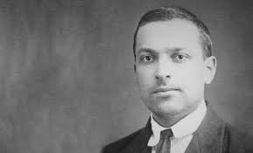
Vygotsky
Lev Vygotsky was born in 1896 in Orsha Mogilev. He completed his studies in 1917 with a diploma in literature from the University of Moscow. Following this, he taught psychology and literature for six years. Though Lev Vygotsky's interests were varied, his writings on psychology included six books published in ten years while he was alive. The way children learn and develop within culture and society is a subject of several significant theories that he developed.
According to Vygotsky's theory of social development, a child's social interactions can direct and moderate their cognitive development and learning speed. Learning is a fundamentally social activity rather than a self-supported voyage of discovery, according to Vygotsky's sociocultural theory.
According to Vygotsky, humans possess four basic mental abilities from birth: attention, sensation, perception and memory. Our social and cultural surroundings enable us to employ these foundational abilities to grow and ultimately acquire "higher mental functions.”

Slide 39

Vygotsky
As stated by Vygotsky, learning occurs more effectively in a social setting for children. For this reason, teaching students to apply social development theory in the classroom could enhance their understanding of concepts faster. Moreover, according to Vygotsky, social connection is essential to learning and fosters a reciprocal teaching approach.
Vygotsky primarily supported his beliefs with methods of observation. He saw children may develop more understanding and skill than they could on their own by working together to solve problems, and communicate with teachers, peers, or parents to reach a higher level of understanding.
“Vygotsky’s ideas were originally forged at another time of rapid and intense social upheaval: the Russian revolution.” Daniels (2008)

Slide 40
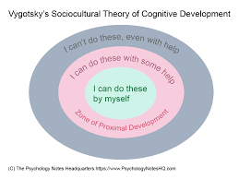
Vygotsky’s theory
Vygotsky's theory provides a contrast to other psychological theories, such Piaget's. The main focus of Vygotsky's theory of cognitive development is on how language and culture influence and mould the learner..
One way to understand Vygotsky's theory of child development is as a cycle. According to Vygotsky, there are three themes that have an impact on one another during the learning process. Vygotsky noted that learners develop cognitive skills through the impact of their community, culture is vital to learning, and language is fundamental to culture. Vygotsky understood that language serves as a bridge between communities and that adult culture affects the education of children within a community. The way parents raise their children is influenced by the pressure within a culture, which has an impact on how children act in particular circumstances. Students absorb the attitudes and viewpoints of those around them whether they attend school or interact with others in the community.
The way children learn and grow is influenced by the prejudices, attitudes, and actions of their society.

Slide 41
Zone of proximal development
Performance Level – What the child can do without any help
ZPD – Pretend play, roles and rules ? Scaffolding cultural tools
Potential level – what the child could do with assistance, direct or indirect
Smidt (2009)
In educational psychology, the Zone of Proximal growth (ZPD) is a crucial idea for recognising cognitive growth. It is especially important for teachers who are guiding their students' learning experiences. Essentially, the ZPD shows the gap between the level of development, of what students can accomplish on their own and the potential level of what they can accomplish with assistance.
The most successful ZPD learning occurs in the "zone" where learning is neither too easy nor too difficult. The ideas of psychologist Lev Vygotsky, whose theories transformed educational theory and child psychology, served as the foundation for the development of the Zone of Proximal Development (ZPD). The ZPD was proposed by Vygotsky in the early 20th century in response to the growing interest in the study of learning and cognitive capacity.

Slide 42
Vygotsky and Piaget
Piaget thought that children develop through a constant urge to learn and modify schemas, which is why his theory, as Ffion noted, states that children's cognitive growth and intelligence undergo changes as they mature.
There are differences between the theories of Piaget and Vygotsky about the relationship between language and cognition.
The two theories of Piaget and Vygotsky diverge primarily in how much emphasis is placed on culture and how developmental stages are defined. In addition to outlining particular developmental phases that happen regardless of cultural influences, Piaget stressed the need of giving children the chance to study on their own. Vygotsky emphasised the value of helping children advance beyond their existing skill level while describing cloudy phases of language development that were greatly influenced by cultural experiences. Both strategies for fostering children's development are valuable and applicable in the classroom.

Slide 43
Schemas
A mental structure known as a schema in psychology assists people in organising, processing, and storing information about their surroundings. These mental models enable us to interpret new experiences through a lens of preexisting schemas, which is crucial for understanding the complexity of the universe. Long-term memory also contains mental models called schemas.
In essence, schemas are constructed from our recollection of our individual experiences.
There are 7 most common types of schemas
Connecting, Orientation, Transporting, Trajectory, Positioning, Enveloping, Enclosing, Rotation
Vygotsky's theory and long-term memory schemas are related since both of them believes that young children are curious and actively engaged in their own learning, as well as in the process of discovering and forming new schemas. On the other hand, Piaget placed more emphasis on self-initiated discovery, whereas Vygotsky highlighted the roles that society played in a child's growth.

Slide 44
How to implement vygotskys theory in the classroom
ChatGPT 2024, when asked How to implement Vygotskys theory in the classroom Open Ais chatgpt (2024) response included:
In order to implement Vygotsky's learning theory in the classroom, a setting that values social interaction, collaboration, and scaffolding must be developed. Here are a few instances of how to apply Vygotsky's theories and concepts in the classroom.
Scaffolding - Teachers should provide direction, indicators, and support depending on each student's unique needs and should gradually decrease help as students gain greater competency. Teachers can additionally use questioning strategies to promote critical thinking and direct students' problem-solving processes.
Collaborative learning - Teachers can provide chances for students to collaborate on projects, discussions, and problem-solving exercises in order to improve cooperative group activities that promote engagement and peer learning. Roles within the groups might be assigned to encourage collaboration and shared accountability.

Slide 45
How to implement Vygotsky’s theory in the classroom
Social interaction – In addition to encouraging peer teaching and mentoring, teachers can create activities that call for cooperation and communication by leading conversations that promote the sharing of ideas and viewpoints.
Cultural context – Teachers are able to incorporate numerous perspectives and cultural components into the curriculum. However, teachers must take care to be aware of the cultural backgrounds of their students, they must provide examples that are relevant to their experiences, and use materials and resources that are appropriate for the students' culture.
Teachers as a guide - Instead of lecturing, teachers now play the role of a guide or an instructor. They must be aware of the unique needs of each student and modify their lessons accordingly. Teachers must create a welcoming and encouraging learning environment.

Slide 46
Reference List
Methodologies (2022) Vygotskys sociocultural theory: how do we apply it in the class? Availiable at: https://additioapp.com/en/vygotsky-sociocultural-theory/#:~:text=Vygotsky%20believed%20that%20children%20learn,promotes%20a%20reciprocal%20teaching%20style. (Accessed 20th February 2024)
ChatGPT (2024) ChatGPT response to how to implement Vygotskys theory in the classroom 21st of February https://chat.openai.com/c/2edfd8a3-0bc5-4ce0-aec3-dad545d26d60
Gowrie (n.d.) Lev Vygotskys theory of child development – Gowrie NSW Avaliable at: https://www.gowriensw.com.au/thought-leadership/vygotsky-theory#:~:text=Vygotsky%27s%20social%20development%20theory%20asserts,an%20independent%20journey%20of%20discovery. (Accessed on 20th February)
Smidt, s . (2009) Introducing Vygotsky, Abingdon : Routledge
Moore, M. (2011) Encyclopedia of xhild behaviour and development : Vygotskys cognitive development theory pp. 1-3 [online] Availiable at: https://link.springer.com/referenceworkentry/10.1007/978-0-387-79061-9_3054#:~:text=Vygotsky%27s%20Cognitive%20Development%20Theory%20argues,%2C%20attention%2C%20and%20problem%20solving. (Accessed 20th February)

Slide 47
Reference List
Reynolds, A. Sherrell, Z. (2024) What are Piagets stages of development, and what are examples of each? Availaible at : https://www.medicalnewstoday.com/articles/325030#:~:text=Piaget%20believed%20that%20children%20develop,psychology%20and%20approaches%20to%20education. (Accessed 20th February)
Mcleod, S. (2024) Vygotsky’s theory of cognitive development Availiable at: https://www.simplypsychology.org/vygotsky.html#:~:text=Like%20Piaget%2C%20Vygotsky%20believes%20that,Piaget%20emphasized%20self%2Dinitiated%20discovery. (Accessed 21st February)
Koblin, J. (2020) Vygotskys theory of cognitive development in social relationships Availaible at: https://sproutsschools.com/vygotskys-theory-of-cognitive-development-in-social-relationships/#:~:text=Vygotsky%20claimed%20that%20we%20are,%27 (Accessed 21st February)
Main, P. (2023) What is a schema in psychology? Availiable at: https://www.structural-learning.com/post/schema-in-psychology#:~:text=In%20psychology%2C%20a%20schema%20is,lens%20of%20pre%2Dexisting%20schemas. (Accessed 21st February)
Main, P. (2021) The zone of proximal development: A teachers guide Availiable at: https://www.structural-learning.com/post/the-zone-of-proximal-development-a-teachers-guide#:~:text=Vygotsky%20observed%20that%20through%20collaborative,skill%20than%20they%20could%20independently (Accessed 21st February)

Slide 48
Reference List
Diehl, E. Hurst, M. (2023) Theory of cognitive development: Stages and examples Availiable at: https://study.com/academy/lesson/lev-vygotskys-theory-of-cognitive-development.html#:~:text=Vygotsky%20created%20three%20stages%20of,through%20interactions%20from%20their%20caregivers. (Accessed 21st February)
Step by step school (2022) 4 benefits of a multi-theory curriculum Availaible at: https://www.thestepbystepschool.com/4-benefits-of-a-multi-theory-curriculum/#:~:text=A%20multi%2Dtheory%20curriculum%20provides%20opportunities%20for%20children%20to%20practice,performance%20in%20school%20and%20beyond. (Accessed 22nd February)
Cherry, K. (2023) Lev vygotskys life and theories Availaible at: https://www.verywellmind.com/lev-vygotsky-biography-2795533#:~:text=Vygotsky%20was%20a%20prolific%20writer,grow%20within%20culture%20and%20society. (Accessed 22nd February)
Daniels, H. (2008) Vygotsky and research, Abingdon: Routledge
WGU, (2020) Five educational learning theories Availiable at: https://www.wgu.edu/blog/five-educational-learning-theories2005.html#:~:text=An%20understanding%20of%20learning%20theories,on%20student%20needs%20and%20aptitudes. (Accessed 21st February)

Slide 49
Video link
Meeting with Lottie Shute (2307996)-20240303_161259-Meeting Recording.mp4

