Slide 2

Last week we talked about…
The Cognitive Process
  Attention - filtering stimuli
  Perception - Gestalt Theory
    Context
    Expectations
    Culture
    Motivations
  Judgement - Assumptions/Logic
  Availability
  Anchoring
  Representativeness
Cognitive dissonance

Slide 3

This week we’ll discuss…
Why we do stuff
  Motivation
  Intrinsic
  Extrinsic
  Positive
  Negative
  Maslow
  McClellands Motivational Theory
  Equity Theory
  Goal Theory
  Anti-motivation

Slide 4

What is motivation?
Notes:
Get pens. Write words on the whiteboard.
Prompts:
If a detective talks about motive, what do they mean?
What does emotive mean?
Think of something you enjoy. What motivates you to do it?
Think of something you do that you don’t particularly enjoy. What motivates you to do that?
What does it mean to motivate someone? What do we do?

Slide 5
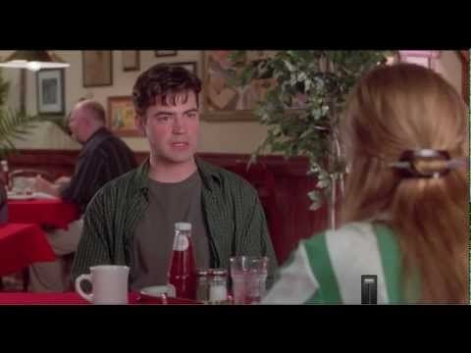
I don't like my job but…
https://www.youtube.com/watch?v=jKYivs6ZLZk
Notes:
1:40 Video Clip from movie Office Space
Why doesn’t he like his job?
What else doesn’t he like?
What does he like?

Slide 6

Today’s BIG IDEA
Results depend on what we do
The amount of effort (if any) we put in depends on how motivated we are
Results depend on motivation, motivating ourselves and others is a critical ability

Slide 7

Last Week….
(Attention:)
Selection and filtering of stimuli
Perception:
Organisation and assignment of meaning
Judgement:
Assessment and selection of options
Behaviour:
Response (or lack of)

Slide 8
What gets our attention?
Attention is called by:
Novelty = new stuff
Ambiguity = stuff that is not clear, so we have to focus better (noise) or work it out (gaps)
Valence = (affective quality referring to the intrinsic attractiveness) positive or negative, and how strong – we tend to give attention to threats, but this varies by individual
Salience = (distinctiveness/prominence) how important is it to me

Slide 9
Motivation links judgement and behaviour…..
(Attention:)
Selection and filtering of stimuli
Perception:
Organisation and assignment of meaning
Judgement:
Assessment and selection of options
Behaviour:
Response (or lack of)
Intent:
Planning and allocation of resources
Motivation
What is the link between motivation and intent?
Notes:
Intent bridges selection of what we want to do and actually doing it. We often work out what we should do but then don’t act – we never really generated sufficient intent. Motivation is central to intent.

Slide 10

What motivates you?
Does motivation predict success?
https://www.youtube.com/watch?v=v2boHczV1C8

Slide 11
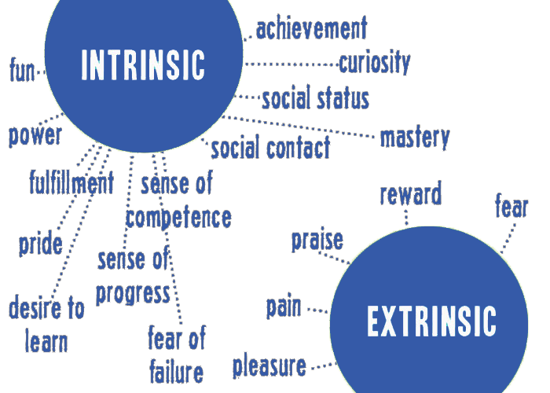
Motivation

Slide 12
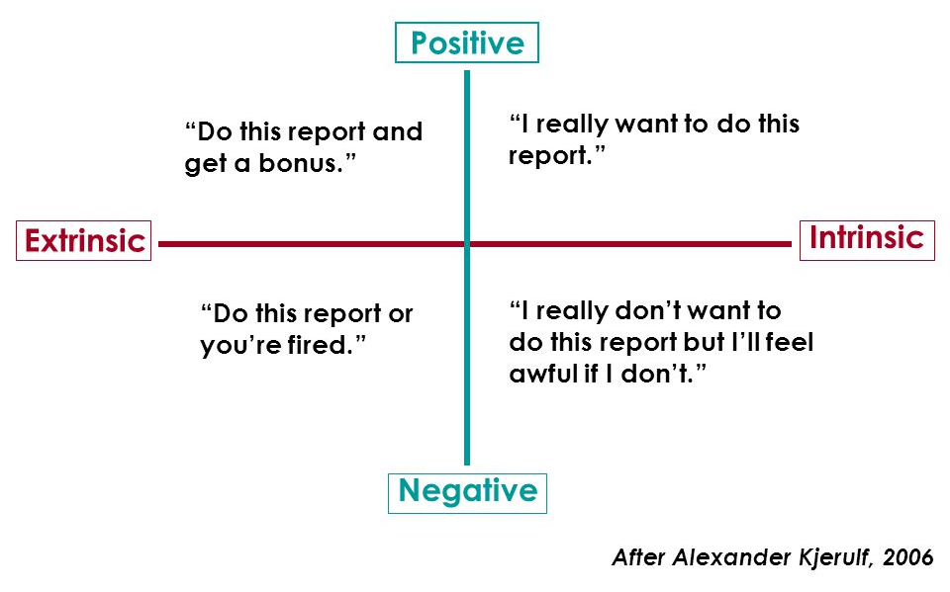
Positive or Negative?
Notes:
Motivation Story, Mike is a very confusing employee when it comes to doing his tasks, one time his employer noticed that he achieves the task perfectly and in no time while other times his employer noticed that it takes him too long while the results are not that good.
Is Mike a good employee?

Slide 13
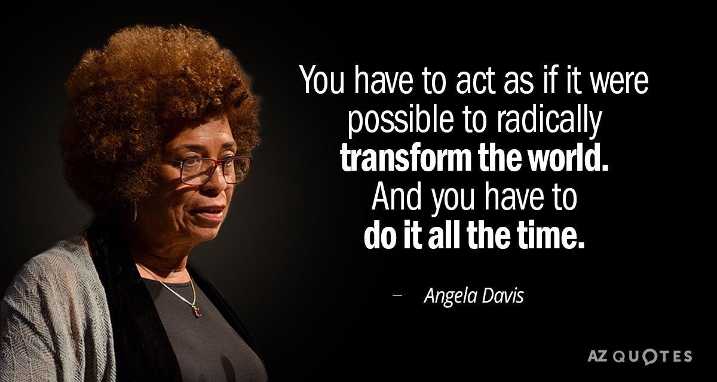
What motivated your leader?

Slide 14

Maslow’s hierarchy of needs
Is both a model of motivational factors, and a process of human development
Notes:
Maslow = 5 levels. Alderfer = 3. Herzberg = 2.
Initially proposed as a hierarchy, i.e. that one a lower need is satisfied a higher one will be activated.
Evidence suggests that this is not the case, but does indicate that a hierarchy does exist, in that needs become successively higher capacity, ie they become more difficult to satisfy and diminish less with “feeding”. In this sense, maybe the pyramid should be inverted.

Slide 15
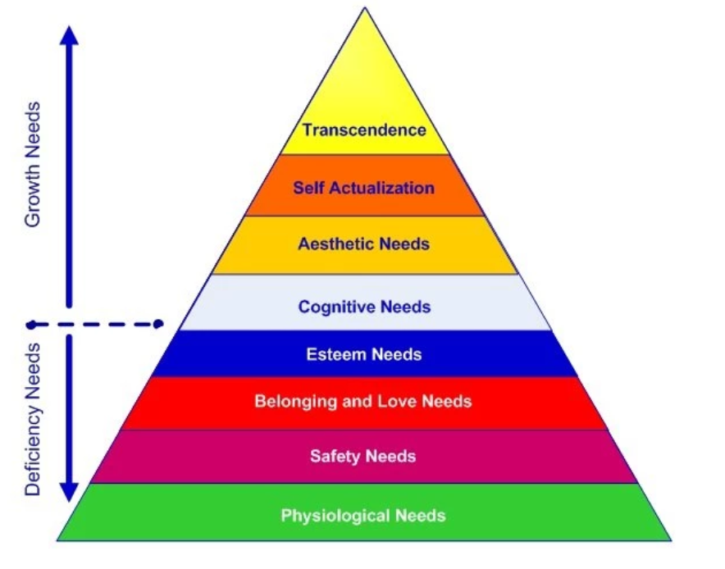
Maslow revised…
Notes:
Changes to the original five-stage model are highlighted and include a seven-stage model and an eight-stage model; both developed during the 1960's and 1970s.
1. Biological and physiological needs - air, food, drink, shelter, warmth, sex, sleep, etc.
2. Safety needs - protection from elements, security, order, law, stability, etc.
3. Love and belongingness needs - friendship, intimacy, trust, and acceptance, receiving and giving affection and love. Affiliating, being part of a group (family, friends, work).
4. Esteem needs - which Maslow classified into two categories: (i) esteem for oneself (dignity, achievement, mastery, independence) and (ii) the desire for reputation or respect from others (e.g., status, prestige).
5. Cognitive needs - knowledge and understanding, curiosity, exploration, need for meaning and predictability.
6. Aesthetic needs - appreciation and search for beauty, balance, form, etc.
7. Self-actualization needs - realizing personal potential, self-fulfillment, seeking personal growth and peak experiences.
8. Transcendence needs - A person is motivated by values which transcend beyond the personal self (e.g., mystical experiences and certain experiences with nature, aesthetic experiences, sexual experiences, service to others, the pursuit of science, religious faith, etc.).

Slide 16
So does Maslow’s hierarchy of needs fully explain our behaviour?
Do we know how he constructed this theory?
Could we criticise the theory?
Are we ‘allowed’ to criticise such a well known theory?
Notes:
Does Maslow cover all of our needs? Whiteboard
What about self sacrifice?
What about see destructive behaviour?
Also there I criticism
The most significant limitation of Maslow's theory concerns his methodology. Maslow formulated the characteristics of self-actualized individuals from undertaking a qualitative method called biographical analysis.
He looked at the biographies and writings of 18 people he identified as being self-actualized. From these sources, he developed a list of qualities that seemed characteristic of this specific group of people, as opposed to humanity in general.
First, it could be argued that biographical analysis as a method is extremely subjective as it is based entirely on the opinion of the researcher.
Furthermore, Maslow's biographical analysis focused on a biased sample of self-actualized individuals, prominently limited to highly educated white males (such as Thomas Jefferson, Abraham Lincoln, Albert Einstein, William James, Aldous Huxley, Beethoven).
Although Maslow (1970) did study self-actualized females, such as Eleanor Roosevelt and Mother Teresa, they comprised a small proportion of his sample. This makes it difficult to generalize his theory to females, to people of different races etc.
Another criticism concerns Maslow's assumption that the lower needs must be satisfied before a person can achieve their potential and self-actualize. This is not always the case, and therefore Maslow's hierarchy of needs in some aspects has been falsified.
Through examining cultures in which large numbers of people live in poverty (such as India), it is clear that people are still capable of higher order needs such as love and belongingness. However, this should not occur, as according to Maslow, people who have difficulty achieving very basic physiological needs (such as food, shelter, etc.) are not capable of meeting higher growth needs.
Also, many creative people, such as authors and artists (e.g., Rembrandt and Van Gogh) lived in poverty throughout their lifetime, yet it could be argued that they achieved self-actualization.
Psychologists now conceptualize motivation as a pluralistic behaviour, whereby needs can operate on many levels simultaneously. A person may be motivated by higher growth needs at the same time as lower level deficiency needs.
Universal human needs appear to exist regardless of cultural differences. However, the ordering of the needs within the hierarchy was not correct.
"Although the most basic needs might get the most attention when you don't have them," you don't need to fulfill them in order to get benefits. Even when we are hungry, for instance, we can be happy with our friends. "They're like vitamins," Diener says about how the needs work independently. "We need them all."

Slide 17

People need strokes…
Transactional analysis suggests that confirming our humanity is a basic human need
Interactions are transactions that supply this need. The currency is “strokes”
Strokes can be positive or negative, positive are better but we take what we can get
Notes:
Eric Berne, in the 1950, developed a therapy based on human relationships and interactions.
Forms of transaction (time structuring):
Rituals: low value, routine and pre-defined interactions such as common greetings etc
Pastimes: moderate value, low effort, generally pre-defined interactions such as chatting about common subjects
Activities (or work): moderate value, planning or doing stuff
Intimacy: High value, honest conversation, sharing feelings, possibly conflict
Games: variable value, defined by one or both parties concealing their “payoff” which is generally negative, predictable and confirms their life view “script”

Slide 18

Some common human ‘games’
“Yes, but…”
  Someone asks for advice, then comes up with reasons why it won’t work
“Kick me”
  Someone acts in a way that will provoke a negative response, then feigns surprise
“Now I’ve got you!”
  Someone waits for another person to do something bad, then reacts
Notes:
Yes but:
A presents a problem
B gives advice
A comes up with reasons why the advice won’t work
The cycle continues ad nauseam
A feels vindicated that they cannot improve their lot
B feels superior
Kick me:
A provokes a negative reaction
B reacts
A says “why does this always happen to me” or equivalent, i.e. it is outside his control
A confirms that something is wrong with him, but it is not his fault
B feels superior
Now I’ve got you
A watches and waits
B does something wrong
A overreacts
A feels superior, negative life view is confirmed
B feels bad

Slide 19
McClelland’s Motivational Theory
Want to excel and avoid very high risk/very low risk tasks. Need feedback and prefer to work alone or with high achievers
Power
Achievement
Affiliation
Need harmonious relationships and to feel accepted – like work with lots of personal interaction
People who want personal power want to direct others – those that want institutional power organise people to achieve goals of organistaion
Notes:
McClelland, 20 years after Maslow.
One or more will be dominant in any individual. This is closely related to personality, as discussed two weeks ago.
People with a strong power need will tend to rise in organisations as they are competitive and promotion is the most direct way to meeting this need.
Achievers will do well in many roles, but satisfaction with a job well done will not necessarily get them into senior positions, plus the need to successfully complete a task can make them more selective and risk averse.
High affiliation need individuals value relationships. As a result they are much less likely to be career focussed, though they tend to be happier.

Slide 20


Slide 21
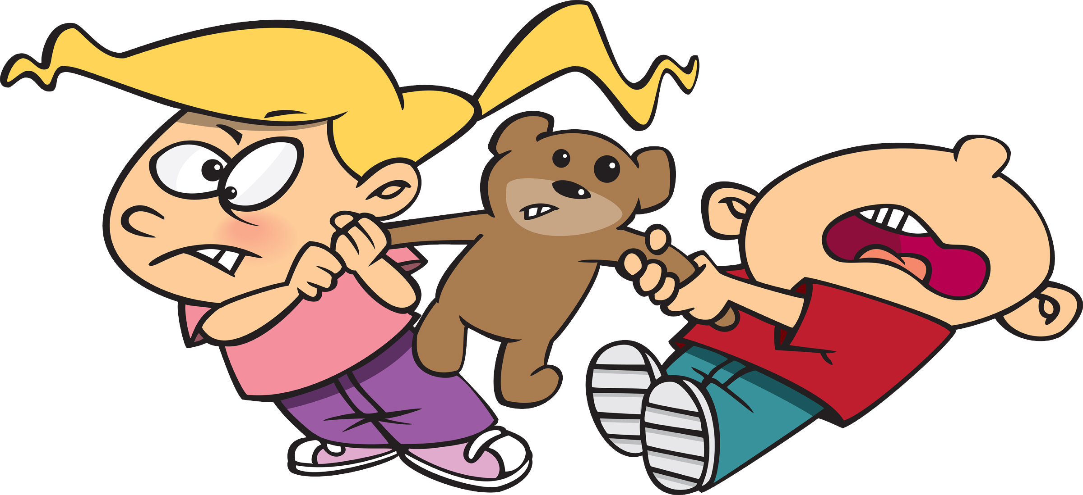
The Ultimatum Game…
Is a game about sharing… or not
Player A is offered £100
Player A has to offer a share to Player B
If Player B accepts, each player receives their share
If Player B refuses, neither player gets anything
Notes:
One volunteer is player A, the other is B.
Ask them to play.
If offers 50%, see if it is accepted. Then ask if anyone would have offered less – how much would they offer?
Ask the class if they would have accepted that offer. Why would they? Why would they not?

Slide 22

Equity Theory
Equity theory is based in the idea that individuals are motivated by fairness. John Stacey Adams suggests that the higher an individual's perception of equity, the more motivated they will be and vice versa: if someone perceives an unfair environment, they will be de-motivated
https://www.youtube.com/watch?v=xot4z1CKFMo
Notes:
1:37 Video Monkey fairness
Fairness is a strong motivator. How does this fit in with the needs models?

Slide 23

Goal Theory
Goal theory suggests that clear targets
and
prompt feedback can lead to higher levels of performance
Notes:
If time, digress into prospect theory

Slide 24

Sometimes, needs aren’t met…
When we experience barriers:
  Frustration
  Can lead to positive or negative responses
When there is to big a gap between what we do and who we are:
  Alienation

Slide 25
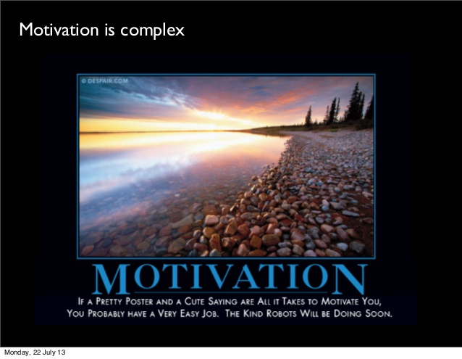
In Summary:
Motivation is complex
Learning what motivates you is an essential part of knowing yourself
Knowing what motivates others is a basic factor that you can use to establish and maintain effective relationships
Each person is motivated by different needs, at varying degrees and at different times

Slide 26
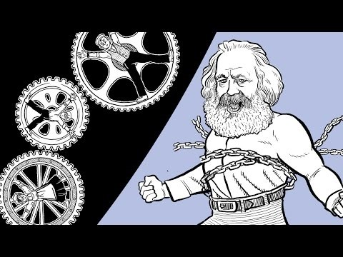
https://www.youtube.com/watch?v=PZ4VzhIuKCQ
Notes:
1:57 Video – Marx and alienation
What about when needs are not met?
Karl Marx and alienation

Slide 27

Any Questions on Today?
Why we do stuff
  Motivation
  Intrinsic
  Extrinsic
  Positive
  Negative
  Maslow
  McClellands Motivational Theory
  Equity Theory
  Goal Theory
  Anti-motivation

