Slide 1
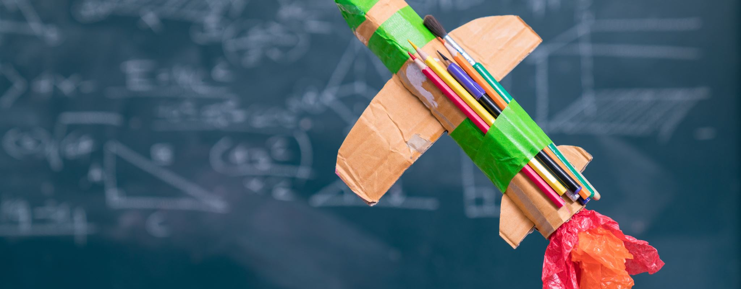
Learning about rockets
By Tristan Francis (2005134)
Course Leader :Brett Aggersberg
Course Code :HPMF6004

Slide 2
Synopsis
I have been asked to produce a task for children teaching them about how rockets work. I must be able to give them everything the need but in a fun way. The age range I’ve been asked to produce this for is 4-13 years old.

Slide 3
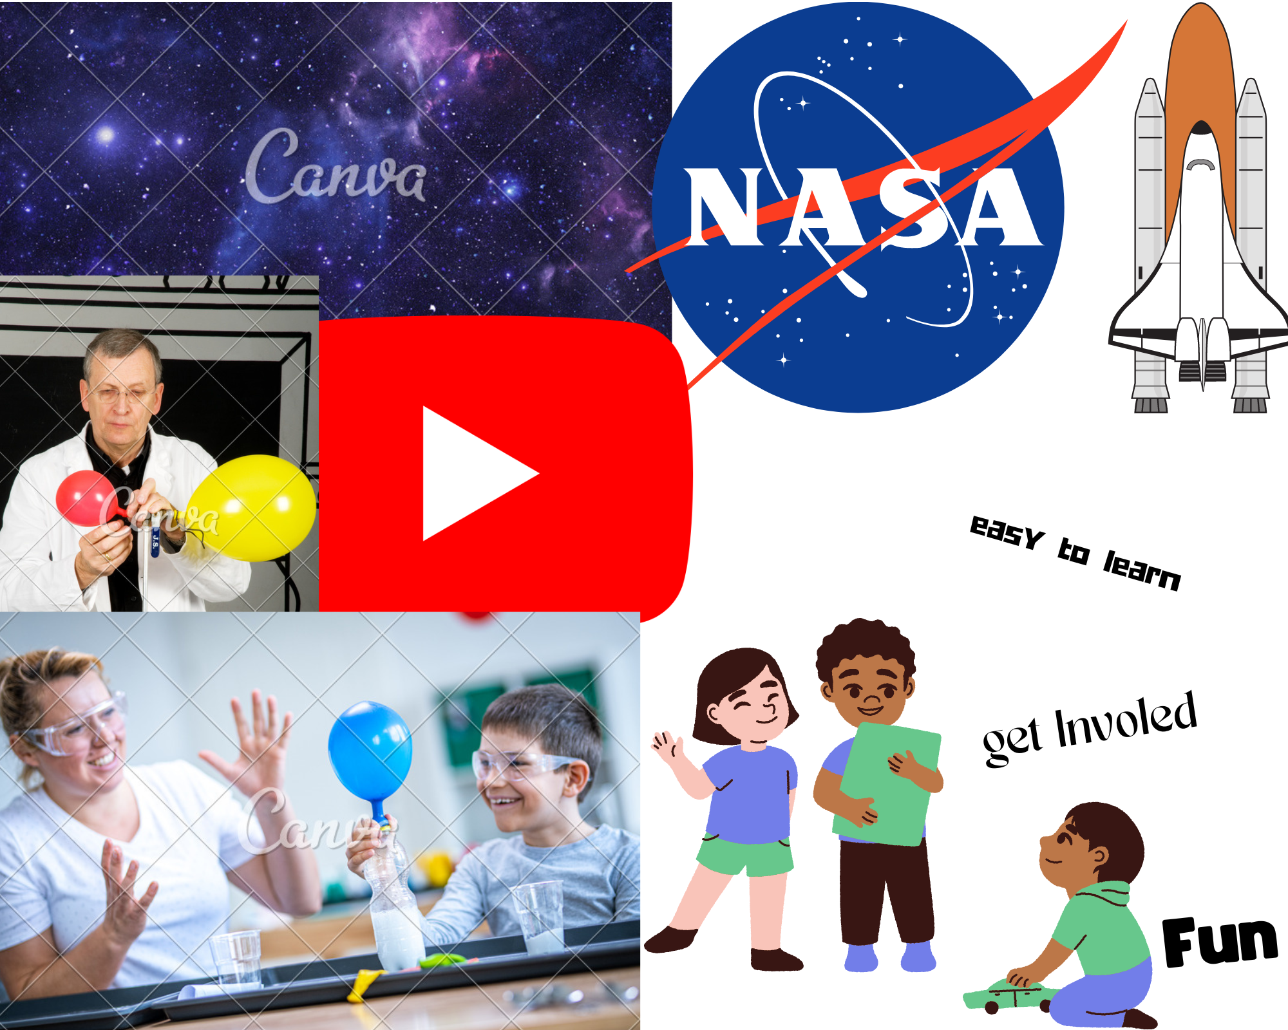
Mood board

Slide 4
5 chosen methods

Slide 5
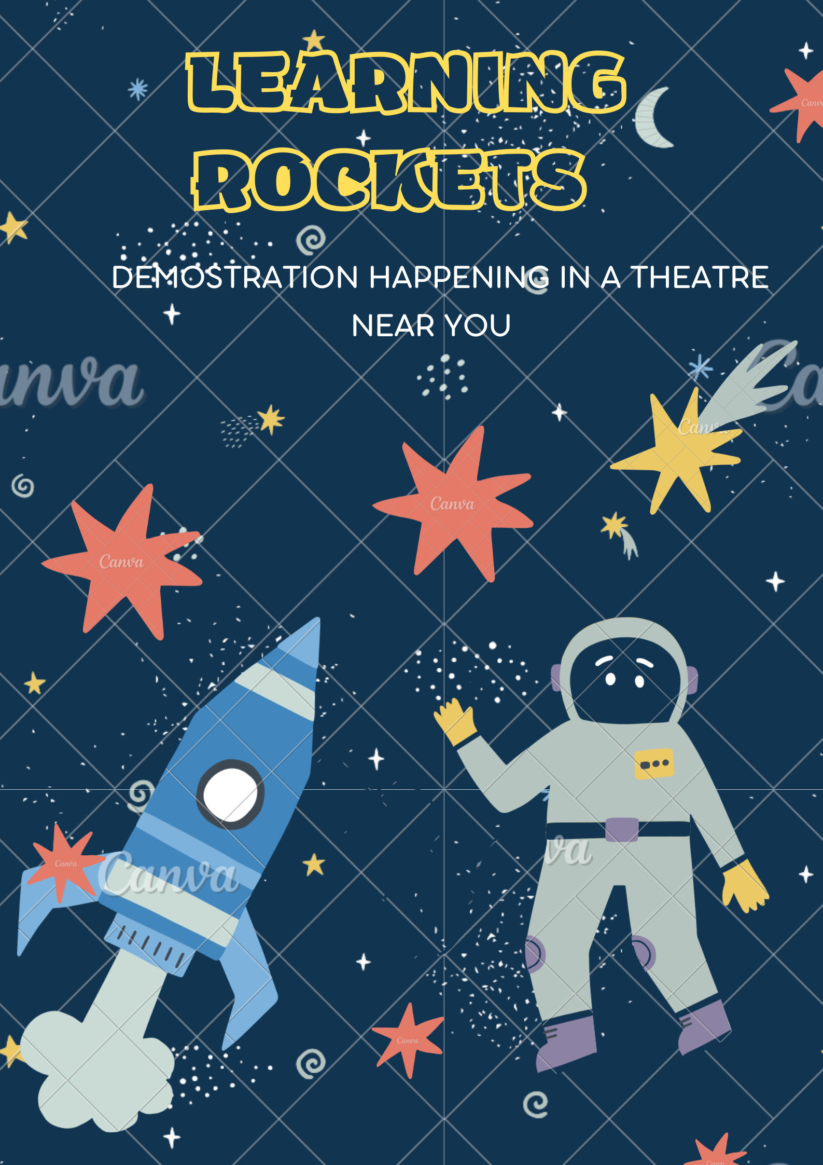

Poster
I feel that a poster would help gain the children's attention.
I have made two posters one for kids aged 4-8 and one made for kids aged 9-13.
This is aimed at 9-13
This would be aimed at ages 4-8

Slide 6
QR Code
I will use a QR code that will be on my poster that would take people to the website. This is where they will be able to find all the interactive videos and a list of the equipment they will need Also, at the end of the video and demonstration there will be a QR code for people to give feedback.

Slide 7

Demonstrating
I hope to hold a live event of the activity that could be done at home. This is where my interactivity could come in as it would be done live it would also allow me to answer any questions.

Slide 8

YouTube
I planned on doing a video that would be out up on YouTube for everyone to use this will include information about rockets, how they work, and the equipment needed to do the experiment. There will also be a QR code At the end of the video that would take them to the website which would allow them to find other videos and dates of live events.

Slide 9

Website
I will do a website that will be linked with QR codes, I want the website to have sections that would take people to the YouTube channel. I would love the website to have a page that would take people to the dates of live shows and events that I would be hosting.

Slide 10

The chosen media to do this project
The media strategy I’ve chosen to use is film. I feel this would keep everyone's attention. There will be times where the video could be paused allowing people to do the activity.

Slide 11
Can Children Interact with my video
There will be chance for the video to be paused and children will be able to as and answer questions. I am also thinking of giving the children instruction on how to do the experiment. There will be times where the video will be paused to let them discuss.

Slide 12
Marketing timeline
Poster
Word & Mouth
QR Code
Website
Live Demonstration
YouTube channel
video of the project
Merch
Feedback QR Code

Slide 13
The 3 C’s
Character - The scientist
Convince - To teach kids about rockets and allow them to experience making a balloon rocket giving them information about what is happening
Community - Primary School’s

Slide 14
Role of characters of my film
Scientist - this will be my only character - they will teach the kids about rockets.
what is the purpose of the scientist?
The purpose of this character is to make it engaging for the audience, he/she is there to teach kids and explain they experiment and what is happening.

Slide 15
Rationale
The reason I’ve chosen to do an educational video on rockets is because I think it is a simple idea that kids love to learn about. I also feel as if there are not many interactive and educational pieces of video on the internet about rockets specifically for children.
I am also doing experiments hence why I believe I could bring a different perspective to this. I also believe that by using the methods I talk about in this project I would be able to engage more children.

Slide 16
The Research

Slide 17

“History and transmedia have a surprisingly long history. Mark J. P. Wolf, claims that the origin of the earliest ‘trans narrative’ characters (characters that appear in multiple stories) was in ‘actual historical figures’.:Lähteenmäki, I. (2021)

Slide 18
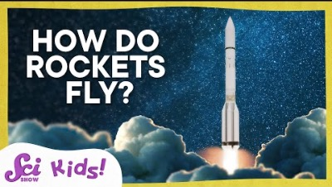
www.youtube.com. (2021). How Do Rockets Fly? | Let’s Explore Mars! | SciShow Kids.
[online]
‌

Slide 19

“When a rocket expels fuel or propellant out of its engine, the rocket moves in the opposite direction. The rocket pushes the propellant out, and the propellant then pushes the rocket. The propellant comes out of the engine. This is the action. The rocket lifts off the launch pad in the opposite direction. This is the reaction. In this activity , the rocket is a balloon propelled by air.” (NASA/JPL Edu, 2019)

Slide 20

National Geographic
“Imagine yourself standing on a skateboard with a basketball in your hands. If you throw the basketball in one direction, you and the skateboard will roll in the opposite direction to conserve momentum.”
(Greshko, 2019)

Slide 21
References
Greshko, M. (2019). Rockets and rocket launches, explained. [online] Science. Available at: https://www.nationalgeographic.com/science/article/rockets-and-rocket-launches-explained.
[Accessed 1 Nov 2022]
Lähteenmäki, I. (2021). Transmedia history. Rethinking History, pp.1–26. doi:10.1080/13642529.2021.1963597.
NASA/JPL Edu. (2019). Simple Rocket Science Activity | NASA/JPL Edu. [online] Available at: https://www.jpl.nasa.gov/edu/teach/activity/simple-rocket-science/ [Accessed 22 Oct. 2022]. www.youtube.com. (2021). How Do Rockets Fly? | Let’s Explore Mars! | SciShow Kids. [online] Available at: https://youtu.be/Lti6a_YYQl0 [Accessed 9 Oct. 2022].
‌
‌
‌

Slide 22
Any Questions?

