Slide 1
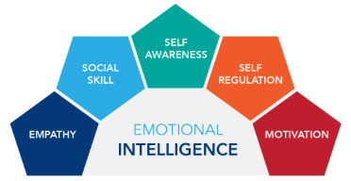
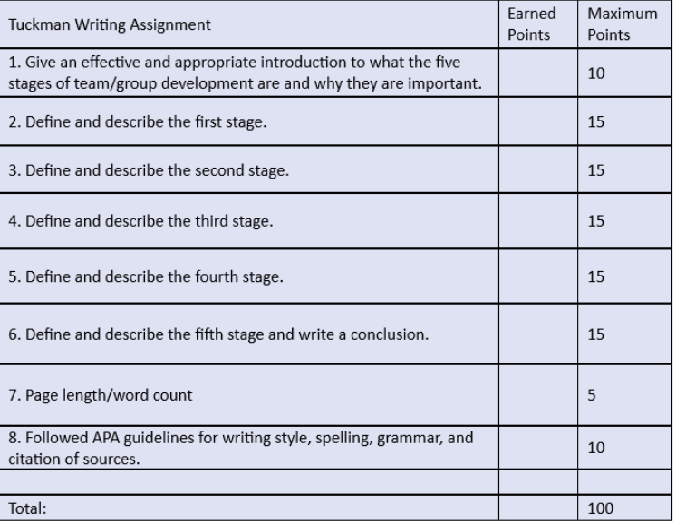
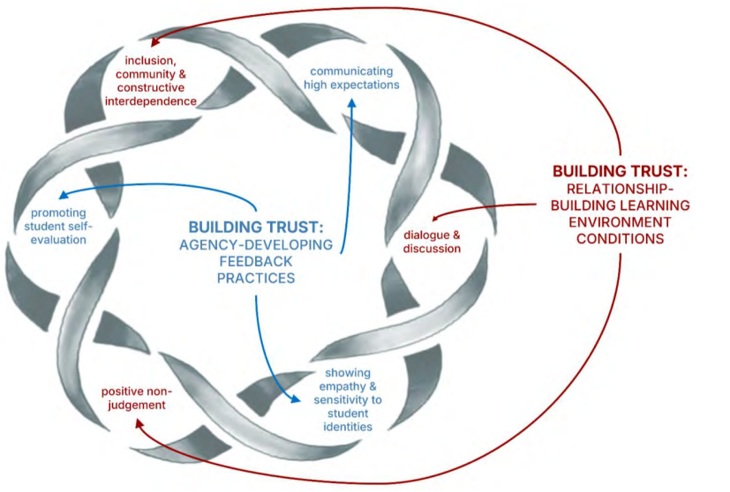
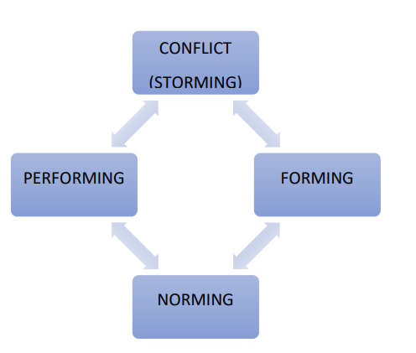
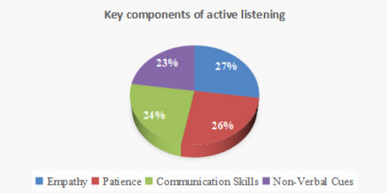
Student Name: George Burlui
Student ID: 1907641
Developing Emotional Intelligence Skills
Introduction
Emotional Intelligence (EI) is the ability to recognise, understand, manage and respond effectively to emotions (Singh et al., 2022).
EI is important in university group projects because students work with people from different backgrounds, personalities and communication styles.
Strong EI helps students manage stress, resolve conflict, communicate clearly and remain motivated during deadlines.
Common group-work challenges include misunderstandings, unequal participation, poor communication and incomplete tasks.
EI enables students to remain calm, respond positively to criticism, show empathy and build effective relationships.
This study discusses how students can manage their own emotions and respond empathetically to the emotions of others.
Figure: Rubric for structured framework
(Source: Fowler et al., 2025)
Section 3: Understanding Others’ Emotions
Empathy helps students recognise and understand the feelings of others (Kakarla, 2025).
It improves both verbal and non-verbal communication.
Emotional awareness reduces misunderstandings and supports respectful conversations.
It helps students adjust their communication style to different situations.
Strong empathy builds trust, inclusion and psychological safety within teams (Sun et al., 2024).
In Tuckman’s team stages, empathy can reduce tension during the storming stage (Wan Yadri et al., 2024).
It also supports constructive feedback, conflict resolution and shared responsibility.
Empathetic team members are more likely to support others and encourage participation.
Overall, empathy strengthens teamwork, communication and project success (Fowler et al., 2025).
Conclusion / Recommendations
Key Takeaways
EI supports effective teamwork among students with different personalities and communication styles.
Self-awareness and self-regulation help students manage emotions, stress and feedback.
Motivation keeps team members focused on shared goals.
Empathy builds trust, inclusion and mutual support.
Social skills improve communication, decision-making and conflict resolution.
Overall, EI strengthens collaboration and project outcomes.
Recommendations
Encourage students to reflect on their emotions, strengths and triggers (Huang and Wang, 2023).
Use active listening and perspective-taking to develop empathy.
Provide constructive feedback respectfully and focus on solutions.
Establish clear team goals and responsibilities.
Create a supportive environment that encourages participation and help-seeking.
Promote trust, collaboration and shared ownership of group tasks (Bayraktar et al., 2025).
Section 1: EI in Teamwork
EI helps students work better in group projects and manage teamwork challenges.
Goleman’s model includes five main EI skills: self-awareness, self-regulation, motivation, empathy and social skills (Maity et al., 2025).
Self-awareness helps students un
derstand their emotions, strengths and weaknesses. For example, a stressed student can recognise nervousness early and ask for support.
Self-regulation helps students stay calm during disagreements and respond to feedback positively instead of reacting emotionally.
Motivation helps students stay focused, meet deadlines and encourage others during stressful periods.
Empathy helps students understand others’ feelings and support team members facing pressure or personal issues.
Social skills support communication, trust, conflict resolution and collaboration (Jaedun et al., 2024).
Overall, EI helps students manage emotions, improve communication and build positive working relationships in group projects.
Empathetic Behaviours
Active listening shows respect, attention and understanding within teams.
Social Exchange Theory suggests that mutual support strengthens positive interactions (Oluwatosin and Darmawan, 2024).
Listening behaviours include summarising ideas, asking questions and showing interest (Petkou et al., 2025).
Perspective-taking helps members understand different concerns and cultural viewpoints.
Constructive feedback should be respectful, supportive and focused on improvement.
These behaviours reduce stress, build trust and encourage participation.
Overall, empathy improves cooperation, inclusion and project performance (Ajobi et al., 2025).
Section 2: Managing One’s Own Emotions
Emotional management helps students reduce stress and remain productive during group projects (Pour, 2025).
Self-awareness allows students to recognise frustration, anxiety and anger before reacting.
Mindfulness techniques, such as deep breathing and short breaks, improve focus and reduce stress (Raugh et al., 2025).
Reflection helps students understand emotional triggers and improve future responses.
Time management, equal task distribution and healthy routines reduce academic pressure.
Pausing before reacting prevents conflict and supports respectful communication (Bradley et al., 2024).
Overall, managing emotions helps students remain calm, cooperative and focused.
Figure: Framework for building trust through feedback
(Source: Bayraktar et al., 2025)
Reference
AJOBI, A.O., ISMAIL, I.A.B., ISMAIL, S.B. and OWUNNA, R., (2025). Enhancing employee performance through training: A theoretical exploration of social exchange theory. Quantum Journal of Social Sciences and Humanities, 6(3), pp.489-501.
Bayraktar, B., Ragupathi, K. and Troyer, K.A., (2025). Building Trust through Feedback: A Conceptual Framework. Teaching & Learning Inquiry, 13.
Bradley, C.M., Greer, L.L., Trinh, E. and Sanchez-Burks, J., (2024). Responding to the emotions of others at work: A review and integrative theoretical framework for the effects of emotion-response strategies on work-related outcomes. Academy of Management Annals, 18(1), pp.3-43.
Fowler, D.S., Musgrave, J. and Zinn, D.F., (2025). Remembering the Titans: A Cinematic Pedagogy for Enhancing Understanding and Improving Performance in Tuckman's Stages of Group Development in Management Education. International Journal for Business Education, 167(1), pp.1.
Huang, Y. and Wang, S., (2023). How to motivate student engagement in emergency online learning? Evidence from the COVID-19 situation. Higher Education, 85(5), pp.1101-1123.
Jaedun, A., Nurtanto, M., Mutohhari, F., Saputro, I.N. and Kholifah, N., (2024). Perceptions of vocational school students and teachers on the development of interpersonal skills towards Industry 5.0. Cogent Education, 11(1), pp.1-2375184.
Kakarla, U., (2025). Emotional intelligence in interpersonal communication. International Journal of Innovative Scientific Research, 3(1), pp.111-121.
Maity, S., De Filippis, S.M., Aldanese, A., McCulloch, M.A., Sandor, A.P., Perez Cajigas, J.E., Antoniadis, Y., Rochester, T.K.D., Carter, L.E., Preisig, A.M. and Kobeissi, J.A., (2025). Enhancing emotional intelligence in medical education: a systematic review of interventions. Frontiers in Medicine, 12, pp.1-1587090.
Oluwatosin, A. and Darmawan, D., (2024). The relationship between psychological well-being and social interaction: Reconstructing social exchange theory in a cross-cultural perspective. International Journal of Service Science, Management, Engineering, and Technology, 6(3), pp.1-5.
Petkou, D., Palioura, M., Papadopoulou, A., Pappa, M. and Aikaterini, S., (2025). Public education teachers' perspectives on the role of active listening in enhancing students' well-being in educational environments. Research on Preschool and Primary Education, pp.101-114.
Pour, F.B., (2025). Mindful Parenting in a Rapidly Changing World: A Framework for Fostering Emotional Resilience in Children. Scientific Hypotheses, 2, pp.72-79.
Raugh, I.M., Berglund, A.M. and Strauss, G.P., (2025). Implementation of mindfulness-based emotion regulation strategies: A systematic review and meta-analysis. Affective Science, 6(1), pp.171-200.
Singh, A., Prabhakar, R. and Kiran, J.S., (2022). Emotional intelligence: A literature review of its concept, models, and measures. Journal of Positive School Psychology, 6(10).
Sun, Y., Zhou, G. and Deng, X., (2024). Emotional intelligence and joyful teaching: pathways to enhanced student engagement and achievement. Lecture Notes in Education Psychology and Public Media, 52(1), pp.163-168.
Wan Yadri, W.S., Ahmad, N.H.F., Abdul Kadar, N.S., Nazym, N.K. and Mohd Johari, M.D., (2024). The influence of conflict in group work according to Tuckman’s Model. ESTEEM Journal of Social Sciences and Humanities, 8(SI), pp.71-85.
Figure: Team Development Model of Tuckman
(Source: Wan Yadri et al., 2024)
Figure: Key components of active listening
(Source: Petkou et al., 2025

