Slide 1
ERGA22W Stainless Steel Decorative Fly Killer project
MODULE CODE:BMSW 5104
LECTURER`S NAME:
ADEREMI OJEBODE
PROJECT PROPOSAL PITCH PRESENTATION
STUDENT NAME:
ELENA BANICA-2126381
GABRIEL VILCU-2126382

Slide 2
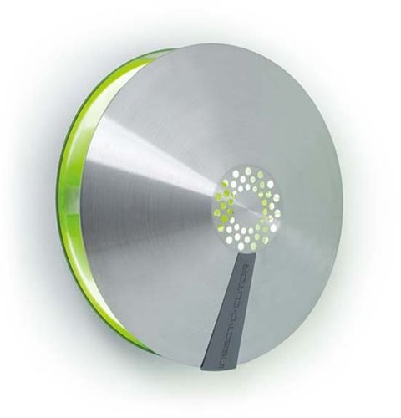
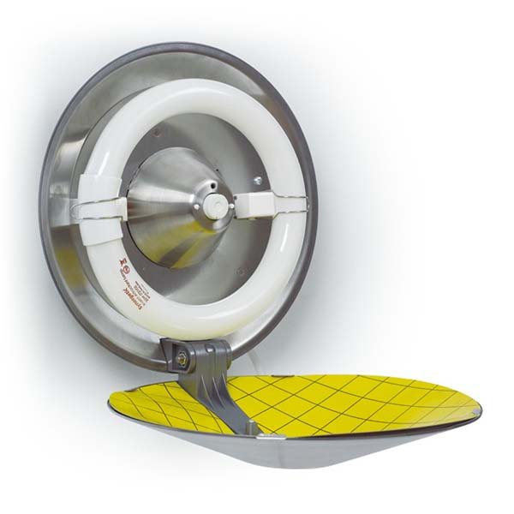
Introduction
Controlling flies and other flying insects is a problem that people from different walks of life would want solved (Hinkle and Hogsette, 2021).
There are activities and businesses that need effective ways of ridding their premises and surroundings of flies and other flying insects.
The solutions in the market have varying deficiencies that are addressed in the product we present.
The project proposes the introduction of an improvised ERGA22W Stainless Steel Decorative Fly Killer.
Our product’s main unique selling point is a light sensor that enables it to prevent battery consumption during the day.

Slide 3

Project description
Project description informs stakeholders on important aspects of the project (Bryde, 2019).
The objective of the project is to introduce to the market a product designed to revolutionize insect control.
The product will be designed to be user-friendly, durable, and easy to integrate with indoor décor for customers who will use it indoors.
The product will be marketed mainly to customers who carry out outdoor activities such as fishing and camping.
However, it will also be marketed to customers who intend to use it for indoor insect control such as homes, restaurants, and other hospitality establishments.
The marketing process will be largely done online with an e-commerce website as the main buying point for customers.
To maximize sales, traditional marketing techniques such as direct approach where the team members will directly approach potential customers to pitch the product.

Slide 4

Project Scope
Defining the scope of the project is important as it provides the project team with clear boundaries that encompass the activities to be carried out in the process of launching the product (Sokowski).
All the activities within the project’s scope will be geared toward positioning the product as the industry standard.
Marketing will involve a multi-channel approach including social media and traditional marketing.
Establishing a distribution network with retailers and delivery services
The timeframe allocated to the project will be six months
Training on installation to be provided to retailers and staff
The budget for the whole project will be set at £130,000

Slide 5
Work Breakdown Structure (Project Life Cycle )
ERGA22W Stainless Steel Decorative Fly Killer project
Initiation
Research
Planning
Implementation
Follow up
Research on requirements
Acquiring operating licenses
Creating the project team
Creating a project plan
Monitor performance
Marketing and Distribution
Research on relevant technologies
Create the project schedule
Risk assessment
Gather information on labor and other key requirements
Management of the e-commerce website
Creating a prototype
Assigning roles to project team members

Slide 6
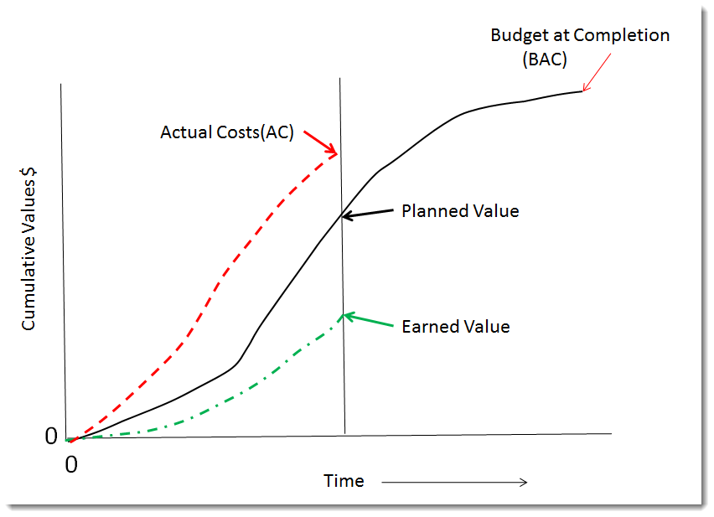
Trend analysis
Trend analysis is important in project management as it enables a project team to make sense of the information they collect and use it to control the project cost and schedule (Doubravský et al., 2020).
In the proposed project, trend analysis will be used to conduct the Earned Value Management (EVM)
The EVM will enable the project team to understand the total work involved in the project, the cost of the work, the cost of the work at any given point during the implementation process, and whether the project team is within the budget.
The graph shown in this slide depicts the EVM focus enabled by trend analysis.

Slide 7
Quad Chart – SWOT Analysis
Strengths Unique and high-quality product Strong distribution network Energy-efficient and easy to use Low Price | Weakness Limited brand recognition and awareness Limited market reach Dependence on a single product New in the market
Opportunities Expansion into new markets such as outdoor events and festivals Partnership opportunities Increasing demand for eco-friendly and sustainable products | Threats Competition from similar products Potential supply chain disruptions Potential changes in regulations Changes in tax regimes can cause fluctuations in prices

Slide 8
Gantt Chart
ERGA22W Stainless Steel Decorative Fly Killer project | Month 1 | Month 2 | Month 3 | Month 4 | Month 5 | Month 6
Initiation
Research
Planning
Implementation
Follow up

Slide 9
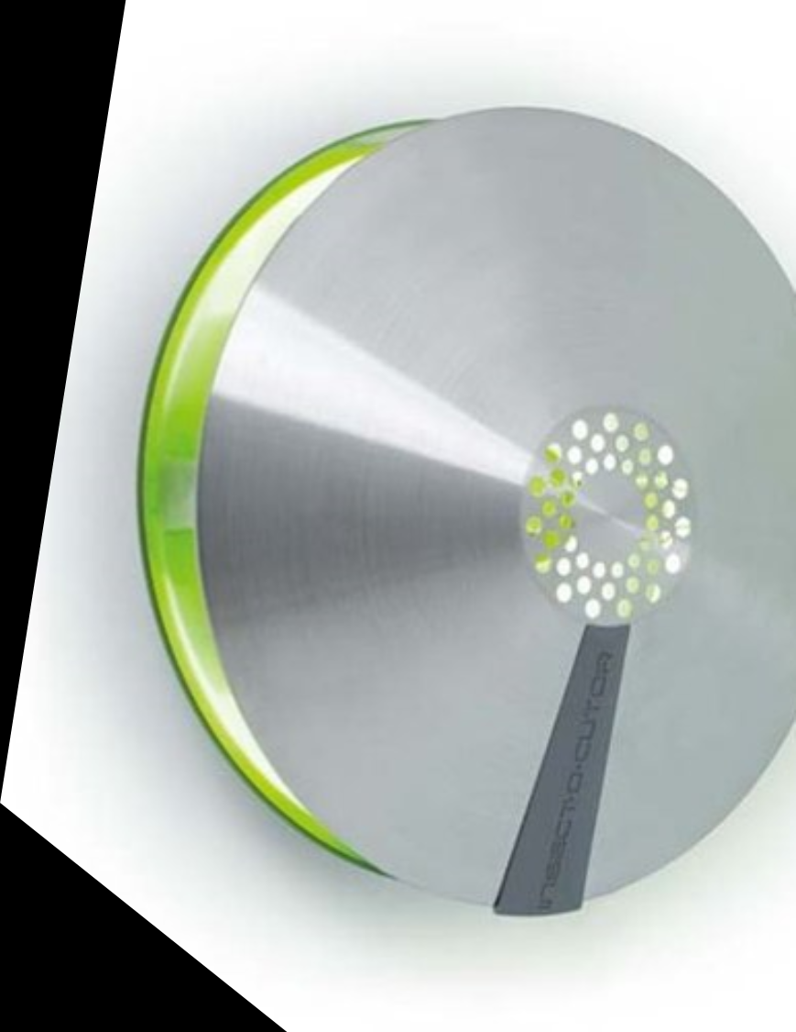
Stakeholders' involvement
Stakeholder involvement is important in project management as it enables the project team to win the support and backing of key stakeholders (Karlsen, 2022). The project will involve the following stakeholders:
Sponsors – the sponsors that will fund the project include the financial institutions that will provide the loans. The project will involve and engage the sponsors when pitching the project to them and demonstrating that they can repay the capital they supply.
The government – the government regulates businesses though regulations and licensure. The project team will engage the relevant governmental bodies at the point of licensure and proof of compliance
Suppliers- the suppliers of the materials the project will need to set up the business are important stakeholders that the project team will engage when purchasing the supplies needed for the project.
Distribution partners – the project team will engage with distribution partners before launching the product to secure their consent and agree on the partnership details.

Slide 10
Allocation of resources
Phase | Percentage of budget
Phase 1 | 5% (6500)
Phase 2 | 20% (26000)
Phase 3 | 30% (39000)
Phase 4 | 40% (52000)
Phase 5 | 5% (6500)

Slide 11
Risk Analysis
Activity | Potential Risk | Impact (out of 10) | Likelihood (out of 10) | Risk factor (impact x likelihood) | Mitigation
Recruitment | Recruiting a poor staff members | 8 | 2 | 16 | Conducting thorough recruitment process with clear goals for the skills and aptitudes required in applicants.
Optimizing the product for safety | Failure to foresee potential risks | 9 | 3 | 27 | Recall the products to fix any identified safety issues.
Stakeholder engagement | Failure to convince powerful stakeholders like licensing bodies | 6 | 2 | 12 | Create a communication plan that details the safety and utility of the product, and the project’s team readiness to comply with the regulations.

Slide 12
Conclusion
Introducing the ERGA22W Stainless Steel Decorative Fly Killer to the market is a project that will require meticulous execution of all the important steps.
The presentation has shown that the project will require quality marketing and establishment of reliable distribution channels.
Strict adherence to the project plan will enable successful introduction of the product into the market.
The project is predicted to be a success given the unique selling points of battery conservation and durability.

Slide 13
References
Hinkle, N.C. and Hogsette, J.A., 2021. A review of alternative controls for house flies. Insects, 12(11), p.1042.
Sokowski, D., 2015. Mastering Project Management Integration and Scope: A Framework for Strategizing and Defining Project Objectives and Deliverables. FT Press.
Karlsen, J.T., 2022. Project stakeholder management. Engineering management journal, 14(4), pp.19-24.
Bryde, D.J., 2019. Project management concepts, methods and application. International Journal of Operations & Production Management, 23(7), pp.775-793.
Doubravský, K., Doskočil, R. and Dohnal, M., 2020. A dynamic knowledge model of project time-cost analysis based on trend modelling. Periodica Polytechnica Social and Management Sciences, 28(1), pp.18-28.

