Slide 1
Critical Reading, Thinking & Writing
Darllen, meddwl ac ysgrifennu beirniadol
MSc Policing (O&SL)
10.06.25

Slide 2

Aim
To introduce you to the following academic skills:
Critical Reading
Critical thinking
Critical writing

Slide 3

Learning Outcomes
Critical Reading –
Define ‘critical reading’
Become a more selective reader
Critical Thinking
Define ‘critical thinking’
Apply critical thinking to
your own work
Critical Writing -
What is critical writing
Effective critical writing

Slide 4

Academic Reading
Reading whilst studying for a degree IS different
You have to read more
Content is different
Vocabulary may be different
Textbooks/journals are difficult to understand/use complex concepts
You have to understand AND remember it!
Do NOT get overwhelmed!

Slide 5

Stages & Types of Reading
3 STAGES of reading
1.Early stage – thorough & slow
2. Middle stage – precise in selection of sources, faster
3.Final stage – check specific points or follow up ideas – fast
4 TYPES of reading
Systematic – slow & careful – summarising, evaluating
Standard – answer specific questions, explain to someone else
Scanning – faster, general ideas, gist of topics
Skimming – faster, searching for something
Notes:
3 stages of Reading
EARLY – where you will read thoroughly and your pace will be slow
MIDDLE – here you will become more precise in relation to the selection of your sources and your pace in reading will increase to being almost optimal
FINAL – here you will merely check specific points or follow up ideas – so the pace will be fast
4 Types of Reading
SYSTEMATIC – where you are slow and careful when you read ensuring that you cover each word, you summarise as you go along and unbeknown you are evaluating at the same time ( multi-tasking!!)
STANDARD - this type of reading is where you are reading to answer a specific question or to explain something to someone else
SCANNING - this type of reading is much faster in its pace, you use it when you just want to have a general idea of something or agist of atopic
SKIMMING – this type is even faster in pace and is used when you are searching for something in particular ( e.g. looking in the contents list)
Can you think of examples where you may use these different types of reading in your day jobs?
My experience – if I was authorising any warrants/production orders I would be quite systematic
But as I have come into academia I find I do far more scanning and skimming – when I'm researching and looking to update my lessons

Slide 6

Purpose of Academic Reading
The 3 main purposes of academic reading are:
Information
Understanding
Analysis
Notes:
There are 3 main purposes for undertaking academci reading
INFORMATION
UNDERSTANDING
ANALYSIS

Slide 7

Purpose of Academic Reading
Reading for INFORMATION
Overview: Looking for specific pieces of data
Example: getting directions, finding specific information about drink/drive limits, age limits for certain activities etc.
Reading for UNDERSTANDING
Overview: gaining a general overview of a topic, area of study
Example: background reading into a specific topic, pre-reads
Notes:
READING FOR INFORMATION
Overview: Looking for specific pieces of data
Example: getting directions, finding specific information about drink/drive limits, age limits for certain activities etc.
Technique: scanning a text to look for keywords or phrases that answer your question then moving on
READING FOR UNDERSTANDING
Overview: gaining a general overview of a topic, area of study
Example: background reading into a specific topic, pre-reads
Technique: reading a text once from start to finish, often passively

Slide 8

Purpose of Academic Reading
Reading for ANALYSIS
Overview: using your prior knowledge and applying it to what you are reading
Example: reading for an assignment, dissertation, literature review etc.
Notes:
Reading for ANALYSIS
Overview: using your prior knowledge and applying it to what you are reading
Example: reading for an assignment, dissertation, literature review etc.
Technique: reading a text actively multiple times, asking questions of the content etc

Slide 9
What is ‘Critical reading’?
Analyse what you are reading
Establishing validity and significance of the text
Distinguish between FACT and OPINION of the author
Fact = can be verified/checked for accuracy
Opinion = cannot!
Academic opinion – evidence, fact and reason to convince reader that it is a valid opinion
Notes:
So we've had a look at reading in general but wat about CRITICAL READING – how do you think that differs?
Critical reading is all about analysing what you are reading, questioning it as you go along,
Analyse what you are reading
Establishing validity and significance of the text in your own mind
Asking yourself:
What is it claiming?
What are the reasons for the author to make that claim?
Do any other authors support that text?
How does that text relate to other available texts?
Distinguish between FACT and OPINION of the author
NB - Fact = can be verified/checked for accuracy
Opinion = cannot!
Academic opinion – evidence, fact and reason to convince reader that it is a valid opinion

Slide 10
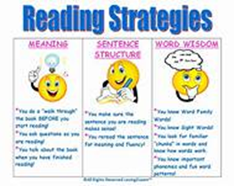

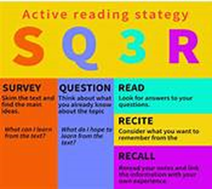
Critical Reading Strategies
5 step tool to aid you – there are others out there!
1.Predict
2. Identify
3. Question
4. Clarify
5. Summarise
Notes:
There are a number of tools that you can use to develop a critical reading strategy
I'll just choose this one - a 5 step approach
1.Predict
Identify
Question
Clarify
Summarise

Slide 11
Critical Reading Strategy
Predict – Guides your reading in purposeful way and creates links
Identify – focus on understanding , identify themes
Question – look for weakness/limitations
Clarify – Develop understanding text/terms
Summarise – if you can't summarise you haven't understood it.
Notes:
So lets quickly break down those 5 steps
Guides your reading in a purposeful way and creates links
PREDICT
Guides your reading in a purposeful way and creates links
Ask:
What do you want to get out of reading it?
What are your expectations?
What is your goal?
What are your limits?
What do you think the main arguments of the text will be?
2. IDENTIFY
Focus on understanding the text by identifying main themes/ideas
Ask:
What are the main ideas/themes in the text?
What are the key pieces of information?
What links these together?
How do these ideas link with others you’ve read?
3. QUESTION
This is where your analysis begins
Look for weaknesses or limitations in the arguments, discussions etc
Ask:
Is there any information missing?
Are the arguments valid?
Is the data reliable?
What is the author’s position?
Any bias?
How does it fit with other evidence/what you already know about topic?
4. Clarify
Developing your understanding of the text
Ensure you understand terminology
Ask:
Are words/phrases or sentences unclear?
Terminology?
Are there any other authors/theories referred to that are relevant to your reading?
5. Summarise
Vital to cement your understanding, grasped important concepts & can explain in your own words
Summarise key arguments of text in your own words
* If you cannot summarise the text you’ve just read – you haven’t understood it!*

Slide 12
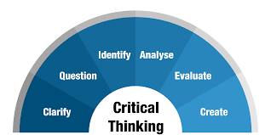
Critical Thinking
Not a new concept
1930’s - Dewey defined as:
“Active, persistent and careful consideration of any belief or supposed form of knowledge in the light of the grounds that support it and the further conclusions to which it tends” (1933, p118)
2009 – Judge et al defined as:
“questioning, challenging approach to knowledge and perceived wisdom which involves examining ideas and information from an objective position and then questioning this information in the light of our own values, attitudes and personal philosophy” (2009, p2)

Slide 13
Cottrell (2005) - Critical thinking
Identifies range of skills and attitudes that constitute critical thinking:
Identifying other people’s positions, arguments and conclusions
Evaluating the evidence for alternative points of view
Weighing up opposing arguments and evidence fairly
Being able to read between the lines, seeing behind surfaces and identifying false or unfair assumptions
Recognising techniques used to make certain positions more appealing than others, i.e. false logic
Reflecting on issues in a structured way, bringing logic and insight to bear
Drawing conclusions about whether arguments are valid and justifiable, based on good evidence and sensible assumptions
Presenting a point of view in a structured, clear, well-reasoned way that convinces others

Slide 14

Identifying and analysing an argument
What is an argument?
Disagreement or dispute
What is an academic argument?
An attempt to persuade others (of the validity of a conclusion) by offering at least one reason that supports that conclusion.
i.e. an argument begins with an issue, which is followed by a line of thinking/reasoning, leads to a conclusion
Notes:
Lets move on to 'arguments' another term that you will be familiar with during your course
So what do we mean by 'argument' - in general??
A disagreement or a dispute
SO what Is an academic argument?
Its an attempt to persuade others of the validity of a conclusion by offering at least one reason that supports that conclusion

Slide 15
Evaluating the evidence of an argument
The author
Specialist knowledge
Bias and hidden agendas
Ambiguity
Inconsistency
Fact or opinion
Notes:
How do we therefore evaluate the evidence of an argument that we have come across in our reading/our research to see if we agree/disagree or to establish its validity
Author – who are they, google them so see are they affiliated to any Uni etc,
Specialist knowledge – what 's in their bio's, what have they written before, are they affiliated to any organisations
Bias and hidden agenda – do they have any, sometimes it comes through in their writing, or you may find that they are affiliated to
Ambiguity – in their writing, does it pose more questions that are not addressed adequately or not at all
Inconsistency – do they provide an alternative view in other academic work , if so what is that based on
Fact/opinion - is it based on fact or on opinion. Don't forget fact an be evidenced, opinion cannot

Slide 16

Group Task
How would you critically evaluate the following claim:
‘In the last year crime figures have dropped by 10 per cent’.

Slide 17

Suggestions…
What is meant by CRIME? It could be that certain acts, previously considered as a crime are no longer so
HAS there been a drop in reported crime? Or is it still going on but we don’t know about it
What does 10% mean? Is it likely to have an impact? Is 10% just an average drop – which means some may go up?
Who made the claim? Newspaper or H.O.
Was the drop in crime nationwide or just within one particular area?
How recent is the claim and/or statistics? Always look for up to date figures/data
Are there other reports that support the claim or claim other stats
DON’T just accept what you are told….QUESTION IT!

Slide 18

Applying critical thinking to your work
Try to convince your readers of your view/conclusion by offering appropriate, logical reasoning
Take a step back from your work – pretend to disagree with the conclusion –
  Where can you see the gaps in your argument, which elements are weak/not supported well
  List all the reasons leading to your conclusion – adequate/sufficient?
Be careful using general statements – ‘all, every, never, always’ – do you have the evidence to make the claim?
Keep your argument factual

Slide 19
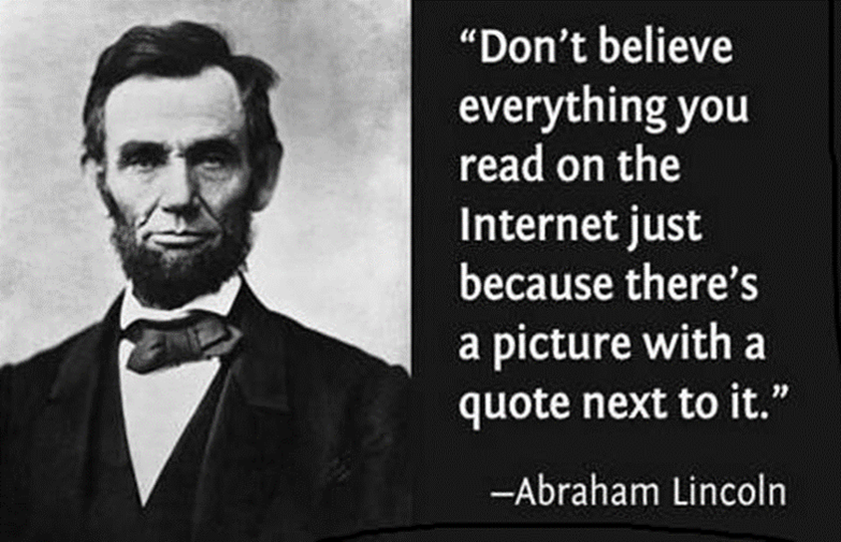
If in doubt – question it!

Slide 20

Academic Writing & Critical writing

Slide 21

Academic Writing
Purpose
To demonstrate-
  Knowledge and understanding of a topic
  Ability to research specific aspect of topic set in the assignment and
  Ability to organise supporting information/evidence within a structured piece of writing
Notes:
What do you think is the purpose of academic writing??
To demonstrate-
Knowledge and understanding of a topic
Ability to research specific aspect of topic set in the assignment and
Ability to organise supporting information/evidence within a structured piece of writing

Slide 22
The 4 Types of Academic Writing
Descriptive
Describe the facts.
Precise and accurate – what happened, what someone said or describe key features.
Associated with report writing.
Ok to use if giving background information
Analytical/argumentative
Your opinion about the subject with evidence to support your opinion
State your point of view
Validity of position supported by evidence or examples
Consideration of counter-argument, including evidence
Persuades others that your position is the strongest
Analytical/Evaluative
Always consider two or more theories/beliefs/ideas that you compare and contrast
By comparing you bring out similarities
By contrasting you focus on the differences
You evaluate your findings – strengths/limitations/implications
Make a judgement on the findings – justify your choice
Must be balanced
4. Personal/experiential
Where you relate theory to your practice/experience
Supportive or contradictory
Does NOT usually form part of essay

Slide 23
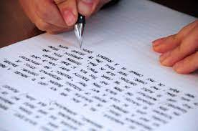
Critical Writing v Descriptive Writing
" Too descriptive"
" Not enough critical analysis"
" Not critical enough"
Sound familiar??
Notes:
How many of you have received these types of feedback during your course?
Did you understand what the tutor was saying?
What did you do about it?
Its really common for students to have this type of feedback as they progress through their studies. And you will find that it is through this 'critical aspect of you rowrk si where you'll get the better marks
As you are now approaching the writing up of your next assignment – its worth me just giving a bit of an overview so that you know that by taking time to look at this aspect of your writing youre aiming to get the best mark

Slide 24
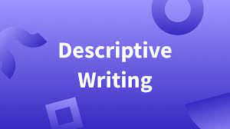
Characteristic of descriptive writing
"Will describe something BUT will not go beyond an account of what appears to be there"
( University of Leicester, 2013)
Notes:
Bangor University 2023
The most characteristic feature of descriptive writing is that it will describe something BUT will not go beyond that – it literally just describes something.
There are no arguments presented and doesn't present any analysis or discussion
Some examples would include:
Facts and figures about a particular issue
Description of a background to a case study
A summary of a sequence of events
Descriptions about what happened in an experiment
Etc
With descriptive writing you are presenting information but not transforing it, you are reporting upon ideas but not taking them forward in any way
You will all be very skilled in this type of writing because of the nature of your job.
But critical writing needs you to develop a new skill.
Your dissertation will most definitely have elements of descriptive writing in it and it needs to be in there – but there will be areas where that critical element needs to shine through to get you the better marks

Slide 25

Characteristic features of critical writing
Clear and confident refusal to accept the conclusions of other writers without evaluating arguments ad evidence that they provide
A balanced presentation of the reasons why the conclusions may be accepted or treated with caution
Clear presentation of own evidence/argument leading to your conclusion
Recognition of limitations
Notes:
The most characteristic features of critical writing are:
Clear and confident refusal to accept the conclusions of other writers without evaluating the arguments and evidence that they provide
A balanced presentation of the reasons why the conclusions may be accepted or may need to be treated with caution
Clear presentation of own evidence/argument leading to your conclusion
Recognition of the limitations in your own evidence, argument and conclusion
(Bangor University, 2023)

Slide 26

Critical writing
Critical writing is:
More complex
Involves discussion, analysis & evaluation
Being "balanced"
Consider the quality of the evidence/argument you have read
Identify key positive/negative aspects
Assess their relevance and usefulness to your dissertation
Identify how best to use them
Notes:
So critical writing is more complex, and involves more discussion, analysis and evaluation than does descriptive writing as you are participating in th eacademci debate. You need to weigh up what others are saying, what arguemenst they are putting forward and the contribute your own
Examples of critical writing activities include: 
Engaging with evidence 
Open minded and objective enquiry 
Presenting reasons to dispute a particular finding 
Providing an alternative approach 
Recognising the limitations of evidence: either your evidence or the evidence provided by others  T
thinking around a specific problem

Slide 27
Descriptive v Critical Writing – when to use
Descriptive Writing |  | Critical Writing
Introduce |  | Organise ( and evaluate evidence)
Present facts ( e.g case summary) |  | Make ( comparisons)
Describe |  | Analyse
List details (e.g resources) |  | Apply ( your own judgements)
Outline (areas of knowledge) |  | Make ( links between knowledge)
Quote (from authors) |  | Weigh ( up alternatives)
Provide ( info/data) |  | Evaluate ( argue/contest)
Summarise |  | Draw (conclusions)

Slide 28
Descriptive v Critical Writing
Parahoo et al (2000) investigated the extent to which learning disability nurses in Northern Ireland used research in their practice. They also examined the attitudes of these same nurses to the importance of research utilisation in general. 87 learning disability nurses responded to the questionnaire. 19.5% of respondents said that they ‘never/seldom’ used research (Parahoo et al, 2000, p. 609). The investigating team concluded that there was still a great deal of work to be done if evidence-based practice was to become the norm in learning disability nursing.
Descriptive OR
Critical?

Slide 29
Descriptive v Critical
Descriptive OR Critical?
Whilst Parahoo et al (2000) argue that evidence-based practice is some way off being a reality in learning disability nursing, more recent work by Mckendry and Boyd (2006) has suggested a more optimistic perspective. The latter paper used a questionnaire to investigate attitudes towards research amongst learning disability nurses in Scotland and England. Research utilisation amongst this population seemed to be much higher than was the case with Parahoo’s sample from Northern Ireland. Both papers used the same method of research, but Mckendry and Boyd were able to draw conclusions from a much greater number of respondents, 632 as opposed to 87. This is likely to mean their findings are more robust. In addition, as the authors point out, the majority of their respondents had qualified after the changes to nursing education which took place from 2000 onwards (Mckendry and Boyd, 2006, p.11). As such it is likely to provide a more up to date picture of attitudes to nursing. The change to degree-level learning may well have resulted in a greater use of and involvement in research amongst learning disability nurses as they are trained in evidence-based practice at university.

Slide 30
Critical Writing - tips
Identifies the significance
Evaluates strengths and weaknesses
Weighs one piece of information against another
Makes reasoned judgements
Argues the case based on evidence
Gives reasons
Evaluates significance of details
Draws reasoned conclusions
Notes:
Handout on moodle

Slide 31

Top tip
Critically = weighing things up
Strengths v weaknesses
Advantages v disadvantages
Pros v cons
Positives v negatives
Benefits v challenges etc.
****Be Balanced!****

Slide 32
The academic voice
The academic voice will involve:
'healthy scepticism....but not cynicism'
'confidence...but not 'cockiness' or arrogance'
Judgement which is critical...but not dismissive'
'opinions...without being opinionated'
'being fair: assessing fairly the strengths and weaknesses of other people's ideas and writing...without prejudice
'making judgements on the basis of evidence...as opposed to assertions without reason'. (Wellington et al, 2005,p84)
Notes:
When you engage in critical writing you are developing your own academic voice – I know I struggled with this at first and then through time I just had a lightbulb moment and it all fell into place

Slide 33

Use of quotations
Interpret quotes used
Explain their relevance
Discuss their validity
Show how they relate to other evidence
Notes:
It can be tempting to string together quotes to support an argument, feeling that the more quotes you use the stronger your argument.
That's not the case
Its important to remember that you also need to
Interpret the quotes to the examiner/reader
Explain their relevance
Discuss their validity
And show how they relate to other evidence

Slide 34

Extra tips - Signposting
Paragraphs will require signposts/linking – these are words you use to join sentences
Will make your essay flow
Handout on Moodle

Slide 35

Any questions?

