Slide 1
Component 1
Research Methods
Presentation
Lecturer : Abdi Rahman
University of Wales
Trinity Saint David

Slide 2















Contrast & Dark Background
Use Contrast to Audience Attention
Colour Combination
Use Dark Background And Light Text
Use Power Point As Supposed To Be Used
Sham:2107279

Slide 3
The Design Principles
of PowerPoint
Source of information
and references :
David J. P. Phillips, Ted Talks

Slide 4

Working memory and Objects ​
Redundancy effect ​: Our brain gets confused when we present sentences and talk at the same time. ​​And that’s also why we have the magical number 6
Cognitive effect : Our brain takes 500% more energy counting many objects. 6 objects can be recognised in approximately two tenths of a second. ​
Alys Oksana Bosneac ​
2113970 ​

Slide 5

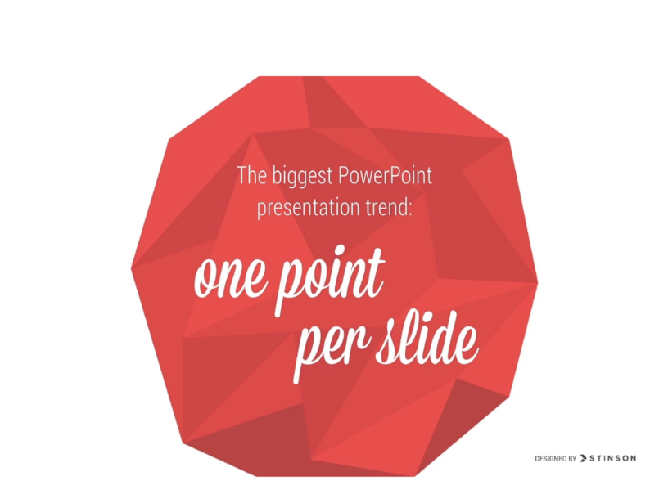
Marina Crihana
2112988
Key Points
No read, to hear speech more important
Keep the attention on you
Quickly digest information
Focus on the point
Too much will bore and overwhelm
Why?
References :
2021 Slide Player.com Inc
TedxStockholmSalon with David J P Philips How to avoid Death of Power Point

Slide 6

SIZE
Main title must be smaller size than the content to control people attention on the main object
The most important object should be the biggest
Angel Stoyanov
2106796

