Slide 1

Myth
SEE SACRED SKIES MYTH FEB 2021
Nick Campion

Slide 2
The reason for the topic
We talk about sky myths in every culture.
The myths of the Greek and Roman celestial deities are a staple part of western culture.
Early New Eastern astrology was connected to the stories and personalities of the celestial deities.
Some modern western astrologers use ancient myths in order to construct astrological meaning.
Sky myths – see Bernadette
Is there a connection between the emergence of astrological meanings of the planets and the myths of those planets?
The study of myth is very much an inter-disciplinary one, involving amongst others anthropology, psychology, philosophy, literature, theology, sociology and the history of religion.
Myth
can refer to something that may be true
or may not be true,
it can mean something that needs to be debunked,
it can be a reference to the stories or narratives associated with mythology (as the telling of myths) and an ancestral past,
but it can also refer to a contemporary cultural phenomena, like the urban myth.
NB

Slide 3
Can we define myth?
‘Unpacking the self-contradictions contained in that single term has taxed the strength of generations of thinkers.’
Glenn W. Most, From Logos to Mythos in From Myth to Reason: studies in the Development of Greek Thought, ed. Richard Buxton. (Oxford: Oxford University Press, 1998) p.44.
‘Myth is characterized by its suitability for telling and retelling...Its themes are often surprisingly constant, in spite of the many fantastic and paradoxical motifs that shape its unmistakable identity; even though slightly distorted, they return again and again.’
Walter Burkert, Homo Necans The Anthropology of Ancient Greek Sacrificial Ritual and Myth, pp. 31-32]

Slide 4
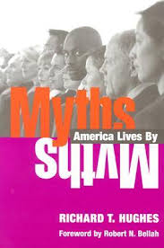
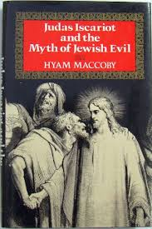
General Considerations
Getting Away From the Esoteric
The Myth of the Chosen Nation
The Mythic Dimensions of American Capitalism
Are myths benign?
The Myth of Jewish Evil
Can Myths Concern Anything?
Wolmar, Christian, ‘The Myth of Driverless Cars’, Transport Network, 14 March 2018, https://transport-network.co.uk/The-myth-of-driverless-cars/14901 [accessed 19 March 2018]

Slide 5
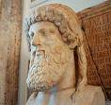
Myth in Plato: Mythos and Logos
Plato distinguished between two modes of understanding and describing inner and outer realities:
mythos – relying on intuition and imagination –
logos – relying on logic and reason.
Therefore myth is one mode of understanding
Plato, Republic, Book X.
Fowler, Robert, ‘Mythos and Logos’, Journal of Hellenic Studies, 2011, Vol.131, p.45 JSTOR
See also Albert A. Anderson, ‘Mythos, Logos, and Telos: How to Regain the Love of Wisdom’, in Albert A. Anderson, Steven V. Hicks, and Lech Witkowski, Mythos and Logos: How to Regain the Love of Wisdom (Rodopi, 2004), 61-74]
This perception of dual modes of perception and expression, is reflected in Stanley J. Tambiah’s distinction between participatory and causal thinking. Causal thinking is defined by Tambiah as the
‘rules and methodology of positive science and discursive mathematico-logical reason’. Participatory thinking is lateral rather than linear and relies on intuitive association rather than causal progression. Myth is thus a way of understanding which works by analogies and sympathies rather than by a preconceived notion of objective ‘truth’.
Stanley J. Tambiah, Magic, science, religion, and the scope of rationality (Cambridge: Cabridge University Press, 1990)].
(page number missing)

Slide 6
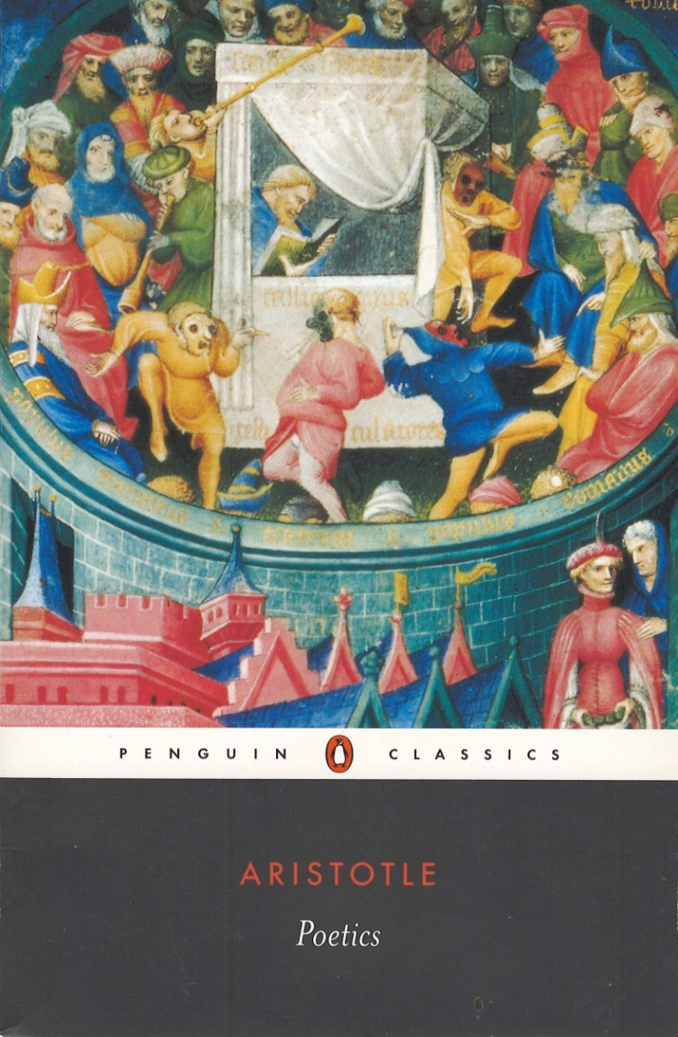

Myth in Aristotle
Aristotle (284-322 BCE) was the first philosopher known to have analysed fictional narratives – ie Greek theatre.
In the Penguin Classic translation by Malcolm Heath, mythos is translated as plot.
Aristotle identifies different kinds of plot, such as tragedy, comedy, epic (Poetics chap 3)
and different components of a plot, such as astonishment (unexpected events which arouse fear, pity, and are more powerful because they contradict a prevailing belief that things happen because they have a purpose); reversal (an unexpected turn of events or plot twist); recognition (when a plot development is explained or understood) or suffering (Poetics chap 6).
Aristotle, Poetics, trans. W. Hamilton Fyfe (Cambridge, Mass., London, Harvard University Press 1927), online through the University Library

Slide 7
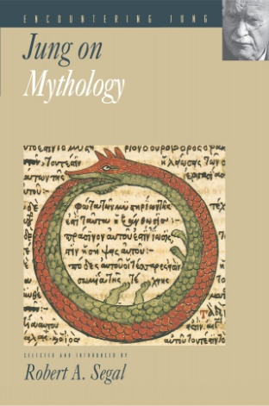
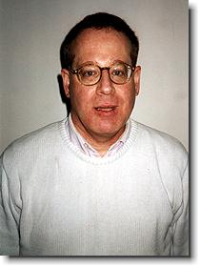
Robert Segal: Origins and Function
Meaning :Greek mûthos, report, tale, story, narrative, plot.
Robert Segal: there are at least three questions that can be asked of myth.
1 what is its origin?
2 what is its subject matter? (in common understanding involves superhuman beings, beings with strange powers, gods and goddesses)
3 what is its function?
Robert A. Segal, Myth, A Very Short Introduction. (Oxford: Oxford University Press, 2004), p.2.
To the question of origin Segal offers two answers:
1.diffusion: ‘Diffusion means that myths originate in one society and spread elsewhere’.
2.independent invention. ‘Independent invention means that every society invents myths on its own.’
How do we explain independent invention of similar myths?
Robert A. Segal, Jung on Mythology, (Princeton: Princeton University Press, 1998) p.13.
EG Flood Myths; catastrophe myths
Meaning.
(Greek mûthos, report, tale, story, narrative, plot).

Slide 8
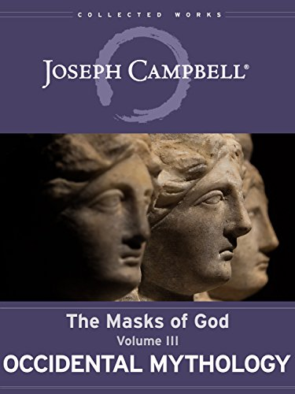
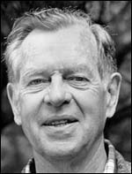
Joseph Campbell
Joseph Campbell, Masks of God, Chapter 1, Experience and Authority, p. 4-6, The function of myth.
1)"to reconcile waking consciousness to the mysterium tremendum et fascinans* of the universe as it is",
2) "to render an interpretive image of the same",
3) "enforcement of moral order",
4) "to foster the centering and unfolding of the individual.
*Enchantment
‘Myth is thus a vital ingredient of human civilization; it is not an idle tale, but a hardworked active force; it is not an intellectual explanation or an artistic imagery, but a pragmatic charter of primitive faith and moral wisdom.’
Joseph Campbell, Masks of God, Chapter 1, Experience and Authority, p. 4-6
See also Scarborough, Myth, p.17.
Campbell is very influential culturally, but he was not an original scholar: he was a brilliant synthesiser of other scholars work. His influence lies not in his scholarship but in his power to shape popular thought.

Slide 9
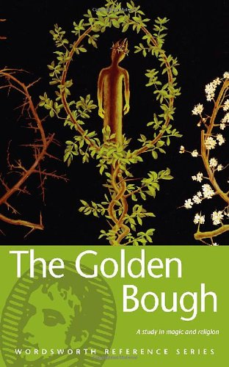
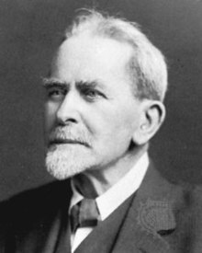

Theories of Origin: Myth as ‘Proto’ or ‘Bad’ Science
Late 19th-century historical-anthropological understandings of myth assume that myths are narratives developed to provide explanations for biological and natural phenomena and experiences that are inexplicable to a pre-modern mentality.
Myth was viewed as ‘bad science’ by James Frazer (1854-1941) in his seminal work, The Golden Bough: myths are ‘primitive’ explanations of natural phenomena which can now be correctly understood through scientific knowledge (e.g. the Greek myth of Kore/Persephone and Hades as an ‘explanation’ of the cycle of the seasons).
Jonathan Z. Smith points out that the notion of myth as ‘bad science’ still lingers in the academic world. (Drudgery Divine: On the Comparison of Early Christianities and the Religions of Late Antiquity, London: School of Oriental and African Studies, University of London, 1990, 128)

Slide 10
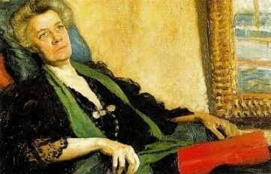
Jane Harrison: Myth and Ritual Theory (action precedes story)
The ‘Cambridge Ritualists’ of the early 20th century – Jane Ellen Harrison (1850-1928), Gilbert Murray (1866-1957), and F. M. Cornford (1874-1943) .
Assumed that ritual preceded myth,. In turn, myth provided a narrative to explain and sanctify ritual actions rooted in earlier, more primitive responses to basic human experiences such as birth, puberty, sexual union, and death.
For example, Jewish Passover myths Christian myths about the death of Christ are stories which were accumulated around rituals of death and rebirth (and in these examples related to the spring equinox)
Strongly influenced by Frazer and Edward Burnett Tylor (1832-1917),
Receptive to Theosophical ideas circulating at the time, and postulated a kind of ‘ur-religion’, or primal form of religion practised in pre-history. She viewed the rituals of the ancient Greek world as 'primitive‘ ways of negotiating with fear of spirits, of death, and of the gods.
Believed that, beneath the surface themes of early Greek poets such as Homer, Hesiod, lay the basis for the earliest forms of ritual, whose original purpose or intent had been forgotten.
Ritual is ’…a stratum of religious conceptions, ideas of evil, of purification, of atonement, ignored or suppressed by Homer...It is this substratum of religious conceptions, at once more primitive and more permanent, that I am concerned to investigate.'
In other words, myth follows ritual and provides it with a sophisticated theology, but ritual is essential, primitive, and concerned with the most basic mysteries of human life.
Jane Harrison, Prolegomena to the Study of Greek Religion (Cambridge U Press, 1903), vii-viii]
''The first preliminary to any scientific understanding of Greek religion is a minute examination of its ritual.'
(Harrison, Prolegomena, vii)

Slide 11

Myth and Ritual: Alternatives
Ritual emerged out of myth
Ritual and myth develop together
The telling of myth is itself a ritual:
Ingvild Gilhus suggests that mythic narratives are themselves rituals, and that the recitation of Gnostic cosmological and cosmogonic myths in the first centuries CE were intended to invoke and sustain a process of change and transformation in the listener: a process that occurs ‘on the psychological level’. Myth is thus neither an explanation for ritual, nor a form of ‘bad science’, but is itself a ritual intended to induce an ‘altered state of consciousness’.
Ingvild Saelid Gilhus, ‘Gnosticism: A Study in Liminal Symbolism’, Numen 31:1 (1984), 110] JSTOR

Slide 12
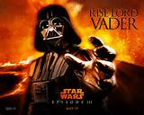
Structure in Mythic Narratives
A number of theorists have identified structures in which mythic narratives progress through standard sequences.
The first was Aristotle in his Poetics.
Jane Harrison’s sequence of mythic stages, which she believed formed the basis of both ritual and Greek
tragedy, include:
1) an agon (Contest), the year-god or solar divinity against his enemy, light against
darkness, summer against winter);
2) a pathos or sacrificial death;
3) a Messenger (whose arrival announces the death of the year-god to the shocked community);
4) a threnos (lamentation), which invokes paradoxical emotions among the community, since they know that the death will lead to a rebirth;
5) a theophany, discovery, or recognition; and
6) a resurrection or apotheosis of the year-god.
See Jane Harrison, Themis
These stages were reformulated and elaborated by Joseph Campbell in The Hero with a Thousand
Faces (Princeton University Press, 1949) as the ‘monomyth’ of separation, initiation, and return: the
archetypal stages of the solar cycle lying behind every mythic narrative of the hero’s journey.
Campbell was consulted by George Lucas in the making of Star Wars
The ‘Hero’s Journey’ is then adapted to psychological astrology by Liz Greene, Juliet Sharman-Burke and others

Slide 13
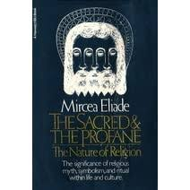
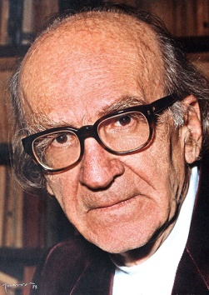
Mircea Eliade: ritual, myth and repetition in cyclical time
Cosmogony (the theory of the universe’s origin) serves as the paradigm for every subsequent creation, for every kind of action.
‘Through annual repetition of the cosmogony, time was generated and that man will seek periodically to return to that original time, the therapeutic purpose of which is to begin life again, a symbolic rebirth. This time of origin has a value and a function and is the reason why man seeks to reactualize it periodically by means of appropriate rituals or festivals, like celebrating the New Year’.
Calendar Rituals are vital examples of astrological/astronomical myth
Mircea Eliade, The Sacred and the Profane. (Orlando: Harcourt, Inc. 1959) pp.80-81.
Bryan S. Rennie, Reconstructing Eliade. (Albany: University of New York Press, 1996) p.258.

Slide 14
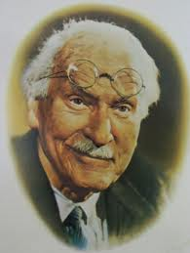
Jung: repetition of ritual time
Ritually enacted myth creates an intuitive link with an archetypal pattern, shifting the individual from the earthbound limits of a specific time, place, and identity, and generating an experience of timelessness, continuity, meaning, and immortality.
The ‘time’ at which the mythic event occurs, historical or symbolic, allows the ‘event’ to be ritually repeated as a specific action or happening
It is both specific and universal/archetypal.
Paradoxically, the mythic event, through its ritual repetition, invokes a timeless, eternally happening ‘now’ through the participation of the initiate.
Writing about the Eleusinian mystery rituals enacting the myth of Demeter and Kore/Persephone), Jung states:
‘We can hardly suppose that myth and mystery were invented for any conscious purpose…We could therefore say that every mother contains her daughter in herself and every daughter her mother, and that every woman extends backwards into her mother and forwards into her daughter. This participation and intermingling gives rise to that peculiar uncertainty as regards time…The conscious experience of these ties produces the feeling that her life is spread out over generations – the first step towards the immediate experience and conviction of being outside time, which brings with it a feeling of immortality…This leads to a restoration or apocatastasis of the lives of her ancestors…An experience of this kind gives the individual a place and a meaning in the life of the generations…At the same time the individual is rescued from her isolation and restored to wholeness.’
Jung, Collected Works Vol 9 part 1, para 316

Slide 15
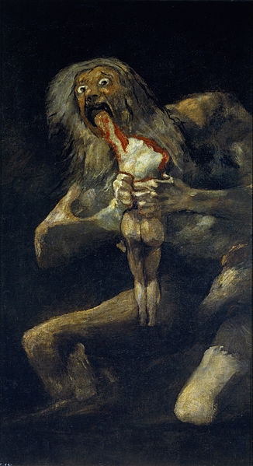
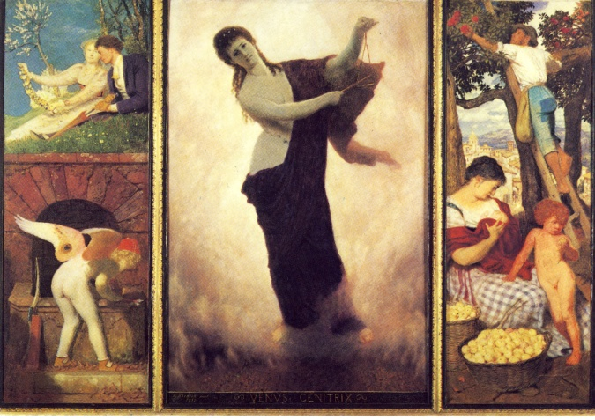
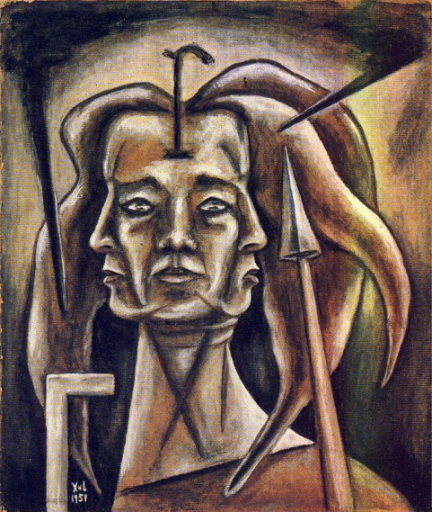
Mythic Images:
Goya: Saturn devouring his son c. 1819-23; Arnold Bocklin, Venus Genetrix, 1895; Xul Solar Sagitaria, 1952.
Mythic images vary according to cultural context and individual predisposition.
For example, Saturn in Gnostic cosmology is represented as a lion-headed serpent, Ialdabaoth. Astrological portrayals of Saturn vary across the centuries.
The myth of Saturn eating his children can be visually portrayed in many ways and used in many contexts, including Goya’s savage vision of Saturn as the best possible representation of the inner meaning and dynamic of the Spanish civil war.
If we adopted a Platonic/Jungian archetypal perspective, we might say that the individual artist or writer resonates with particular aspects of a myth and perceives the myth enacted in the outer world or within the human psyche.

Slide 16
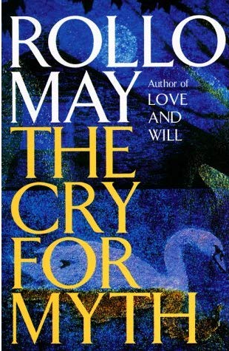
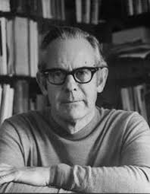
Is Astrology a Myth?
Rollo May, the psychiatrist and author, considered (a) astrology’s nature as myth and (b) its appeal and function as myth, He wrote
‘Astrology is a myth and requires the language of myth. It has both the shortcomings and the positive effects of myth’.
But he also bemoaned the directionless, frantic people who, at the end of the twentieth century, were flocking to cults, longing for relief from the guilt and anxiety of their lives, searching for something to fill the vacuum in their souls. Such people, he suggested ‘also beg guidance from astrologers’. Myth, he argued, fulfils a vital need. Hence the title of his book – The Cry for Myth.
May, Rollo, The Cry for Myth, New York: Delta, 1992, p. 22.
Is astrology a myth? IE is the claim that works/is valid/is helpful a myth and therefore false. Or is it a myth in the sense that it contains deep truths. Or does it make use of myths

Slide 17
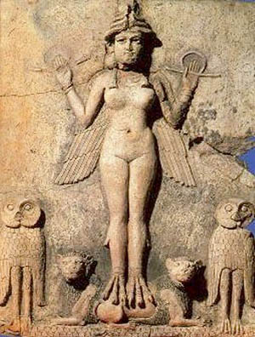
Sky/Astronomy/Astrology and Myth
Cosmological and cosmogonic myths usually involve anthropomorphised narratives about the heavenly bodies and the fixed stars.
These myths usually also include anthropogony: the emergence, creation, and fate of humans in relation to the heavens and heavenly bodies.
All the planets in Babylonian astrology were associated with goddesses and gods whose lives were described through epic narratives.
Some can be clearly related to astronomical phenomena.
Eg Venus’ periodic disappearance from the night sky when it is close to the Sun is dramatised in the story of Ishtar’s descent to the underworld.
(Bucellati, Giorgio, 'The Descent of Inanna as a Ritual Journey to Kutha?', Syro-Mesopotamian Studies, Vol 4, issue 3, Dec 1982, Undena Publications, Malibu, pp. 3-8.
http://128.97.6.202/EL2/Buccellati_1982_Descent_of_Inanna_as_a_Ritual_Journey_to_Kutha%20-%20SMS_4.3.pdf)

Slide 18
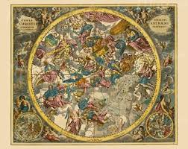
Astronomy/Astrology and Myth
In the ‘western’ tradition of astrology the plot is contained within interlocking interpretations of planets, star and sign positions.
Manilius, Astronomica,
2.265: ‘The signs also enjoy power in their special seasons; winter begins with the Archer’, etc.
4.560: ‘As for the Archer, when the foremost portion of his cloak rises, he will give birth to hearts renowned in war and will conduct the conqueror, celebrating great triumphs in the sight of all, to his country’s citadels. Such a one will build high walls one moment and pull them down the next. But if Fortune favours them too generously with success, the mark of heaven is to be seen on their faces, for she works cruel havoc upon their features. So it was that a dread warrior [Hannibal] paid for his victories a the Trebia, Cannae, and the Lake, even before the hour of his retreat, with such disfigurement. [Hannibal lost an eye].
Does this single passage contain a mythic structure?
Pagan mythology enjoys a revival in European culture in the Renaissance.
Analytical and archetypal psychologies involved with astrology often use myths as a technique of ‘amplification’, i.e. myths provide a meaningful narrative through which a planetary symbol should be understood on an intuitive, non-rational level as a dynamic rather than a static factor.
Andreas Callarius (c. 1596–1665) Star Map – visual stories?

Slide 19
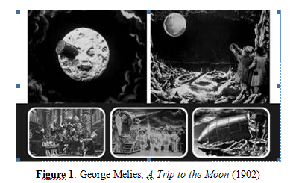
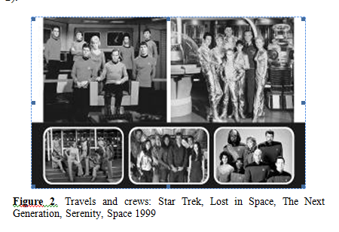
Up to date: film
Beatriz García, Estela Reynoso, Silvina Pérez Alvarez and Raúl Gabellone, ‘Inspiration of astronomy in the movies: a history of a close encounter’, eds. Nicholas Campion and Rolf Sinclair, Culture and Cosmos, Vol. 16 nos. 1 and 2, 2012, pp. 357-371.
http://www.cultureandcosmos.org/pdfs/16/Garcia_et_al_INSAPVII_Astronomy_in_the_Movies.pdf

Slide 20
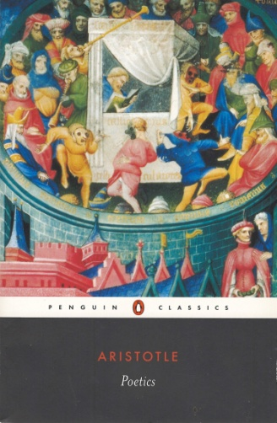
Questions and Reading
How do we see sky phenomena represented, described and embodied in myths (stories, narratives, plots) in literature, oral traditions, visual arts, film etc…
What is the use, function and structure of sky, star and planet myths?
Reading:
See the reading this week on Moodle
Search the web for primary sources
Check JSTOR
Search for the University library using words such as ‘myth, ‘sky’, ‘function’, ‘structure’, ‘purpose’.

