Slide 1
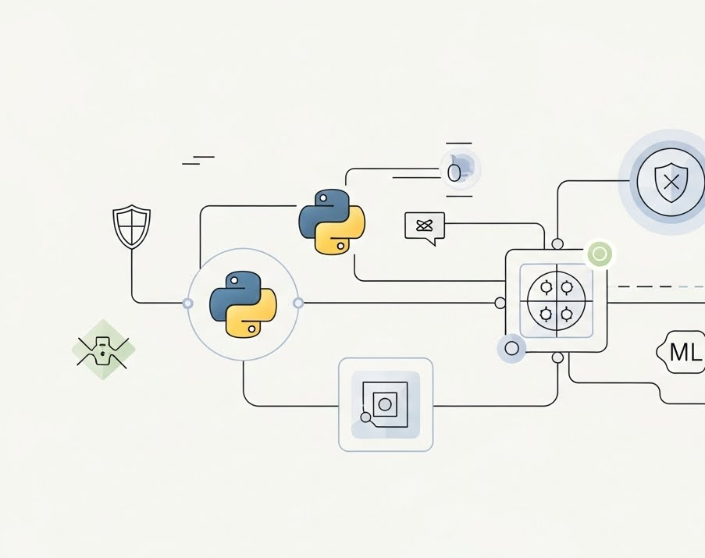
Automated Python-Based Cyber Threat Intelligence Framework Using Machine Learning
STUDENT ID : 2437474
STUDENT NAME : PARTH KUMBHANI
Module : Research Methods and Professional Development

Slide 2
Introduction
Online surf increases the attack surface of organisations
Conventional defences becoming less and less effective [1]
Fragments of broken alerts suffixate SOCs [2]
ADWs developed in terms of secrecy and sophistication [3]
Reactive defence is no longer effective
Requirement of intelligence-Governed CTI
Notes:
The modern cyber security environment has experienced a high rate of change because of enhanced digitalisation, cloud systems, and development of interconnected systems. This has resulted in much larger attack surfaces that subject organisations to an increased threat range. Conventionary firewalls, signature-based threat detection methods are becoming more and more ineffective [1] due to their tendency to depend on familiar patterns of threats and fail to react to changing methods of adversarial activity. Security Operation Centres (SOCs) are further burdened with excessive alerts, disjointed intelligence data, [2] and the technical issue of how to identify significant threats and the background noise. This complexity is increased by the emergence of high-level persistent threats (APTs) [3], which do so by stealth, persistence, and intent. Reactive defence models are no longer adequate in such environment. The organisations currently demand proactive information, intelligence-oriented effects that combine various threat information, aid in the timely detection and ensure robustness against advanced cyber attackers.

Slide 3
Problem Context
Too many CTI false alarms
Multi-feed correlation at a low rate
Proactive as opposed to reactive
Considerable and varied threat datasets
Inconsistency of manual analysis [4]
Demand to automatize and scale
Notes:
Although its relevance is increasing, there are severe operational and analytical constraints to the current Cyber Threat Intelligence (CTI) practice, which limit its usefulness. Most CTI systems produce lots of false positive [4], which overwhelm the analyst and hides real threats that must be taken urgent care of. The various feeds of the same intelligence are not always fast and reliable because they differ in the form of data, their quality as well as the detail of the context [5]. This has meant that the organisations are mostly reactive and therefore react to threats when the indicators are found instead of predicting the emergence of new pattern of attack. Moreover, the number and variety of threat data, including network logs and open-source intelligence, become huge burdens to manual analysis. Major part of the CTI processing remains a matter of human estimation [6], and is therefore inconsistent, time-consuming and prone to cognitive overload. These structural constraints raise the awareness of automated, scalable, predictive methods of CTI that will be able to aid faster, more precise decision-making of contemporary security work.

Slide 4
Research Problem Statement
ML used but still limited
Rape generalization
Noisy datasets of CTI in small sizes [5]
Poor time performance [6]
None of the integrated Python CTI pipelines
Requirement built-in identification + forecasting
Notes:
Despite the continued adoption of machine learning in Cyber Threat Intelligence (CTI), the current applications continue to have significant limitations that limit their efficiency at work. Most models face significant problems with inability to generalise [7] and they can effectively predict based on the training data but cannot detect new or changing dangers. The lack of available high-quality and labelled datasets can include this issue, and the existence of noise and inconsistencies in real-world intelligence sources can further increase this challenge [8]. Moreover, the majority of machine-learning-based CTI systems are not real-time [9], which means that it requires time to detect an actor and cannot be useful in situations associated with fast-moving threats. More importantly, the literature shows that there is no comprehensive, fully automated Python-based CTI pipeline that can consolidate various intelligence feeds [10], which will be preprocessed in a scalable way, and which both detects and predicts in an integrated system. This lapse indicates the necessity of a CTI architecture which is more powerful, more data driven to augment automation, accuracy, and response of its operations.

Slide 5
Research Aim
Establish computerized CTI infrastructure
Python based intelligence pipeline
Include use of machine-learning techniques
Improve detection accuracy
Availability of foresight (threat analysis prediction)
Improve correlation and response
Notes:
The main task of the study is to plan and create an automated Cyber Threat Intelligence (CTI) architecture based on Python processing and machine-learning functionality [11] to increase the precision, effectiveness, and intelligence of the threat-identifying exercise. In this study, the authors aim to break the common reactive practices and instead combine them with predictive features that can be used to foresee the emerging trends of malicious activity [12]. The proposed framework will enhance correlation of various threat datasets in a single automated pipe, minimizing the cost of false positives, and providing the Security Operations Centres with improved information on how to respond timely and appropriately to incoming intelligence. By doing so, the study aims to show how a machine-learning-endowed data-driven architecture can help organisations to be more resilient to cyber threats and add to the future train of CTI practices.

Slide 6
Research Objectives
Examine the current CTI restrictions
Preprocess and collect CTI data
Training of ML detection model
Performance in train and test model
Evaluate using key metrics
Propose automated CTI structure
Notes:
The research aims are well-designed and arranged in a way that the goal of creating an automated machine learning-enabled CTI framework is achieved in a systematic approach. The former aims at critically assessing the currently available CTI systems to determine weaknesses in its workings, including false positives, poor prediction [13], and slow correlation. On this basis, the second aim will be to extract and preprocess varieties of diverse CTI data in Python in order to provide high quality and structured inputs in modelling. The third goal will focus on the creation of a machine-learning model that will identify and forecasting threats with better precision [14]. The fourth goal presents stringent assessment where accuracy, precision, recall, F1-score and ROC-AUC are used to evaluate the performance of the model. Lastly, the fifth objective summarises these results into a proposed automated CTI framework that can be implemented into the SOC and SIEM infrastructures. The combined effect of these objectives constitutes a logical line on the way toward defining a problem and achieving its practical application.

Slide 7
Literature Review Themes
Four types of CTI summarize [3]
Underlying analytical models in CTI [2]
MISP and OpenCTI platforms
Threat enrichment made with SIEM
ML in CTI automation
NLP and outlier detection [6]
The behavioural modelling develops
Notes:
The literature review marks the extent and development of Cyber Threat Intellection, in terms of explaining its fundamental classifications, analytical frameworks and technology developments. CTI is frequently categorised into strategic, operational, tactical [3] and technical sectors, which deal with various organisational decision-making levels. The basic models like MITRE ATT&CK, the Diamond Model, and the Cyber Kill Chain [2] are structured methods of knowing the adversary behaviour, tracing attack patterns, as well as assisting threat-hunting. More important CTI platforms that are reviewed are MISP and OpenCTI and how SIEM systems are used in enhancing and correlating intelligence. The recent trends revolve around the growing application of machine learning and automation, whether it is natural language processing to extract indicators or the modelling of behaviour [8] or the detection of anomalies [15]. All these themes point to the increased requirement of systemic, data-based CTI solutions that will be able to facilitate proactive and scalable defence measures.

Slide 8
Research Design
Design Science Research methodology
Refinement of the development process
Real-world CTI problem focus
Design/implementation of artefact
Evaluation using ML metrics
Refinement based on results
Scientific practical CTI solution
Notes:
The research methodology applied is Design Science Research (DSR), which has been a proven approach to development and testing of technological artefacts, resolving real-world challenges. Cyber Threat Intelligence is particularly the right tool to apply DSR to since the challenges inherent in CTI include automation gaps, messy data, and slow analysis; means that an innovative [16], but nonetheless, practical solution is developed as opposed to conceptual exploration. These cycles of the methodology start out with the problem identification making sure that the research is based on the actual operational requirements. The next step is a development of artefacts, and the automated Python-based CTI pipeline is developed and implemented. This artefact will go through an extreme assessment with machine-learning performance metrics and working applicability standards applicable to SOC processes. However, evaluation provides insight into subsequent refinement to provide continuous improvement and strength. DSR through this iterative process facilitates the development of a CTI framework that is scientifically proven and operationally effective bridging the academic research and the operational cyber quality defence.

Slide 9
Research Gap
Manual CTI analysis is not very efficient [4]
Threat feeds are not structured siloed
The lack of correlation background
ML models that are noise-sensitive
Debilitations in generalising to new threats
No combined intelligent pipeline
Require CTI automation that is scalable
Notes:
The available literature has shown that there are severe gaps in the literature that put together constitute the basis of the research gap. The current CTI practice uses much of the manual analysis [6], which is, by nature, slow, inconsistent, and incapable of scaling to the exponential rate of cyber threats generated. OSINT threat feeds, commercial sources, and community-based sources tend to be in an unstructured format, siloed, and not enriched with contextual information, which limits their ability to be useful in correlation and operational decision-making [4]. Even though machine learning has been proposed in order to overcome certain of these issues, the existing models are extremely susceptible to negative feedback [7] (Kale and Thing, 2023), asymmetrical data and are prone to extrapolation to new or changed attack patterns. Notably, no literature contains the full, automated, CTI pipeline and opens up to data ingestion of multi-source data via Python-authorized habilitation, machine-learning-informed orthodox use, and predictive analytics in a single system. This lack of EL means that there is a need to have a more scalable, automated CTI architecture that can assist in real-time and intelligence-based defence [10]

Slide 10
Research Methods
Quantitative experimental research methodology
Separate datasets of MISP, OTX, CIC-IDS
The feature engineering is done using python
Compare ML algorithms
Training and testing phases
Recall, precision, F1 evaluation
ROC-AUC for model robustness
Notes:
The study has a quantitative and experimental, which is aimed at developing and testing rigorously the performance of a machine-learning-enhanced CTI framework. This starts with the systematized gathering of various datasets, including MISP, AlienVault OTX, and the CIC-IDS package [4], to be sure to access both indicators-level and behavioural threat information. These datasets are subjected to massive feature engineering where python based pre-process is applied to clean, normalise and organise the data to be analysed. The research would then dive into the implementation of various machine-learning implementations, such as Random Forest, Support Vector Machines, Logistic Regression, and Gradient Boosting [14], to identify the best model to be implemented in its detection and prediction missions. The training and testing are carried out involving the conventional methods of validation to provide quality assurance in the performance assessment. The essential measures used to quantify model effectiveness comprise precision, recall, F1-score, and ROC-AUC which provides a solid, evidence-based insight into the accuracy and the generalisation potential of the pipeline [9]. Such experimental methodology will guarantee the rigour of the methodology and the formulation of a credible CTI solution.

Slide 11
Research Materials & Tools
Analysis Python libraries
Jupyter Notebook workflow
MISP data and OSINT data [4]
CIC-IDS traffic logs
AlienVault OTX indicators
Laptop/GPU for computation
Safe data processing
Notes:
The study will be based on a series of software applications, data, and computing facilities to aid in the design of automated CTI pipeline. Python is the most likely to be the core systems environment because it has a rich set of data-science libraries, such as pandas and NumPy to prepare data, scikit-learn to implement machine-learning, and matplotlib to analyze data [17]. The entire experimentation is done in Jupyter Notebook, which supports the iterative development, clear workflows, and the reproducibility in experimentation. The literature uses a wide range of data which includes MISP threat indicators, OSINT-based intelligence feeds, CIC-IDS datasets of network traffic and an AlienVault OTX community data [6] making sure that both technical and behavioural threat data are covered. Hardware needs are also unproblematic, but by access to the GPU, more complex models can be trained faster. The whole data utilization approach relies on ethical considerations: the data utilized must be publicly available and non-personal [5], and the artefacts with potential harm are contained in controlled and isolated conditions. The above materials can be credited to provide a solid, ethical, and technically sound basis of the research.

Slide 12
Expected Outcomes
Increased detection of threat [6]
Fewer CTI false positives
Emerging threat predictive insight has been made
Quickened SOC triage
Reduced analyst workload
Evidence of better automation of CTI
Effective operational and academic influence
Notes:
It is projected that the suggested automated CTI system will provide considerable enhancements in the analytical and working power. The system will obtain greater detection accuracy by incorporating machine learning into one single Python-based pipeline, which ought to find malicious behaviours that would otherwise be missed by traditional rule-based techniques [9]. One of the expectations is that false positives will decrease [11], which will relieve analysts of loaded cases and enable SOC teams to follow a real threat [18]. The modelling of predictive aspect should help predict new emerging patterns of attacks, to help in the prior and more informed defense measures. The structure will improve triage speed, incident investigation efficiency and minimize manual work, operationally. In addition to practical contribution, the project is an academic contribution to literature due to its ability to illustrate new methods of automated CTI, combine various data types, and use strict assessment methods. Generally, the findings are placed to enhance resiliency and academic knowledge on how to counter cyber attacks that are intelligence-led.

Slide 13
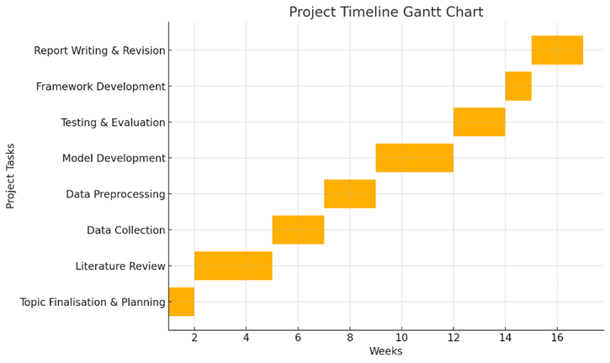
Project Timeline
The foundation of literature review
Preprocess databases and gather data
Design machine-learning models
Training and evaluation processes
Introduce better CTI framework
Full final report writing
Gantt chart: Project Structure
Notes:
The project schedule is systematic and has ordered development that will see methodological rigour and effectiveness in processes of carrying out all the research phases. It begins with a thorough literature review, which will form the theoretical basis and find the missing links that will help in the design of the CTI pipeline. The next stage is the data phase, during which informative datasets are obtained, cleaned, and pre-processed to obtain strong inputs to be used in machine-learning experimentation. The modelling phase is concerned with the implementation and optimisation of the choice of algorithm with the help of refinement processes (iterative training and testing). Evaluation stage involves the use of quantitative measures to measure performance, generalisation, and operational appropriateness. On the basis of those insights, findings are introduced by the framework phase into a better CTI architecture being in the SOC requirements. The final stage of the project is the write-up stage where the results, implications, and contributions are clearly written. This sequential process is visualized in the table that comes with the Gantt chart.

Slide 14
Conclusion
Overcomes critical CTI shortcomings
Python ML+ ML improvements detection
Automated intelligent pipeline that is scalable
Sponsors active cyber defence
Reduces SOC workload
Good academic contribution
Enhances security, which is intelligence-led
Notes:
The research proposal introduces a systematic methodology to overcome basic shortcomings of the present practices of Cyber Threat Intelligence i.e. there is a high false positive rate, sluggish correlation rate and limited predictability. Combining python based automation with machine-learning, the suggested CTI pipeline provides a scalable and data-driven solution that has the potential to enhance processing accuracy as well as functional practices. Predictive analytics feature in the framework allow organisations to pursue more proactive defence measures and gives them the ability to anticipate and respond to emerging threats instead of only responding to signs that they already know about. In addition to improvements in operations, the research has an academic contribution in order to develop methodological knowledge of automated CTI, prove the efficiency of data integration, and implement strict evaluation indicators. On the whole, the proposal will provide a line of research that will add significant value to the industry and research through enhancing intelligence-led cyber defence.

Slide 15
References
[1] P. R. J. Trim and Y.-I. Lee, “Advances in Cybersecurity: Challenges and Solutions,” Appl. Sci., vol. 14, no. 10, p. 4300, May 2024, doi: 10.3390/app14104300.
[2] Sushama Pawar, Yogita Khandagale, Archana Gopnarayan, and Manisha Pokharkar, “Cyber Threat Intelligence: A Comprehensive Overview and Practical Implementation,” Int. J. Adv. Res. Sci. Commun. Technol., pp. 529–534, May 2024, doi: 10.48175/IJARSCT-18179.
[3] O. E. O. Eltayeb, “The Crucial Significance of Cyber Threat Intelligence in Mitigating Cyber Attacks,” J. Ecohumanism, vol. 3, no. 4, pp. 2422–2434, Aug. 2024, doi: 10.62754/joe.v3i4.3767.
[4] J. H. Al-Yasiri, M. F. B. Zolkipli, and N. F. N. M. Farid, “Multilingual Cyber Threat Intelligence Feeds Preprocessing for Threat Intelligence Event Extraction: A Systematic Literature Review,” Karbala Int. J. Mod. Sci., vol. 11, no. 3, July 2025, doi: 10.33640/2405-609X.3421.
[5] M. Arazzi et al., “NLP-Based Techniques for Cyber Threat Intelligence,” 2023, doi: 10.48550/ARXIV.2311.08807.
[6] R. Mills, A. K. Marnerides, M. Broadbent, and N. Race, “Practical Intrusion Detection of Emerging Threats,” IEEE Trans. Netw. Serv. Manag., vol. 19, no. 1, pp. 582–600, Mar. 2022, doi: 10.1109/TNSM.2021.3091517.

