Slide 1
Medea and her connection to Hysteria
By Elizabeth Hoskins

Slide 2
Purpose of dissertation
Discover what exactly is Medea’s link to Hysteria
Is the link between Medea and Hysteria a modern concept, or is it one that has always existed?

Slide 3
Why am I looking at this?
From own knowledge of hysteria, I wanted to understand the link between Medea and Hysteria
  I wanted to understand how they were linked
  I wanted to know why they were linked

Slide 4
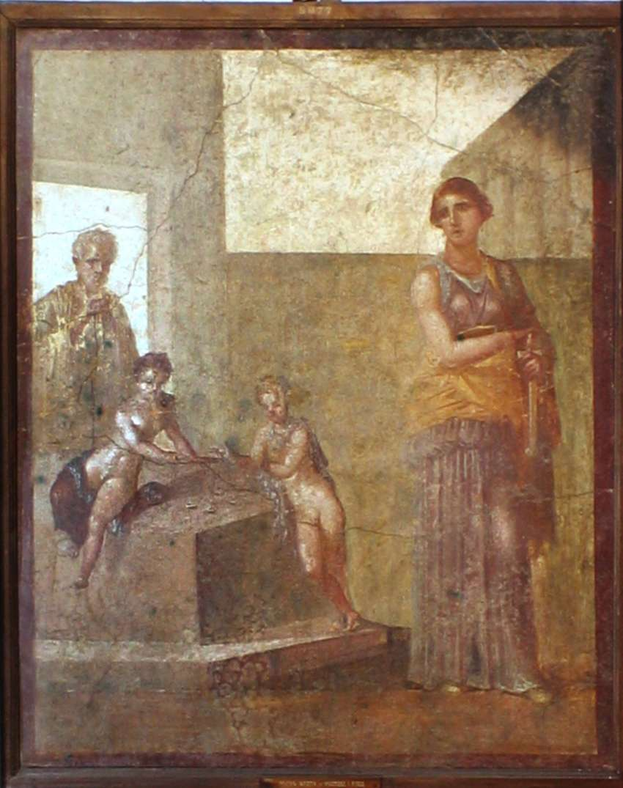
Figure 1: Medea preparing to kill her sons

Slide 5
How am I going to achieve this?
Research:
  Women
    How did women live in the ancient world?
    What was the general perception of women in ancient societies?
  Hysteria
    What is hysteria? (Then and Now)
  Medea
    Who was Medea?
    How has she has been represented throughout time?
  Medea and Hysteria
    What links have been made between Medea and Hysteria?
    How common are the two linked together

Slide 6
Problems with research
No modern source discovered that definitively links Medea to Hysteria
Putting modern concepts onto ancient texts

Slide 7
Current research

Slide 8
Women of the ancient world
Negative:
  “We should look upon the female state as being as it were a deformity though one which occurs in the ordinary course of nature” (Aristotle. Generation of Animals. 775a)
Positive:
  Plato’s Republic
    Compares the treatment of women to that of the treatment of dogs
    Encourages the same education for women that men have

Slide 9
Women of the Ancient world
“She was not considered a legally competent, autonomous individual responsible for her own actions or capable of determining her own interests”. (Just 1989:26)
  A woman was constantly under supervision of her “Kyrios” (Just 1989:26)
    1st – Father
    2nd – Husband
    3rd – Closest, and eldest male relative
In creation myths, women tend to appear after man.
  Nancy Tuana argues that woman’s nature appears to be inferior to that of man in Hesiod’s Theogony
    The creation of women comes after Prometheus’ deceit, and was Zeus’ response to being deceived
    Women seem to have been placed between “man and animal in the hierarchy of being” (Tuana 1993:6)

Slide 10
Ancient Hysteria
What is Hysteria?
  First case of Hysteria appears in the Kahun Papyrus (appx. 1900 BC.)
    Originally used to mean the movement of the womb made around the woman’s body.
    It was originally cured by placing various scented items near the mouth, nose, and vagina
    Originally evolved so that the cure involved the woman sleeping with her husband

Slide 11
Modern Hysteria
For several centuries later, Hysteria then always had some form of connection with sex
  From the 13th century until the 20th century, hysteria was believed to be female sexual frustration
In more recent years, has been linked to a multitude of mental illness
  Anxiety
  PTSD
  Phobia’s (arachnophobia, claustrophobia, ornithophobia, etc.)
  Panic disorders
Hysteria has began to fall out of use in medical terms as one specific illness or disease

Slide 12
Why DOES THIS RESEARCH MATTER?
Hysteria:
  Understand what hysteria is
  Can Medea be diagnosed with hysteria
Women:
  Understand Ancient belief’s of women
  Understand how Medea fits into the image of the average women

Slide 13
Conclusion
Future Research Plans:
  Get a better understanding of Medea, her myth, and her various representations
  Learn more on Medea’s connection with Hysteria
Current Research:
  It is possible that Medea and her link to hysteria could be an entirely modern belief

Slide 14
Bibliography
Images
Figure 1. Medea preparing to kill her sons. Museoarcheologiconapoli.it https://www.museoarcheologiconapoli.it/en/room-and-sections-of-the-exhibition/frescoes/ [Date accessed: 21st January 2018]
Ancient Sources
Aristotle, Generation of Animals. A.L. Peck (trans.). 1942. London: William Heinemann Ltd.
Hesiod, Theogony. Glenn W. Most (trans.). 2007. Massachusetts: Harvard University Press
Plato, The Republic. Francis Macdonald Cornford (trans.).1955. London: Oxford University Press
Modern Sources
CalmClinic, Hysteria is a normal Effect of Anxiety. 2009-2017. https://www.calmclinic.com/anxiety/symptoms/hysteria [Accessed: 9/12/17]
Castleman, M. “Hysteria” and the Strange history of Vibrators. 2013. Psychologytoday.com https://www.psychologytoday.com/blog/all-about-sex/201303/hysteria-and-the-strange-history-vibrators [Accessed: 10/21/17]
Hoskins, E. 2017. Hysteria and the Wandering Womb
Just, R. 1998. Women in Athenian Law and Life. London: Routledge
Tasca, C., Rapetti, M., Giovanni-Carta, M., Fadda, B. 2012. ‘Women & Hysteria in the History of Mental Health’, Clinical Practice and Epidemiology in Mental Health, 8, October, 110-119
Tuana, N. 1993. ‘Scientific, Religious, and Philosophical Conceptions of Woman’s Nature’. Indiana: Indiana University Press
Tucker, A. History of the Hysterical Man. 2009. Smithsonianmag.com https://www.smithsonianmag.com/science-nature/history-of-the-hysterical-man-43321905/ [Accessed: 9/12/17]

