Slide 1

Assessment Component 1
Time management and Critical thinking

Slide 2
Contents
Element 1 – Racing against the clock -Time management blog p3-6
Blog reference page p7
Element 2 – Critical thinking poster p8
Poster reference p9

Slide 3

Racing against the clock
Time Managment Blog

Slide 4




Racing against the clock
Introduction
We all know how fast time goes by and we are guilty of trying to get the most out of our time, often leaving little time between each task. Leading to unnecessary rushing at the very last minute. I am a self-confessed mum on the run. This morning I jumped out of bed already in a sudden rush to reach my timely morning targets with two children and two dogs in tow this often gets diverted. Whether it be " I do not want to wear this" or " mum I have spilt my cereal" each morning if different. As we scrambled to the car just in time to leave, I glanced across the road to see several of my neighbours in the exact same scenario, 'lightbulb moment' it is not just me. Now adding studying into my daily life, I need to know what is good time management and how can we
achieve it?.
Planning
When investigating time management, I found planning to be the most
important part of succeeding and being in control of our time. In his article
(Bast 2016 p71,88) 'Crux of time management for students' explains how
prioritization when planning is key when students do not prioritise,
they become overwhelmed leaving no time to unwind from Studies.
Having time off from studying can reduce stress overall effecting academic
outcome. Bast uses the theory of urgency over importance. This concept
originated from Dwight Eisenhower.
This Photo by Unknown author is licensed under CC BY-NC-ND.

Slide 5
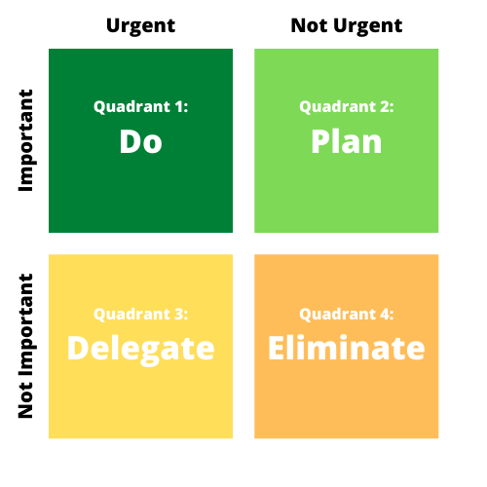
In their blog History of the Eisten Hower Matrix ( Peforny) they inform us that Eisenhower was the 34th Us President during his run as president in 1953 he developed the structure of the table known as the Eisenhower matrix to help regulate time management when running the country. This can be used for studying and in everyday life. This will make targets far more achievable.
Other Techniques
Alongside planning there are many other ways to ensure time management is supported in her Study Skills Handbook (Cottrell,2019,p145) explains how to manage procrastination and distractions. I know easier said than done but Cottrell explains how to use your distractions to your advantage such as her 'study on the move' method it advises the learner to think on the move for example if you spend ten minutes researching or reading about your topic and still feel the need get up proceed with a distraction e.g., housework, then do it but lock it in and repeat it in your mind and make mental notes. In my opinion this is a fabulous idea I will soon be loading the dishwasher reciting my notes but, in her book Cottrell uses a controversial opinion on using your distractions as a resource such as using your phone to text and talk about your relative topic rather than just everyday conversations, To me this is impossible I know having my phone there chatting to my friend it is inevitable we will be diverted from the topic and before I know it an hour will pass and we will have discussed 55 ways to get our children to eat healthy foods. This will never work for me, but I can see why it would work for students with friends with the same interest and for people who need reassurance or students that are isolated and need conversations to motivate them and keep them going. On the other hand, in his article (Russell 2019) shares with us the effect that smartphones can have on us when we are studying. He has found that in a study made by Dr Adrian Ward along with Kristen Duke and Ayelet Gneezy from the University of San Diego and Maarten Bos with Disney Research they experimented the theory and found that students with access to their phones during a task had the lower results compared to those who didn’t have phones with them at all even just having it near screen side up was still affecting them.
History of the Eisten Hower Matrix (Perfony)

Slide 6
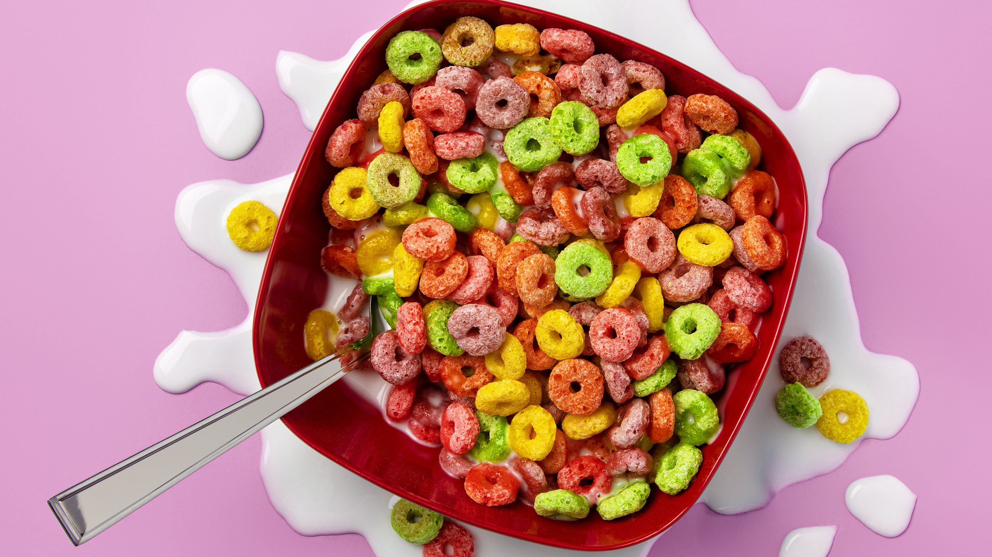
Conclusion
Taking all this information onboard do I as a university student think I am able to manage time to my advantage. Yes, I do. It is not about being able to manipulate time because we simply cannot add hours on to our day but taking action and control of our circumstances allowing us time to breathe as well as be organized and structured, adjusting our surrounding and techniques to suit our individual needs.
As Antoine De Sante once quoted ' A goal without a plan is just a wish' (De Sante 1943) And I plan to reach my goal, I will no longer race the clock but stride alongside it. Will my mornings dramatically change, maybe not but I have got this. Do you have what it takes? With the right planning and techniques your possibilities are endless.

Slide 7
References
Bast,F. (2016) 'Crux of time mannagment' New Delhi: Springer India; Resonance, Vol.21 (1), p.71-88
Cottrell,S. (2019)The Study Skills Handbook. 5th edn. London: Red Globe Press
De Sante, A. (1943) 'Le Petite Prince'. United States: Reynal & Hitchcock, Blurb
Perfony. History of the Eisten Hower Matrix. Available at: History of the Eisenhower Matrix - Perfony (Accessed: 17 October 2023)
Russell.B (2018) 'The effects smasrtphoones on Studying' Texas undergraduate College News.
The Effects of Smartphones on Studying | TEXAS Undergraduate Studies (utexas.edu)

Slide 8
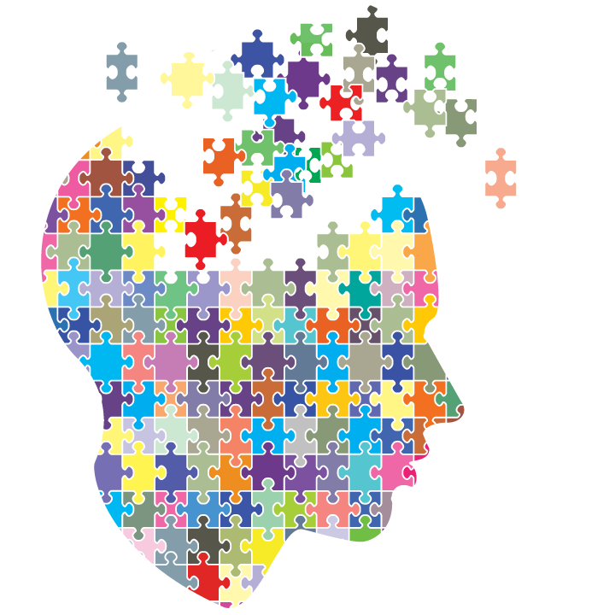
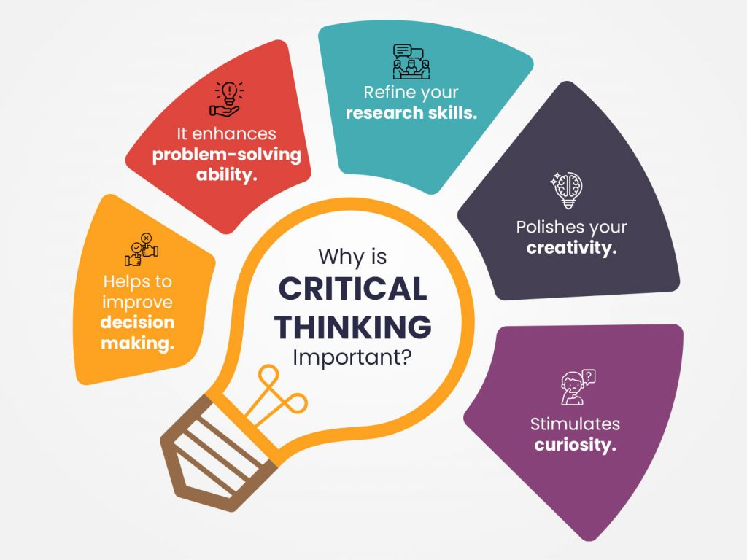
How can you become a critical thinker?
It's Critical to think!
How to become a critical thinker.
1.Formulate your question
2.Gather your information
3.Apply your information
4.Consider the implications
5.Explore other points of view
"Critical thinking is the art of making clear, reasoned judgements based on interpreting, understanding, applying and synthesising evidence gathered from observation, reading and experimentation." Burns and Sinfield (2016) p94.
(Agoos)2016
5 ways to improve your critical thinking
"Critical thinking is far less about our problem solving and much more analysing our thinking, finding the flows in it and becoming good thinkers". (Roland 2018).
Why does critical thinking matter to a learner?
When it comes to learning our brain automatically thinks of the easy route simply because sometimes, we are set in our ways but being able to think critically as a leaner is crucial to our studies it ensures we work is more in-depth. Allowing the ability to break down research and understand both perspectives of an argument. Making self-opinions devised. Allowing one's mind to open and absorbing information that is an important part of studying despite not being opinion.
STOP!
Stop and think for awhile, do not only look at your side of the story.
Quarry(2019) explains that there are not always two ways to solve a problem.
Avoid confirmation bias listening to facts that support our own opinion but being aware of other possibilities.
Switch off those emotions, take deep breaths before you react, clear your mind.
Think rationally and logically, emotions are only natural but make sure they are for the right intention.
Take the time to research reliable information and data that doesn’t only support your theory but others to.
Be open minded possibilities are endless a
What is Critical thinking?
Cottrell (2019) explains Critical thinking is allowing yourself to have a detective-like mind, encouraging us to think and use the wider picture rather than looking for shortcuts and easy answers. Critical thinking ensures you open your mind to all possibilities even when your own opinion feels so strong. Keep asking yourself 'Why' allowing yourself to look at all situations, learning and arguments from a different perspective, thinking critically and fairly.
The Benefits of Critical thinking and how to develop it. (2023)

Slide 9
References
Agoos,S.(2016) 5 tips tips to improve critical thinking [video]. Available at: (1) 5 tips to improve your critical thinking - Samantha Agoos - YouTube ( accessed:17 October 2023)
Burns, T., & Sinfield, S. (2016)Essential Study Skills: The Complete Guide to Success at University (4th ed.) London: SAGE, p94.
Cottrell,S.(2019) The Study Skills Handbook. 5th edn. London: Red Globe Press
TSCFM(2023)The Benefits of Critical Thinking and How to Develop it (illus) https://tscfm.org/wp-content/uploads/2021/04/why-is-critical-thinking-important-1024x768.jpg ( accessed on 15 October 2023).
Quarry,P. (2019) 3steps to critical thinking [video]. Available at:3 Steps to Critical Thinking - Alexander Street, a ProQuest Company (uwtsd.ac.uk) (acsessed:17 October 2023)
Rowland,D.(2018) Penny for your Critical Thinking Thoughts?[video]. Available at:Penny for Your Critical Thoughts? | Darcy Roland | TEDxNewport - YouTube (Accessed on:27th October 2023).

