Slide 1
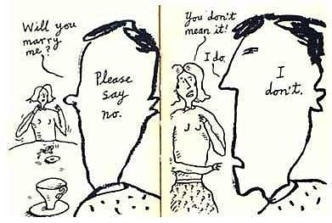
HPEN 4004 The Language(s) of Persuasion
Communicating
advertising: the language that sells

Slide 2
Aims & Learning Outcomes
AIM(S)
To introduce students to an understanding of the mechanisms of persuasion employed by powerful interests, from ideological propagandists to fake news sites, conspiracy theorists and more
LEARNING OUTCOMES
Upon the completion of this module, the student should be able to demonstrate the ability to :
deploy critical literacy skills both in reading the work of others and in their own writing
recognise and critique techniques of emotional manipulation used in the language of exploitative ideologies or persons

Slide 3
Communication: key to all writing
It is insight into human nature that is the key to the communicator's skill. For whereas the writer is concerned with what he puts into his writings, the communicator is concerned with what the reader gets out of it. He therefore becomes a student of how people read or listen.
William Bernbach (US businessman & forerunner of modern advertising campaigns

Slide 4
Identifying patterns & being sensitive to possible threats
All of us have suspicious minds – and for good reason. Identifying patterns and being sensitive to possible threats is what has helped us survive in a world where nature often is out to get you:
“Conspiracy theory books tend to come at it from the point of view of debunking them. I wanted to take a different approach, to sidestep the whole issue of whether the theories are true or false and come at it from the perspective of psychology … The intentionality bias, the proportionality bias, confirmation bias. We have these quirks built into our minds that can lead us to believe weird things without realising that’s why we believe them. ”
“If you ask a young kid why somebody sneezed, the kid thinks that they did it on purpose, that the person must really enjoy sneezing. It’s only after about the age of four or five that we begin to learn that not everything that everybody does is intended. We’re able to override that automatic judgment. But research shows that it still stays with us even into adulthood.” Rob Brotherton, Suspicious Minds, Bloomsbury Sigma, 2015

Slide 5
What’s the wildest conspiracy theory you have come across?
One of the most kind of colourful and extensive is [that of] David Icke. He says for example that the moon is hollow, that it is an artificial spaceship and the rings of Saturn are a broadcast device beaming mind control waves to the moon which amplifies them and sends them down to Earth.and colours or shapes, distorts our perception of reality so that we are all kind of living inside a hologram. It just goes on and on - he has an answer for absolutely everything. It is fairly implausible, I think it is fair to say. [But] as wild as it sounds it is kind of a hopeful message in a way in that it is saying: “Yes, there is a lot of stuff wrong with the world but we can put our finger on who’s responsible and what’s responsible for it and then we can do something about it.” That is appealing to a lot of people, especially those who don’t feel like they have a lot of control over their lives.
Nicola Davis, ‘Conspiracy theories: why people need to believe
that the truth is hidden out: interview with Rob Bretherton’ https://www.theguardian.com/science/2015/nov/07/conspiracy-theories-why-people-need-to-believe-them

Slide 6
Why are conspiracy theories so attractive?
"People who believe that Bush blew up the Twin Towers were mostly Democrats, people who thought that Obama faked his own birth certificate were mostly Republicans - but it was about even numbers within each party.“
There is not so much of a difference between conspiracy theorists and the rest of us. We are drawn to the idea of conspiracy because it resonates with us; we understand the idea of people being self-interested and not having our best interests at heart, and having hidden motives and getting together to do shady stuff. Conspiracy theories extend upon that and tap into these assumptions and fears we have about the world. But we all have them, that’s why conspiracy theories make sense to us all.
‘Why so many people believe conspiracy theories’, By James Tilley, Professor of politics at the University of Oxford 12 February 2019 https://www.bbc.co.uk/news/world-47144738

Slide 7
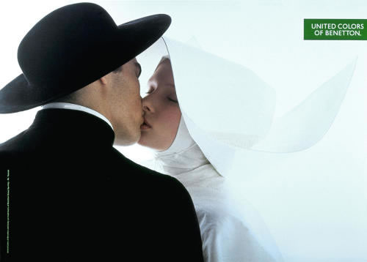
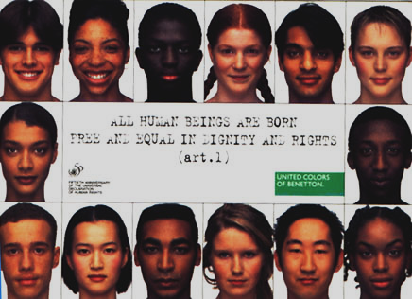
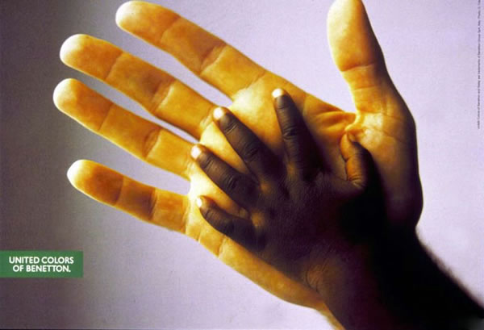
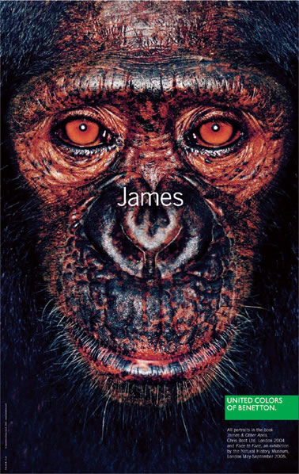
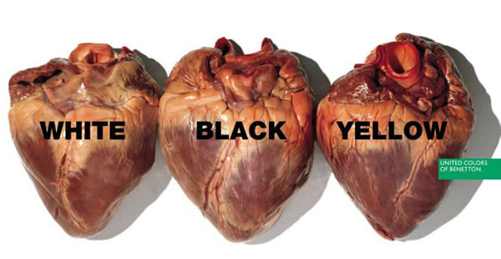

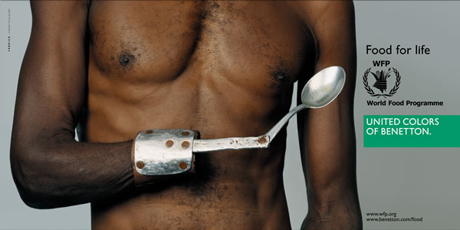
Image & subtext
https://abduzeedo.com/awesome-and-controversial-ads-benetton

Slide 8
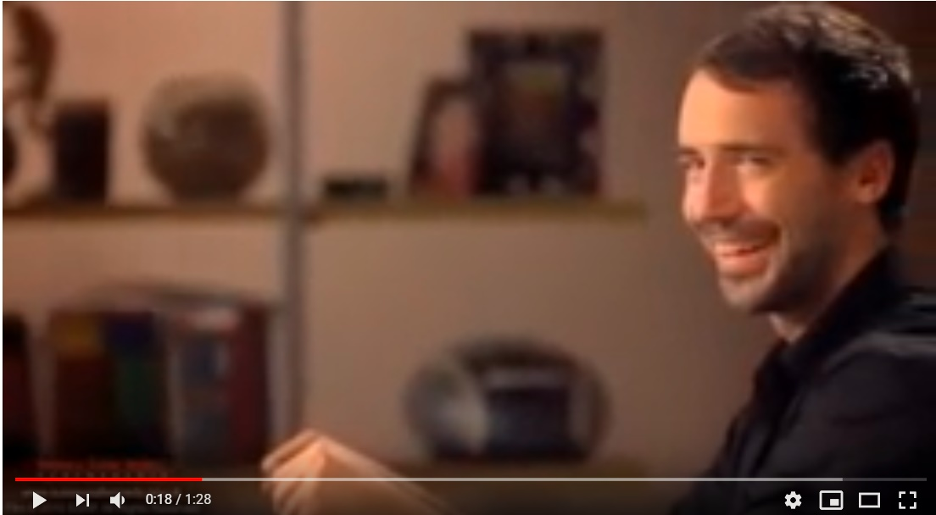
How does this work?
https://www.youtube.com/watch?v=Zn4GTzvJkkQ

Slide 9
Julia Ebner, ‘Stop the Online Conspiracy Theorists Before They Break Democracy’
The QAnon community, which began on the message-board site 4chan, strongly overlaps with the support networks of far-right movements such as the EDL and Pegida Most recently, it co-opted yellow vest demonstrations and boosted hardline Brexit campaigns and Tommy Robinson protests By injecting conspiratorial narratives into these movements, its members can leverage existing networks and alter their political direction. A commonly used tactic is to combine conspiricist hashtags with those of viral campaigns and trending topics. The scale this generates is disproportional enough to distort public perception: In 2018, ISD identified close to 30m uses of the word “QAnon” across Twitter, YouTube and forums such as Reddit and 4chan.
https://www.theguardian.com/commentisfree/2019/feb/18/online-conspiracy-theorists-democracy

Slide 10
Across Europe, conspiracy theories that mix old antisemitic tropes with new ones that demonise migrants and Muslims have gained huge traction since the refugee crisis in 2015. A recent study showed that a stunning 60% of Brits believe in at least one conspiracy theory. The ideas that a cabal of global elites run the world, that there is a plot to replace white English natives with Muslim migrants and that the author- ities are covering up immigration numbers are among the most commonly held.
In QAnon forums, it is hard to overlook the holy mess of logical fallacies and contradictions. Its adherents link the MI6, Facebook and the Rothschilds to the Vatican, Hollywood, the Nazis, the Illuminati and aliens in order to explain that climate change is a hoax, the Holocaust never happened, the world is run by paedophiles, Satanists and cannibals and that the Queen is a direct descendent of prophet Mohammed. …
Beyond inspiring attacks on perceived enemies, the spread of conspiracy theories can, in the long-term, sow societal divisions and undermine confidence in democratic processes, institutions and representatives. At a time when distrust in the political establishment runs exceptionally high, it is easy to tap into existing suspicions and fill information gaps with fabricated news and distorted statistics.
Links with advertising model
The architecture of social media platforms plays into the hands of extreme fringe groups by pushing users towards sensationalist content. The tech firms’ business models and algorithms are geared to maximise the time users spend on their platforms. (Ebner)

Slide 11
Bin Laden’s library 1
“I don’t doubt that Osama would have found Griffin’s brilliant book really informative,” said Jim Fetzer, a founder of Scholars for 9/11 Truth, “but Osama died on about 15 December 2001. He was suffering from serious diseases, including a kidney disease, and it’s hard to get those dialysis machines in and out of those caves in Afghanistan.
“Even Fox News reported this at the time, although I don’t regard that as an always reliable source,” Fetzer added.
Indeed, while the wrinkle of Bin Laden’s taste for tales about 9/11 truthers and the occult was “fascinating”, Fetzer said, the entirety of the documents released Wednesday, as well as the 2011 raid by US Navy Seals on Bin Laden’s Pakistan compound in which the al-Qaida leader was killed, constitute “elaborate political theater” in Fetzer’s mind.
“Osama bin Laden had nothing to do with 9/11,” Fetzer said, dismissing the 2004 videotape in which Bin Laden took credit for the attacks. “The whole story we’ve been told is a complete charade.”
…

Slide 12
Bin Laden’s library 2
“Am I the only one who thinks that a bunch of CIA documents released years after the fact are nothing more than propaganda?” asked Jesse Wyneck at InfoWars, the website of conspiracy theorist and radio host Alex Jones.
“I wish they’d get more creative with this nonsense,” bemoaned another commenter.
“We live in a world of lies. Nothing more,” said another.
The commenter badgerpit suggested that Bin Laden’s possession of a book about 9/11 might be “a sort of wink”. …
Jones himself did not broach the disclosures on his Wednesday radio show, instead railing on about changing gender norms in American society and declaring: “The fall of humankind is here. It’s going down.”
On the other great center of truthers, Reddit, people were less credulous about conspiracy theories. There reactions ranged from “9/11 was a fraud” to blaming Nasa to “I bet they used to sit around the compound at night and read each other the theories for laughs.”
Bin Laden’s odd collection also included The Conspirators’ Hierarchy, a book about how an elite cadre of manipulators are somehow involved in every thing from the Kennedy assassination to the East India trading company and the international drug trade.

Slide 13
Jacob Rees-Mogg, Victorian Titans
The historian AN Wilson, whose book The Victorians was published in 2002, wrote in the Times that Rees-Mogg’s effort was “anathema to anyone with an ounce of historical, or simply common, sense”. Describing the work as “a dozen clumsily written pompous schoolboy compositions”, he said it claimed to be a work of history, but was in fact “yet another bit of self-promotion by a highly motivated modern politician”.
On the chapter about Gen Charles Napier’s conquest of Sindh, Wilson wrote: “At this point in the book you start to think that the author is worse than a twit. By all means let us celebrate what was great about the Victorians, but there is something morally repellent about a book that can gloss over massacres and pillage on the scale perpetrated by Napier.”

Slide 14
TASK : exploring rhetoric
How persuasive is it and how does it work?
Examine two of the extracts on the handout & unpick their argument/s.
  Do they make claims without any proof?
  When they cite authorities who are they?
  Do they depend on any terms of hatred without explanation ?
  Do they twist any facts? Which, how and why?

