Slide 1
Radical neu Chwyldroadol?
Radical or Revolutionary?
Su Crowther

Slide 2

Radical neu Chwyldroadol?
Cynnwys
Radical neu Chwyldroadol?
CCUHP – Erthygl 26
Addysg yw …..
Diben addysg
Sut rydym yn dysgu
Addysgu adref
Godwin, Fielding, Hicks, Holt, Gray, Robinson, Gatto, Kumar, Icke, Freire
Rhyfel ar blant
Dim jyst ysgol – ffyrdd o dderbyn addysg (EOTAS)
Felly pam bod codiad mewn plant a phobl ifanc yn cael eu haddysgu ar wahan i ysgol?
PISA, lles a’r £
Addysg yn y Cartref Etholedig - y ddadl dros
Fideo
Ystadegau a rhesymau
Dadl glo!

Slide 3
Radical or Revolutionary?
Content
Radical or Revolutionary?
UNCRC – Article 26
Education is…….
Purpose of Education
How we learn
Home schooling
Godwin, Fielding, Hicks, Holt, Gray, Robinson, Gatto, Kumar, Icke, Freire
War on kids
Not just school - Ways of receiving an education (EOTAS)
So why is there an increase in CYP being educated otherwise?
PISA, Well-being and the £
Elective Home Education - the argument for
Video
Statistics and reasons
Closing argument!

Slide 4
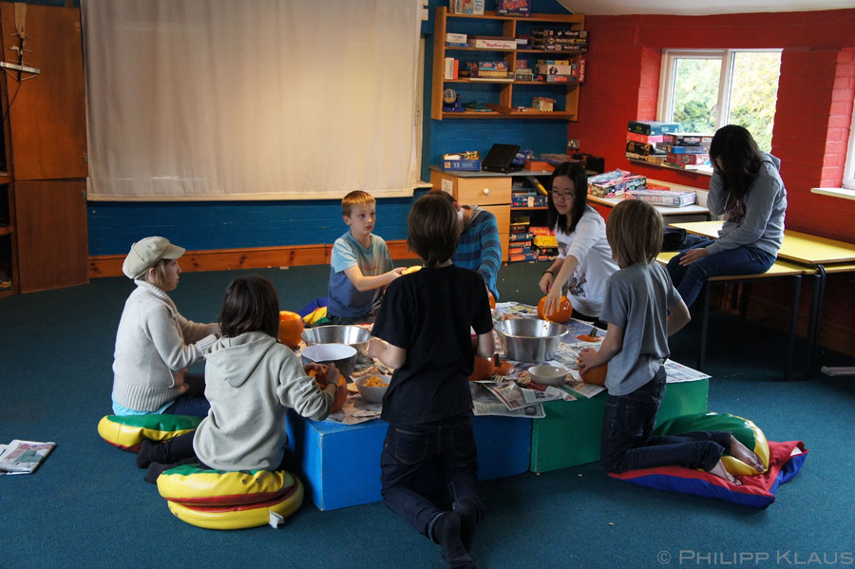
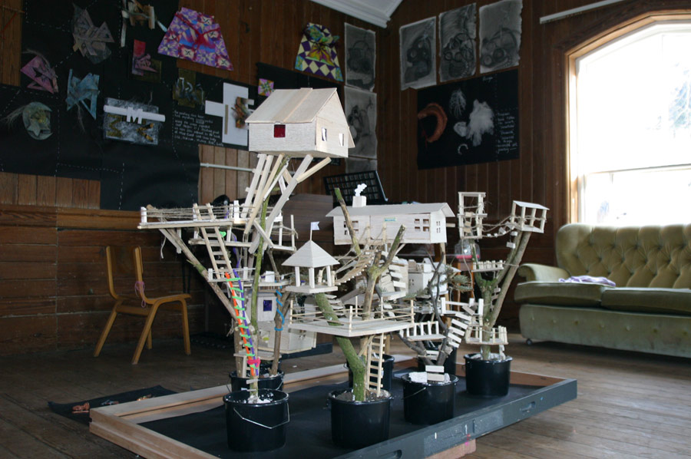
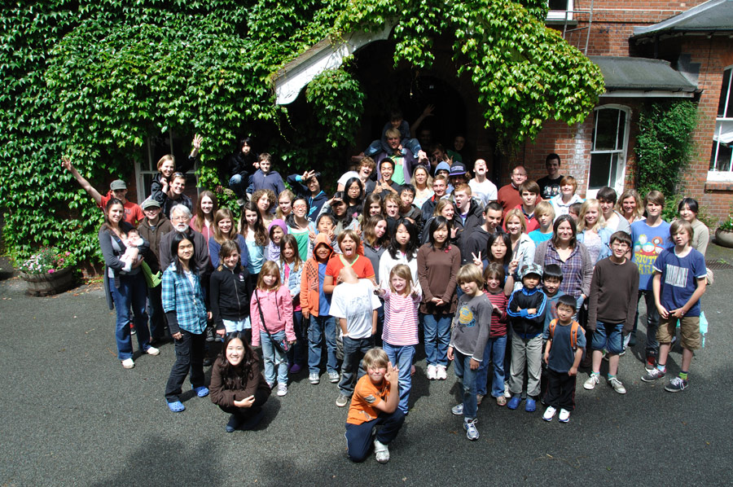
Radical or Revolutionary?
Setting the scene……..
Radical neu Chwyldroadol?
Gosod yr olygfa…
‘Ideoleg radical’
Addysgwyr rhyddfrydig
Addysgwyr radical
A ‘radical ideology’
Libertarian educators
Radical educators
4 Ideoleg Addysgol / Four Educational Ideologies (Askew and Carnell, 1998)
Notes:
I’m going to challenge the terminology ‘radical’ and here's why…
Radical ideology questions the dominant belief and challenges the status quo.
Radicals are driven by their vision of what a better society could look like and the need to act in order to bring about change.
Radicals oppose injustice and inequality and abuse of power and privilege.
My own opinion is to seek to promote empowerment, and believe that all should have more control over their own lives.
Radicalism, ( I do not mean this is the sense that you are thinking regarding Radicalism of Islam for example) is viewed as being dangerous but think what this has done for
Abolition of slavery and the establishments of votes for women?
Better working conditions in the `19th Century.
I have included this diagram to illustrate the work of Neill (1966) who believed in Libertarian ideology and this is what lead him to set up Summerhill school in 1921. He believed that true learning can only happen as part of a natural interest in the CYP he did not believe in coercion and CYP should be free to explore what interest them. They believe in the basic goodness of human nature. CYP should play until they are ready to learn? Neill taught at the beginning of the 19th century he disliked what he saw and with the strict discipline, rote learning and frequent punishment.
The libertarian ideology- experiment in progressive education. These are the principles he used to establish Summerhill, Suffolk in 1921.

Slide 5
Datganiad Cyffredinol o Hawliau Dynol Universal Declaration of Human Rights
Erthygl/Article 26
Everyone has the right to education. Education shall be free, at least in the elementary and fundamental stages. Elementary (Primary) education shall be compulsory. Technical and professional education shall be made generally available and higher education shall be equally accessible to all on the basis of merit.
Education shall be directed to the full development of the human personality and to the strengthening of respect for human rights and fundamental freedoms. It shall promote understanding, tolerance and friendship among all nations, racial or religious groups, and shall further the activities of the United Nations for the maintenance of peace.
Parents have a prior right to choose the kind of education that shall be given to their children.
https://www.unicef.org.uk/what-we-do/un-convention-child-rights/

Slide 6
Nid yw ysgol yn statudol…
Hawliau & Chyfrifoldebau
Mae erthygl 2 o Protocol 1 o’r Confensiwn Ewropeaidd ar Hawliau Dynol yn nodi:
O Adran 7 o Ddeddf Addysg
1996
…..ond mae addysg yn.

Slide 7
School is not compulsory…
Rights & Responsibilities
Article 2 of Protocol 1 of the European Convention on Human Rights states that:
From Section 7 of the Education Act
1996
…..but education is.

Slide 8
Diben Addysg / Purpose of Education
Hanes Byr
Brief History
6 problems with our school system
I baratoi myfyrwyr i gyd-fynd â'r safbwynt neo-liberal presennol o gymdeithas
I gyfreithloni'r farn ddominyddol hon ar gymdeithas a'i strwythurau
Addysg yn cael ei yrru gan berfformiad ac yn dangos ei effeithiolrwydd yn ôl canlyniadau
To prepare students to fit into the existing neoliberal view of society
To legitimate this dominant view of society and its structures
Education is performance driven and demonstrates its effectiveness by results
Notes:
The problem is, the current system of education was designed and conceived and constructed for
a different age. It was conceived in the intellectual culture of the enlightenment and in the
economic circumstances of the industrial revolution. Before the middle of the 19th century there
were no systems of public education. Not really… I mean you could get educated by Jesuits, you
know, if you had the money. But public education, paid for from taxation, compulsory to
everybody, and free at the point of delivery, that was a revolutionary idea. And many people
objected to it. They said “It’s not possible for many street kids, working class children, to benefit
from public education. They’re incapable of learning to read and write, and why are we spending
time on this?” Robinson

Slide 9
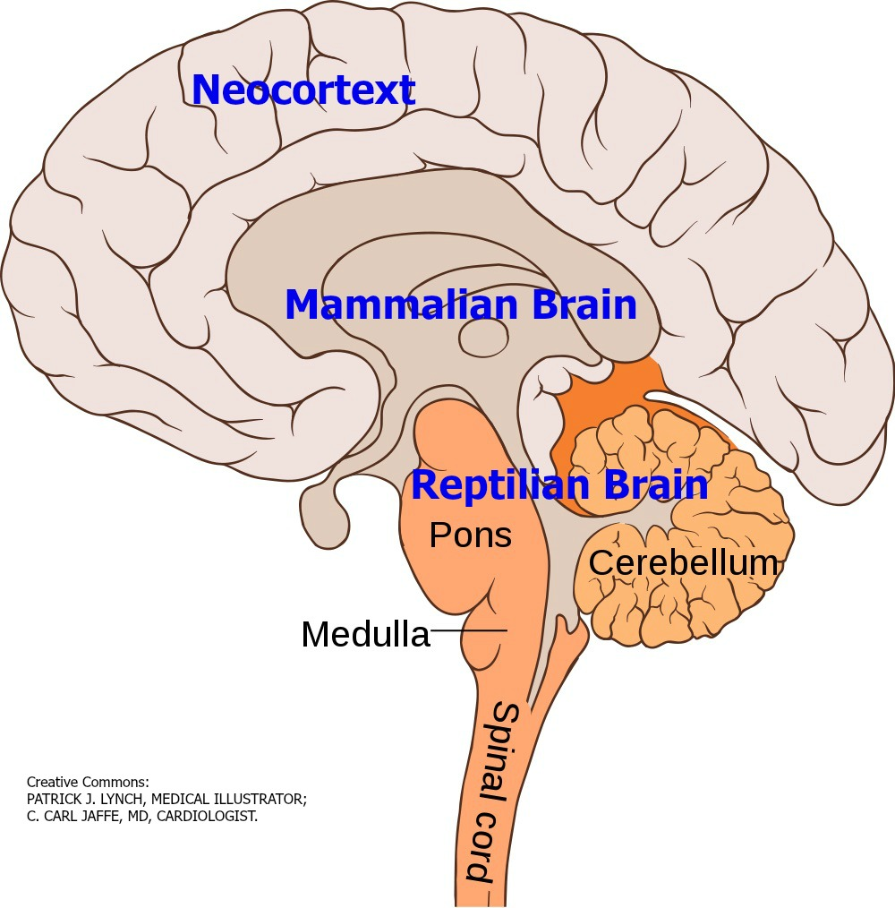
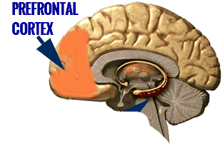
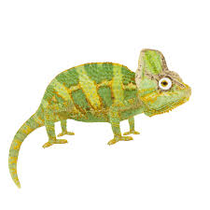
Sut mae plant a phobl ifanc yn dysgu?
Mae tystiolaeth o niwrowyddoniaeth bod rhan ymlusgiadol ein hymennydd, sy'n eistedd yng nghanol ein hymennydd, pan fydd dan fygythiad, yn cau popeth arall i lawr, mae'n cau'r cortecs rhagarweiniol, y rhannau sy'n dysgu.
Mae cosb ac arholiadau yn cael eu hystyried yn fygythiadau.
Rydyn ni'n cymryd ein plant, rydyn ni'n gwneud iddyn nhw gau eu hymennydd i lawr, ac yna rydyn ni'n dweud, "Perfformiwch."
Beth sy'n digwydd i greadigrwydd yn ein hoes ni?
Mae angen inni symud y cydbwysedd hwnnw yn ôl o fygythiad i bleser.
Mitra (2013)

Slide 10
How do CYP learn?
There is evidence from neuroscience that the reptilian part of our brain, which sits in the centre of our brain, when it's threatened, it shuts down everything else, it shuts down the prefrontal cortex, the parts which learn.
Punishment and examinations are seen as threats.
We take our children, we make them shut their brains down, and then we say, "Perform.“
What happens to creativity in our age? We need to shift that balance back from threat to pleasure.
Mitra (2013)

Slide 11
Sut mae plant a phobl ifanc yn dysgu?
How do CYP learn?
“If you can light the spark they will learn without the need for assistance, as children are natural learners”
“Children are biologically designed to educate themselves”
Robinson (2013)
Gray (2013)
Notes:
Peter Gray is an American researcher and scholar
“Children are biologically designed to educate themselves,” Gray said. “They are naturally playful and curious. We can maximize that instead of forcing them to do schoolwork.”
Gray is a well-known critic of standard educational systems and is frequently invited to speak to groups of educators, parents, and researchers about children's needs for free play, the psychological damage inflicted on children through our present methods of schooling, and the ways in which children are designed, by natural selection, to control their own education. He is a founder and current board president of the Alliance for Self-Directed Education, which is dedicated to promoting opportunities for Self-directed education for children and teenagers as replacement for coercive schooling. He is also a founder and board member of Let Grow, which is dedicated to renewing children’s freedom to play and explore, outdoors, in public spaces, without continuous adult supervision.
(Sir) Kenneth Robinson is a British author, speaker and international advisor on education in the arts to government, non-profits, education and arts bodies
Robinson has suggested that to engage and succeed, education has to develop on three fronts. First, that it should foster diversity by offering a broad curriculum and encourage individualisation of the learning process. Second, it should foster curiosity through creative teaching, which depends on high quality teacher training and development. Finally, it should focus on awakening creativity through alternative didactic processes that put less emphasis on standardised testing, thereby giving the responsibility for defining the course of education to individual schools and teachers. He believes that much of the present education system in the United States fosters conformity, compliance and standardisation rather than creative approaches to learning. Robinson emphasises that we can only succeed if we recognise that education is an organic system, not a mechanical one. Successful school administration is a matter of fostering a helpful climate rather than "command and control".[

Slide 12
“The truth is that schools don't really teach anything except how to obey orders”.
Gatto (1990)
“Education systems within capitalist societies are a form of ‘ideological state apparatus’
designed as a means of social control”
(Althusser, 1971 cited in Pollard et al, 2008).
Schools are state mechanisms for control.
Emphasis in schools on ‘classroom management’ is more about discipline and less about learning. It’s a way of getting students to conform to society’s expectations.
Curriculum – prescribed knowledge which is the accepted ‘truth’ of a subject
  Who decides what should be included?
The ‘hidden curriculum’ – reproducing social conformity?
There is more of a concern about the quantity and quality of work irrespective of purpose.
Pollard et al, 2008
Bowles and Gintis (1976) argued school processes tend to induce passivity and the acceptance of authority.
Hegemony
Defines the meaning of common sense by making particular ideas seem normal for example:-
“That all children should go to school” Hicks
Notes:
I've noticed a fascinating phenomenon in my 27 years of working in education - that the current education system is increasingly . The secret is out! Hence the increase in numbers who choose to home educate. no one believes anymore that scientists are trained in science classes or politicians in civics classes or poets in English classes.?

Slide 13
Sugata Mitra & The Hole In the Wall
https://www.youtube.com/watch?v=HE5GX3U3BYQ
‘Schools are meant to produce happy, healthy, productive people. Are they actually doing that?’
Sugata Mitra & The School in the Cloud
https://www.youtube.com/watch?v=BFdqvCL2W2k
Notes:
1999 Mitra set up the Hole in the wall experiment, he’s not saying that we don’t need teachers, but questions if we need schools?
He’s the guy who put a computer in a hole in the wall in India
He invented the School in the Cloud
He recruits grannies
He thinks children can learn all they need from computers
He wants to get rid of teachers.
He identified children as being able to teach themselves through a system called Self-Organisation from this he created SOLEs Self organised learning environments

Slide 14
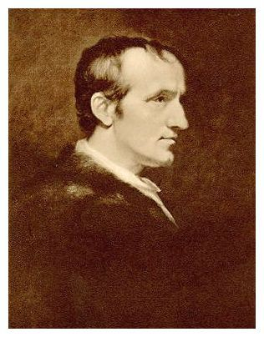
“The aim of education should be the promotion of happiness”
William Godwin (1756 - 1836) oedd yr ysgrifennwr cyntaf ‘i roi datganiad clir o egwyddorion anarchaidd’.
Roedd yn un o'r ysgrifenwyr Saesneg cyntaf i gydnabod bygythiad addysg a reolir gan y wladwriaeth ac i nodi rhinweddau addysg amgen, rydd.
Yn briod â Mary Wollstonecraft, a ysgrifennodd y clasur ffeministaidd: A Vindication of the Rights of Woman -1792
Tad Mary Shelley (awdur Frankenstein - 1818) a thad-yng-nghyfraith y bardd Shelley.
Notes:
William Godwin argued that all are entitled to ‘an appropriate portion of independence’ – children and adults alike. He disliked the various ways in which adults coerced children – whether through harsh discipline and punishments or through the more general ‘unkindenesses’ of life. teachers appear to be allowing children to do as they please but in reality are really in control – a disguised form of coercion
William Godwin recognized the significance of motivation and desire:
The most desirable mode of education… is that which is careful that all the acquisitions of the pupil shall be preceded and accompanied by desire… The boy, like the man, studies because he desires it. He proceeds upon a plan of is own invention, or by which, by adopting, he has made his own. Everything bespeaks independence and inequality. William Godwin (1797) The Enquirer (reprinted in Woodock 1977)
William Godwin’s educational thinking made some impact upon thinkers but it does not appear to have been a significant reference point for those seeking to develop more libertarian forms of education in the later part of the nineteenth century
A pedagogy that respected this and sought to build on the child’s own motivation and initiatives. William Godwin recognized the significance of motivation and desire:
However he has left a legacies in the form of a powerful statement in support of non-curricula forms of education.
In his An Enquiry Concerning Political Justice (1796) he attacked the state, saying that it has no right to tell people what to do, he was suspicious of the national system of education

Slide 15
“The aim of education should be the promotion of happiness”
William Godwin (1756 – 1836) was the first writer ‘to give a clear statement of anarchist principles’
He was one of the first English-language writers to recognize the threat of state-controlled education and to set out the qualities of an alternative, free, education.
Married to Mary Wollstonecraft, who wrote the feminist classic: A Vindication of the Rights of Woman -1792
Father of Mary Shelley (the author of Frankenstein – 1818) and the father-in-law of the poet Shelley
Notes:
William Godwin argued that all are entitled to ‘an appropriate portion of independence’ – children and adults alike. He disliked the various ways in which adults coerced children – whether through harsh discipline and punishments or through the more general ‘unkindenesses’ of life. teachers appear to be allowing children to do as they please but in reality are really in control – a disguised form of coercion
William Godwin recognized the significance of motivation and desire:
The most desirable mode of education… is that which is careful that all the acquisitions of the pupil shall be preceded and accompanied by desire… The boy, like the man, studies because he desires it. He proceeds upon a plan of is own invention, or by which, by adopting, he has made his own. Everything bespeaks independence and inequality. William Godwin (1797) The Enquirer (reprinted in Woodock 1977)
William Godwin’s educational thinking made some impact upon thinkers but it does not appear to have been a significant reference point for those seeking to develop more libertarian forms of education in the later part of the nineteenth century
A pedagogy that respected this and sought to build on the child’s own motivation and initiatives. William Godwin recognized the significance of motivation and desire:
However he has left a legacies in the form of a powerful statement in support of non-curricula forms of education.
In his An Enquiry Concerning Political Justice (1796) he attacked the state, saying that it has no right to tell people what to do, he was suspicious of the national system of education

Slide 16
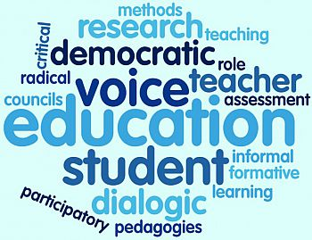

Michael Fielding (2011)
Paulo Freire (1972)
David Icke (2016)
Notes:
Michael Fielding is one of the most-recognized researchers in the field of student voice around the world. His work has deeply influenced SoundOut, informing our concept of moving from simply listening to student voice towards Meaningful Student Involvement for every student in every school all of the time.
Michael Fielding was a teacher for more than two decades, focused on practicing radical democratic education. After that, he taught at the universities of Cambridge and Sussex. Today he is the Emeritus Professor of Education at University College London. Michael is one of the key writers in the field of student voice, leading innovative research in the areas of school improvement, educational leadership and radical education.
schools, and thus learning, should open
spaces for complexity, for new interpretations and connections, and allow for the emergence of
independent thinking.
Our current
educational systems “seem stuck in a time warp . . . displaying an unwillingness or inability to
engage with either new thinking or the state we are in—and worse, the state we are heading
towards” (p. 33). Talks about radical education and that schools should become places of ethical and political practice.
schools that are small in scale, age integrated, and staffed with
multidisciplinary teams of teachers, pedagogues, and atelieristas
The pedagogue is described as
attending to the whole child, his/her mind, body, creativity, and history, recognizing the
interconnectedness of relationships and social context to learning.
Ongoing, attentive dialogue between adults and children of all ages
opens up understandings and opportunities for making meaning together that “nudge us away
from the individualistic preoccupation of personalization and high-performance schooling
towards a person-centered approach . . . not as an instrumental lubricant for a smoother running
organization” (p. 80).
The authors also argue for schools as public spaces where all members of the community cometogether to “produce ideas, images, knowledge, communication, cooperation, and affectiverelations” (p. 111). Common schools are for and of the community, offering resources, advocacy,
and services particular to the area and members it serves.
David Icke said that schools were prisons of the mind.
He said that the education system is not about educating CYP but is programming them.
Paulo Freire
1921- 1997 (76)
Born in Brazil, in a very poor area.
Was accused of spreading subversive ideas.
Exile 1964-1980
Freire avoided tradition forms of education and authority
Freire believed that people cannot be truly human until they have real freedom in society
Friere’s approach to learning was to promote participatory, non-hierarchical, draw on the learner’s experience, empowering, exposing of injustice

Slide 17
Satish Kumar on Alternative Education (Addysg Amgen)
Education: derived from educatum or educare means to bring out what is already there
Education: should not encourage the individual to conform to society or to be negatively harmonious with it, but help him (her) to discover the true values, which come with unbiased investigation and self-awareness. When there is no self-knowledge, self expression becomes self-assertion, with all its aggressive and ambitious conflicts.
Education: in the true sense, is the understanding of oneself, for it is within each one of us that the whole of existence is gathered.
Education: is part of the problem and not part of the solution
Education: is brain washing CYP to become part of the industrial system
https://www.youtube.com/watch?v=RU5OvA5jsos
Notes:
Satish Kumar
A former monk and long-term peace and environment activist, Satish Kumar has been setting the Global Agenda for change for over 50 years.
He was just nine when he left his family home to join the wandering Jains and 18 when he decided he could achieve more back in the world, campaigning for land reform in India and working to turn Gandhi’s vision of a renewed India and a peaceful world into reality.
Inspired in his early 20s by the example of the British peace activist Bertrand Russell, Satish embarked on an 8,000-mile peace pilgrimage together with E.P. Menon. Carrying no money and depending on the kindness and hospitality of strangers, they walked from India to America, via Moscow, London and Paris, to deliver a humble packet of ‘peace tea’ to the then leaders of the world’s four nuclear powers.
In 1973 Satish settled in the United Kingdom taking up the post of editor of Resurgence magazine, a position he has held ever since, making him the UK’s longest-serving editor of the same magazine. During this time, he has been the guiding spirit behind a number of now internationally-respected ecological and educational ventures including Schumacher College in South Devon where he is still a Visiting Fellow. And the Small School in 1982 closing in 2016 approx. Set up because he didn’t want to send his children to the local school, small school was about nurturing the whole child
In his 50th year, Satish undertook another pilgrimage – again carrying no money. This time, he walked 2,000 miles to the holy places of Britain, a venture he describes as a celebration of his love of life and nature. In July 2000 he was awarded an Honorary Doctorate in Education from the University of Plymouth. In July 2001, he received an Honorary Doctorate in Literature from the University of Lancaster.
Kumar states that That the problems in society today are created by highly educated people, such as nuclear weapons and war which are both created by these people.
.
Satish is on the Advisory Board of Our Future Planet, a unique online community sharing ideas for real change and in recognition of his commitment to animal welfare and compassionate living, he was recently elected vice-president with the RSPCA. He continues to teach and run workshops on reverential ecology, holistic education and voluntary simplicity and is a much sought-after

Slide 18
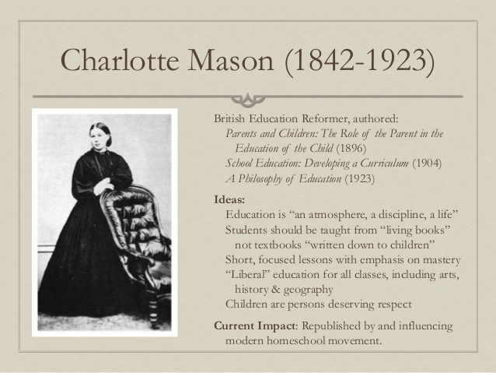
Charlotte Mason
"Education is an atmosphere, a discipline, a life"
Notes:
The Charlotte Mason style of homeschooling uses rich literature and “living books” rather than textbooks or dumbed-down twaddle. Charlotte was a British educator in the late 1800s and early 1900s who emphasized respecting each child as a person and giving him a broad education. Her approach works with the way children naturally learn and presents a generous curriculum, including nature study, art and music appreciation, and handicrafts, as well as the usual academic subjects. It seeks to “spread a feast” before the child and let him digest what is appropriate for him at the time. And it uses methods that will nurture a love for learning and reinforce good lifelong habits, not just present a body of information.

Slide 19
Addysg yn y cartref etholedig – addysg radical?
EHE – Radical Education?
Credai Hicks y dylai addysg:
Gweithlu ~ greu gwithlu cystadleuol byd-eang
Unigolyn ~ i ddod a’r gorau allan o bob un person
Byd-eang ~ i ddeall cyd-ddibyniaeth lleol – byd-eang
Byd gwell ~ cynorthwyo i newid cymdeithas am y gorau
Hicks believes that education is meant:-
Workforce ~ to create a globally competitive workforce
Individual ~ to bring out the best in every person
Global ~ to understand local-global interdependence
Better world ~ to help change society for the better
“We should be helping young people think more critically and creatively about probable and preferable futures”
Hicks, 2018
Notes:
Impacts on education
In the UK Conservatives in 80s (Thatcher) and Labour in 90s (Blair) wanted greater control of education and privatisation within it.
Money spent on education seen as a waste of time unless helps the country compete efficiently and effectively in the global market place.
Stress on competition by results, e.g. SATs and league tables; focus on ‘surface’ learning, i.e. knowing how to pass exams.
Market metaphors: parents as consumers, business model for education, competition brings out best in individuals and schools.
Education based on a technocratic, managerial and performance driven view of teaching and learning. Controlled now by politicians rather than profess- educators.
ional
David Hicks was formerly Professor in the School of Education, Bath Spa University, where he helped develop and taught on the undergraduate Education Studies degree. David is now a freelance educator with a particular interest in education for sustainability, climate change and the shift to a post-carbon future. For the last decades his research, writing and teaching have focused on ways of helping students and teachers think more critically and creatively about sustainable futures.
Hi stance is after teaching for more than 40 years is that we should be teaching CYP about the future:-

Slide 20
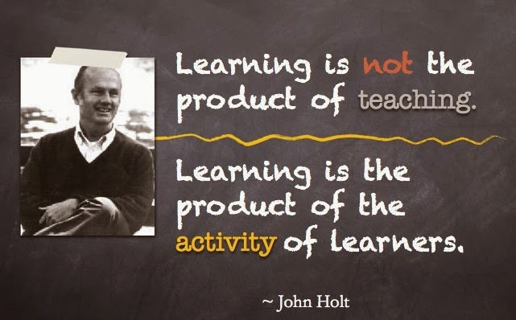
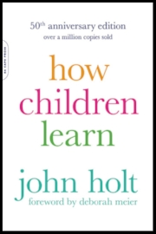
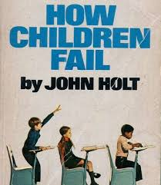
John Holt – tad ‘addysgu adref’ / the ‘father of homeschooling’
https://www.youtube.com/watch?v=0tH_t5HDhHc
Notes:
John Holt taught in schools and was an advocate for school reform. When it became apparent that reform would not happen he turned his efforts to promoting home education. He wrote prolifically, including ten books, many articles, and America’s first home education newsletter. Even though much of his work was published in the 1970s-1980s it remains relevant today, and his books are still a source of inspiration for many homeschooling parents.
Holt was disillusioned with school he saids in 1969;-
Almost every child, on the first day he sets foot in a school building, is smarter, more curious, less afraid of what he doesn’t know, better at finding and figuring things out, more confident, resourceful, persistent and independent, than he will ever again be in his schooling or, unless he is unusually lucky, for the rest of his life. The Underachieving school (1969)

Slide 21

‘The War on Kids……’
https://www.youtube.com/watch?v=1kP02lxpX2E
Notes:
USA Documentary in 2009 worth a watch!

Slide 22
Ym mha ffyrdd eraill y gall plant a phobl ifanc dderbyn addysg ar wahân i fynychu ysgol prif-ffrwd? Gelwir hefyd yn EOTAS.
Steiner (Waldorf)
Montessori
Small Schools
Ysgolion Stiwdio
Summerhill
Coedwig/Glan Môr/Mwdlyd
Siarter (UDA)
Hojskøle: Addysg Amgen
Dysgu yn y cartref (EHE)
SOLE (Self-Organising Learning Environments, Mitra)
Ysgol Ddemocrataidd
Addysg ‘Flexi’
Notes:
Children and young people (CYP)
Steiner - pedagogy emphasizes the role of imagination in learning, striving to integrate holistically the intellectual, practical, and artistic development of pupils.
Montessori - Italian physician and educator Maria Montessori based on her extensive research with “phrenasthenic” (mentally challenged) children and characterized by an emphasis on independence, freedom within limits, and respect for a child’s natural psychological, physical, and social development.

Slide 23
In what other ways can CYP receive an education other than attending a mainstream school? Sometimes known as EOTAS.
Steiner (Waldorf)
Montessori
Small Schools
Studio Schools
Summerhill
Forest/Beach/Muddy
Charter schools (USA)
Hojskøle: An Alternative Education
Home school/educating (EHE)
SOLE (Self-Organising Learning Environments, Mitra)
Democratic Schools
Flexi-schooling
Notes:
Children and young people (CYP)
Steiner - pedagogy emphasizes the role of imagination in learning, striving to integrate holistically the intellectual, practical, and artistic development of pupils.
Montessori - Italian physician and educator Maria Montessori based on her extensive research with “phrenasthenic” (mentally challenged) children and characterized by an emphasis on independence, freedom within limits, and respect for a child’s natural psychological, physical, and social development.

Slide 24

Beth sy’n digwydd yng Nghymru?
What's happening in Wales?
PISA
LLES /
WELL-BEING
£
https://www.youtube.com/watch?v=gv9fgQ8iirg
PISA 2015
PISA 2018
Notes:
PISA -Scores of Welsh students in science, reading and maths were below the average of 72 countries and economies taking part in a major study of educational performance.
Welsh students also did worse than their counterparts in England, Scotland and Northern Ireland.
The Pisa tests are taken by 15-year-olds every three years.
This is the fourth time Wales has done worse than the other UK nations.
Well-being
Time to Change Wales – an alliance of leading Welsh mental health charities – reports that one in ten young people will experience a mental health problem, and
WG What we know about children's well-being (2017-18). During secondary school there are dramatic changes in children’s well-being, self-reported health and lifestyles. Whilst at age 11 girls and boys report similar well-being and self-reported health, by aged 16 a gap is evident, with girls reporting lower well-being and worse health.
£ Investment in terms of money 7 Million investment into CAMHS!
But like Kumar said education is part of the problem…..

Slide 25
EHE
Elective Home Education
also known as:-
Home schooling
Home education
Home educating
De-schooling
Unschooled
Home based education
Home based learning
And many more…….

Slide 26
Cymhelliant Cynhenid (mewnol)
Cymhelliant Anghydhenid (allanol)
Athroniaethau
Bruner a Vygotsky yn pwysleisio amgylchedd plentyn, yn enwedig yr amgylchedd cymdeithasol. Mae'r ddau yn cytuno y dylai oedolion chwarae rhan weithredol wrth gynorthwyo dysgu'r plentyn
Athrawon yn ymdrechu i ddatblygu amgylcheddau dysgu sy'n rhoi boddhad cynhenid. Yn anffodus, llawer o baradeimau traddodiadol yn awgrymu bod y rhan fwyaf o fyfyrwyr yn teimlo bod dysgu'n ddiflas felly mae'n rhaid eu cynnwys yn allgyrsiol mewn gweithgareddau addysgol.
Cymhelliant anghynhenid ​​yn digwydd pan fyddwn ni'n cael ein cymell i berfformio ymddygiad neu gymryd rhan mewn gweithgaredd i ennill gwobr neu osgoi cosb. Yn yr achos hwn, rydych chi'n ymddwyn mewn ymddygiad nid oherwydd eich bod chi'n ei fwynhau neu oherwydd eich bod chi'n ei gael yn foddhaol, ond er mwyn cael rhywbeth yn ôl neu osgoi rhywbeth annymunol.
Strwythuredig; ymreolaethol neu led-strwythuredig / hunangyfeiriedig / dan arweiniad plentyn
Mae addysg ddyneiddiol yn agwedd drugarog tuag at addysg sydd â plant a phobl ifanc yn credu ynddynt eu hunain a'u potensial, gan annog tosturi a dealltwriaeth, a meithrin hunan-barch a pharch at eraill.

Slide 27
Philosophies
Intrinsic Motivation
Extrinsic Motivation
Both Bruner and Vygotsky emphasize a child's environment, especially the social environment. Both agree that adults should play an active role in assisting the child's learning.
Teachers strive to develop learning environments that are intrinsically rewarding. Unfortunately, many traditional paradigms suggest that most students find learning boring so they must be extrinsically goaded into educational activities.
Extrinsic motivation occurs when we are motivated to perform a behaviour or engage in an activity to earn a reward or avoid punishment. In this case, you engage in a behaviour not because you enjoy it or because you find it satisfying, but in order to get something in return or avoid something unpleasant.
Structured; autonomous or semi-structured/self-directed/child led
Humanistic education is a humane approach to education that has CYP believe in themselves and their potential, encouraging compassion and understanding, and fostering self-respect and respect for others.

Slide 28
One of the most impressive things about home education is that in most cases learning is based on the child’s intrinsic motivation to learn.
Riley (2016)
Cymhwysedd / Competence
Hunan-reolaeth / Autonomy
Perthnasedd / Relatedness
Notes:
There are three psychological needs which need to be fulfilled for self-motivation to happen. These are feelings of competence, autonomy and relatedness to parents and their learning community. Home education naturally fulfils these three elements which is what makes it such an effective educational option. Traditional education does not typically support this style of learning, instead very much focusing on external rewards and disincentives.
The realisation of a child’s loss of interest in learning is a factor behind many parents’ choice to home educate.
Within education, curiosity and engagement are important, and essential to academic success (Akey, 2006). Traditional education looks to external rewards and disincentives to drive learning.
The benefits of intrinsically motivated learning can be seen in home educated students in terms of academic success which tends to be better than or equal to children who went to traditional schools.(Cai, Reeve, & Robinson, 2002). Research by Cogan (2010) found home educated students tend to score higher on standardised tests and graduate at a higher rate. .
For many home educated families grades and tests are not an adequate way to measure success of education. Instead, success is a much deeper, lifelong outcome of understanding the “responsible exercise of freedom – the freedom to learn, to create, to grow, to be” Albert and Chilton Pearce (1999).
Research by Rudner (1999), Lines (2000), Blok (2004), and Cogan (2010) all found that home education could indeed be effective.
A 2012 study by Dr Riley compared home educated and traditionally schooled children in competence, feelings of autonomy and relatedness. The results showed higher levels of competence and autonomy in home educated students and the same levels of relatedness. Dr Riley highlighted the importance of the relatedness findings in showing that concerns about lack of socialisation were unfounded.

Slide 29
Data Addysgu yn y Cartref / EHE Data
Caer | 2017 | 2018 | 2019
Sir Fon / Anglesey | 36 | 36 | 37
Gwynedd | 45 | 53 | 65
Conwy/ Conway | 76 | 104 | 116
Sie Ssinvyxh / Denbighsire | 51 | 65 | 80
Sir y Fflint/Flintshhire | 63 | 71 | 94
Wrecsam / Wrexham | 68 | 72 | 85
Powys | 131 | 133 | 156
Ceredigion | 139 | 151 | 171
Sir Benfro / Pembrokeshire | 132 | 195 | 182
Casnewydd / Newport | 42 | 59 | 92
Caerdydd / Cardiff | 188 | 188 | 218

Slide 30
Data Addysgu yn y Cartref /
EHE Data
 | 2017 | 2018 | 2019
Sir Gar / Carmarthenshire | - | - | 284
Abertawe / Swansea | 157 | 153 | 137
NPT | 117 | 147 | 177
Penybont / Bridgend | 88 | 103 | 128
Bro Morgannwg Vale of Glamorgan | 33 | 45 | 68
RCT | 118 | 119 | 146
Merthyr | 31 | 42 | 43
Caerphilly | 78 | 61 | 62
Blaenau Gwent | 30 | 51 | 71
Torfaen | 51 | 67 | 70
Sir Fynwy / Monmouthshire | 49 | 52 | 60
CYFANWM / TOTAL |  |  | 2,517
(ONS, 2019)

Slide 31
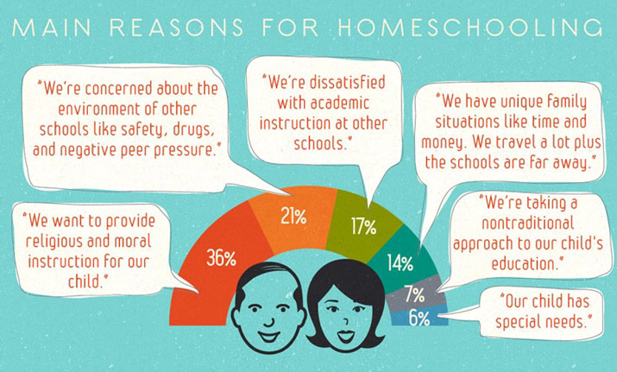

Slide 32
DATA-Beth mae’n dweud wrthym?
DATA-What is this telling us?

Slide 33
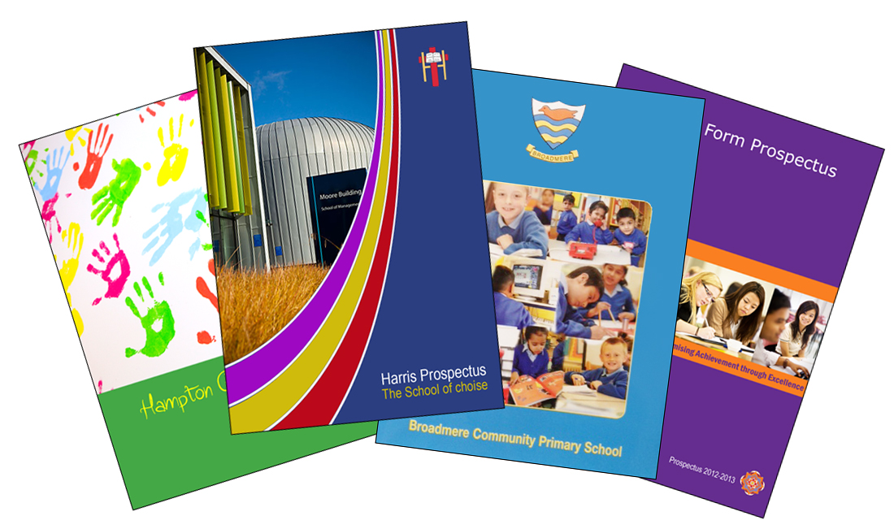
EOTAS
Darllen Pellach / Further reading…..
Hern (1996) Deschooling Our Lives
Gribble (1998) Real Education: Varieties of Freedom
Carnie (2003) Alternative Approaches to Education
Education Otherwise
What is education worth if it does not include discussion of moral and ethical dilemmas as one of its central concerns? Hicks (2004)

Slide 34
Watson, D. (ed.) (2012) Children’s Social and Emotional Wellbeing in Schools, Bristol: Policy Press.
Negroponte, N (2014) A 30 year history of the future [video]. Available at: https://www.ted.com (Accessed: 9 March 2019).
Mitra, S (2013) Build a school in the cloud. [video] Available at: https://www.ted.com/talks (Accessed: 9 March 2019).
Negroponte, N (2006) One laptop per child [video]. Available at: https://www.ted.com (Accessed: 9 March 2019).
Mulgan, G (2011) A short intro to the Studio School [video]. Available at: https://www.ted.com (Accessed: 10 March 2019).
Montessori Society AMI (UK) - Montessori Education Available st: https://www.montessorisociety.org.uk (Accessed: 11 March 2019).
Steiner Waldorf School Fellowship (2018) What is Steiner Education? Available at: https://www.steinerwaldorf.org (Accessed: 11 March 2019).
Hume, C (2016) PISA: Wales still worst in UK world education tests. Available at: https://www.bbc.co.uk/news/uk-wales-38208738 (Accessed: 12 March 2019).
Time to Change Wales, Myths and Facts, Available at: https://www.timetochangewales.org.uk (Accessed: 12 March 2019).
WG (2018) Well-being of Wales 2017-18: What do we know about children’s well-being? Available at: https://gov.wales/ (Accessed: 12 March 2019).
Smith, M. K. (1998) ‘William Goodwin and informal education’, the encyclopaedia of informal education. Available at: www.infed.org/thinkers/et-good.htm. (Accessed: 12 March 2019).
UNICEF (n.d.) What is the UNCRC? Available at: https://www.unicef.org.uk (Accessed: 16 March 2019).
WG (2017) Home education Non-statutory Guidance for local authority. Available at: https://beta.gov.wales/elective-home-education (Accessed: 16 March 2019).
Education Act 1996 Chapter 1. Available at: https://www.legislation.gov.uk (Accessed: 16 March 2019).
War on Kids (2009) Cevin Soling [documentary] https://www.youtube.com (Accessed: 16 March 2019).
Robinson, K (2013) How to escape education death valley. [video] TED.com. April 2013. Available at: https://www.ted.com (Accessed: 16 March 2019).
Fielding, M (2008) Personalisation, Education, Democracy and the market. Soundings Issue 38 spring pp 56-69.
Fielding, M., & Moss, P. (2011) Radical education and the common school: A democratic alternative. London, UK: Routledge.
Freire, P (1992). Pedagogy of hope: Reliving pedagogy of the oppressed. London: Continuum.
Riley, G (2016) The role of self-determination theory and cognitive evaluation theory in home education. Cogent Education, 3 (1), 1163651
Hicks, D (2012) The future only arrives when things look dangerous: Reflections on futures education in the UK Available at: www.teaching4abetterworld.co.uk (Accessed: 16 March 2019).
Askew, S. & Carnell, E. (1998) Transforming Learning: Individual and global change. London: Cassell.
Rhestr Gyfeirnodi / Reference List

