Slide 1
Cognitive development
By Letisha mcintosh
2128932
LCHS4006

Slide 2
Introduction
This will propose a crèche created for children from birth up until the age of 2 years old, for any mother who will be attending support sessions. I will be suggesting age appropriate activities for the children relating it to relevant existing physiological theory’s such a Paiget's theory.

Slide 3
Existing research
Piaget was interested in how a child thinks and learns rather than how much they learn. He identified 4 major stages in child development and he believed that each stage is discontinuous from another and more advanced than the previous, describing the process as structured. Controlled through a mental organisation or a systematic sequence called schemes. For example schemes are a cluster of patterned repeated action, a Perceived role or a worldview that later develops into concepts that has under gone the process controlled through mental organisation that then are replaced with constructed Schemes to adapt to the environment. This is described as assimilation and accommodation used simultaneously, meaning that as new experiences happen, current information is modified added to, or changing previous existing schemas to make suitable for given situation.
Huitt,W.,and Hummel,J. (2003)

Slide 4
Piaget Theory
Piaget’s theory
Given that it is a systematic sequence through which development proceeds. Sensory learning is not random, more structured. Sensory motor skills is developed in the first years of a child’s life. The sensory motor stage is the first of four stages of cognitive development, where babies and toddler learn through exploring the world around them. Making use of all of their senses, sensory play enables the child to stimulate there senses which helps them to keep engaged and involved with learning and utilising the skills and abilities that they where born with.
A,Halpenny. (2013)

Slide 5
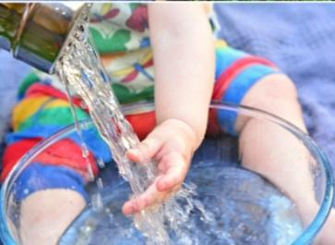
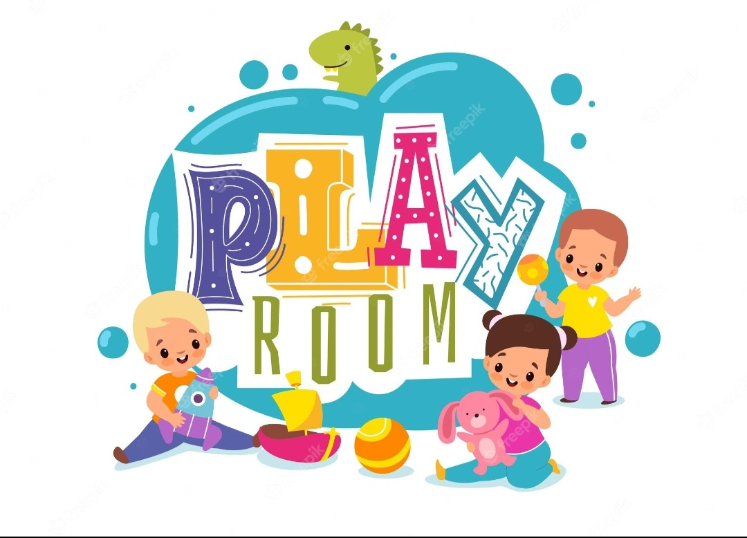
Proposed Staff activities
A brilliant source of child exploration
Has a effect on all senses
Discover and explore outcomes
Water play
Finger painting
Finger painting develops a child’s sense of vision through mixing paint and touch by painting a picture by hand, further developing fine motor skills, coordination and creativity.
J,Peacock. (2022)
Water play naturally Leads children to be curious and curiosity itself will lead to experimentation and perseverance; stimulating further curiosity, learning to explore and understand environment.
J, Horvath.(2016)

Slide 6
Paiget’s theory example
Reflecting on the first stage of Paiget’s cognitive development theory, creative activities such as finger painting and water play used with verbal therapies can help trauma children to enhance communication. Children are active in constructing their development, through actions of their own learning to make sense of the world around them. For example if the child softly touches water then that child can then identify the gentle sound that the water makes. Buts if the child hits the water the louder the sound becomes and at that point the child is challenged to adjust their way of thinking.
s.crosser,(2012)

Slide 7
Conclusion
Physiological theories such as Paiget’s is relevant to understanding how children from birth up until 2years old learn and adapt to the environment. During this stage infants are only reliant on sensory information, so more varieties and opportunities a child has to explore the more they abstract meaningful ideas. Therefore stimulating sensory motor skills is one of the best ways to encourage a child to explore and understand the world around them and for that reason it is important that their natural desire to explore are accommodated. Having proposed age appropriate activities that not only offer endless enjoyment but positively motivates sensory motor skill in order to move on to the next stage of development

Slide 8
Reference
S,Crosser.(2012) Making the most of water play community playthings Available at: https://www.communityplaythings.co.uk/learning-library/articles/making-the-most-of-water-play (Accessed: February 19, 2023).
A,Halpenny. (2013) Introducing piaget: A guide for practitioners and students in early years education. London: Routledge.
J,Horvath. (2016)Educating young children through natural water: How to use coastlines, rivers and lakes to promote learning and development. Abingdon, Oxon: Routledge, is an imprint of the Taylor & Francis Group, an Informa business.
W,Huitt and J,Hummel. (2003) Piaget's theory of cognitive developmentl Educational psychology interactive 3 (2), 1-5,
https://scholar.google.com/scholar?hl=en&as_sdt=0%2C5&q=piaget%27s+theory+on+cognative+theory&btnG=#d=gs_qabs&t=1676846526305&u=%23p%3DbTGPomHj3uEJ
J,Peacock. (2022) Sensory activities for babies, infants & toddlers: Procare, Procare Solutions. Available at: https://www.procaresoftware.com/resources/list-of-sensory-activities-for-infants-toddlers/ (Accessed: March 1, 2023).
C. A,Malchiodi .(2015) Creative interventions with traumatized children. Second edition New York, NY: Guilford Press.

