Slide 1
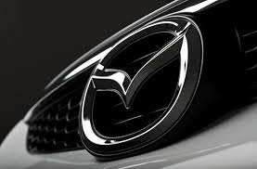
Mazda
Presented by
Mariana Claudia Drajneanu
2030896

Slide 2

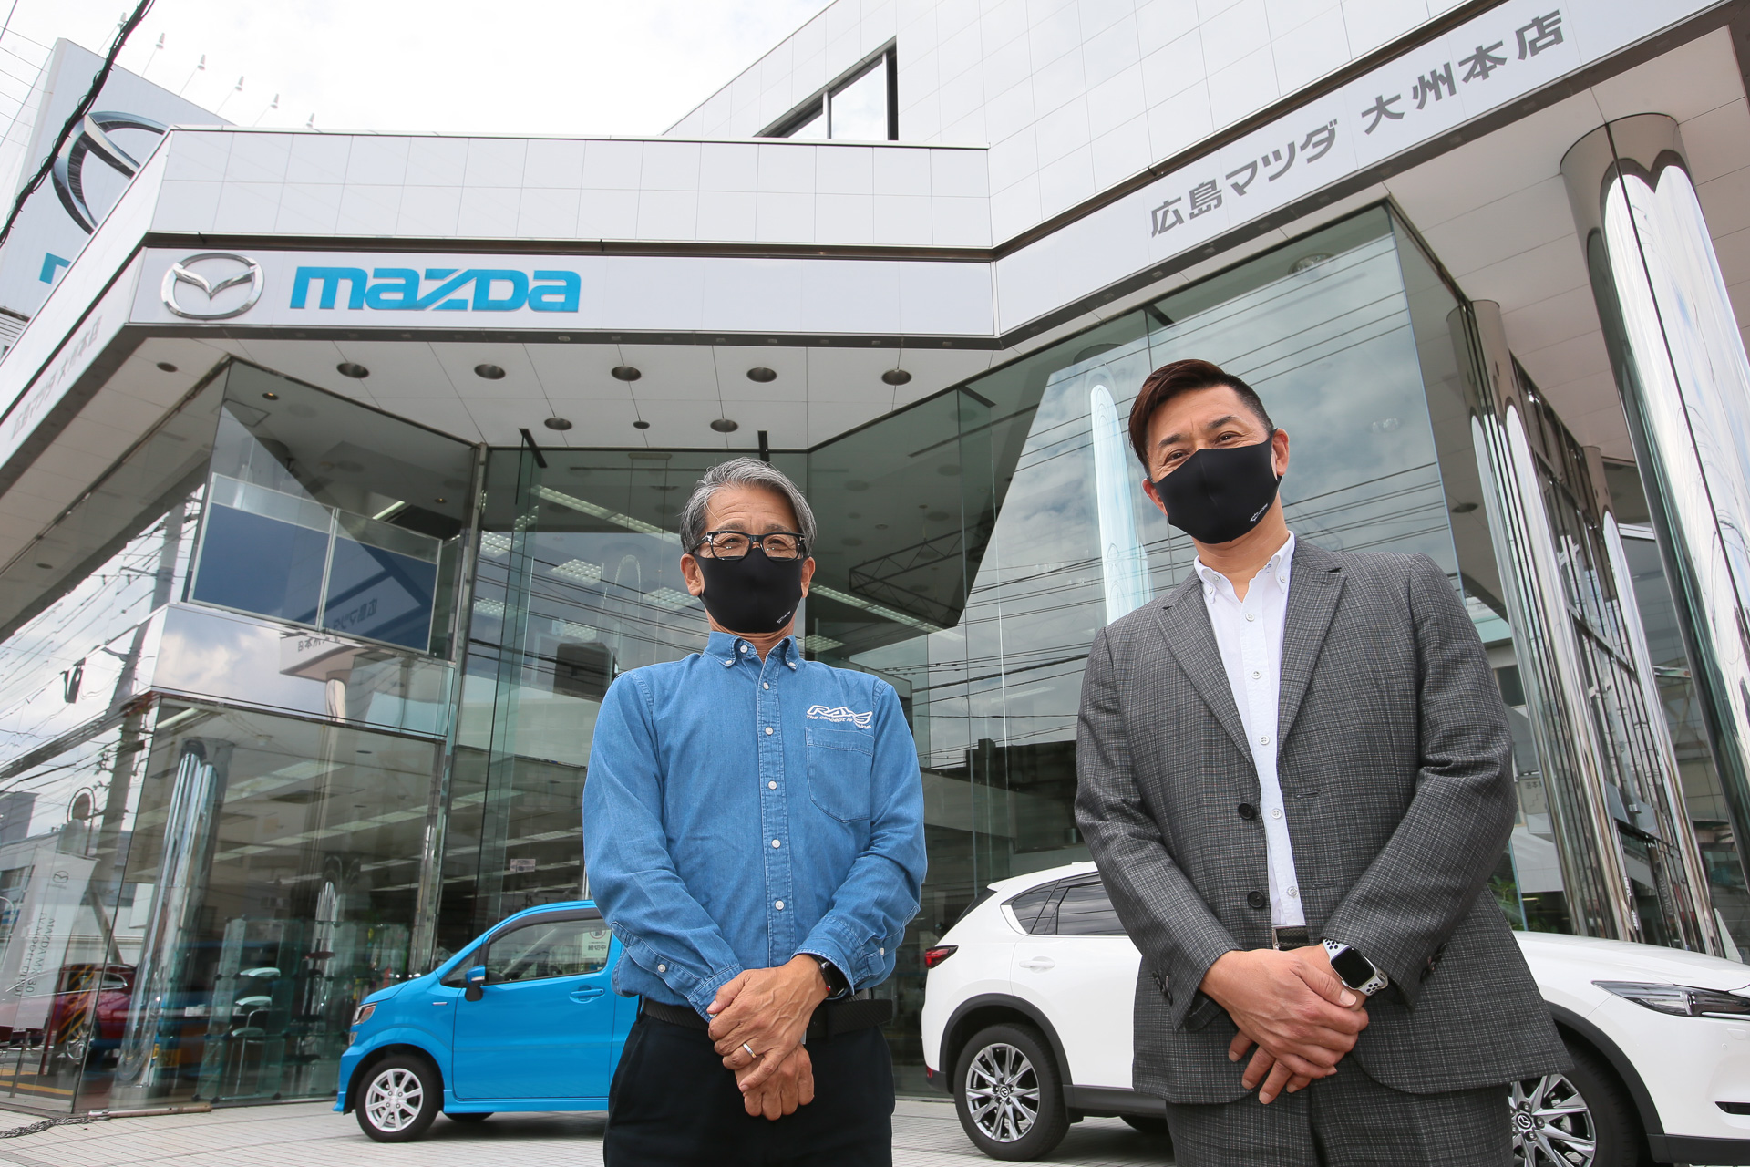
Introduction
Changes in the nature of the supervisory role in the automobile industry are being examined.
This is in the context of a transition from mass production to lean or just-in-time production.
A case study of UK Mazda's Flat Rock plant in the US highlights the difficulties faced by existing manufacturers in reforming the role of supervisors.

Slide 3

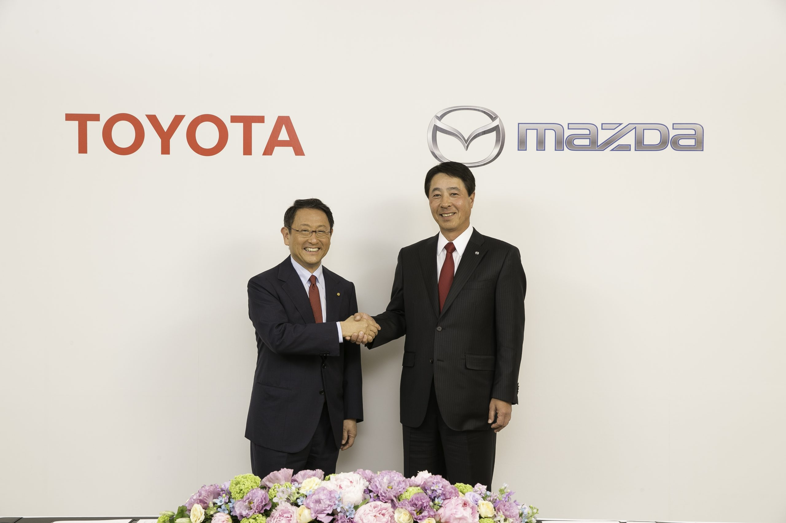

Team work between brands
A production-based strategy has enabled Mazda to compete in a highly competitive industry.
Production strategies are a response to specific market circumstances and variations in organisation capability.
In undergoing radical restructuring, Mazda re-thought JIT into mixed-model production.
As a result, it developed the means to compete effectively against Toyota and Nissan.

Slide 4

Advantages and disadvantages
There are plenty of exciting jobs in the automotive industry.
Industrial designers are responsible for developing new automotive concepts.
Auto mechanic and technician positions aren't your only choices for working in the industry.
Mechanics can be exposed to dangerous chemicals and machinery.
One of the major concerns of working in an auto body shop is the possible exposure to asbestos.
Auto parts, including clutches and brakes, contain asbestos due to its heat-resistant abilities.

Slide 5

Conclusion
Despite from all the mention above I can say that will always exist a balance hard or easy to maintain in every job in this world.
The key to success starts from you, from us accepting the situation and find the way to complete the criteria for that day or period and be successful.

Slide 6
References
Babson, S. 1995 Lean Work: Empowerment and Exploitation in the Global Auto Industry [Google Scholar]
Mechanics Hub. (1988) Pros and Cons of Working in the Automotive Industry. http://www.mechanicshub.com.
Taylor Francis Online. (2022) International Automobile Industry. Http://doi.org/10.1080/09585192.2012.725081

Slide 7

For your attention!
z

