Slide 1

Title: Prevalence of physical activity among students in a public university
Student name- Riddhi Popat
Student id- 2228983
Module Name – Practice bases research (LCHS7001)
Lecturer’s name- Dr. Ogochukwu Aguenye

Slide 2
Contents of This Presentation
Introduction
Background
Rationale
Research Questions
Research methodology
Data analysis technique
Implications of the research

Slide 3
Background
The health and well-being of college students are greatly affected by how much they engage in physical exercise while attending a public university. Physical fitness, academic performance, and mental health, are just a few domains where regular exercise has been shown to increase the quality of life. Many variables, such as heavy course loads, sedentary lifestyles, and an absence of appropriate sports facilities, have been linked to low rates of physical activity among college students (Romero-Blanco et al., 2020). Knowing the prevalence of this issue at a public university might inform interventions and campaigns targeted at getting students to exercise more and eat better. Educational institutions may develop initiatives to promote and allow students to engage in more excellent physical activity if they first identify obstacles and facilitators.

Slide 4
Introduction
The proportion of students at a public university that engages in regular physical activity is referred to as the "prevalence of physical activity among students." The quantity of physical activity a student engages in to enhance their health and fitness is reflected in their degree of physical activity. Sports, exercise, entertainment, and any other physical activity that keeps students moving are all included.
Physical exercise benefits the health of the mind and body at any age. However, the World Health Organisation (WHO) reports that just 27% of adults and 80% of adolescents are physically active enough.
Physical activity levels among students at public institutions are a prominent focus of research and public concern. Regular physical activity is crucial for good health and happiness for various physiological, psychological, and social benefits (Zhu et al., 2019). On the other side, research has shown that when children do not receive enough exercise, their health and academic performance deteriorate.
There are various reasons why it is essential to learn about the amount of physical activity among students at a public university. It helps to measure the magnitude of the problem and identify segments of the student population that may be at higher risk of inactivity. This understanding may assist educators in developing more effective techniques to get students active and improve their health.

Slide 5
Impact of physcial activity on academic performance
The regularity with which students participate in physical activity has a significant impact on their academic progress at a public institution. Regular exercise improves brain capacity, memory, intellect, and academic performance. Physical activity increases the amount of oxygen and nutrients transported to the brain by the blood. As a result, youngsters who regularly exercise have better levels of focus, attention, and memory..
Regular physical activity may benefit university students since it helps them manage their stress. Stress levels grow in response to school expectations and demands, which may have a detrimental influence on academic performance (Rhodes et al., 2020). When student exercise regularly, the "feel-good" endorphins in the brain are produced, helping student feel less anxious.
As a consequence, Students may benefit from improved mental health, less anxiety, and improved overall performance in the classroom. Students who exercise regularly report feeling more invigorated and conscious. Physical activity boosts energy and alertness by boosting blood and oxygen flow to the brain. Students who work up a sweat during the day report feeling more alert, focused, and invigorated, which benefits their academic performance.

Slide 6
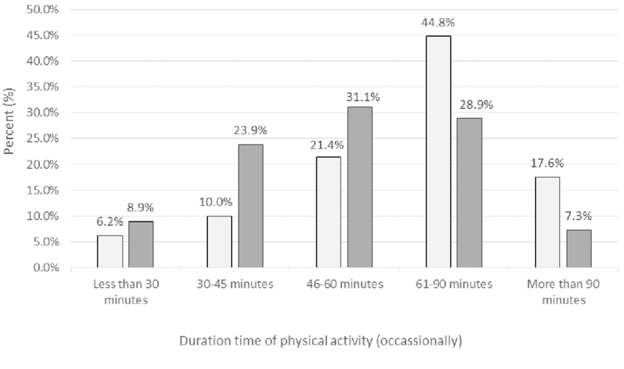
Source- Research gate, 2020

Slide 7
Rationale
The necessity to promote and uphold healthy lifestyles within this particular demographic group is what drives the inquiry of the level of physical activity among students attending public institutions. It is common knowledge that regular physical activity has several positive effects on health and well-being, including a reduction in the chance of developing chronic diseases and an improvement in mental health (III, Murray and Salvo, 2019). By examining the degree of physical activity that is prevalent among university students, one may assess the activity levels that are currently being maintained, locate any activity gaps or disparities, and develop focused interventions to encourage and increase levels of physical activity. This research may contribute to the establishment of evidence-based programmes and programmes that promote an active living culture on campus, ultimately enhancing the health outcomes and quality of life for students attending public institutions.

Slide 8
Research Questions
What is the current level of physical activity between students at a public institution regarding how often they exercise, how long they exercise for, and how intense their workouts are?
What variables influence students' levels of physical activity at a public college?
What are the obstacles and facilitators to physical exercise participation between students at a public university?

Slide 9
Research methodology
Research design
For this study’s research design, a method known as a cross-sectional survey will be used. The technique of this research project enables the gathering of data at the same moment, which gives a snapshot of the amount of physical exercise among students attending public universities (Dishman et al., 2022). Using a cross-sectional approach is the most effective way to investigate the current level of physical activity between students as well as the discovery of patterns or trends in this area.

Slide 10
Recruitment, Sampling & Study Participants
The study will include recruiting a statistically valid sample of students from a public university. Researcher shall use a multi-stage sampling strategy. The university's structure will be based on divisions called "faculties" or "departments."
After that, students will be picked at random from each group. Using this strategy, researcher can be sure that students from all departments and programs will be represented.
The recruiting process will include many strategies. Initially, all students will be invited to participate in the study by receiving an email via the university's official email system (Hu et al., 2020). Informational posters and brochures will be posted throughout campus to inform students about the study and how they may become involved. Participation will be entirely voluntary, and everyone who chooses to do so will have their privacy and identities protected.

Slide 11
Material and data collection method
A reliable questionnaire will be used to determine the extent to which people engage in physical activity. This research will use the IPAQ (International Physical Activity Questionnaire) to gather information. The International Physical Activity Questionnaire (IPAQ) is a well-known and reliable tool for gauging overall levels of physical activity in contexts as diverse as free time, the workplace, and commutes (Bull et al., 2020). It records data like how often, for how long, and strenuously student engage in various physical activities.
To maximize participation and minimize barriers to entry, an online survey platform will br provided. Additional demographic questions, including Gender, Age, department and Academic year, will be included in the survey design based on the selected questionnaire. The online survey will be made available to participants via a private link.
All participants will be made aware of the study's goals, the confidentiality of their responses, and their autonomy over whether or not they choose to participate (Ghrouz et al., 2019). They will be provided explicit directions on how to finish the survey, and they can do it whenever and wherever they like on any electronic device they own.

Slide 12
Data analysis technique
Descriptive statistics is one method of data analysis that will be used to examine the level of physical excercise among students at a public institution through the collected data (Ramón-Arbués et al., 2020). Students' activity levels and demographic traits may be better understood using descriptive statistics. Following are the steps:
Step 01
Step 03
Data preparation
Visulization of Data
Step 02
Step 04
Calculation of statistics
Analysis and intrepreatation of results

Slide 13
Steps for Descriptive statistics
Step 1: Data preparation:
Step 2: Calculation of statistics
Data cleansing and preparation is the initial phase of the analytical process. It's essential to search for anomalies, outliers, and gaps in the data. Now is an excellent time to make necessary changes to the data or recode the variables.
Students' levels of physical activity will be described using descriptive statistics (Shimoga, Erlyana and Rebello, 2019). Metrics for variables including mean, median, standard deviation, minimum and maximum values like students' frequency, duration, or intensity of physical activity will be determined.

Slide 14
Steps for Descriptive statistics
Step 3: Visulization of data
Step4: Analysis and intrepratation of Data
It is possible to create visual representations of students' physical activity levels using data visualization techniques, including histograms, bar charts, and pie charts. One can quickly get a feel for the range of activity levels and look for patterns with these charts and graphs.
Rates of physical activity may be broken down by factors like age, education, and occupation using subgroup analysis. It is possible to get descriptive data for each subgroup separately and then compare them (Wang and Boros, 2019).
Descriptive statistics and data visualizations will be used to learn about the level of physical activity among students at public universities. Overall physical activity, differences between student groups, and trends or patterns may all be addressed in light of the data.

Slide 15

Ethical considerations
Several ethical questions will be considered in research on the level of physical exercise at a public institution. At the outset, participants will provide permission after being given all relevant information and the opportunity to engage in the research activities. At every point throughout the study, participants' anonymity will be ensured. Participants' anonymity will be protected by using appropriate data security methods. It cannot be emphasized enough that participating will be entirely voluntary, and no one will be forced to participate in the study. Researchers must ensure that all fitness-related activities and assessments are risk-free for study participants (Pascoe et al., 2020). Prejudice and bigotry have no place in a community that values variety and welcomes all students. Careful deliberation on ethical concerns is essential before data publishing to ensure the confidentiality of study participants. In addition to collecting valuable data on the extent to which college students engage in physical exercise, adherence to these ethical issues assures the rights and well-being of research participants.

Slide 16
Implication of the research
This research's findings are crucial for many different groups since they provide information on the level of physical exercise among students at a public institution. Possible implications for campus health education activities are discussed. It is essential to examine the current state of physical activity and to identify obstacles and motivators to design effective therapies to encourage healthy and active behavior among students (DiPietro et al., 2020). Awareness campaigns, more accessible access to fitness centers, and incorporating physical exercise into the school curriculum are all practical options. There might be policy repercussions from this study. The findings may give valuable data for informing policies and recommendations to get more kids moving. Suggestions may be made on the value of physical education, the design of campuses to encourage active commuting, and the development of relationships with local fitness clubs. The findings of the study are relevant to the student's lives. If students know how often they engage in physical activity, they may have a more accurate idea of how physically active they are compared to their classmates. After reading this, maybe some people may decide to change their eating habits and start exercising regularly. The findings may provide new information on how much college students engage in physical exercise. It might serve as a benchmark for such research in the future, facilitating future comparisons across fields and regions (Grasdalsmoen et al., 2019). The information gained from this study might help inform the creation of more efficient policies and programs that encourage students at public universities to lead physically active lives. Significant implications for health promotion, policymaking, individual behavior modification, and the development of this discipline are drawn from the study's findings. To improve the health of their student bodies, colleges should take preventative measures by addressing these issues and creating an environment that encourages students to engage in physical exercise.

Slide 17
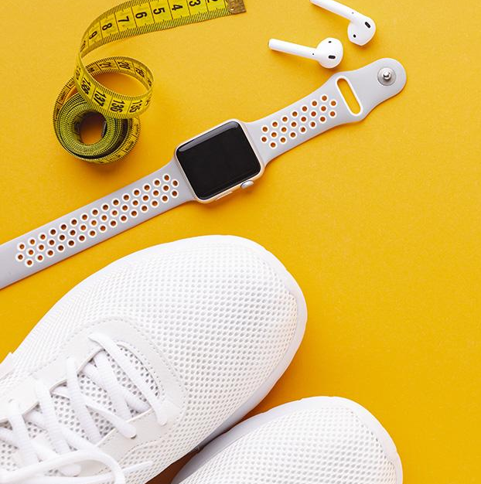
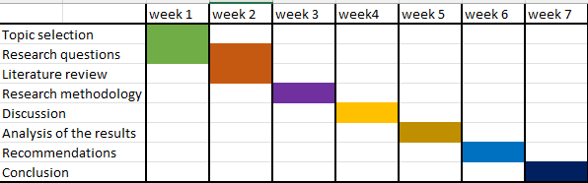
Time schedule
Source- Self created

Slide 18
Reference list
Bull, F.C., Al-Ansari, S.S., Biddle, S., Borodulin, K., Buman, M.P., Cardon, G., Carty, C., Chaput, J.-P., Chastin, S., Chou, R., Dempsey, P.C., DiPietro, L., Ekelund, U., Firth, J., Friedenreich, C.M., Garcia, L., Gichu, M., Jago, R., Katzmarzyk, P.T. and Lambert, E. (2020). World health organization 2020 guidelines on physical activity and sedentary behaviour. British Journal of Sports Medicine, [online] 54(24), pp.1451–1462. doi:https://doi.org/10.1136/bjsports-2020-102955.
DiPietro, L., Al-Ansari, S.S., Biddle, S.J.H., Borodulin, K., Bull, F.C., Buman, M.P., Cardon, G., Carty, C., Chaput, J.-P., Chastin, S., Chou, R., Dempsey, P.C., Ekelund, U., Firth, J., Friedenreich, C.M., Garcia, L., Gichu, M., Jago, R., Katzmarzyk, P.T. and Lambert, E. (2020). Advancing the global physical activity agenda: recommendations for future research by the 2020 WHO physical activity and sedentary behavior guidelines development group. International Journal of Behavioral Nutrition and Physical Activity, 17(1). doi:https://doi.org/10.1186/s12966-020-01042-2.
Dishman, R.K., Heath, G.W., Schmidt, M.D. and Lee, I.-M. (2022). Physical Activity Epidemiology. [online] Google Books. Human Kinetics. Available at: https://books.google.com/books?hl=en&lr=&id=nQgiEAAAQBAJ&oi=fnd&pg=PR1&dq=Prevalence+of+physical+activity+among+students+in+a+public+university&ots=g0cnLojJvz&sig=gNtS_FnPvdYn_9tBBskF7kqxZ7U
Ghrouz, A.K., Noohu, M.M., Dilshad Manzar, Md., Warren Spence, D., BaHammam, A.S. and Pandi-Perumal, S.R. (2019). Physical activity and sleep quality in relation to mental health among college students. Sleep and Breathing, [online] 23(2), pp.627–634. doi:https://doi.org/10.1007/s11325-019-01780-z.
Grasdalsmoen, M., Eriksen, H.R., Lønning, K.J. and Sivertsen, B. (2019). Physical exercise and body-mass index in young adults: a national survey of Norwegian university students. BMC Public Health, 19(1). doi:https://doi.org/10.1186/s12889-019-7650-z.
Hu, Z., Tang, L., Chen, L., Kaminga, A.C. and Xu, H. (2020). Prevalence and Risk Factors Associated with Primary Dysmenorrhea among Chinese Female University Students: A Cross-sectional Study. Journal of Pediatric and Adolescent Gynecology, 33(1), pp.15–22. doi:https://doi.org/10.1016/j.jpag.2019.09.004.
III, H.K., Murray, T. and Salvo, D. (2019). Foundations of Physical Activity and Public Health. [online] Google Books. Human Kinetics. Available at: https://books.google.com/books?hl=en&lr=&id=8LG8DwAAQBAJ&oi=fnd&pg=PP1&dq=Prevalence+of+physical+activity+among+students+in+a+public+university&ots=U0FbhfD_gV&sig=1zOSqBvE1AD3-3keUVqUZLezFLw .
Islam, S., Akter, R., Sikder, T. and Griffiths, M.D. (2020). Prevalence and Factors Associated with Depression and Anxiety Among First-Year University Students in Bangladesh: A Cross-Sectional Study. International Journal of Mental Health and Addiction. doi:https://doi.org/10.1007/s11469-020-00242-y.
Pascoe, M., Bailey, A.P., Craike, M., Carter, T., Patten, R., Stepto, N. and Parker, A. (2020). Physical activity and exercise in youth mental health promotion: a scoping review. BMJ Open Sport & Exercise Medicine, [online] 6(1), p.e000677. doi:https://doi.org/10.1136/bmjsem-2019-000677.
Radwan, H., Hasan, H.A., Ismat, H., Hakim, H., Khalid, H., Al-Fityani, L., Mohammed, R. and Ayman, A. (2019). Body Mass Index Perception, Body Image Dissatisfaction and Their Relations with Weight-Related Behaviors among University Students. International Journal of Environmental Research and Public Health, 16(9), p.1541. doi:https://doi.org/10.3390/ijerph16091541.
Ramón-Arbués, E., Gea-Caballero, V., Granada-López, J.M., Juárez-Vela, R., Pellicer-García, B. and Antón-Solanas, I. (2020). The Prevalence of Depression, Anxiety and Stress and Their Associated Factors in College Students. International Journal of Environmental Research and Public Health, 17(19), p.7001. doi:https://doi.org/10.3390/ijerph17197001.
Rhodes, R.E., Guerrero, M.D., Vanderloo, L.M., Barbeau, K., Birken, C.S., Chaput, J.-P., Faulkner, G., Janssen, I., Madigan, S., Mâsse, L.C., McHugh, T.-L., Perdew, M., Stone, K., Shelley, J., Spinks, N., Tamminen, K.A., Tomasone, J.R., Ward, H., Welsh, F. and Tremblay, M.S. (2020). Development of a consensus statement on the role of the family in the physical activity, sedentary, and sleep behaviours of children and youth. International Journal of Behavioral Nutrition and Physical Activity, 17(1). doi:https://doi.org/10.1186/s12966-020-00973-0.
Romero-Blanco, C., Rodríguez-Almagro, J., Onieva-Zafra, M.D., Parra-Fernández, M.L., Prado-Laguna, M. del C. and Hernández-Martínez, A. (2020). Physical Activity and Sedentary Lifestyle in University Students: Changes during Confinement Due to the COVID-19 Pandemic. International Journal of Environmental Research and Public Health, 17(18), p.6567. doi:https://doi.org/10.3390/ijerph17186567.
Sampasa-Kanyinga, H., Colman, I., Goldfield, G.S., Janssen, I., Wang, J., Podinic, I., Tremblay, M.S., Saunders, T.J., Sampson, M. and Chaput, J.-P. (2020). Combinations of physical activity, sedentary time, and sleep duration and their associations with depressive symptoms and other mental health problems in children and adolescents: a systematic review. International Journal of Behavioral Nutrition and Physical Activity, 17(1). doi:https://doi.org/10.1186/s12966-020-00976-x.
Shimoga, S.V., Erlyana, E. and Rebello, V. (2019). Associations of Social Media Use With Physical Activity and Sleep Adequacy Among Adolescents: Cross-Sectional Survey. Journal of Medical Internet Research, 21(6), p.e14290. doi:https://doi.org/10.2196/14290.
Snedden, T.R., Scerpella, J., Kliethermes, S.A., Norman, R.S., Blyholder, L., Sanfilippo, J., McGuine, T.A. and Heiderscheit, B. (2018). Sport and Physical Activity Level Impacts Health-Related Quality of Life Among Collegiate Students. American Journal of Health Promotion, 33(5), pp.675–682. doi:https://doi.org/10.1177/0890117118817715.
Steene-Johannessen, J., Hansen, B.H., Dalene, K.E., Kolle, E., Northstone, K., Møller, N.C., Grøntved, A., Wedderkopp, N., Kriemler, S., Page, A.S., Puder, J.J., Reilly, J.J., Sardinha, L.B., van Sluijs, E.M.F., Andersen, L.B., van der Ploeg, H., Ahrens, W., Flexeder, C., Standl, M. and Shculz, H. (2020). Variations in accelerometry measured physical activity and sedentary time across Europe – harmonized analyses of 47,497 children and adolescents. International Journal of Behavioral Nutrition and Physical Activity, 17(1). doi:https://doi.org/10.1186/s12966-020-00930-x.
Stensel, D.J., Hardman, A.E. and Gill, J.M.R. (2021). Physical Activity and Health: The Evidence Explained. [online] Google Books. Routledge. Available at: https://books.google.com/books?hl=en&lr=&id=4wg0EAAAQBAJ&oi=fnd&pg=PT36&dq=Prevalence+of+physical+activity+among+students+in+a+public+university&ots=jnR95y0NF6&sig=0mG7IKx32UCgFcNrl5WaD9I20Mc [Accessed 16 Jun. 2023].
Wang, F. and Boros, S. (2019). The effect of physical activity on sleep quality: a systematic review. European Journal of Physiotherapy, [online] 23(1), pp.1–8. doi:https://doi.org/10.1080/21679169.2019.1623314.
Zhu, Z., Tang, Y., Zhuang, J., Liu, Y., Wu, X., Cai, Y., Wang, L., Cao, Z.-B. and Chen, P. (2019). Physical activity, screen viewing time, and overweight/obesity among Chinese children and adolescents: an update from the 2017 physical activity and fitness in China—the youth study. BMC Public Health, 19(1). doi:https://doi.org/10.1186/s12889-019-6515-9.

Slide 19
Thank you!

