Slide 1

Coaching & Mentoring
BMPF7303D Day 2

Slide 2
Learning Outcomes
These are the broad topics this module will cover
01
02
Coaching Theories
Differentiation
03
Coaching Models
04
Coaching Practice

Slide 3



Differentiation

Slide 4


Slide 5
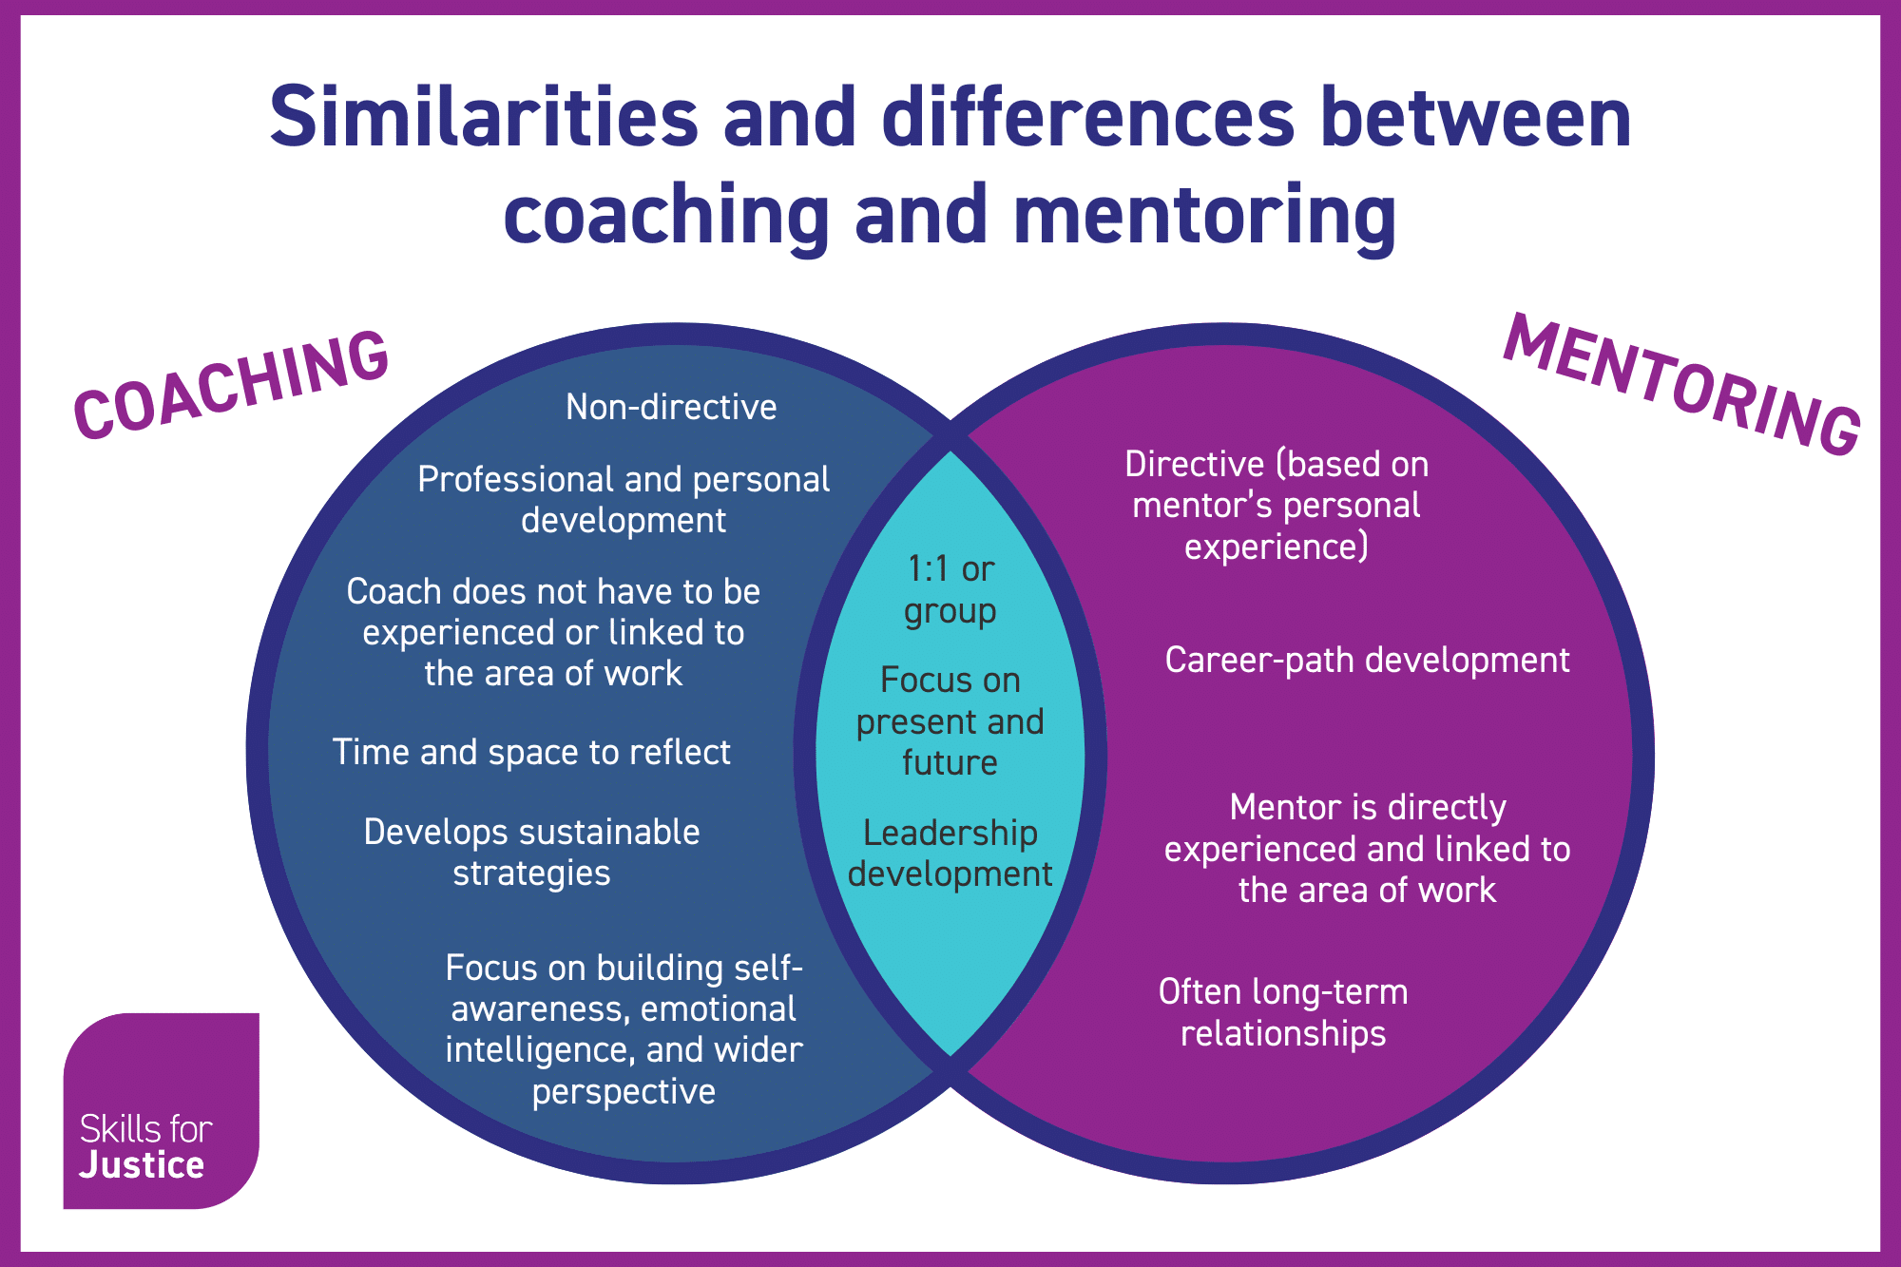

Slide 6
Coaching Theories
  Humanistic - Emily
  Psychodynamic - Sarah
  Behavioural - Lisa
  Cognitive Behavioural Coaching - Jess
  Positive Psychology
  Transpersonal
  Neurodiversity Coaching - Gwen

Slide 7
Theory | Primary Focus | View of the Client | Role of the Coach
Humanistic | Growth, self‑actualisation | Naturally capable, resourceful | Facilitates, listens deeply
Psychodynamic | Unconscious patterns | Shaped by past experience | Helps raise awareness
Behavioural | Observable behaviour | Capable of learning new habits | Directs behaviour change
Cognitive‑ Behavioural | Thoughts → feelings → behaviour | Can revise unhelpful beliefs | Challenges and reframes
Positive Psychology | Strengths, resilience, wellbeing | More than problems or deficits | Builds strengths
Transpersonal | Meaning, identity, purpose | Seeking fulfilment beyond ego | Explores purpose & values
Neurodiversity | Neurodiversity coaching draws selectively from multiple theories, adapting them to be inclusive, accessible, and ethical.

Slide 8

SUMMARY
TRANSPERSONAL
(meaning, purpose, identity)
↑
HUMANISTIC ------------------ POSITIVE PSYCHOLOGY
(growth, autonomy, values) (strengths, wellbeing)
↑
PSYCHODYNAMIC COGNITIVE-BEHAVIOURAL (unconscious patterns) (thinking–behaviour link)
↓
BEHAVIOURAL
(habits, actions, reinforcement)
Coaching theories differ in depth (inner world vs behaviour)
and focus (change, wellbeing, meaning)
Neurodiversity coaching is not a single new theory.
Instead, it is a neuro‑affirming application of coaching theories.

Slide 9
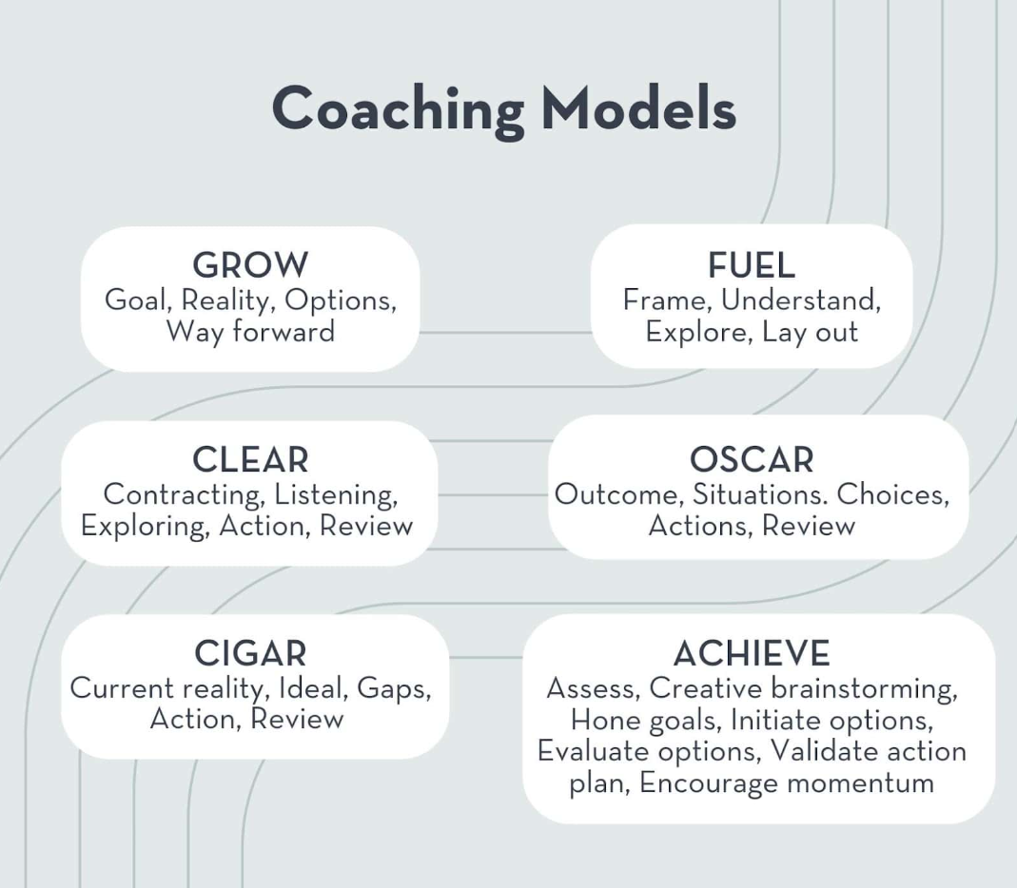
Coaching….
…Models
Models are neutral tools.
The theory you work from determines how and why you use them.

Slide 10

LISTEN

Slide 11
SILENT

Slide 12

Coaching activity – triad work
Notes:
Read out the bed words

Slide 13

Thank you!
Diolch
Next session date: 29th April

