Slide 1
Optimizing Security Posture in an Enterprise Network: Role of Balancing Components in Checkpoint Architecture
Julien DORFFER– Baptiste FAGET – Adrien FRIEH
Léa MARTIN– Bao Tu PHAM– Morgan ROY
26/02/2024

Slide 2

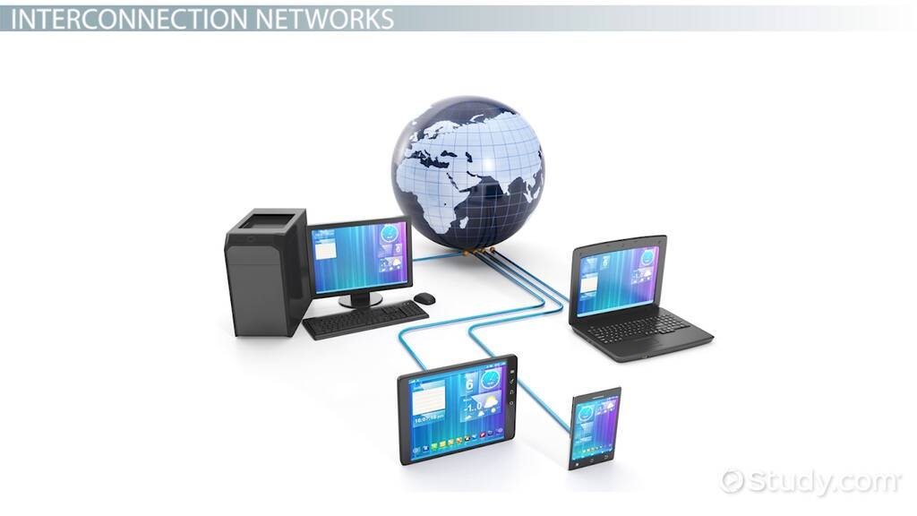
Enterprise network security
Protecting an organization's interconnected systems, data, and communication channels from unauthorized access, cyber threats, and data breaches.
This encompasses a range of security aspects: risk assessment, threat modeling, access controls, endpoint security, and adherence to regulatory standards.
Notes:
brief overview of enterprise network security.
Importance of balancing components in Checkpoint Architecture.

Slide 3




Threat Modeling
Analyzing representations of a system to highlight concerns about security and privacy characteristics
According to Threat modeling manifesto :
What are we working on ? -> Set context and objectives
What can go wrong ? -> Identify threats
What are we going to do about it ? -> Mitigate
Did we do a good enough job ? -> Validate
Requires teamwork
"Think like an attacker" mindset
Easier to create during the development phase of the system

Slide 4




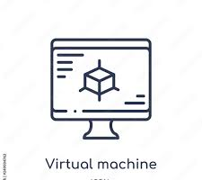

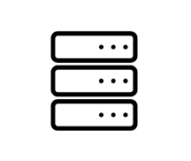
End Point Security
With the increase in remote working and the diversity of connected devices, ensuring the security of every endpoint becomes imperative to protect sensitive data and maintain network integrity.
Update and Patch Management
Antimalware and Antivirus
Data Encryption
Multi-factor authentication
Employee training

Slide 5
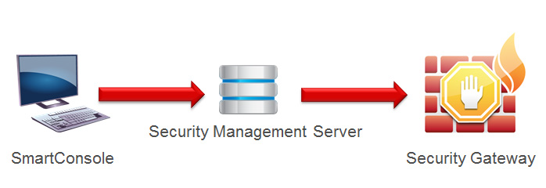
Checkpoint Architecture
Leading framework designed to fortify network defenses.
Main components
The Security Gateway acts as the frontline guardian, enforcing policies and scrutinizing network traffic.
The Management Server and Smart Console provide centralized management, monitoring, and real-time adjustments.
Notes:
Checkpoint Architecture Overview
Components: Security Gateway, Management Server, Smart Console.
Role in optimizing security posture: Centralized management, policy enforcement, threat prevention.

Slide 6


Stateful Inspection Technology
A packet is divided in two parts the first is the header which contain the informations of the packet (IP source, protocol packet,), the second is the playload who contains the message himself.
What is a statefull inspection and what's the difference with traditonnal packet filterring.
Stateful packet filtering keeps track of all connections on the network, making sure they are all legitimate.
Notes:
Stateful Inspection Technology
Comparison with traditional packet filtering.
Importance in modern cybersecurity: Comprehensive analysis of traffic, context-aware

Slide 7
Check Point Harmony for GIMV
Context
European investment company.
Invests in companies that fit into one of four investment platforms: Connected Consumer, Health & Care, Smart Industries and Sustainable Cities.
Security challenges
Secure critical data as GIMV develops its cloud IT strategy email and other attack vectors.
Simplify the task of managing an ever-changing threat landscape.
Solution
Check Point Harmony Email & Office.
Check Point Harmony Endpoint.
Benefits
Secured data as users move to Office365 and SharePoint Online.
Consolidated security architecture from one vendor, reducing costs and simplifying management.
Provided single pane of glass to manage distributed security environment.

Slide 8
An enterprise cloud protection
Check Point Harmony solution: what is it?
Family of cloud security products.
Prevent the latest fifth generation (Gen V) cyber-attacks targeting enterprise cloud services.
The portfolio includes Harmony Email & Office, CloudGuard Posture Management and CloudGuard Network Security.
Harmony Email & Office provides GIMV with unmatched protection for their software-as-a-service (SaaS) applications.
Results/success
Single control center to manage all the equipments to a single pane of glass.
CloudGuard SaaS solution integration to filter and protect mailbox.
E.g: Gimv receives 1,000 emails an hour. The solution flags all suspicious mails, removing any threats before they arrive at a user’s inbox = gives end users the confidence to know that the mail has already been checked.
With one single query they can find all the reports they need.
Notes:
Distributed

Slide 9
Conclusion
To conclude we can say that protecting an enterprise system from cyber attack is complex.
We have to delimit the needs and the level of security for each subsystems.
Cybersecurity is a domain that constantly evolves => as soon as a protection protocol is created, a crack is found and the protocol is not reliable.
It needs to be managed at each level in the system architecture and has to be monitored in order to keep the harmony of the protection.
Notes:
Conclusion
Recap of key points discussed.
Emphasis on the significance of balancing components in Checkpoint Architecture for enhancing security in enterprise networks.

