Slide 1
Lucifer-Satan: through Late Antiquity.
Paul Ian Adams
1701130
History And Theology
Notes:
How Lucifer was depicted before Christianity, How Christianity remoulded the Devil for their own needs, How Lucifer was reimagined in modern contemporary.
My research question is….modelled around what Lucifer was seen as in early Christianity Lucifer as the rebel son,, Personification of temptation.
And perhaps position of rulership.

Slide 2

Aims and Objectives
To investigate the character of Lucifer and Satan.
From Heaven to Hell, and his personification of temptation.
Notes:
J. Harris (Violence and Responsibility pg. 19) “occurs when injury or suffering is inflicted upon a person or persons by an agent who knows (or ought reasonably to have known) that his actions would result in the harm in question”
Jeffrey Burton Russel, The Devil: Perceptions of Evil From Antiquity to Primitive Christianity, (New York: Cornell University Press, 1987).
The place of evil within the world, as a blend of an entity to remove and fight against but also to accept for some evil for Jeffrey Burton Russel is Neutral and not linked with Satan but seen as occurrences within life.
My aims and objectives for my dissertation is….. To investigate the story and debate behind two key aspects of lucifer-satan, what he was before the rebel, why he rebelled, the necessity of this character, etc etc
And the possible expansion into the attribute of rulership, from heaven to hell, while the rulership is a later belief.

Slide 3
Research Questions And Why
Origins- Who was Lucifer, what did he resemble and what was he associated with?
Contrasting the change in description and associations, what Lucifer has become.
Angels have been key in Christian history but remained within the Christian domain and their depiction were thus controlled.
How and Why did the Christian early fathers manifest Satan?
Notes:
Origins will start before Satan, to what was taken and corrupted to suit another need, in this case the Greek God Pan was turned evil and his form and associations made into evil and sinful.
This is an important question to ask as…… the area of angels is not really academically studied, with the idea of lucifer in modern times being, false and seen through a narrow perspective
Therefore my dissertation will be laid out….. Focusing on two key aspects of Lucifer, The rebel son (before and after), and his dealing with temptation, (Temptation of Jesus). With time permitting a focus upon His position as a ruler, both heaven and in hell.

Slide 4
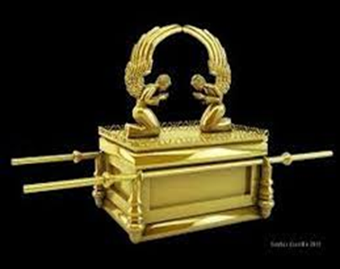
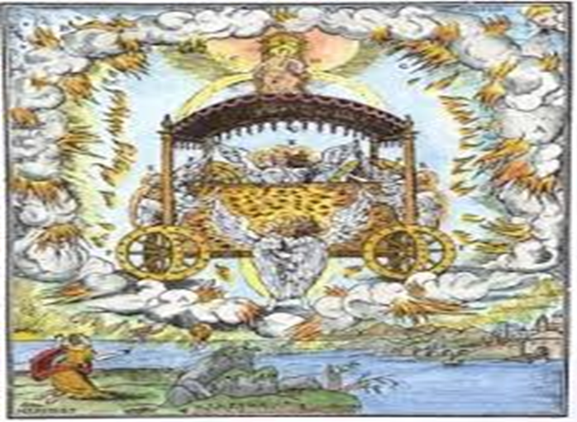
Original Research
Basic imagery and descriptions on the topic of angels, their medieval and modern usage and their importance.
Branched out to specific type of angels, such as Cherubs, depicted on the ark of the covenant. And angels known as “watchers”.
Notes:
Within these two images we see examples of the original focus, but they still have relevance to the refined topic.
The ark of the covenant was believed to hold two angels atop of its lid, creatures of beauty built within the religious sphere. And also the notion of what “watchers” looked like within the belief of angels. Seen more like machines or wheels rather than anything beautiful or radiant as was and is currently the norm. This can be useful as it conveys the transformation of what is considered as beautiful. And the changing imagery of the Christian church.
My original research was focused upon a broader perspective of angels as a whole, unfortunately the topic did not have adequate academic research, resulting in the focus being narrowed down to singular named angels.
So basically I changed away from this topic due to its broad nature.

Slide 5
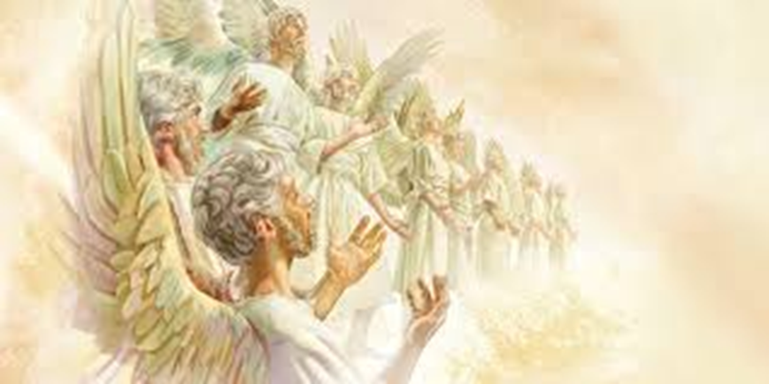
Refining Research
The original topic of just “Angels” and their depictions was too broad. The idea of selecting a specific type of angel was the next possible approach however again with limited sources and it being such a wide topic it was refined again to focus on named angels.
Lucifer being an easily sourced and renowned biblical figure.
Notes:
My research started upon the topic of angels, a heavenly concept known to all but understood by very few, even those within academic fields are few. This being the first reasoning for change of focus, to that of a singular angel. Michael and Lucifer were the top contenders being strong throughout history and seen as opposites, loyalty and disloyalty, light and dark. But for me Lucifer won the battle and became the singular focus. Lucifer stole what became his image and associations from others but within modern religious and secular canon he personifies them.
As stated on the previous slide the task was too broad. It then fell upon me to redirect my focus to another redefined aspects of the topic. I have chosen Lucifer due to the fact that he is well known as well as the fact that there is more sources relating to him. Also because of the fact that the Lucifer depicted in modern culture, while publicly accepted as Christian Canon, it is not thus resulting in my study upon Lucifer- Satan the Origin story.

Slide 6
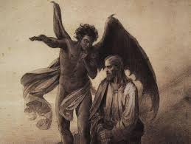
Two personifications of Lucifer
Rebellious, Lucifer before the fall as the brightest of all, the “Morning star” and what his rebellion and fall represented-Revelations 12:10
Temptation, Lust, Stolen from Pan alongside his depiction. Temptation of Jesus.
Notes:
Book of Job also addresses the inclusion of Evil in the world, and why the “righteous suffer”. Job destroyed Pagan temple-cause of satan’s despise.
Lucifer, Satan the Big devil, he is known by many names and is attributed as the cause of all Evil, but Jeffrey Burton Russell explains that not all Evil can be associated with the Devil for some most be deemed as “Neutral” or “Natural”. Events necessary to transpire otherwise Lucifer would be seen to have power on par with God and capable and committing deeds of evil with no repercussions.
references to Gospels of Matthew, Mark and Luke. Jesus temptation.
This is my research so far……

Slide 7
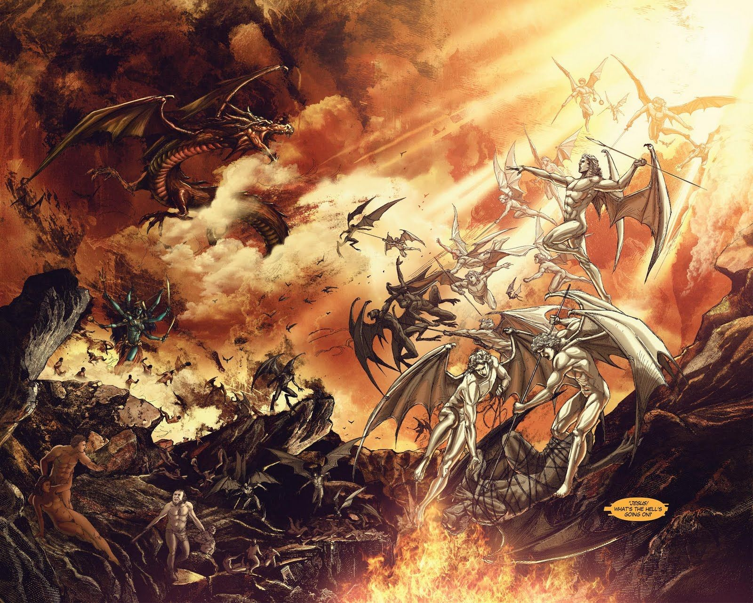
Rebel
Fall of Angels and Temptation.
In Balaam and the Ass, we see the first instance of an angel, being sent as an adversary. Dubbed as the Angel of the lord and assumed to be none other than Lucifer himself. As the name Satan later became synonymous as Adversary.
Garden of Eden, Snake as the embodied of the two focuses, Tempting of the fruit as a symbol of rebellion, to seek to be higher and better than God.
Notes:
“The angel of the Lord” being the King James Version
Numbers 22:21-38,
Balaam’s Ass- Angel as adversary.
While the focus here is based upon the inner meaning, this image capitulates the fall perfectly. Lucifer as a strong magnificient beast battling the light
VITA ADAE ET EVAE
Rebellious cause-After God had created Adam in his image, Michael commands the angels to worship him. The Devil becomes jealous and refuses to worship, saying: ‘I will not worship one inferior and subsequent to me. I am prior to him in creation; before he was made, I was already made. He ought to worship me’ (14:3).
Lucifer responds his position will be higher than God.
‘If he [God] be wrathful with me, I will set my throne above the stars of heaven and will be like the most high’ (15:3).
Fall of Lucifer.
‘He [Jesus] said to them, “I watched Satan fall from heaven like a flash of lightning”’ (Luke 10:18; cf. also Rev. 12).

Slide 8
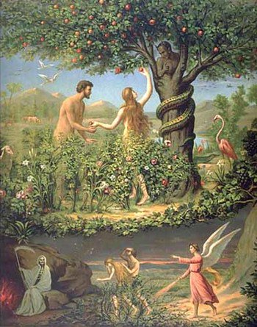
Tempter and Lust
As mentioned in previous slide, the role of the snake in the Garden of Eden as the tempter in God’s perfect garden. The Original Tempter and cause of the fall of man.
Lucifer became the embodiment of Lust, seen as the most sinful vice to the Early fathers.
Luicfer used as “Scapegoat” by the growing Christian church, associated with any other religion, sect or immoral behaviour. Seen with the combining of Egyptian Bes and the Greek Pan.
Notes:
Within Genesis, Job, and the books of the Apostles we have the tempter, cause of original sin, and inciting the tradition of rebellion within the Children of God. Tempting Job to rebel, to fall and curse god. And of course the temptation of Jesus, by Satan
Hedonism (hunger/satisfaction), Egoism (spectacular throw/might) and Materialism (kingdoms/wealth).
Importance of Pan towards to depiction and associated characteristics of Lucifer/Satan. 3rd to 5th Century
Pan was one of the Greatest obstacles for the Christian church to overcome, Situated within the hearts of the people as the God of fertility and lust the church wanted to dominate the heart alone, so the imagery and associations of Pan became associated with the ultimate evil, this is when The devil became the champion of Lust and seen as the cause when men fell to Lust outside of marriage.

Slide 9

Any Questions or Remarks?
Good and bad welcome

Slide 10
Bibliography
Primary
Bible:
  Genesis
  Numbers
  Isaiah
  Revelations
The book of Enoch
Secondary
Jeffrey Burton Russel, The Devil: Perceptions of Evil From Antiquity to Primitive Christianity, (New York: Cornell University Press, 1987).
John Harris, Violence and responsibility, (London, Routledge and K. Paul,1990).
Rev. Thomas Knowles, Satan’s Devices Exposed, (London: J. and J. Jackson, Market Place louth, 1821).
The Snake in the Grass: Or Satan Transform’d into An Angel of Light, (London: Gun of the West-End of St. Paul’s, 1698).
Satan The Leader in chief to all who resist the preparation of Sion, (London: Order of the House of Commons, 1643).
Notes:
Speak about blibio if time allowed, take a summary of what each source is providing
The Apocryphal Adam and Eve in Medieval Europe
Vernacular Translations and Adaptations of the Vita Adae et Evae
BRIAN MURDOCH
Oxford University Press

