Slide 1
Health Trends
Presentation Support Activity

Slide 2
Admission Episodes in English NHS hospitals/ English independent sector with diagnosis of Rickets in 0-17 year olds (2002-2012)
Parliament UK (2013) Statistics provided by The Hospital Episode Statistics, Health and Social Care Information Centre.

Slide 3
Measles Notifications in England and Wales 1940-2010
(Public Health England, 2010)

Slide 4
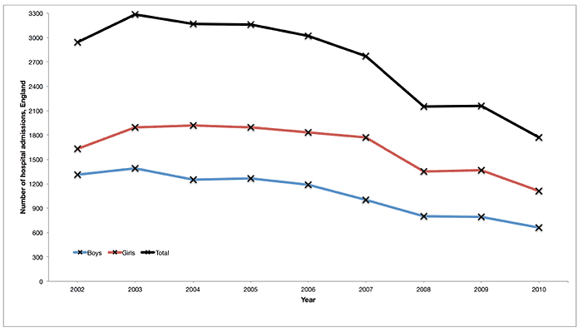
Alcohol-related hospital admissions
2003 – 3286 hospital admissions in England for children up to the age of 14
2010 – 1772 hospital admissions in England (roughly half)
(Institute of Alcohol Studies 2013)

Slide 5
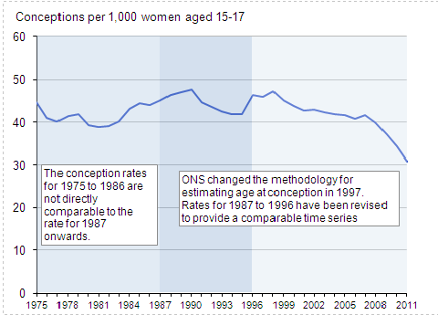
Under 18 Conception Rate, 1975–2011
England and Wales
(Office of National Statistics, 2013))

Slide 6
Confirmed Cases of Measles in Wales 1996-2012
(Public Health England 2013)

Slide 7
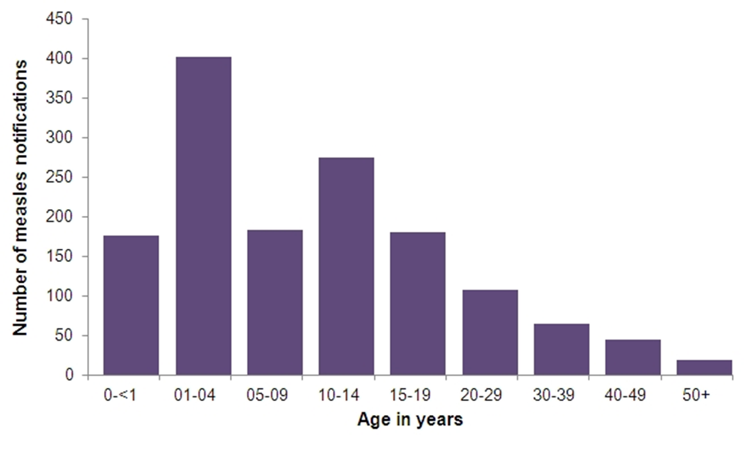
Welsh Measles Outbreak 2013 – Age statistics
(Public Health Wales, 2016)

Slide 8
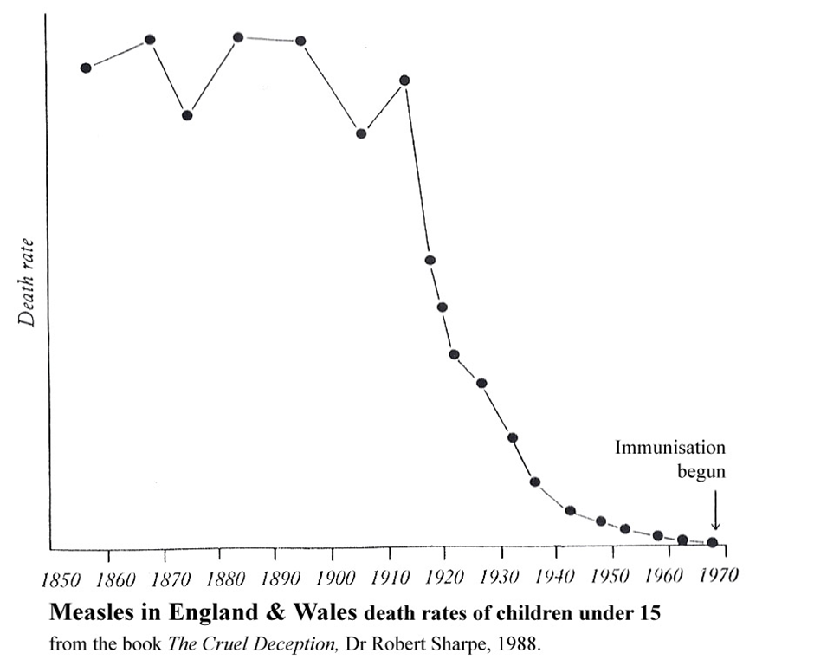
Death Rate of Children under 15 in England and Wales from Poliomyelitis
(Sharpe, 1988)

Slide 9
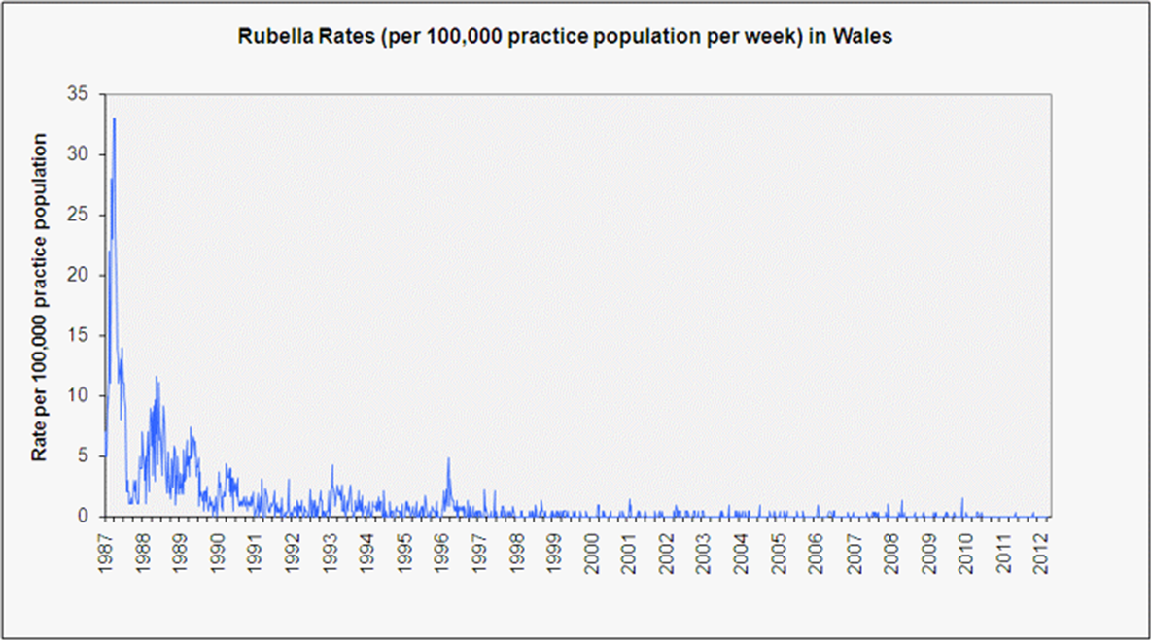
Rubella Rates in Wales 1987 – 2012
(Public Health Wales, 2014)

Slide 10
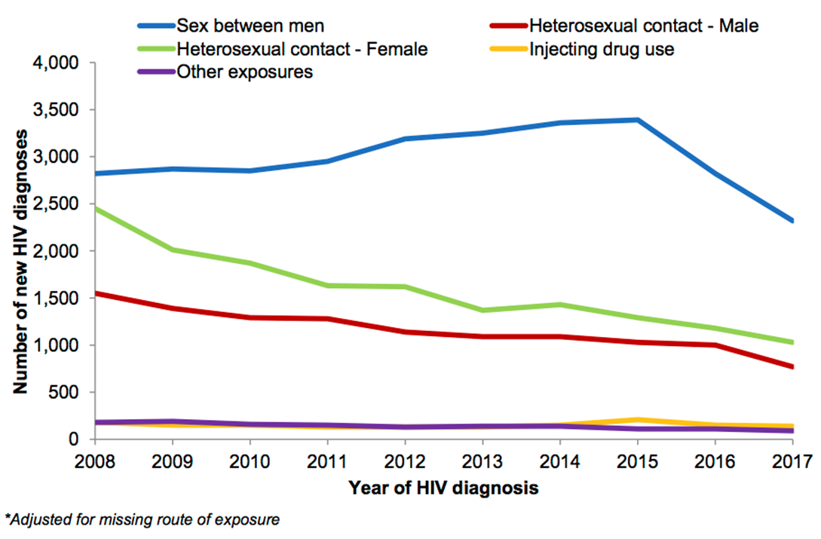
HIV Diagnosis in the United Kingdom
(Public Health England, 2018)

Slide 11
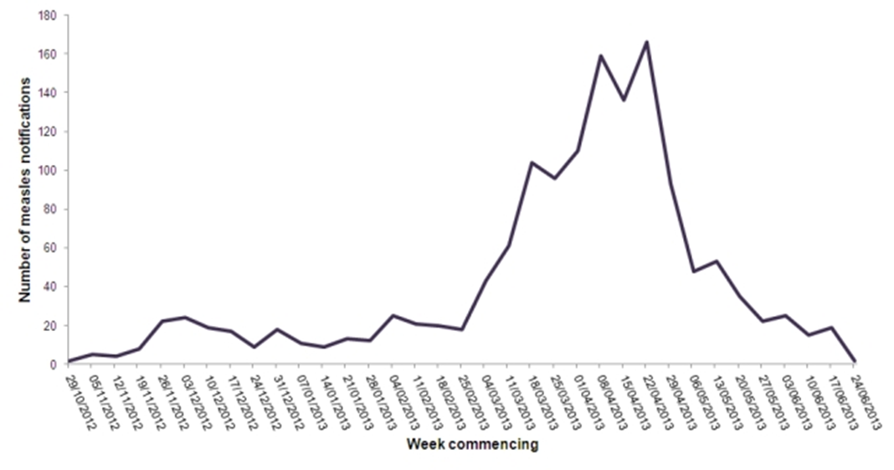
Measles Outbreak in Wales in 2013
(Public Health Wales, 2016)

