Slide 1
Scriptwriting
M4X01654

Slide 2
Genre & Scriptwriting
Conventional wisdom

Slide 3
What is genre?
Genre is a set of conventions between:
  Filmmakers
  Industry
  Critics
  Audience
Notes:
Filmmakers – directors, producers who choose to work in genres they wish to explore or are comfortable working within
Film Industry – studios, distributors, censors, who use genre to decide what to make, how to market it, who to market it to
Critics – some dismiss genre films as generic, others embrace specific genres as a specialism
Audience – use genre to help make consumer choice

Slide 4
How do genres develop?
Genres do not arrive fully formed and develop through different phases:
  Evolution
  Definition
  Decline
  Deviation
Notes:
Evolution – early developments that build elements of the genre, such as silent Westerns of Tom Mix, Edwin S Porter
Definition – the period where 'classics' are produced that establish the conventions that provide the essence of what genre is, such as the Westerns of the 1930s and 1940s, of the major studios and figures like John Ford and Howard Hawks
Decline – the fall in popularity of Western movies in 1950s and 1960s, partially through decadence of genre, partially through TV series exhausting the genre, culminating in the parody of Blazing Saddles exposing the fascist heart of much of the Western myth
Deviation – reinvention, reinterpretation, the mixing of genres, from Sam Peckinpah's work, to Spaghetti westerns to 'modern' westerns, from Hud to Brokeback Mountain

Slide 5
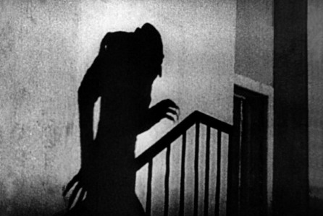
Nosferatu (1922)
Notes:
https://www.youtube.com/watch?v=e7p3ct5hcks
1:23-02

Slide 6
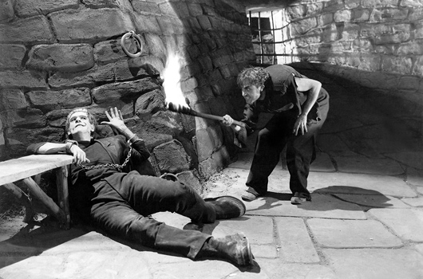
Frankenstein (1932)
Notes:
https://www.youtube.com/watch?v=1qNeGSJaQ9Q

Slide 7
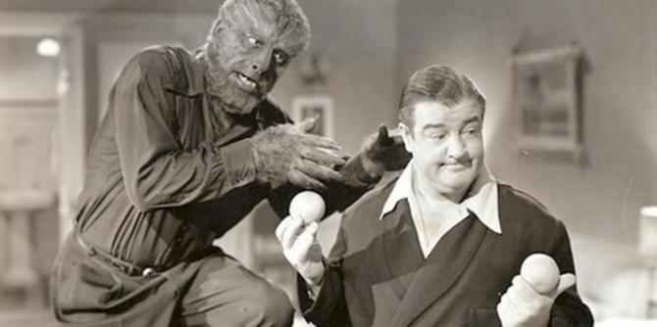
Abbott And Costello Meet Frankenstein And The Wolfman (1945)
Notes:
https://www.youtube.com/watch?v=x0YLLkr7VfU

Slide 8
The cultural functions of genre
Genres have iconography – what else does?
Genres address commonly held values:
  Reaffirm cultural values
  Exploit ambivalent values
  Validate changing values
Notes:
There is another cultural aspect to consider with respect to genre, and that is the role of genre as ritual, as ceremony.
The conventions of genre serve much the same purpose as rituals, both civil, like holidays, and religious. That word iconography is not used by accident, it is potent religious terminology for what are totemic images, symbols that are become a shorthand across films in a genre.
Reaffirm cultural values – heroism in war, romantic love triumphing, criminals punished
Exploit ambivalent values – transgressive thrill in gangster's success, cathartic excitement of horror
Validate changing values – Ripley in Alien series shows changing role of women, roles in Morgan Freeman's career show America's changing attitude to race (from pimp in Street Smart, to President in Deep Impact, to God in Bruce Almighty)

Slide 9
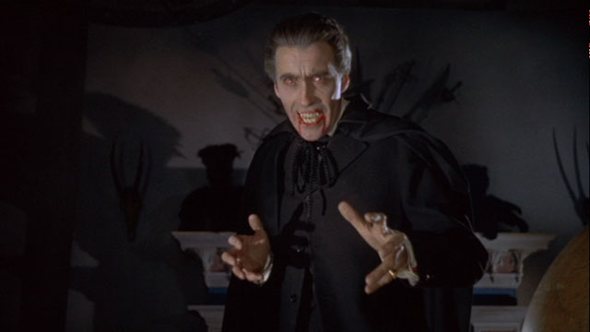
Dracula (1958)
Notes:
https://www.youtube.com/watch?v=ssvgMHCa45s

Slide 10
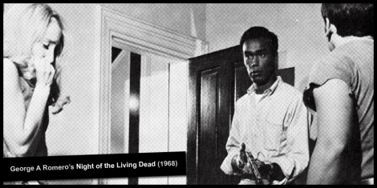
Night Of The Living Dead (1968)
Notes:
https://www.youtube.com/watch?v=-_f2Enn8x5s

Slide 11
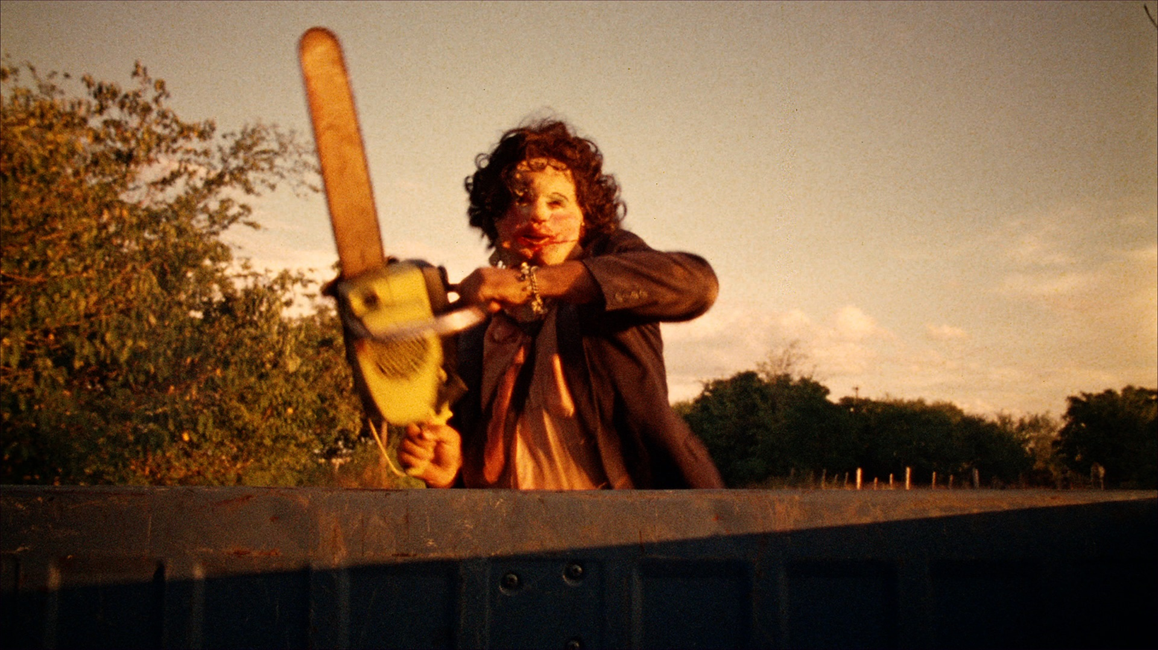
The Texas Chainsaw Massacre (1974)
Notes:
https://www.youtube.com/watch?v=hTj4jype5Ec

Slide 12
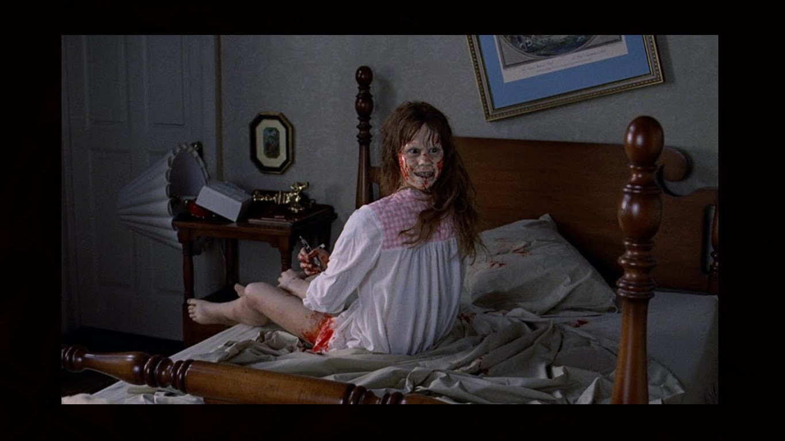
The Exorcist (1973)
Notes:
https://www.youtube.com/watch?v=_JUS23RCOfc

Slide 13
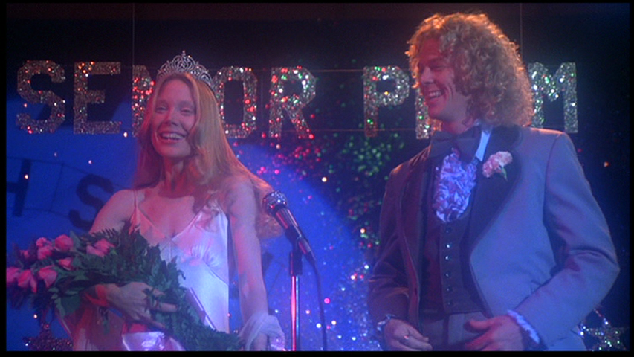
Carrie (1976)
Notes:
https://www.youtube.com/watch?v=0xe0BayQQuc

Slide 14
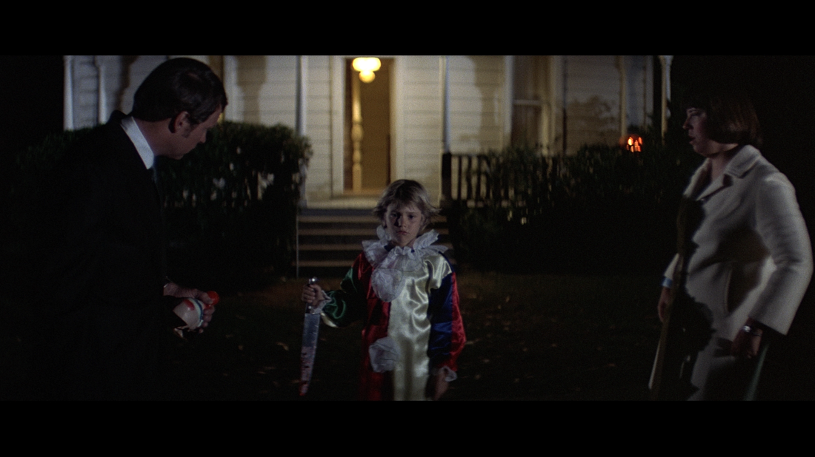
Halloween (1978)
Notes:
https://www.youtube.com/watch?v=jXrhObXq42o

Slide 15
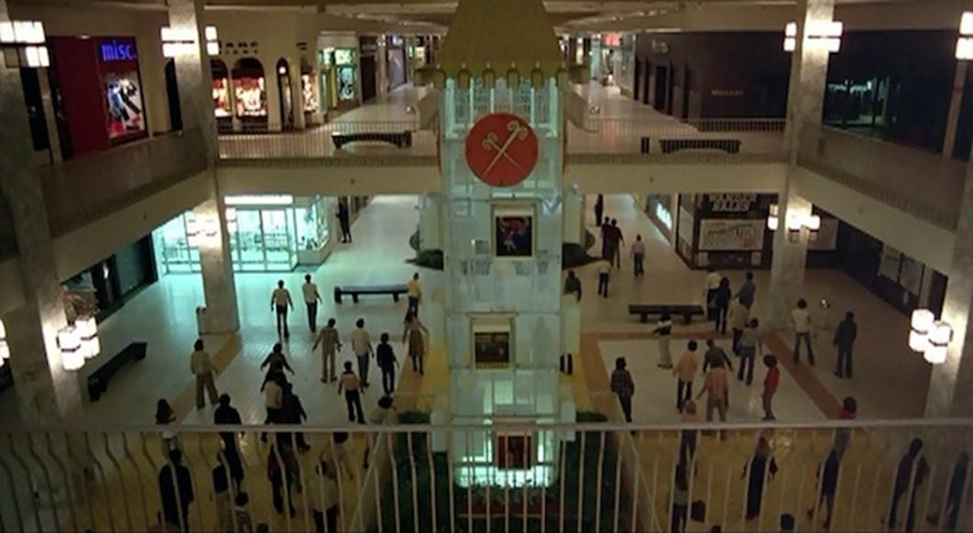
Dawn Of The Dead (1978)
Notes:
https://www.youtube.com/watch?v=dyucU5rtIu8

Slide 16
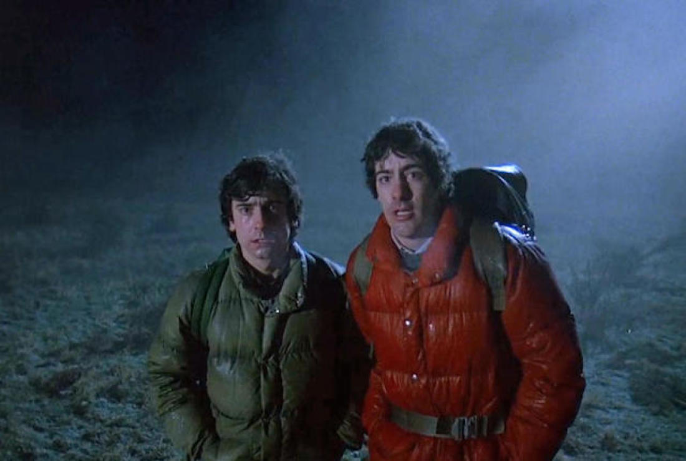
An American Werewolf In London (1981)
Notes:
https://www.youtube.com/watch?v=Hb7zhYzenhY

Slide 17
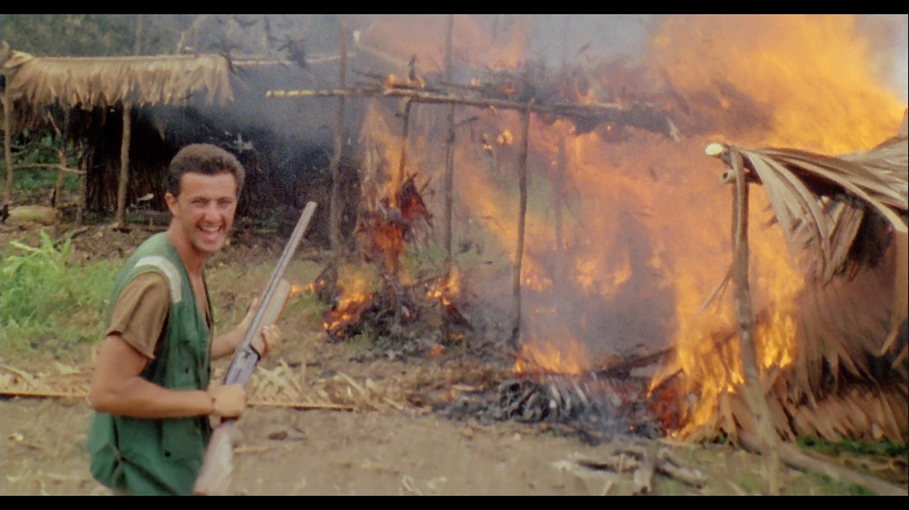
Cannibal Holocaust (1980)
Notes:
https://www.youtube.com/watch?v=dnwsZc6gPdY

Slide 18
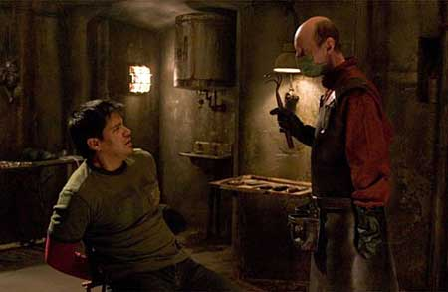
Hostel (2005)
Notes:
https://www.youtube.com/watch?v=Sheczj5F9lY

Slide 19
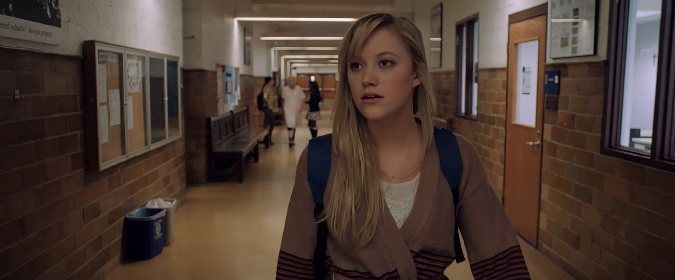
It Follows (2013)
Notes:
https://www.youtube.com/watch?v=BRGZbILssWo

Slide 20
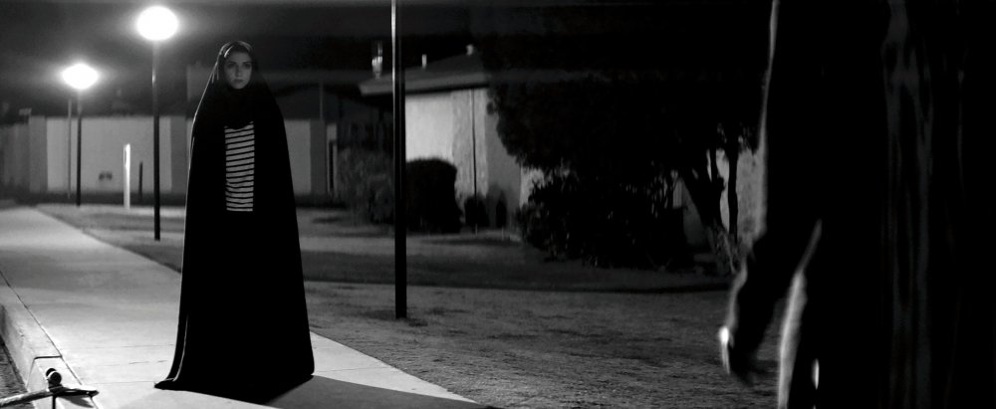
A Girl Walks Home Alone At Night (2014)

Slide 21
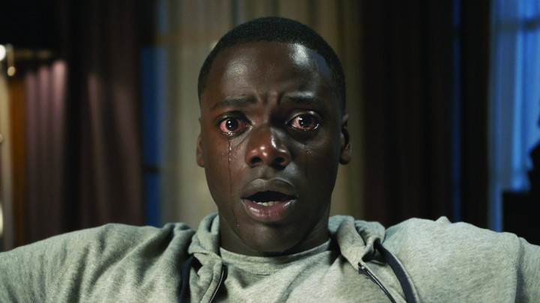
Get Out (2017)
Notes:
https://www.youtube.com/watch?v=OT61p6s77_U

Slide 22
Levels of genre
Sub-genre
Genre
Blanket genre
Supra-genres
Notes:
At the smallest level, there is the subgenre, such as: Vietnam war, Torture porn, Spaghetti western
At the next level, is the genre, such as: War, Horror, Western
Above this, blanket genres, mega genres, very large and complex and containing genres and sub genres, such as:
Comedy – romantic, screwball, gross out, black, western, war, horror and many more
Crime – just switching the point of view of story gives us gangster, detective, courtroom drama, investigative reporter films, prison movies
Action/adventure and social issue drama are similarly broad.
And above even these are the supra-genres, styles, techniques, settings that can contain sub genres, genres and blanket genres, such as:
Historical drama
Biography
Musical
Science Fiction
Animation

Slide 23
Genre conventions
A genre is defined by various conventions:
  By subject or theme – gangster films concentrate on activities of criminal underworld, typically a gangster's rise and fall, science fiction films are about technology beyond what is currently available
  By presentation – in musical films, characters express themselves through song and dance as well as dialogue
  By narrative form – the mystery or detective film is plot centred around severely restricted narration
  By technical application – the 3D film, the phantom ride film, the digital backlot film, the Dogme 95 film
  By emotional response – the comedy offers laughs, the thriller offers tension

Slide 24
The genre scriptwriter’s dilemma
Stick too closely to conventions:
  Lapse into cliché
  Limit funding opportunities
  Limit audience to die-hard fans
Veer too far from conventions:
  Confuse readers
  Deter an audience
  Limit funding opportunities

Slide 25
Working with genre
Genre films are inherently intertextual
Genre films are, to an extent, hybrids
Genre films are necessarily self-conscious
To what extent is every film a genre film?

Slide 26
Workshop exercise
Take the one of the three genres you have been assigned for the portfolio and create a genre image kit identifying the following key conventions:
  Characters
  Locations
  Objects
  Events
Use a digital format (create a doc, use Pinterest, etc.)
You have 20 minutes

Slide 27
Workshop exercise
Using the assignment brief as a guide, select the required number of characters and locations from your genre image kit
Select an event and an object from your genre image kit
Brainstorm a short story idea for a script
You have 20 minutes

Slide 28
Workshop exercise
Choose at least one of the conventions
Brainstorm how you might subvert this convention
  Switch identity (gender, sexuality, race, class)
  New location
  Blend with conventions of a different genre
Rewrite your story pitch
You have 20 minutes

