Slide 1
Computer Architecture & OS ACCA4022
Week 3: Session 2:
Computer Buses

Slide 2
Learning Outcome
By the end of this session, students should be aware of:
What is Computer bus?
How to describe Computer bus?
Types of Computer bus
Functions of Computer bus
Structure and Topologies of Computer bus

Slide 3
What is Computer bus?
In peers, please search on the Internet about computer bus and come up with the best description you can about it.
Take 10 minutes to compete this task

Slide 4
What is Computer Bus?
A computer bus is also known as a local bus, data bus and address bus, where a bus is a link between components or devices linked to a computer
A bus is a communication system in computer architecture that transfer data between components inside a computer, or between computers
Computer bus is collection of wires through which data is transmitted from one part of a computer to another
It is an electrical or digital pathway through which bits are transmitted between the various computer components
In other words, computer bus is the channel which lets the parts of a computer communicates with each other

Slide 5
How to Describe Computer Bus?
A bus group of lines/wires which carry computer signals
A bus is the means of shared transmission
Data can be transferred from one computer system location to another between different I/O modules, memory, and CPU
The bus is not only cable but also hardware (bus architecture), protocol, program, and bus controller
The term bus refers to the internal bus of a computer system. It is also known as communication pathways
Every bus has a clock speed measured in MHz. In a 32 bit but, data are sent over 32 wires simultaneously

Slide 6
How does Computer Bus Look Like?
Cable buses – connection cables
Motherboard buses

Slide 7
Types of Computer Bus

Slide 8
Types of Computer Bus – Address Bus
It is a channel which transmits address of data (not the data) from the CPU to memory
The address bus is a one-way pathway that allows information to pass in one direction only, carries information about where data is stored in memory
The address bus consists of 16, 24, or 32 parallel signal lines
The number of lines (wires) determines the amount of memory that can directly addressed as each line carries one bit of the address
For example, a computer with 32 bit address can address 4GB of physical memory

Slide 9
Types of Computer Bus – Data Bus
Data bus is a channel across which actual data are transferred between the CPU, memory and I/O devices
The data bus consists of 8, 16, 32, or 64 parallel signal lines. Each wire can transfer 1 bit of data at a time. For example: an 8 wire bus can move 8 bits at a time which is bull byte
The number of wires in the bus affects the speed at which data can travel between hardware components. The wider the data bus, more data it can carry at one time
The data bus is bidirectional. This means that the CPU can read data in from memory or it can send data out to memory

Slide 10
Types of Computer Bus – Control Bus
The physical connections that carry control information between the CPU and other devices within the computer.
This bus is mostly a collection of unidirectional signals
It is the path for all timing and controlling functions sent by the control units to other units of the system
It carries signals that report the status of various devices
For example: one line of the bus is used to indicate whether the CPU is currently reading from or writing to main memory. Others are I/O Read/Write

Slide 11
Types of Computer Bus – System Bus
System bus is the set of wires, that interconnects all the components (subsystems) of a computer
- A source component sources out data onto the bus
- A destination component inputs data from the bus
May have a hierarchy of buses
  Address, data and control buses to access memory and an I/O controller
  Second set of buses from I/O controller to attached devices/peripherals
  Peripheral Component Interconnect (PCI) bus is an example of a very common local bus

Slide 12
Types of Computer Bus (Additional)
Bus types based on the components being connected: The computer system buses can be classified on the basis of type of the components being connected as:
- System bus
- Expansion bus
- Input and Output bus
Bus types based on the location of components: The computer system buses can also be classified on the basis of location of the component being connected as:
- Internal bus
- external bus

Slide 13
Functions of Computer Buses
Below are a few of the functions in a computer bus:
Data sharing:
  All types of buses used in network transfer data between the connected computer peripherals
  The buses either transfer or send data in serial or parallel transfer method
Addressing: A bus has address lines that suit the processors. This allows us to transfer data to or from different locations in the memory
Power: A bus supplies the power to various connected peripherals

Slide 14
Functions of Computer Buses - Summary

Slide 15
Structure and Topologies of Computer Buses
Lines are grouped as mentioned below:
Power line provided electrical power to the components connected
Data lines carrying data or instructions between modules of the system
Address lines indicate the recipient of the bus data
Control lines control the synchronization and operation of the bus and the modules linked to the bus

Slide 16
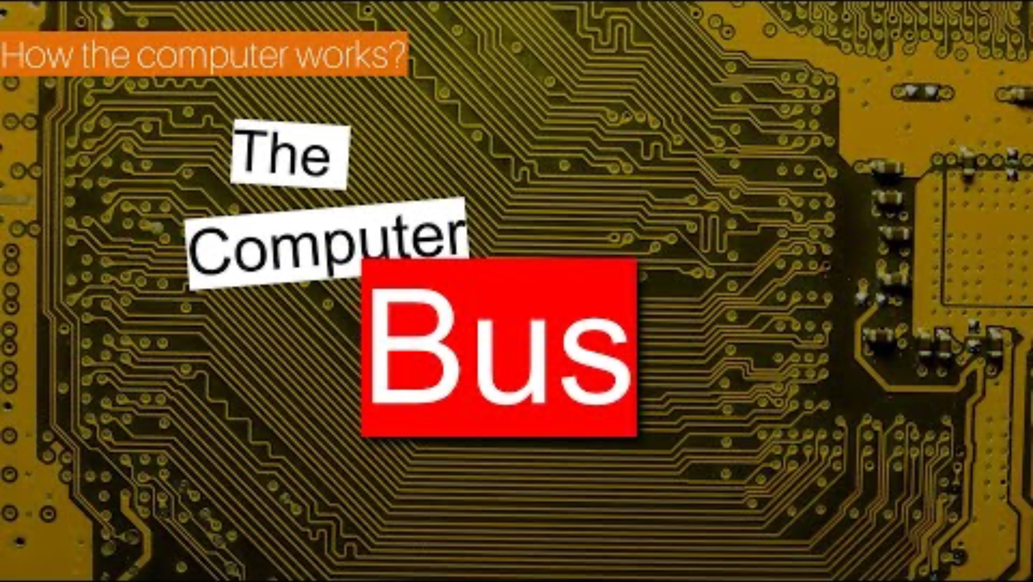
To Summaries
https://www.youtube.com/watch?v=VvEikwvyN8k&t=90s

Slide 17
References
W. Stallings, Computer Organisation and Architecture, London: Pearson, 2016
I. Englander, The architecture of Computer Hardware, Systems Software & Networking – An Information Technology Approach, London: John Wiley & Sons, 2014
M. M. Mano, Digital Logic and Computer Design, India: Prentice-Hall, 2003
V. Vijayendran, Fundamentals of Microprocessor – 8085, Chennai: S. Viswanathan (Printers & Publishers), PVT. LTD, 2004
Learn Computer Science (2021) Computer Bus [Online] https://www.learncomputerscienceonline.com/computer-bus/

Slide 18
Any Questions?

Slide 19
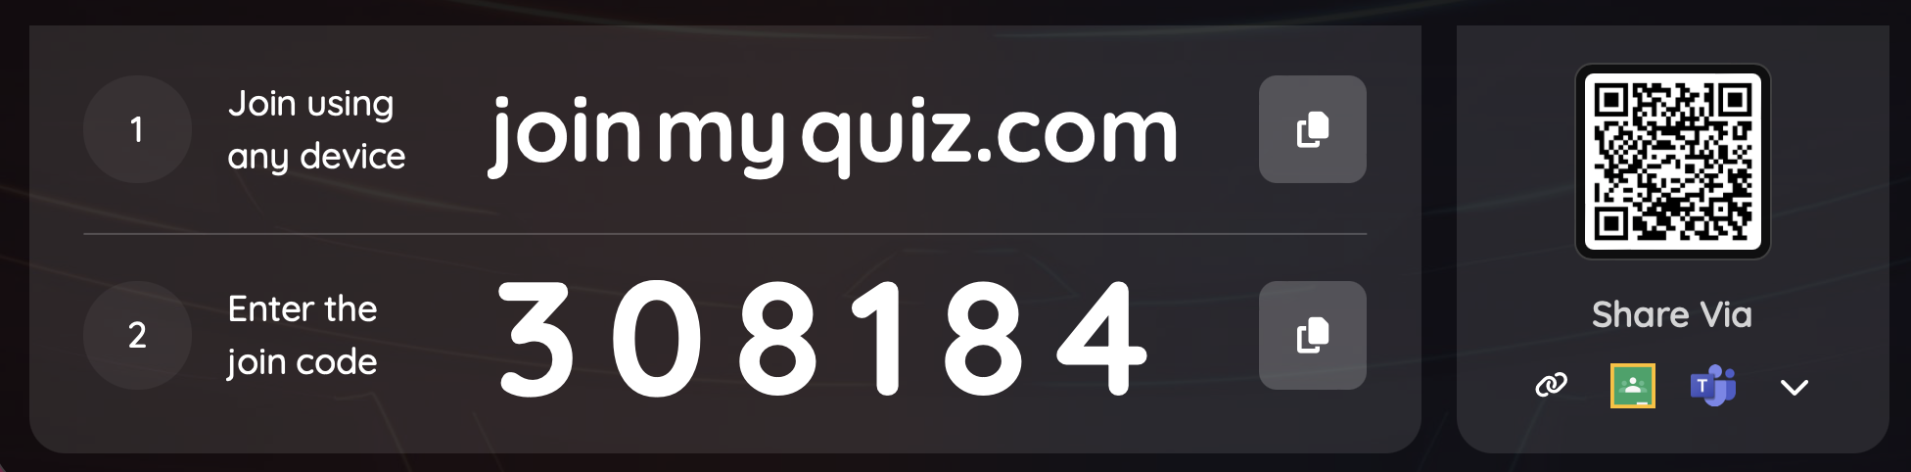
Testing Your Understanding

