Slide 1
Week 6
Community Care and Management of Longer-term Conditions
LCHS7003
Consolidation

Slide 2
Module Summary
The module aims overall to develop student understanding of the theories, values and policies in managing patients with longer term conditions in different healthcare settings.
To gain an understanding of healthcare work across traditional primary/secondary/social care boundaries and collaborate with patients/carers and other professionals within the NHS, social and private/voluntary sector to continuously improve the information, support, care, and person-centred approaches to treatment of people living with long term conditions.

Slide 3
Long term conditions
What do we mean by this?
Definition: A Long Term Physical Health Condition (also known as a Chronic Condition) is a health problem that requires ongoing management over a period of years or decades and is one that cannot currently be cured but can be controlled with the use of medication and/or other therapies. (NHS, n.d.)

Slide 4
Examples?
Diabetes
Cardiovascular (e.g. Hypertension, Angina)
Chronic Respiratory (e.g. Asthma, Chronic Obstructive Pulmonary Disease (COPD))
Chronic Neurological (e.g. Multiple Sclerosis)
Chronic Pain (e.g. Arthritis)
Post-COVID-19 syndrome (see Long COVID)
Other Long Term Conditions (e.g. Chronic Fatigue Syndrome, Irritable Bowel Syndrome (IBS), Cancer) etc.
(NHS, n.d.)

Slide 5
What are the causes of long term conditions?
Broadly speaking these can be either
Modifiable.
Non-modifiable.
What is the difference?
How many of each can you identify?

Slide 6
Modifiable risk factors
Things that can be changed in some way.
For example
Levels of activity
Tobacco use
Alcohol consumption
Diet

Slide 7
Non-modifiable factors
These are factors which cannot be changed.
For example
Age
Sex (not Gender)
Ethnicity
Genes

Slide 8
Examples of Long Term Conditions
Task: In pairs, thinking back to slide four (Examples from the NHS) can you divide these into broadly resulting from either modifiable or non modifiable risk factors.
There may be more than one factor, for example traditionally more men than women smoked potentially resulting in the higher rates of lung cancer in men. (Cancer Research UK, n.d.)

Slide 9
Feedback
Alcohol use
Diet
Age
Sex
Ethnicity
Genes

Slide 10
Multiple Long Term Conditions (MLTC)
Definition:
MLTC refers to the co-existence of two or more chronic conditions (physical or mental) in a person. In medical and research circles, this has often been referred to as 'multimorbidity’ (National Institute for Health and Care Research, n.d.)

Slide 11
Risk Factors for MLTC
Deprivation
Obesity
Diet
Smoking
Pollution
Alcohol
What is the common factor? Take five minutes to think about this.

Slide 12
The Challenge
There are an estimated 14 million people in England living with MLTC. This number is growing, in line with an ageing population.
MLTC also affects young people, with almost 20% of 25–64 year-olds having more than one condition. Those living in the most deprived areas are more likely to develop MLTC earlier in life.

Slide 13
People with MLTC account for more than half of NHS primary and secondary care costs.
Clinical services are typically organised around single conditions. This means the health and care system does not work as well for people living with MLTC.
People are often passed between specialists, having to repeat their stories and feel the management of their conditions fails to take account of their needs.

Slide 14
Levels of Care
Primary- for example?
Secondary- for example?
Tertiary- for example?
Community health- for example?

Slide 15
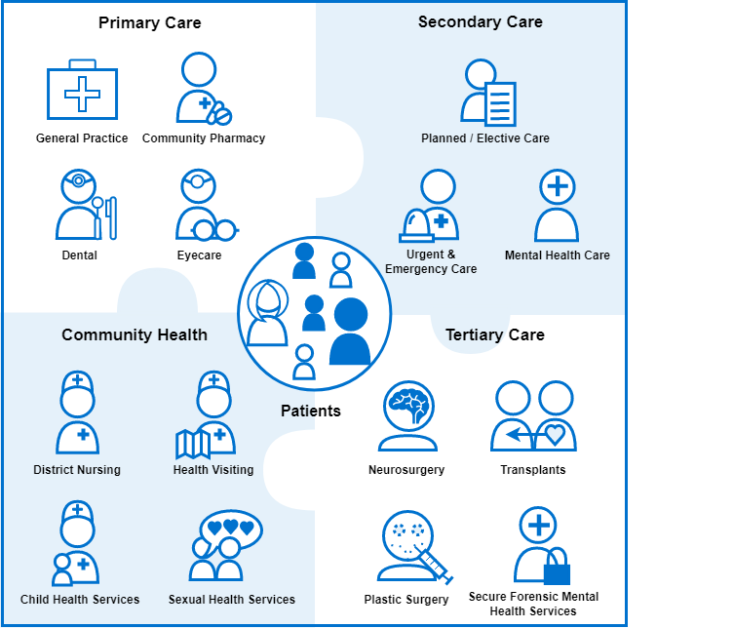
(NHS Digital, n.d.)

Slide 16
Levels of care
Care providers do not operate in isolation. Primary, secondary, tertiary and community care are intended to act as a single, integrated care system.
Patients are passed from one provider to another as appropriate, for example when a General Practitioner refers a patient to a specialist in secondary care.
Ensuring continuity of care when a patient is transferred between providers is an important part of the overall patient experience. (NHS Digital n.d.)

Slide 17
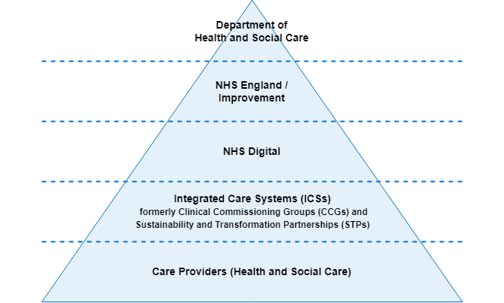
Elements of care
(Now referred to as Integrated care)

Slide 18
Recent changes
Clinical Commissioning Groups (CCGs) were replaced by Integrated Care Systems (ICSs) in April 2022.
The ICSs will fund NHS care providers at a local level. This change is intended to bring together healthcare providers, commissioners and local authorities at a local level to improve the level of integrated care

Slide 19
Other relevant organisations
NHS Digital (NHSD) provides digital healthcare services at national level.
The Department of Health (DoH) and NHS England (note devolution of some areas in Wales, Scotland and Northern Ireland)
National Institute of Clinical Excellence (NICE) provides national guidance and advice to improve health and social care. This includes evidence based treatments and quality standards.

Slide 20
Models of Care
Many different models of care.
House of Care model
The Year of Care approach
NHS and Social Care model
Innovative Care for Chronic Conditions model
Public Health model
Continuity of Care model

Slide 21
Group Activity
Use the VLE or other resources to find the key features of one of the models on the previous slide.
Feedback key points to other groups

Slide 22
Person Centred Care
What do we (professionals) mean by this? How might this differ for people living with MLTC think of person centred care?
Take five minutes to discuss this with someone else in the class.
NOTE. Person Centred rather than Patient Centred.
Extension activity. Does this matter? Why?

Slide 23
Sounds simple doesn’t it?
Most people working in the health services believe they’re already delivering it. Yet research shows that only half of patients say they are involved as much as they want to be in decisions about their health care.
Only 3% of people living with a long-term condition report having a care plan – and only three-quarters of them report having helped put it together.

Slide 24
What do people think
People living with long-term conditions give their views

Slide 25
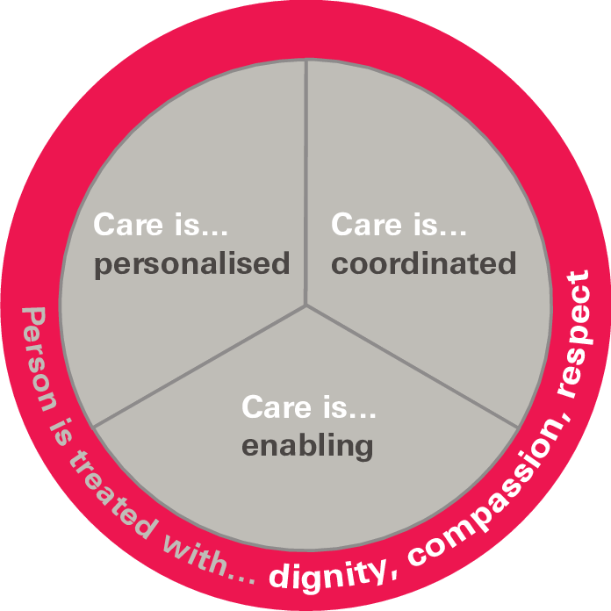
Collins’s Four principles of PCC (cited in Louw et al., 2017)

Slide 26
Group Work
In groups consider what these principles mean and give examples from practice.
Extension activity. Collins’s four principles is one model use the internet to see what other models you can find. How do they differ? Are there any similarities?

Slide 27
Principles of Person-centred care
“Affording people dignity, compassion and respect.
Offering coordinated care, support or treatment.
Offering personalised care, support or treatment.
Supporting people to recognise and develop their own strengths and abilities to enable them to live an independent and fulfilling life”.

Slide 28
Self management for people with MLTC
Spend five minutes thinking about the risk factors for people with MLTC.
Now think about how able they might be to be self managing.
What issues can you identify?

Slide 29
End of life care
What does this mean?
Definition.
End of life care is support for people who are in the last months or years of their life. (NHS, n.d.)
Sometimes used interchangeably with Palliative Care

Slide 30


Palliative Care

Slide 31
Things to consider
Liverpool Pathway for the Dying Patient (LCP)
The Liverpool Care Pathway for the dying: what went wrong?

Slide 32
Support for people
Lasting Power of Attorney
Not for Resuscitation agreement (DNACPR)
Respect Agreement

Slide 33
References
Cancer Research UK (n.d.) Lung Cancer Statistics [https://www.cancerresearchuk.org/health-professional/cancer-statistics/statistics-by-cancer-type/lung-cancer#heading-Zero] accessed 22/3/2023
Knights, D., Wood, D. and Barclay, S. (2013) “The Liverpool Care Pathway for the dying: what went wrong?” British Journal of General Practice. 63(615) 509-510 available at [https://www.ncbi.nlm.nih.gov/pmc/articles/PMC3782767/] accessed on 22/3/2023)
Louw, Jakobus & Marcus, Tessa & Hugo, Jannie. (2017). “Patient- or person-centred practice in medicine? – A review of concepts”. African Journal of Primary Health Care & Family Medicine. 9. 10.4102/phcfm.v9i1.1455.
National Institute for Health and Care Research (2021) Multiple long-term conditions (multimorbidity): making sense of the evidence. Available at [https://evidence.nihr.ac.uk/collection/making-sense-of-the-evidence-multiple-long-term-conditions-multimorbidity/] accessed on 22/3/2023
National Institute for Health and Care Research (n.d.) Multiple long-term conditions research [https://www.nihr.ac.uk/about-us/our-key-priorities/multiple-long-term-conditions.htm#:~:text=What%20are%20multiple%20long%2Dterm,referred%20to%20as%20'multimorbidity’.] accessed 22/3/2023
NHS Digital, (n.d.) The healthcare ecosystem. Available [https://digital.nhs.uk/developer/guides-and-documentation/introduction-to-healthcare-technology/the-healthcare-ecosystem] accessed 22/3/2023
NHS, (n.d.) NHS Data Model and Dictionary [https://www.datadictionary.nhs.uk/nhs_business_definitions/long_term_physical_health_condition.html#:~:text=Examples%20of%20Long%20Term%20Physical,Obstructive%20Pulmonary%20Disease%20(COPD))] accessed 22/3/2023
NICE (n.d.) Managing long-term conditions in the community. Available at [https://www.nice.org.uk/about/what-we-do/into-practice/measuring-the-use-of-nice-guidance/impact-of-our-guidance/niceimpact-children-and-young-peoples-healthcare/ch2-managing-long-term-conditions-in-children] accessed on 22/03/2023
Social Care Institute of Excellence (SCIE) (2019) Video about achieving dignity in end of life care
The Health Foundation, (2014) A quick guide to person-centred care. Availible at [https://www.health.org.uk/newsletter-feature/a-quick-guide-to-person-centred-care] accessed 22/03/2023

