Slide 1
Causation

Slide 2
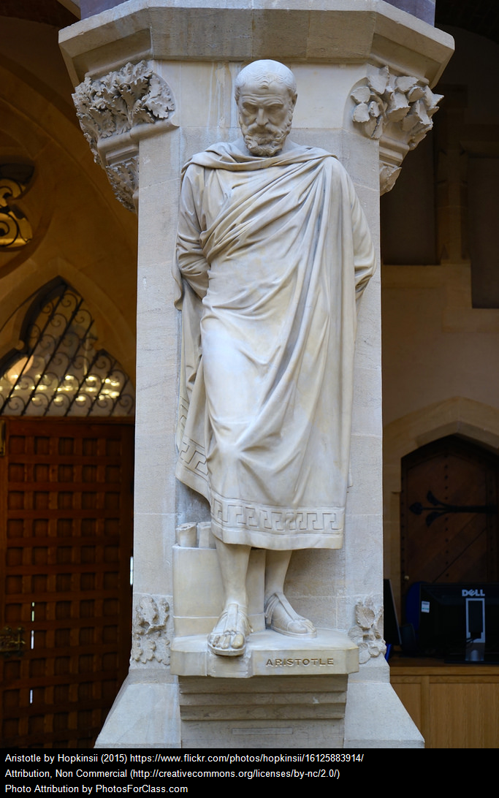
Aristotle
Four causes:
Efficient
Material
Formal
Final

Slide 3
Universality
Uniformity
Power
Necessity

Slide 4

Hume
Impressions
Ideas
Difference between impressions and ideas
Importance of source
Source of necessary connection?

Slide 5
Seeks the impression of necessary connection in single cases of objects.

Slide 6
Seeks the impression of necessary connection in the mind’s control of bodily movements.

Slide 7

Experienced regularities
Constant conjunction

Slide 8
(a) Each thing of the first kind is spatially contiguous with a thing of the second. (Bk 1, part III, sec 2, p.75)
(b) Things of the first kind are temporally prior to things of the second. (Bk1, part III, Sec 2, p.76)
(c) We have a habit (or disposition) when presented with things of the first kind to expect things of the second. (Bk 1, part III, Sec 14, p.165).

Slide 9
Imperfect definitions
‘an object, followed by another, where all the objects similar to the first are followed by objects similar to the second’.
‘an object followed by another, and whose appearance always conveys the thought to that other.’

Slide 10
Concluding Analysis
Two interpretations?

Slide 11
1. What do you think of Hume’s theory of causation? Do you get the impression that he believes in causation or not?
2. Has Hume succeeded in clarifying the metaphysical idea of causation? Or should he, in all consistency, admit that there is no such idea? Is what we have here a word with no real meaning, and a theory about how we delude ourselves into thinking it has one?
3. Do you think he is being too sceptical about the nature of causation or do you think he has good grounds to reconsider our usual ideas about causation?

Slide 12
See further questions on the exercise sheet handed out in class, including questions to do with being aware of the distinction between a correlation or reciprocal relation and a cause and effect relation.

