Slide 1
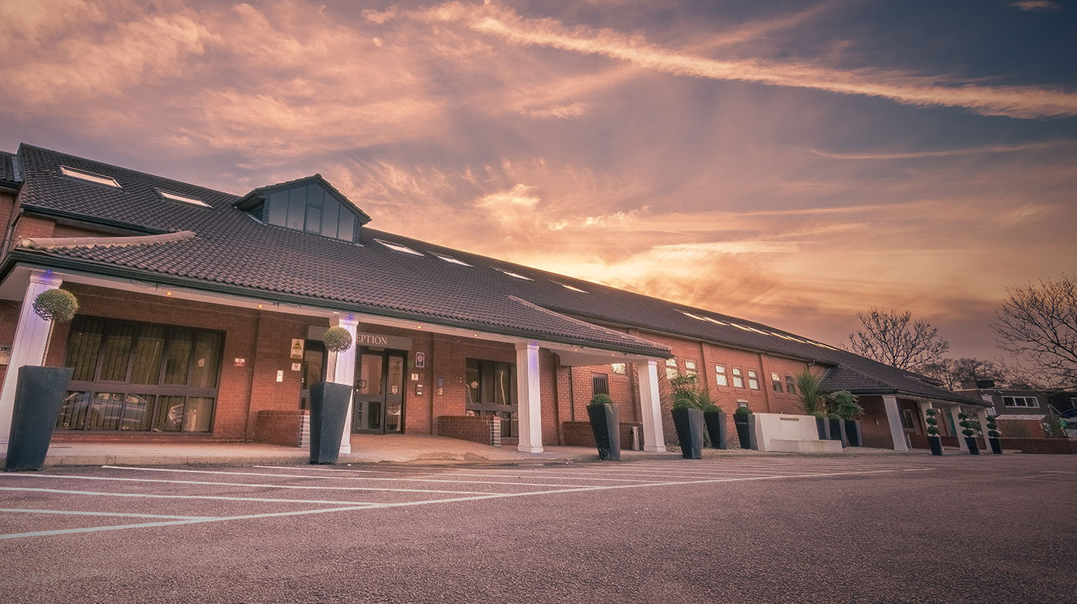
The Rockingham Forest Hotel
University of Wales Trinity Saint David
Hospitality and Guest Services
M4X01915
Lecturer: ABDI RAHMAN
Raluca Urloi 1905716,
Ionela VLAD 1905718,
Andreia Stefana Dumitrascu 1905740

Slide 2

To come
Introduction
About us
Guest service experience
USP
SWOT
Market Segments
Skills Used by the Rockingham’s Hotel Staff
Products and services

Slide 3
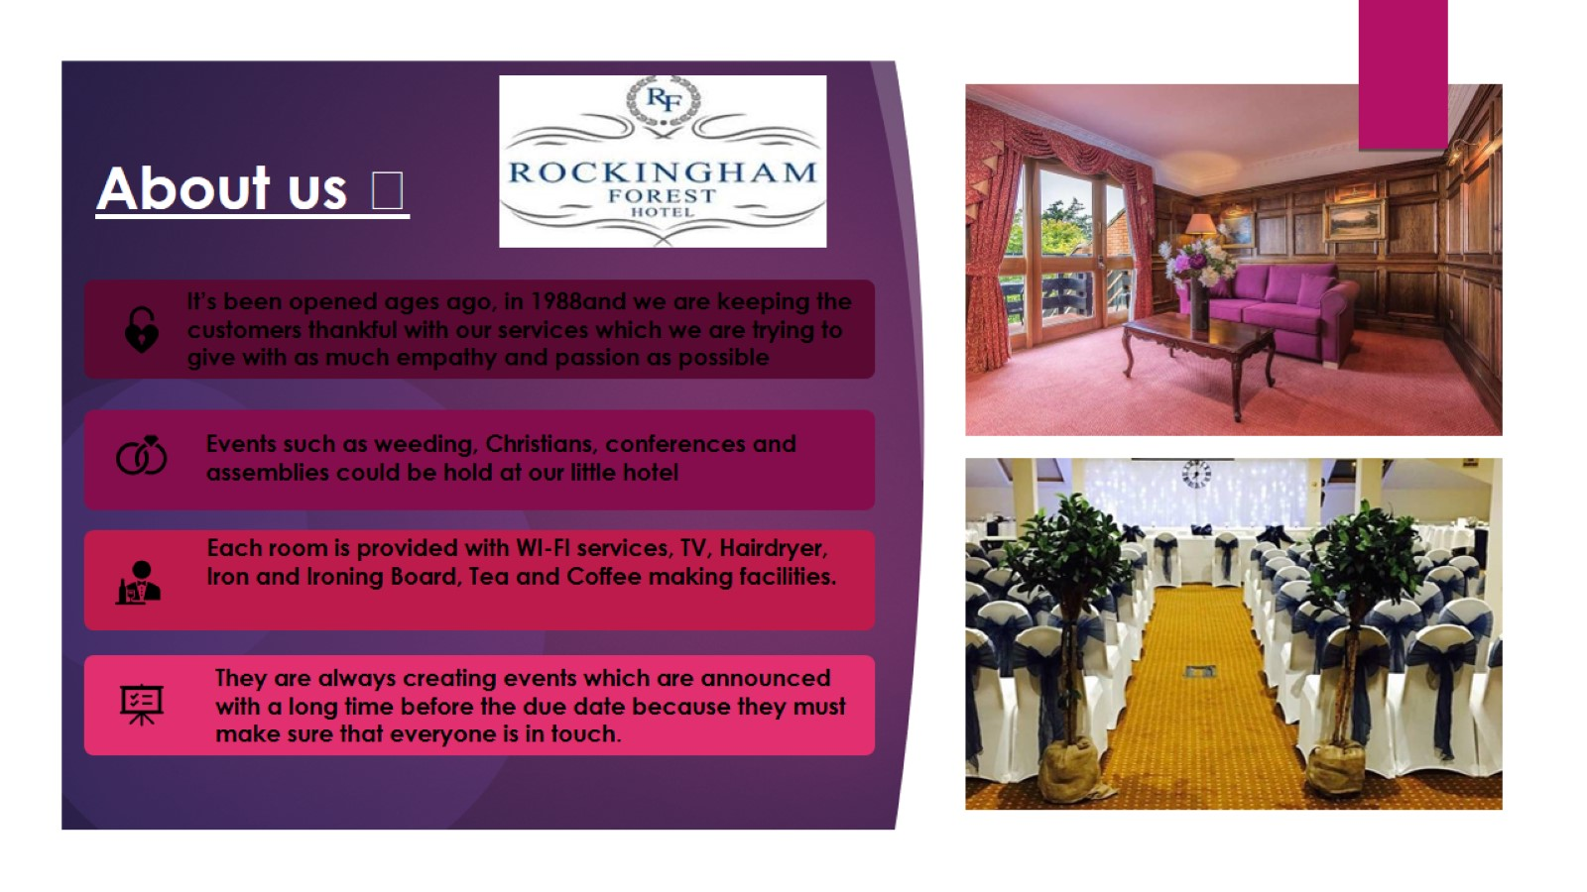
About us ☺
Source: www.rockinghamforest.co.uk

Slide 4
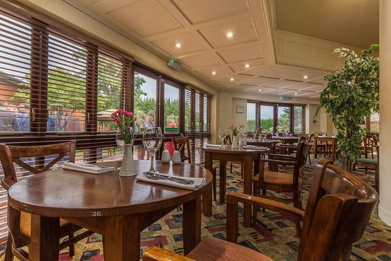

GUEST EXPERIENCES
According to Heppell (2010), a 5 star experience is what every customer would like to receive. That is when you feel cared about and even loved by the ones that offer you the service.
A positive feedback about The Rockingham Forest Hotel says: Myself and my wife we came for food at the hotel on Friday night, we were amazed by the food standard, 5*. We will be back and we hope the chef keep on pushing on this standard and quality of dishes! We will be back! Thank you very much!”
Traveler rating:
Excellent-263
Good-219
Average-88
Poor-36
Terrible-18
Very good 452 reviews
Staff-8.6
Facilities-7.9
Cleanliness-8.1
Comfort-8.2

Slide 5

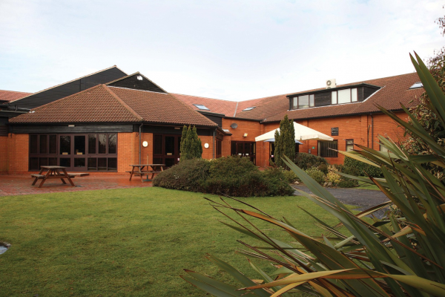
What are they known for?
*** 3 Star Hotel in Corby Northamptonshire –perfect for a short break in England.
This modern hotel is 4.5km from Rockingham Motor Speedway and 1.1km drive from Rockingham castle, this meaning that it is around touristic places as well.
It is a good hotel to go to because it offers a good experience with a high level of relaxation and calamity. Therefore, the reason for coming for a stay is irrelevant because of the experience you will end up having.
Also, next to the level of calamity they convey everyday, they are also very appreciated for the increased number of events they organize to attract as many people as possible
The food, including the traditional breakfast, is one of the aspects that pushes the hotel up as well and, their food uses to be prepared with natural ingredients to offer a healthy style even if it is still fast food.

Slide 6
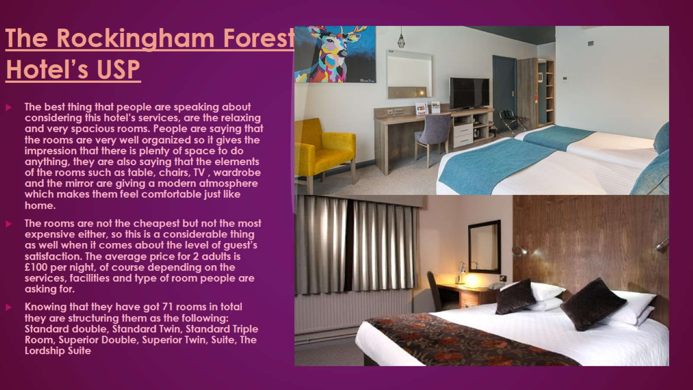
The Rockingham Forest Hotel’s USP
Source: www.rockinghamforest.co.uk

Slide 7

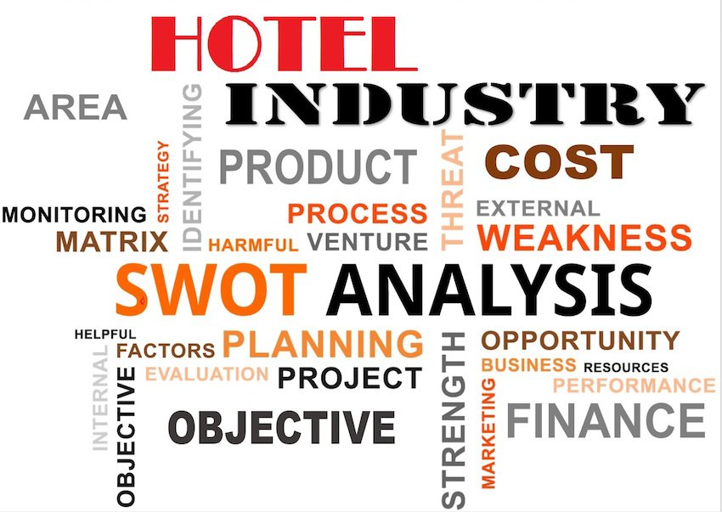
SWOT Analysis
Strengths · Easy access to the airport · Can accommodate 350 guests or more · 5 conference suites and catering for up to 400 delegates · Romantic setting for an elegant wedding -5 miles away from Prior Hall Golf Course | Weaknesses · No lifts · No SPA · No GYM · No activities for family with kids
Opportunities · to build up a gym , spa design plan · to employ trained staff to do activities with kids · to install a lift | Threats · Competition with Hotel Hampton by Hilton and Premier Inn -Future financial difficulties due to competition
Source: www.rockinghamforest.co.uk

Slide 8
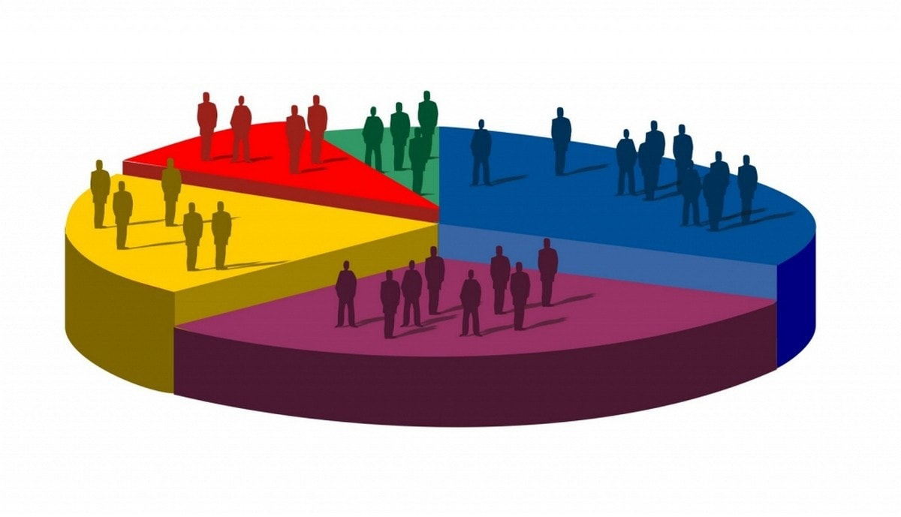
Market segments (Guest Services)
Cultural Factors | Social Factors | Psychological Factors | Personal Factors
Culture- Is a basic term that uncovers a person’s wants and behaviour. Subculture-Is a smaller group from a culture. This group being based on common experiences. Social Classes-These are divisions in society that are based on similar values, interests and behaviours. It is also based on the variety of income depending on the occupation and source of income | Reference Groups-Are groups that are acting face to face. Family-In an society the family has an huge impact over the consumers decisions. Roles and status-Depending on each person’s role in the society, their expectations will vary. | a) Motivation-It creates a tension in a person’s mind to decide if they want or not something. b) Perception-Is the concept of a person creating its own image and impression about something c) Learning-It affects people behaviour. | Age- The things they buy and have interest for are changing over the years Occupation-It has an impact on what the person needs to buy. Economic Situation- Affects the product choice and the expected quality and also level of investment. Lifestyle-Contributes at the buyers behaviour when buying of asking for something. Personality and sell concept-It controls a persons decisions

Slide 9


Skills used by the employers. (The Rockingham Hotel)
“Hoteliers need to fully acknowledge which service attributes are most likely to influence customers’ choice intentions”
There are plenty of skills required to rise the economy and reputation of a hotel continuously, but unfortunately, usually there are limited people that are able to show the existence of skills and abilities that can be also used in practical situation, next to the theory.
Skills such as: Communication skills, Motivational Skills, Teamwork skills, Problem-Solving Skills, Organizing and Planning Skills, Reliability and Responsibility Skills, Adaptability and Flexibility Skills, are just a part of the needed skills.
Most of the mentioned skills are in usage at the Rockingham Hotel and this because the people in charge are showing interest in how the guests are feeling while they are staying at the hotel and they are continuously asking for feedback after. Also, while their stay, the staff is frequently asking if there is something they could help with.

Slide 10
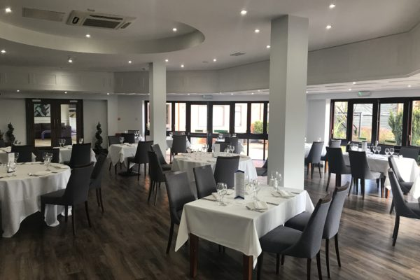
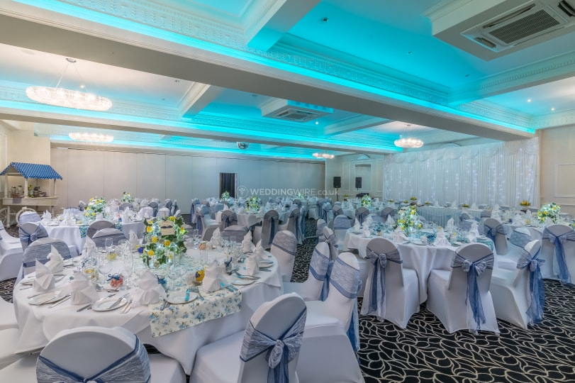
Products and services.
“The most unhappy customers are the greatest source of learning and improving” – Bill Gates
The Rockingham Forest Hotel is known for the very often organised events, for example they use to organise Easter Sunday Lunch, Dinners, Megaslam Wrestling.
Also, the room service is at a high level as everyone is trying to provide the best experience for each and everyone coming for a stay. Free WI-FI, free parking, 24h available reception, ball room, are just some of the services provided when you are going to the Rockingham Forest Hotel.
Food products are also a strong point when it comes about our chosen hotel and this because their menu contains food for everyone, vegans, vegetarians, ‘chicken people’ and whoever. Traditional food is also considered in their menu, this being the English breakfast which tends to be very popular.
Another services are linked to the fact that they have specific rooms for conference and for weddings. They could offer facilities for the people coming at a special deals. Services such as barbeque and drinks provision are just the main facilities that they could offer.
Source: www.rockinghamforest.co.uk

Slide 11
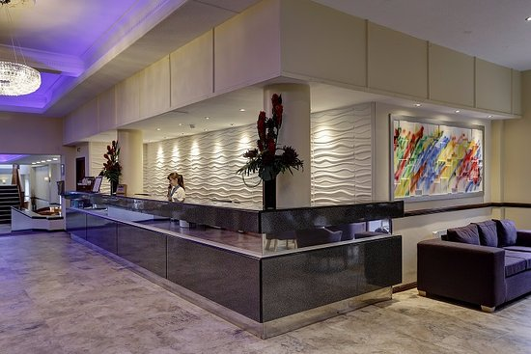
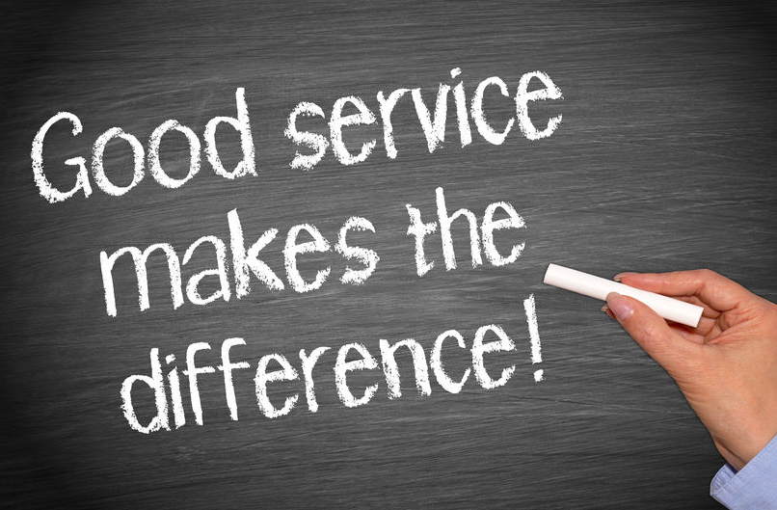
The Disney Service Model
Smile- Is the first sign of treating the guest with empathy and respect, therefore the staff should not hesitate to smile frequently.
Make EYE contact: Has a high impact and this because it engaders the trust and a relationship within professional boundaries even from the start of the conversation.
Respect and welcome all guests: This aspect should not be missed by any member of staff because people are coming for the services your hotel offers, but also for the way you treat them and make them feel
Value the magic: It is important that you find a positive side of anything to make sure that the guest will have the expected experience while their stay.
Initiate Guest Contact: Make sure that you are being friendly with the guests next to the basic conversations that you would normally have. Ask them how their day is, what they like the most at your hotel and stuff that will make them feel comfortable with you.
Creative Solutions: As previously mentioned you need to make sure that you find a positive side out of everything and that you keep the and things away from happening
End with a thank you: It is more that necessary to say thank you to your guests because it shows the level of respect you have for them because they are using your services and that they are being nice with you.

Slide 12
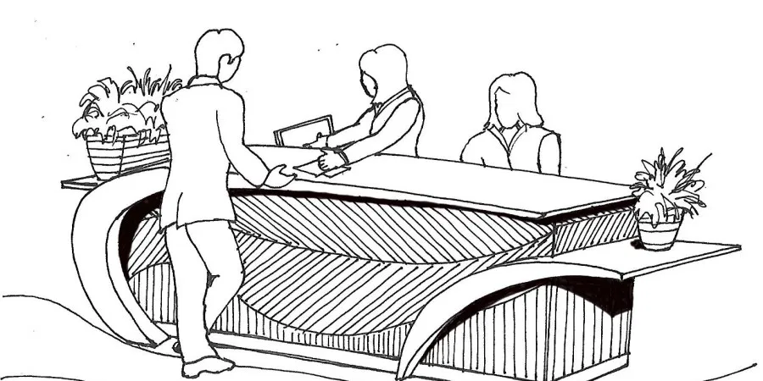
Conclusion
As a conclusion, us as a group can say that the Rockingham Forest hotel uses its strategies and customer service to provide the guests with the most expected and wanted services and products.

Slide 13

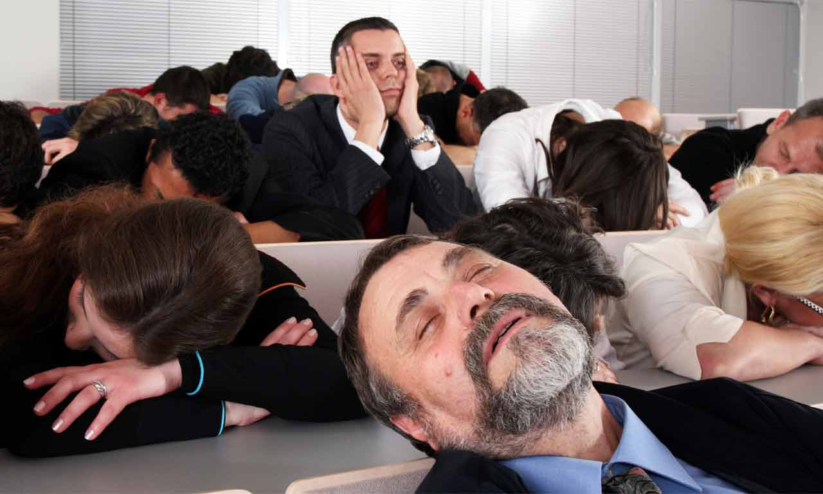
T H A N K
Y O U
!!
We hope you are like that
Not like this ☺

Slide 14

References
Bill Gates.
booking.com / The Rockingham Forest Hotel
chrome-extension://oemmndcbldboiebfnladdacbdfmadadm/https://www.researchgate.net/profile/Gandolfo_Dominici/publication/47619084_Customer_Satisfaction_in_the_Hotel_Industry_A_Case_Study_from_Sicily/links/0bc49b470bd4c2491b2aab37/Customer-Satisfaction-in-the-Hotel-Industry-A-Case-Study-from-Sicily.pdf?origin=publication_detail
Dominici Gandolfo and Guzzo Rosa , (2010). Customer Satisfaction in Hotel Industry> A Case Study from Sicily, available @ : https://www.researchgate.net/publication/47619084_, (accessed 24/10/2019)
Richard M.D., & Sundaram D.S. (1993). Lodging choice intentions: a causal modeling approach. Journal of Hospitality and Leisure Marketing, 1 (4): 81–98.
Source: www.rockinghamforest.co.uk
tripadvisor.com / The Rockingham Forest Hotel
http://upyourmargin.blogspot.com/2013/01/market-segment-pricing.html (accessed 24/10)
Michael Heppell (2010) from the book “How to deliver EXCEPTIONAL customer service.

