Slide 1
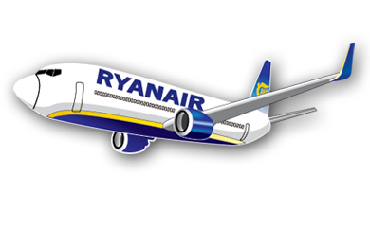
Ryanair
By Fiona Bowskill
1601312
Notes:
Hello, my name is Fiona Bowskill. I have chosen the airline Ryanair as a business to look into. This presentation shall be looking into the approaches and strategies to its organisation and management.

Slide 2
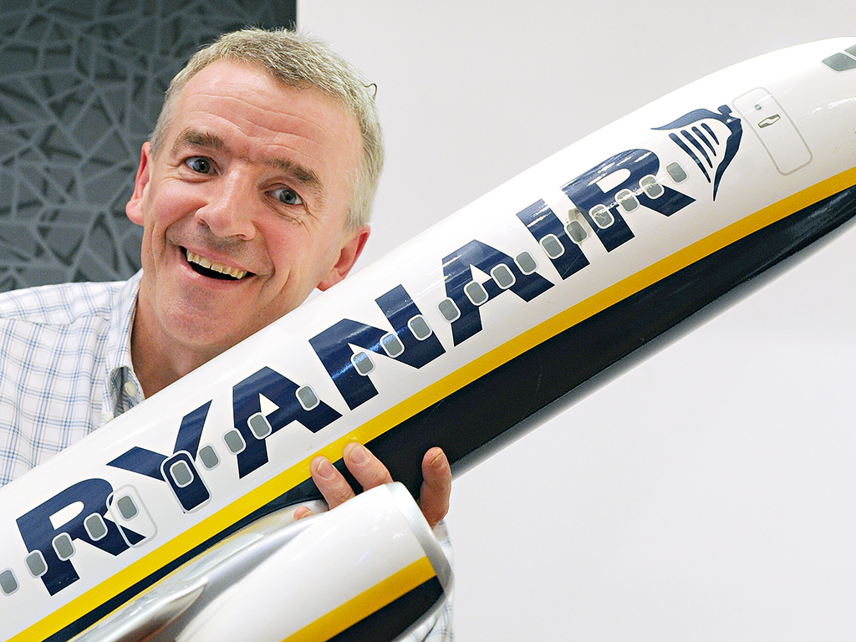
Ryanair's CEO Michael O'Leary
Image (google Image, 2017)
Notes:
This is the founder and CEO of Ryanair Michael O’Leary.

Slide 3
Ryanair and its History
1985 - Ryanair was founded
1986 - Ryanair gets permission to challenge the British Airways and Aer Lingus’ for the Dublin-London route.
2003 - Rapid expansion of Ryanair right across Europe continues.
1995 - Ryanair becomes the largest airline on the Dublin-London route
2006 – The first airline to carry more than 4 million international passengers in one month
2000 - In January, Ryanair launches Europe’s largest booking website.
2013 - Ryanair announced full year net profit of €523m which is around £46,000,0000.
(Ryanair History, 2017)
Notes:
What is Ryanair and its history?
Ryanair is a low cost airline founded in 1985 by the Ryan family. It has 87 bases in Europe and connects 33 countries.
Here are a few key points since it was founded
In 1985 - Ryanair was founded by Ryan family with a share capital of just £1, and a staff of 25.
In 1986 – Ryanair manages to get permission to challenge the British Airways and Aer Lingus’ for the Dublin-London route.
1995 - Ryanair becomes the largest airline on the Dublin to London route which is the biggest international scheduled route in Europe.
2000 - In January, Ryanair launches Europe’s largest booking websit.
In 2003 – Ryanair experiences a rapid expansion right across the European countries.
2006 – Ryanair becomes the first airline to carry more than 4 million international passengers in one month.
In 2013 - Ryanair announced a full year net profit of €523m which is around £46,000,0000.

Slide 4
Its people
The Ryanair website states that “Our people have made Ryanair the success story that it is today. (Ryanair, 2017)
“Is a nice job were you learn how to deal with customers and control emergencies. You can develop a sales profile because you will work with targets. The hardest part of the work is the earliest reports and some busy flights and the most enjoyable part is working in a young and friendly environment.” (Indeed, 2017)
“As a crew member I have no base salary and I am only paid for flying time,” “we were told that Ryanair doesn’t do teamwork: it wants us to compete with each other.” (Morris, 2017)
“Ryanair operates under a fear culture. There is no margin for error, you must pay for your own training. They do not see you as a person, but as an enemy” (Indeed, 2017)
Notes:
Ryanair is a staff motivated company that like to ‘get on with the job’ (Ryanair, 2017) . The Ryanair website states that “Our people have made Ryanair the success story that it is today, without the hardwork and dedication of our pilots, cabin crew, engineering, ground operations and head office teams, we would not be able to continue to grow and provide our customers with the best service and even more destinations to travel to.” (Ryanair, 2017)
However not all staff have this positive experience with Ryanair
Hear are a few experiences from ex – Ryanair staff.
Cabin Crew (Former Employee) – Liverpool, Merseyside – 31 January 2017 “Is a nice job were you learn how to deal with customers and control emergencies. You can develop a sales profile because you will work with targets. The hardest part of the work is the earliest reports and some busy flights and the most enjoyable part is working in a young and friendly environment.”(Indeed reviews (n.d) 2017)
“As a crew member I have no base salary and I am only paid for flying time,” “we were told that Ryanair doesn’t do teamwork: it wants us to compete with each other.” (Morris, 2017)
Cabin Crew Member (Former Employee) – Stansted Airport – 28 June 2017 “Ryanair operates under a fear culture. There is no margin for error, you must pay for your own training. They do not see you as a person, but as an enemy” (Indeed, 2017)

Slide 5
Its goals!
Transport as many customers as possible.
Notes:
Ryanair has 1 main Goal and that’s to transport as many customers as possible. They compete with other airlines by offering competitive prices and often suppling the lowest flight cost. This is due to Ryanair being a low cost airline that likes to compete with other airlines to give customers the best price.

Slide 6
Approaches to strategies using
PESTAL
Notes:
For the approaches to strategies this presentation will be taking the PESTAL approach.

Slide 7
Political
Ryanair operates in the Eurozone
Increased security levels this then affects customer relations.
'The U.S. Department of State warns U.S. citizens of increased threats from terrorist groups throughout Turkey and to avoid travel to southeastern Turkey,' instructs their official website. (Diebelius and Mcguire, 2016)
Notes:
Political – Ryanair operates in the Eurozone, this can effect Ryanair’s political environment in the individual regions, as each country has different laws and cultures.
Security levels have increased in airports due to the threat of terrorism which is then affects customer relations.

Slide 8
Economy
With fewer people travelling by air
The downturn of ticket prices
Notes:
Economic - With fewer people travelling by air and the decrease of ticket prices and the airline competing against each other, the economy of airlines have taken a hit.

Slide 9
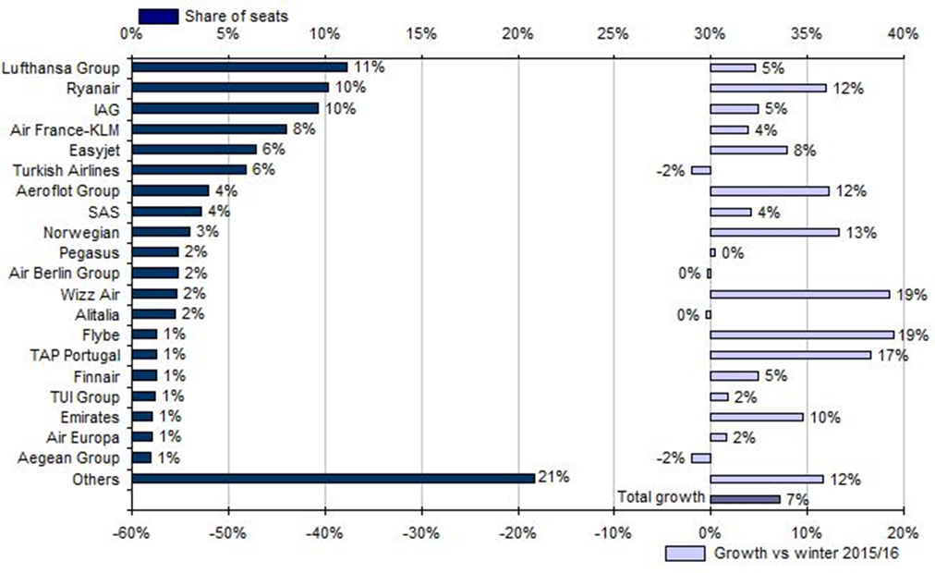
Europe to all regions: Top 20 airline groups by share of scheduled seats winter 2016/2017, and their seat growth versus winter 2015/2016
Note: growth rate adjusted to take account of winter 2016/2017 being one week shorter than winter 2015/2016.
Source: CAPA - Centre for Aviation, OAG Schedules Analyser.
(Capa, 2017)
Notes:
This graph shows the estimated number of seats used in winter of 2015/16 verses that of which are used in 2016/17. Although many airlines have taken a hit in their companies due to ticket prices and the decrease in the number of customers, Ryanair is still going strong due to its low cost prices.

Slide 10
Social
Customers are always on the lookout for low price airlines
Notes:
Social - Customers are always on the lookout for low price airlines, this pushes airlines to compete against each other. This is linked to economic deflation as peoples finances nay not be as good as they were and so keeping a tight leash on their finances.

Slide 11
Costs per passenger (EUR, ex fuel)
Source: CAPA - Centre for Aviation and latest available accounts via Ryanair presentation 28 January 2013
 | Ryanair | easyJet | Norwegian | Air Berlin | Spirit | Southwest
Staff | 5 | 8 | 15 | 14 | 16 | 33
Airports & Handling | 8 | 18 | 8 | 26 | 15 | 22
Route Charges | 6 | 6 | 13 | 8 | - | -
Aircraft O’ship & Maint. | 6 | 8 | 17 | 20 | 16 | 17
Sales & Marketing | 2 | 6 | 12 | 31 | 4 | 2
Total | 27 | 46 | 65 | 99 | 51 | 74
% vs Ryanair | - | +67% | +137% | +262% | +86% | +170%
(CAPA, 2017)
Notes:
This graph shows the price difference between many of the airlines, it shows the different areas where the charges acure . The largest price differential is between Air Berlin and Ryanair, with Ryanair coming up as 262% cheaper.

Slide 12
Technology
Airline tickets are becoming easier to buy with new technology
Fuel efficiency also improves
New improved jets and other aircrafts
Environment
Paris Agreement
LEGAL
EU laws and regulations.
Notes:
Technology – Airline tickets are becoming easier to buy with new technology and faster Wi-Fi. Technology is also improving and this is then bringing in new ways to improve airline fuel efficiency. The improving technology also brings new improved jets and other aircrafts which increase the amount of customers and flight that can be made.
Environment – The main demand on the environment is the amount of carbon emissions that aircrafts produce. With the Paris Agreement in place businesses are being pressured into finding ways in which to reduce this.
Legal – there are many laws and regulations that Ryanair must abide by when traveling to different countries.

Slide 13
Approaches to organisation and management
Notes:
Approaches to organisation and managment

Slide 14
Systems
The Systems theory is when an organisations have different department called “System’s” that work separately, and when brought together make a whole. (Mullins, 2013)
“Our people have made Ryanair the success story that it is today, without the hardwork and dedication of our pilots, cabin crew, engineering, ground operations and head office teams, we would not be able to continue to grow and provide our customers with the best service and even more destinations to travel to. Our people are vital to our operation, which is why we hire the best in the business. “ (Ryanair, 2017)
Notes:
As Ryanair has many departments is can be argued that it uses the systems approach to its organisation. The systems approach is when an organisations have different department called “System’s” that work separately, and when brought together make a whole. (Mullins, 2013).
Ryanair states that;
“Our people have made Ryanair the success story that it is today, without the hardwork and dedication of our pilots, cabin crew, engineering, ground operations and head office teams, we would not be able to continue to grow and provide our customers with the best service and even more destinations to travel to. Our people are vital to our operation, which is why we hire the best in the business. “ (Ryanair, 2017) this can be seen as using the Systems approach to its management.

Slide 15
Contingency
There is no single right way to lead but rather the situation at the time influences the best method in which to use.
“Ryanair hoped a bonus payment could entice some pilots to change their holiday plans.” (Staff and agency, 2017)
Notes:
It can also be argued that Ryanair uses a Contingency approach to its management as there is no clear sign that they use one approach. For example; “Ryanair hoped a bonus payment could entice some pilots to change their holiday plans.” (Staff and Agency, 2017) this statement shows that when needed Ryanair can change its approaches to management to suit their needs.

Slide 16
This presentation has looked into the Goal of Ryanair, it has demonstrated the PESTAL approach and the two approaches it uses to its organisation and management approach.
Notes:
This presentation has looked into the Goal of Ryanair, it has demonstrated the PESTAL approach and the two approaches it uses to its organisation and management approach.

Slide 17
THANK YOU FOR YOUR TIME

Slide 18
References
CAPA, 2017 https://centreforaviation.com/insights/analysis/european-airline-seat-capacity-growth-accelerates---perhaps-too-quickly-outlook-for-winter-201617-310109
Georgia Diebelius and Caroline Mcguire for mailOnline, 2016. http://www.dailymail.co.uk/travel/travel_news/article-3665531/Ataturk-International-Airport-reopens-wake-terrorist-attack-experts-call-rethink-security-aviation-hubs.html
History of Ryanair, 2017 https://corporate.ryanair.com/about-us/history-of-ryanair/
https://www.theguardian.com/business/2017/oct/07/michael-hickey-ryanair-chief-operations-officer
Hugh Morris, TRAVEL NEWS EDITOR 27 September 2017 the Telegraph http://www.telegraph.co.uk/travel/comment/ryanair-flight-attendant-union-secrets-reveals/

Slide 19
REFRANCES CONTINUED
Image Google, 2017 https://www.google.co.uk/search?q=ryanair+ceo+and+founder&source=lnms&tbm=isch&sa=X&ved=0ahUKEwirlfbN0PXXAhUIWhQKHYXIBQgQ_AUICigB&biw=1680&bih=955
Indeed reviews 2017 https://www.indeed.co.uk/cmp/Ryanair/reviews
Mullins, L, Harlow: Pearson. (2013). Management and Organisational Behaviour.
Ryanair, 2017 https://corporate.ryanair.com/
Staff and Agency, 2017 Ryanair chief operations officer to quit crisis-hit airline
https://www.theguardian.com/business/2017/oct/07/michael-hickey- ryanair chief-operations-officer

