Slide 1
Lecture 6
Measures of Dispersion

Slide 2
Measures of Dispersion
Calculate and interpret:
  range, quartiles and interquartile range
  a five-number summary
  variance, standard deviation and coefficient of variation
Identify outliers
Construct a box plots
Choosing which measure to use

Slide 3
Introduction
When describing a data set, it is therefore important to provide information about the variation of individual values as well as defining a single representative value
Measures of dispersion allow us to quantify this variability for a set of data

Slide 4
Range
The simplest measure of dispersion to calculate and interpret is the range
It is defined as the difference between the largest and smallest values in a data set
The formula for the range can be written as:
range = maximum value – minimum value

Slide 5
Range
When comparing two sets of data:
  a larger range is associated with the data set which shows more variation from the centre value
  a data set which shows less variation among its values will have a smaller range
The range is not the most useful measure of dispersion because it only uses two of the data values in its calculation and is strongly influenced by extreme values

Slide 6
Quartiles
Three quartiles are required to divide a set of data into four equal parts.
Q₁, also known as the first or lower quartile, is the value which separates the smallest 25% of the values from the remaining data set
The second quartile, Q₂, is the median
Q₃ separates the smallest 75% of the values from the remaining data set; it is also known as the third or upper quartile

Slide 7
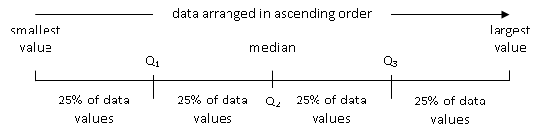
Quartiles
Graphical representation of the quartiles
The quartiles are resistant to extreme values which may occur within the data set: Q₁ and Q₃ are not influenced by these values

Slide 8
Finding Quartiles
Arrange the data in numerical order, from the smallest value to the largest
Identify the median value
Use the median value to separate the data set into two halves
Q₁ is the median of the data values that are less than the median of the entire data set
Q₃ is the median of the data values that are greater than the median of the entire data set

Slide 9
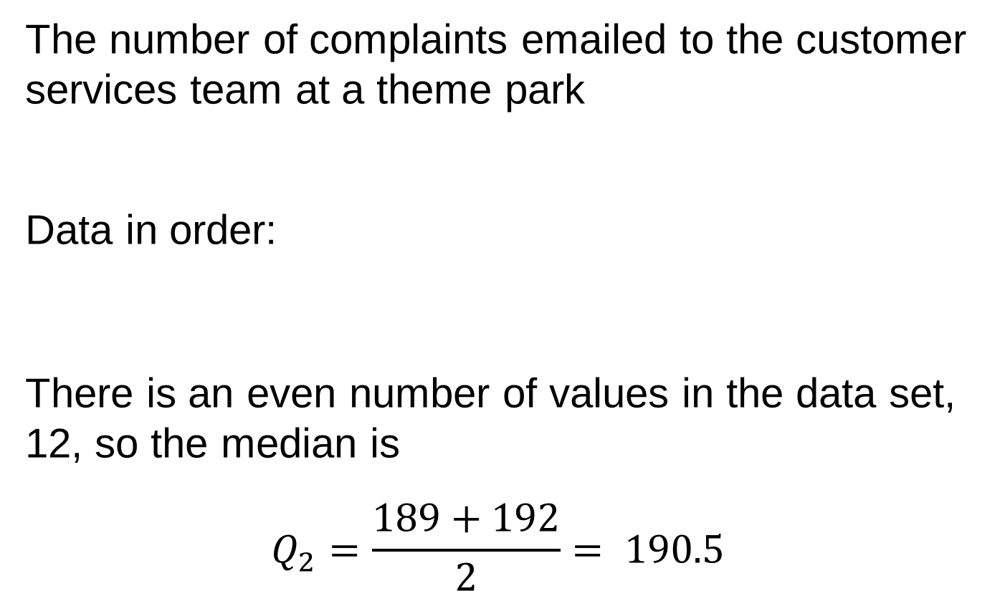
Quartiles – Example 1
The number of complaints emailed to the customer services team at a theme park
Data in order:
There is an even number of values in the data set, 12, so the median is
$$Q_{2}=\frac{189+192}{2}= 190.5$$
214 | 189 | 152 | 206 | 237 | 158 | 192 | 146 | 203 | 177 | 165 | 221
146 | 152 | 158 | 165 | 177 | 189 | 192 | 203 | 206 | 214 | 221 | 237

Slide 10
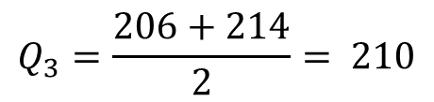
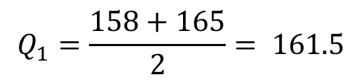
Quartiles – Example 1
data values less than the median
in approximately 25% of the weeks, the customer services team received less than 161.5 emails
146 | 152 | 158 | 165 | 177 | 189
$$Q_{1}=\frac{158+165}{2}= 161.5$$
data values greater than the median
less than or equal to 210 emails were received from customers in approximately 75% of the weeks
192 | 203 | 206 | 214 | 221 | 237
$$Q_{3}=\frac{206+214}{2}= 210$$

Slide 11
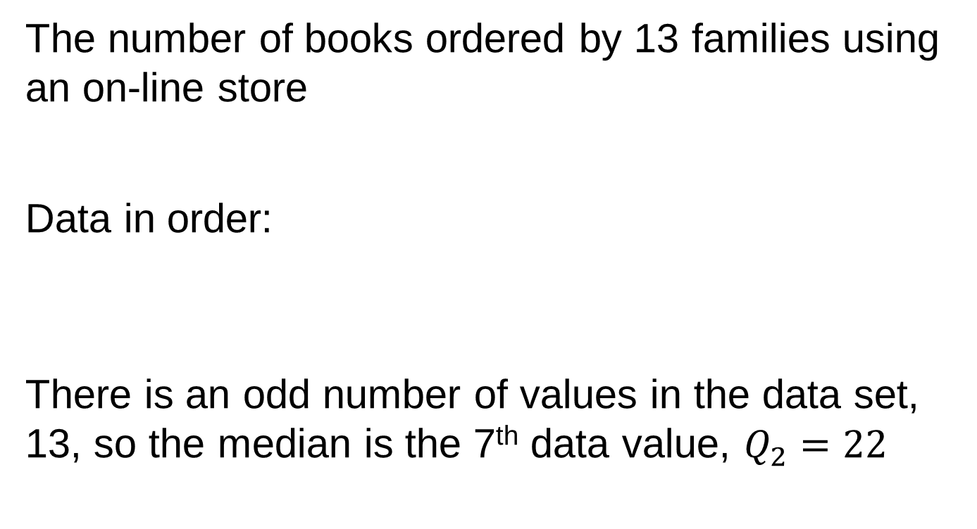
Quartiles – Example 2
The number of books ordered by 13 families using an on-line store
Data in order:
There is an odd number of values in the data set, 13, so the median is the 7th data value, $Q_{2}=22$
6 | 14 | 51 | 3 | 17 | 22 | 29 | 40 | 35 | 11 | 23 | 9 | 32
3 | 6 | 9 | 11 | 14 | 17 | 22 | 23 | 29 | 32 | 35 | 40 | 51

Slide 12
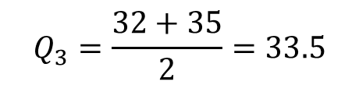
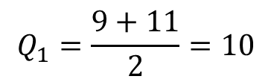
Quartiles – Example 2
data values less than the median
approximately 25% of the families ordered less than or equal to 10 books
3 | 6 | 9 | 11 | 14 | 17
$$Q_{1}=\frac{9+11}{2}=10$$
data values greater than the median
less than 33.5 books were ordered by approximately 75% of the families
23 | 29 | 32 | 35 | 40 | 51
$$Q_{3}=\frac{32+35}{2}=33.5$$

Slide 13
Interquartile Range
The difference between the upper and lower quartiles provides us with a measure of dispersion known as the interquartile range, sometimes abbreviated to IQR
It is calculated as:
interquartile range = Q₃ – Q₁
It is defined as the range of the central 50% of the values in a data set

Slide 14
Interquartile Range
A data set with a large interquartile range will have greater variation than a data set with a smaller interquartile range
The interquartile range is resistant to extreme values because it is calculated using the quartiles
A disadvantage of the interquartile range is that it ignores 50% of the data values, only using the middle section of the set

Slide 15
Five-Number Summary
A five-number summary includes both a measure of central tendency and an indication of variation for a data set
It consists of the minimum and maximum data values, the lower and upper quartiles and the median, listed in ascending order, as follows:
minimum | Q₁ | median | Q₃ | maximum

Slide 16
Five-Number Summary – Example
Ages of the top ten wealthiest male billionaires
The five-number summary is:
45 | 64 | 66 | 69 | 72 | 73 | 77 | 78 | 83 | 85
minimum | Q₁ | median | Q₃ | maximum
45 | 66 | 72.5 | 78 | 85

Slide 17
Box Plots
Based on a five-number summary, a box plot is a graphical display which tells us about the average value of a data set and the variability of its individual data values
A box plot is a very useful way to visually summarise and compare data sets; it is sometimes known as a box-and-whisker plot

Slide 18
Drawing a Box Plot
Create a horizontal axis with a scale that allows the smallest and largest data values
Draw a box above the axis; the left-hand vertical side of the box should be located at the position of the lower quartile, and the right-hand side at the position of the upper quartile

Slide 19
Drawing a Box Plot
3. Inside the box, draw a vertical line which is located at the position of the median on the axis scale
4. Draw a line that extends from the left-hand side of the box at Q₁ to the smallest value in the data set, marked by a small vertical line; create a corresponding line that joins the right-side of the box at Q₃ to the largest value in the data set

Slide 20
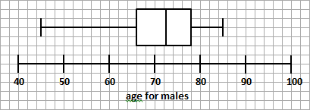
Box Plot – Example
Ages of the top ten wealthiest male billionaires
minimum | Q₁ | median | Q₃ | maximum
45 | 66 | 72.5 | 78 | 85

Slide 21
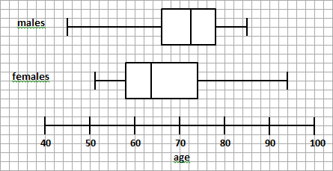
Comparing Box Plots
The median age for the males is greater than the median age for the females
The range for each gender is fairly similar
The interquartile range for males is smaller than for females

Slide 22
Identifying Outliers
We can identify outliers using a rule-based technique which is preferable to relying on subjective judgement
A value in the data set is classified as an outlier if it is positioned:
  less than 1.5 times the interquartile range below the first quartile
  or
  more than 1.5 times the interquartile range above the third quartile

Slide 23
Limits for Outliers
As part of the method for constructing a modified box plot, we determine the lower and upper limits for a data set:
  lower limit = lower quartile Q₁ – 1.5 x IQR
  upper limit = upper quartile Q₃ + 1.5 x IQR
Any data values that are positioned below the lower limit or above the upper limit are then identified as outliers

Slide 24
Outliers – Example
Ages of the top ten wealthiest male billionaires
lower limit
Q₁ – 1.5 x IQR = 66 – (1.5 x (78-66)) = 66 – 18 = 48
upper limit
Q₃ + 1.5 x IQR = 78 + (1.5 x (78-66)) = 78 + 18 = 96
The data value “45” is below the lower limit of 48, so this age as an outlier; there are no further outliers to be identified
45 | 64 | 66 | 69 | 72 | 73 | 77 | 78 | 83 | 85

Slide 25
Modified Box Plots
Outliers are highlighted on a modified box plot using an asterisk (*) or an equivalent symbol
If there are outliers in the lower data values, the extension line on the left-side of the box is shortened so that it reaches the smallest data value that is not an outlier
If outliers are identified in the upper part of the data set, the right-side line is shortened to the largest data value that is not an outlier

Slide 26
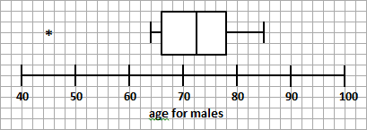
Modified Box Plot – Example
The outlier is represented using an asterisk and the line on the left-side of the box is shortened so that it extends only to the data value “64” rather than the minimum value in the data set

Slide 27
Variance
The variance provides an indication of variability by considering the distance of each data value from the mean of the data set
This distance is called the deviation
We may choose to calculate the total deviation of the individual values from the mean but this will equal zero for every set of data: the totals of the positive and negative deviations will exactly cancel each other

Slide 28
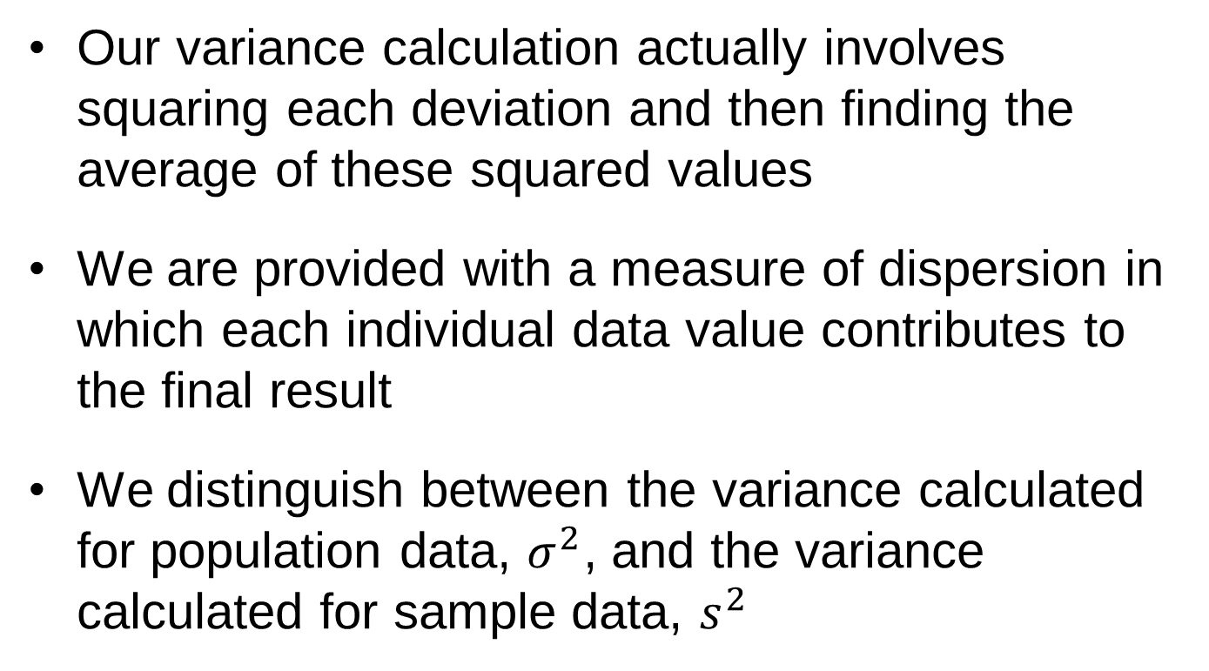
Variance
Our variance calculation actually involves squaring each deviation and then finding the average of these squared values
We are provided with a measure of dispersion in which each individual data value contributes to the final result
We distinguish between the variance calculated for population data, $σ^{2}$, and the variance calculated for sample data, $s^{2}$

Slide 29
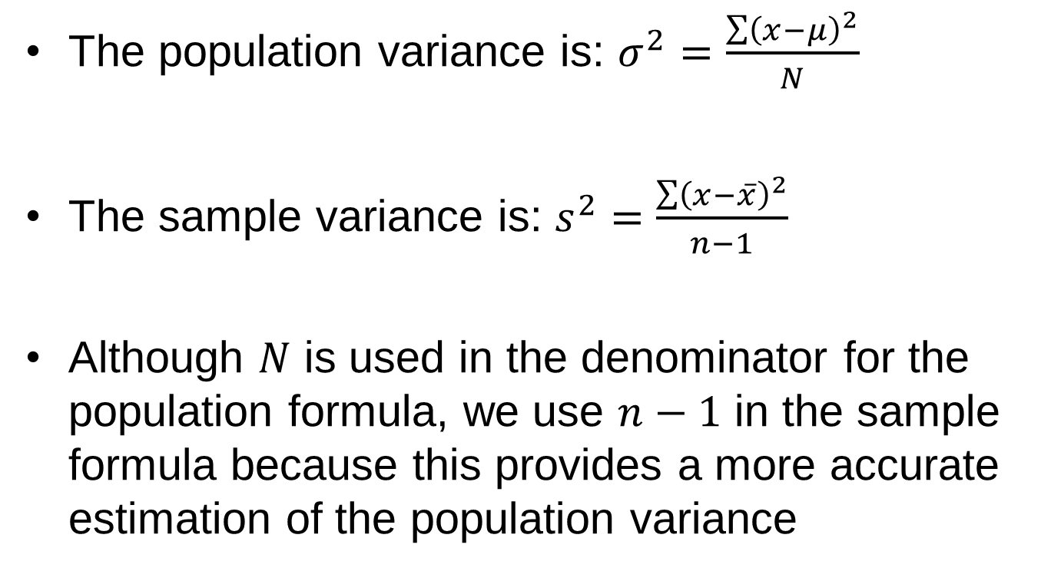
Variance – Conceptual Formulae
The population variance is: $σ^{2}=\frac{\sum{{\left(x−μ\right)}^{2}}}{N}$
The sample variance is: $s^{2}=\frac{\sum{{\left(x−\overline{x}\right)}^{2}}}{n−1}$
Although $N$ is used in the denominator for the population formula, we use $n−1$ in the sample formula because this provides a more accurate estimation of the population variance

Slide 30
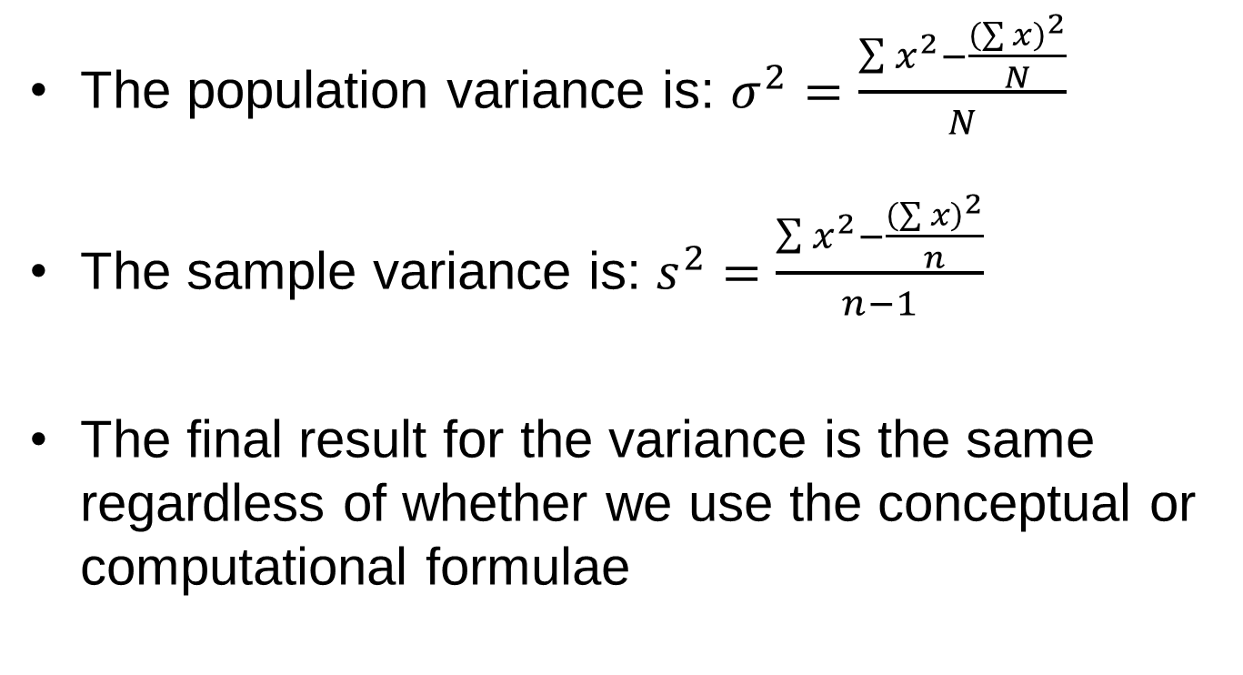
Variance – Computational Formulae
The population variance is: $σ^{2}=\frac{\sum{x^{2}−\frac{{\left(\sum{x}\right)}^{2}}{N}}}{N}$
The sample variance is: $s^{2}=\frac{\sum{x^{2}−\frac{{\left(\sum{x}\right)}^{2}}{n}}}{n−1}$
The final result for the variance is the same regardless of whether we use the conceptual or computational formulae

Slide 31
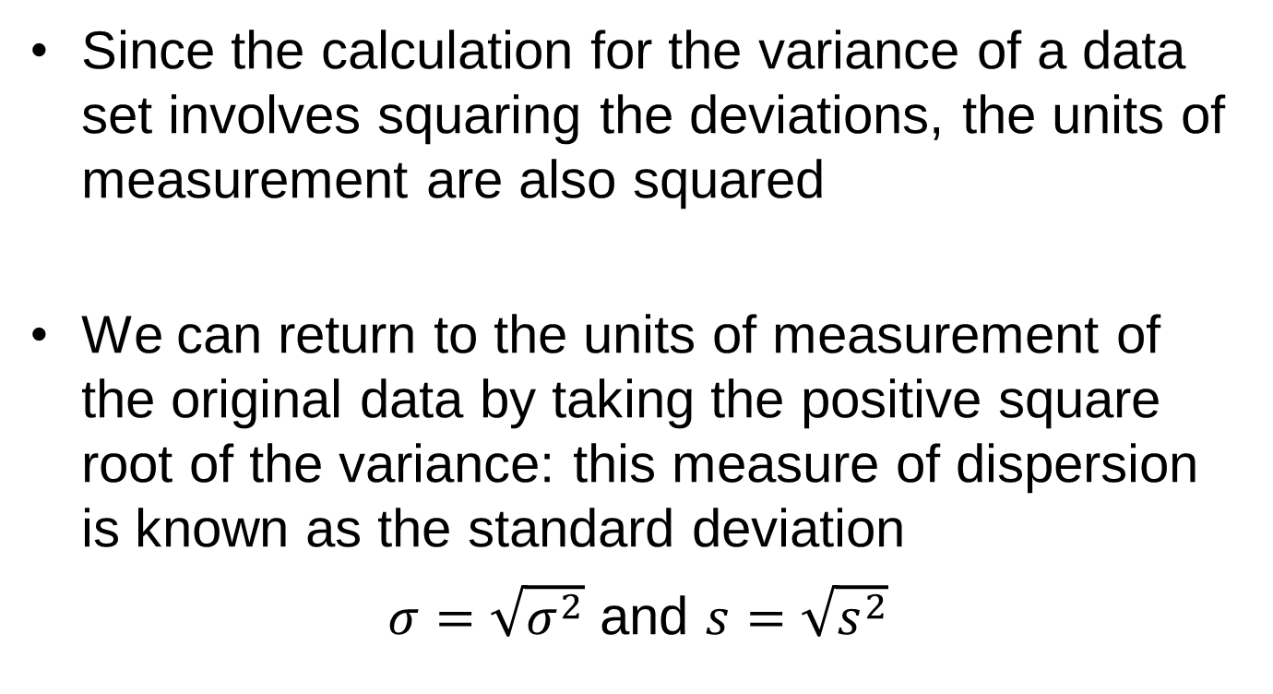
Standard Deviation
Since the calculation for the variance of a data set involves squaring the deviations, the units of measurement are also squared
We can return to the units of measurement of the original data by taking the positive square root of the variance: this measure of dispersion is known as the standard deviation
$σ=\sqrt{σ^{2}}$ and $s=\sqrt{s^{2}}$

Slide 32
Interpretation
In terms of interpretation, the variance and standard deviation provide us with a measure of variability in relation to the mean of the data set
A large value indicates that the data values are spread out from the mean
If a data set contains many values that are close to the mean, then its variance and standard deviation will be small

Slide 33
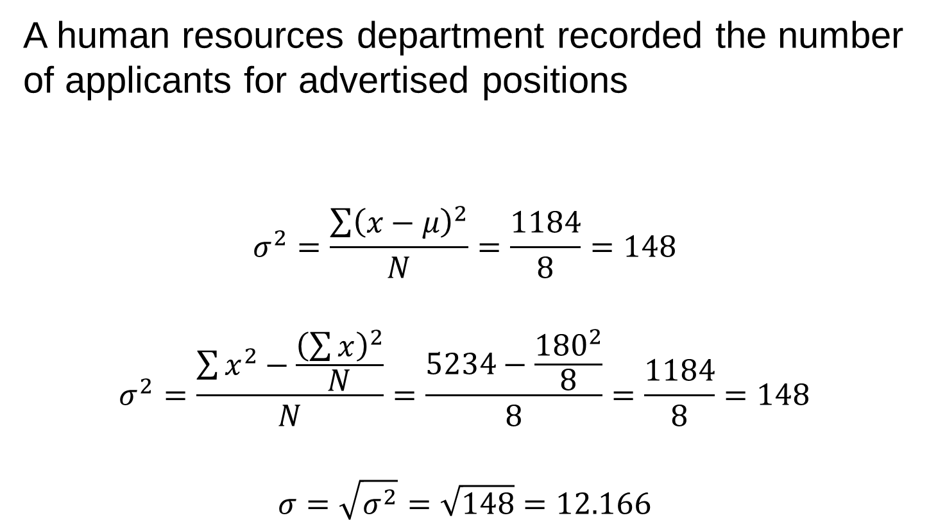
Examples – Population Data
A human resources department recorded the number of applicants for advertised positions
$$σ^{2}=\frac{\sum{{\left(x−μ\right)}^{2}}}{N}=\frac{1184}{8}=148$$
$$σ^{2}=\frac{\sum{x^{2}−\frac{{\left(\sum{x}\right)}^{2}}{N}}}{N}=\frac{5234−\frac{{180}^{2}}{8}}{8}=\frac{1184}{8}=148$$
$$σ=\sqrt{σ^{2}}=\sqrt{148}=12.166$$
45 | 12 | 37 | 21 | 9 | 18 | 27 | 11

Slide 34
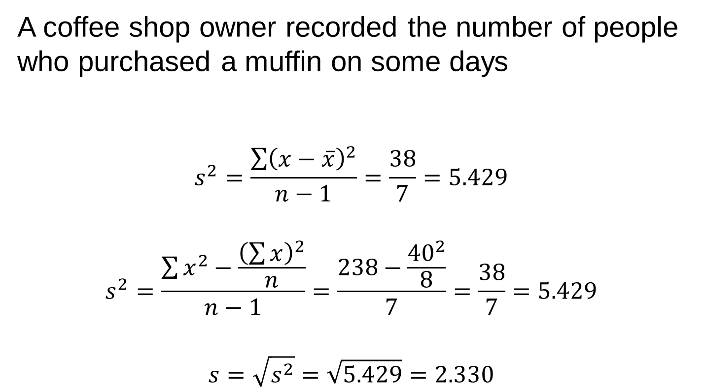
Examples – Sample Data
A coffee shop owner recorded the number of people who purchased a muffin on some days
$$s^{2}=\frac{\sum{{\left(x−\overline{x}\right)}^{2}}}{n−1}=\frac{38}{7}=5.429$$
$$s^{2}=\frac{\sum{x^{2}−\frac{{\left(\sum{x}\right)}^{2}}{n}}}{n−1}=\frac{238−\frac{{40}^{2}}{8}}{7}=\frac{38}{7}=5.429$$
$$s=\sqrt{s^{2}}=\sqrt{5.429}=2.330$$
6 | 7 | 9 | 2 | 3 | 5 | 3 | 5

Slide 35
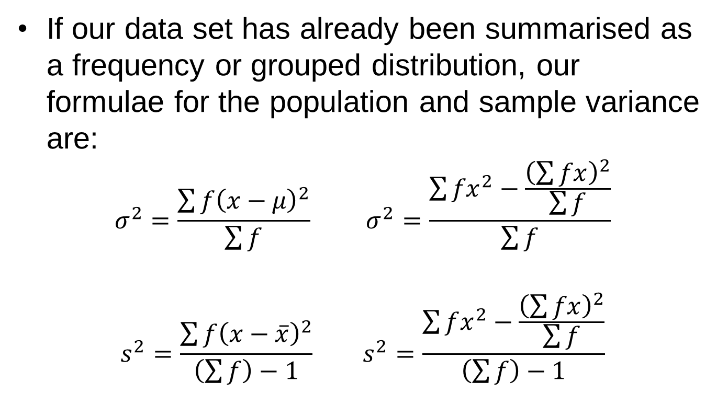
Frequency Distributions
If our data set has already been summarised as a frequency or grouped distribution, our formulae for the population and sample variance are:
$$σ^{2}=\frac{\sum{f{\left(x−μ\right)}^{2}}}{\sum{f}} σ^{2}=\frac{\sum{{fx}^{2}−\frac{{\left(\sum{fx}\right)}^{2}}{\sum{f}}}}{\sum{f}}$$
$$s^{2}=\frac{\sum{f{\left(x−\overline{x}\right)}^{2}}}{\left(\sum{f}\right)−1} s^{2}=\frac{\sum{fx^{2}−\frac{{\left(\sum{fx}\right)}^{2}}{\sum{f}}}}{\left(\sum{f}\right)−1}$$

Slide 36
Coefficient of Variation
When we want to compare two data sets we cannot use the standard deviation if the data sets have different units of measurement
The coefficient of variation is a measure of dispersion that can be used as an alternative
It expresses the standard deviation as a percentage of the mean: it relates the variability of the data values to the mean of the data set

Slide 37
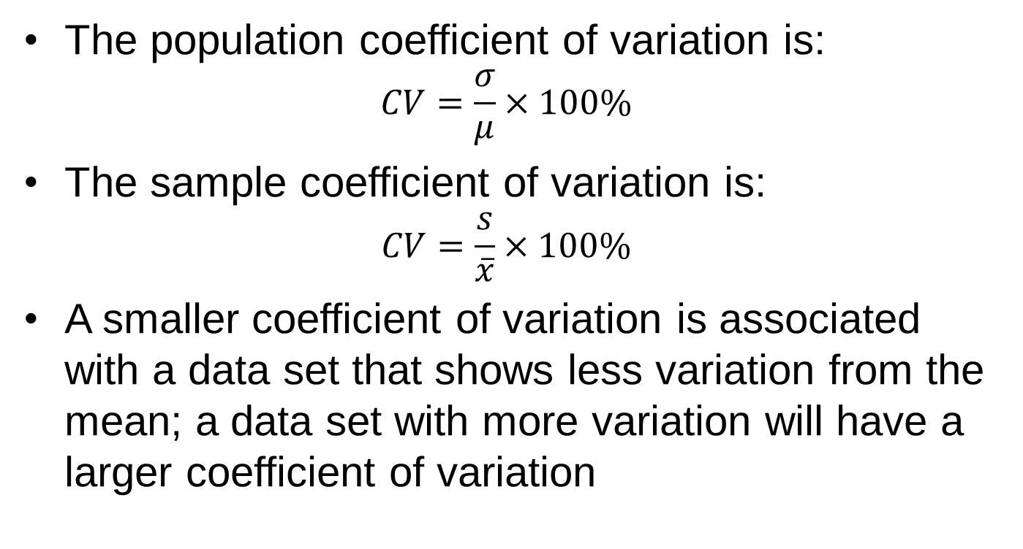
Coefficient of Variation
The population coefficient of variation is:
$$CV=\frac{σ}{μ}×100\%$$
The sample coefficient of variation is:
$$CV=\frac{s}{\overline{x}}×100\%$$
A smaller coefficient of variation is associated with a data set that shows less variation from the mean; a data set with more variation will have a larger coefficient of variation

Slide 38
Advantages and Disadvantages
 | range | interquartile range | variance | standard deviation | coefficient of variation
easy to calculate and interpret | yes | yes | no | no | no
uses all of the data values in the set | no | no | yes | yes | yes
is influenced by extreme values | yes | no | yes | yes | yes
useful for comparing data sets | yes | yes | no | no | yes

Slide 39
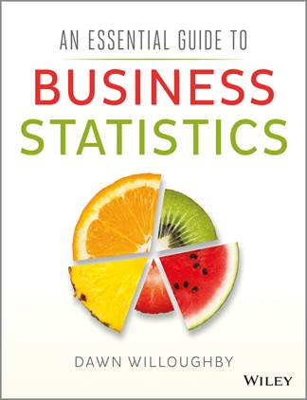
An Essential Guide to Business Statistics
Dawn Willoughby

