Slide 1
Module Title: International Financial Management
Module Code: LCBB6002
BA BUSINESS MANAGEMENT
Week 6
Foreign Exchange Market and Exchange rates

Slide 2
Recap
Investment appraisal
Stakeholders
Dividends
MNCs
Agency problems

Slide 3
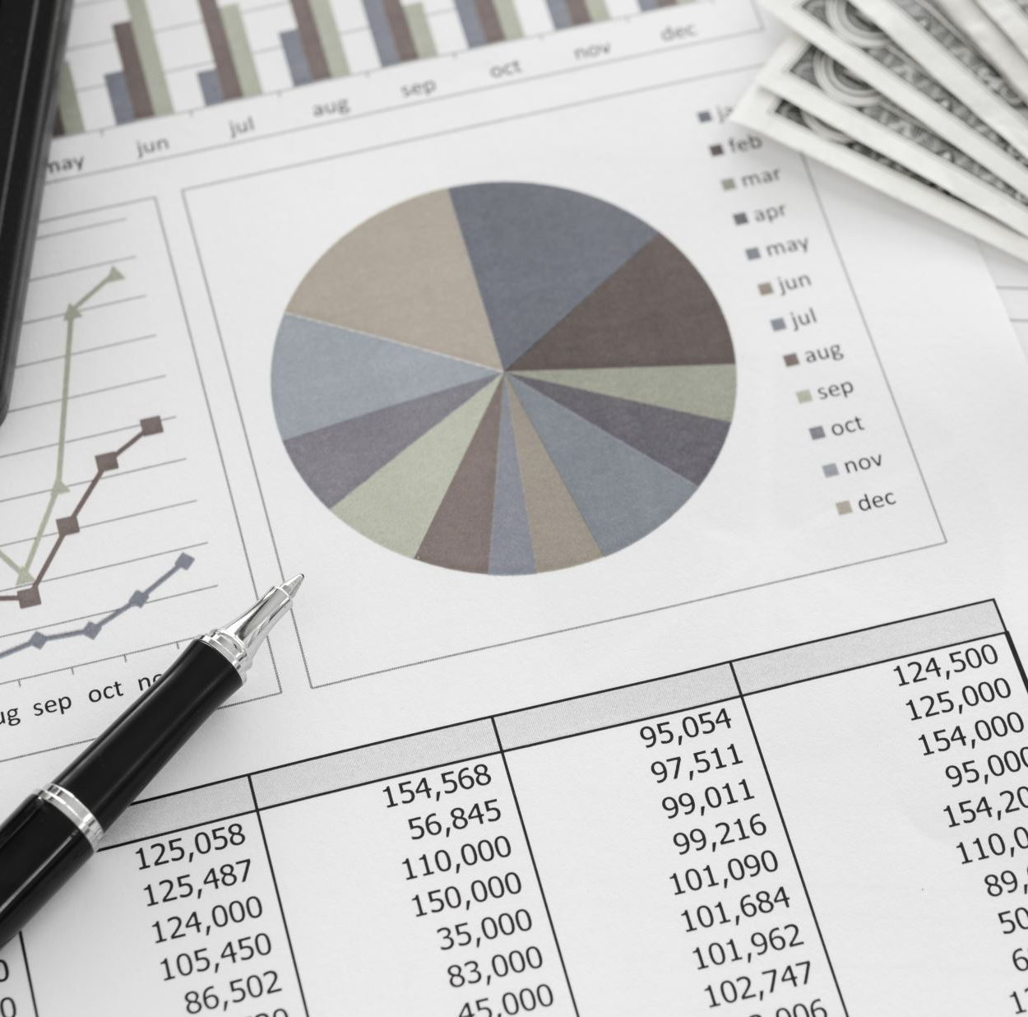
Lecture Overview
At the end of this lecture, you will have an understanding of the following:
Foreign exchange (Forex)
Foreign exchange markets
Exchange rates
Exchanges rate systems

Slide 4


Slide 5
Foreign Exchange
Foreign Exchange or Forex or FX.
The conversion of one country's currency into another.
Country's currency is valued according to the laws of supply and demand.
Exchange rates are important because they enable us to translate different countries’ prices into comparable terms.
According to Bank of England, from 2016 and 2019 average daily turnover increased from US$2.4 trillion to US$3.6 trillion globally.
Source: https://www.bankofengland.co.uk/quarterly-bulletin/2019/2019-q4/the-foreign-exchange-and-over-the-counter-interest-rate-derivatives-market-in-the-uk

Slide 6
Foreign Exchange Markets
The function of the currency (forex) market is to facilitate the exchange of one currency into another.
24 hours operation
Liquidity
Dynamic/Fast
International Trade
Trading cost

Slide 7
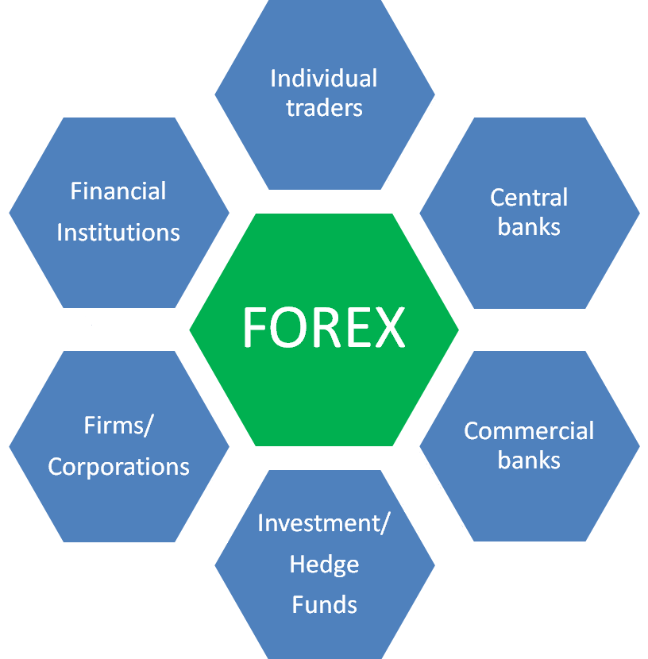
Who is trading?
Investors (tourist, need to pay)
Exporters/Importers
Fund managers (pension, insurance)
Governments (to pay abroad)
Central Banks (deal with fluctuations)
Speculators
Banks
Dealers/brokers (corporate)
First five - small fraction of the transactions, rest are big players.

Slide 8
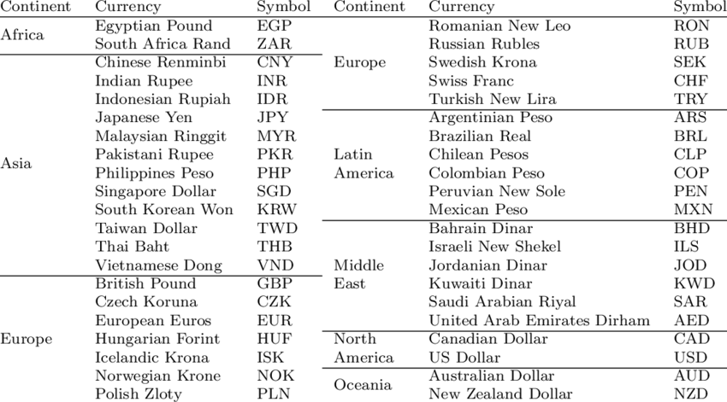
Currencies and Currency Symbols

Slide 9
Exchange Rates
If the exchange rate between the US dollar and the pound is -
USD$1.57 = £1.00 this means that £1.00 will cost USD$1.57.
Taking the reciprocal, USD$1.00 will cost 63.69p. The standardised forms of expression are:
USD$/£ : 1.57 or USD$1.57/£ or USD 1.57/£

Slide 10
Exchange Rates and International Transactions
An exchange rate can be quoted in two ways:
  Direct
    The price of the foreign currency in terms of dollars (e.g. £0.63/$)
  Indirect
    The price of dollars in terms of the foreign currency (e.g. $1.57/£)

Slide 11
Exchange rate example
USD$/£:
Dollars per pound
1.57
Quotation type/style
1 GBP will buy 1.57 USD
£/USD$
Pounds per dollar
0.6369
Quotation type/style
1 USD will buy 0.64 pounds

Slide 12
Exchange Rates and International Transactions
Domestic and Foreign Prices
  If we know the exchange rate between two countries’ currencies, we can compute the price of one country’s exports in terms of the other country’s money.
    Example: The dollar price of a £50 sweater with a dollar exchange rate of $1.50 per pound is (1.50 $/£) x (£50) = $75.
    The dollar price of a £50 sweater with a dollar exchange rate of £0.667 per dollar is (£50/£0.667) = $75.

Slide 13
Exchange Rate Equilibrium
An exchange rate represents the price of a currency, which is determined by the demand for that currency relative to the supply for that currency.
Value of £
S: Supply of £
$1.60
$1.55
equilibrium exchange rate
$1.50
D: Demand for £
Quantity of £

Slide 14
Exchange Rate Depreciation
Depreciation is a decrease in the value of a currency relative to another currency.
A depreciated currency is less valuable (less expensive) and therefore can be exchanged for (can buy) a smaller amount of foreign currency.
$1/£1 → $1.20/£1 means that the dollar has depreciated against the GBP. It now takes $1.20 to buy one GBP, so that the dollar is less valuable.

Slide 15
Exchange Rates and International Transactions
  Two types of changes in exchange rates:
    Depreciation of home country’s (UK) currency
      This means a rise in the home currency prices of a foreign currency (e.g. from £0.67/$ to £0.80/$)
      It makes home goods cheaper for foreigners and foreign goods more expensive for domestic residents.
    Appreciation of home country’s currency
      A fall in the home price of a foreign currency (e.g. from £0.67/$ to £0.50/$)
      It makes home goods more expensive for foreigners and foreign goods cheaper for domestic residents.

Slide 16
Exchange Rate Depreciation 2nd Example
U.S. dollar (US$) to the Canadian dollar (CAD$)
On January 6, 2010, C$/US$ = 1.03
On January 6, 2009, C$/US$ = 1.19
Use the percentage change formula –
(new value − old value)/old value,
And Multiply by 100 to write as a percentage to get
(1.03 – 1.19)/1.19 = -0.134 x 100 = -13.4%
Canadian dollar depreciated against the US$ over the past year as for the same amount of Canadian dollar, it is now worth 0.134 fewer US$.
Percentage depreciation of CAD$ against US$ -13.4%

Slide 17
Exchange Rate Appreciation
Appreciation is an increase in the value of a currency relative to another currency.
An appreciated currency is more valuable (more expensive) and therefore can be exchanged for (can buy) a larger amount of foreign currency.
$1/€1→ $0.90/€1 means that the dollar has appreciated against the euro. It now takes only $0.90 to buy one euro, so that the dollar is relatively more valuable.

Slide 18
Exchange Rate Appreciation 2nd Example
U.S. dollar ($) to the Pakistani rupee (R)
On January 6, 2010, R/$ = 84.7
On January 6, 2009, R/$ = 79.1
Use the percentage change formula –
(new value − old value)/old value,
And Multiply by 100 to write as a percentage to get
(84.7 – 79.1)/79.1 = 0.071 x 100 = +7.1%
U.S. dollar ($) appreciated against the Pakistani rupee (R) over the past year as for the same amount of U.S. dollar ($), it is now worth .071 more US$.
Percentage appreciation of US$ against Rupee (R) +7.1%

Slide 19
Exchange Rates and International Transactions
Exchange Rates and Relative Prices
  Import and export demands are influenced by relative prices.
  Appreciation of a country’s currency:
    Raises the relative price of its exports
    Lowers the relative price of its imports
  Depreciation of a country’s currency:
    Lowers the relative price of its exports
    Raises the relative price of its imports

Slide 20
The value of currencies
Price of Levis jeans in Birmingham today is £65.00
The price of Levis jeans in Paris today is € 80.57
Therefore, the implied real sterling-euro exchange rate should be
80.57/65.00 = 1.2395 euros per pound. And, 65.00/80.57 = 0.8067 pounds per euro
However, if the actual published Forex market sterling-euro rate is
1.1103 (making a euro worth 90.1 pence), then the euro is overvalued by
1.2395-1.1103 = 0.1163649 or 11.63%
1.1103
The theory of purchasing power parity tells us that over time all prices will return to the equilibrium price suggested by the implied real rate suggested in the above example. That is, all the distortionary influences of the foreign exchanges markets will be eliminated over the long-term

Slide 21
Cross exchange rates
 | (C$) | (DKr) | (€) | (¥) | (NKr) | (SKr) | (SFr) | (£) | ($)
Canada (C$) | 1 | 5.201 | 0.698 | 111.4 | 5.448 | 6.477 | 1.152 | 0.481 | 0.958
Denmark (DKr) | 1.923 | 10 | 1.342 | 214.2 | 10.480 | 12.450 | 2.215 | 0.926 | 1.862
Eurozone (€) | 1.432 | 7.449 | 1 | 159.6 | 7.804 | 9.276 | 1.650 | 0.689 | 1.387
Japan (¥) | 0.898 | 4.668 | 0.627 | 100 | 4.890 | 5.813 | 1.034 | 0.432 | 0.869
Norway (NKr) | 1.835 | 9.545 | 1.281 | 204.5 | 10 | 11.89 | 2.114 | 0.883 | 1.777
Sweden (SKr) | 1.544 | 8.030 | 1.078 | 172.0 | 8.412 | 10 | 1.779 | 0.743 | 1.495
Switzerland (SFr) | 0.868 | 4.514 | 0.606 | 96.71 | 4.729 | 5.622 | 1 | 0.418 | 0.840
UK (£) | 2.077 | 10.80 | 1.450 | 231.5 | 11.32 | 13.45 | 2.393 | 1 | 2.012
USA ($) | 1.033 | 5.371 | 0.721 | 115.1 | 5.627 | 6.689 | 1.190 | 0.497 | 1
International exchange rates of selected countries as at 13th September 2007
Source: Financial Times derived from Reuters

Slide 22
Cross exchange rates example (continued)
In the above table, on the 13th of January 2007, 1 euro would buy 1.387 US dollars.
On the same day, 1 pound would buy 2.012 US dollars
This means that 1 pound could buy 1.450 euros, because the pound-dollar exchange rate is 2.012 and the euro-dollar rate is 1.387
So, 2.012/1.387 = 1.450

Slide 23
Cross exchange rates example
 | (C$) | (DKr) | (€) | (¥) | (NKr) | (SKr) | (SFr) | (£) | ($)
Canada (C$) | 1 | 5.201 | 0.698 | 111.4 | 5.448 | 6.477 | 1.152 | 0.481 | 0.958
Denmark (DKr) | 1.923 | 10 | 1.342 | 214.2 | 10.480 | 12.450 | 2.215 | 0.926 | 1.862
Eurozone (€) | 1.432 | 7.449 | 1 | 159.6 | 7.804 | 9.276 | 1.650 | 0.689 | 1.387
Japan (¥) | 0.898 | 4.668 | 0.627 | 100 | 4.890 | 5.813 | 1.034 | 0.432 | 0.869
Norway (NKr) | 1.835 | 9.545 | 1.281 | 204.5 | 10 | 11.89 | 2.114 | 0.883 | 1.777
Sweden (SKr) | 1.544 | 8.030 | 1.078 | 172.0 | 8.412 | 10 | 1.779 | 0.743 | 1.495
Switzerland (SFr) | 0.868 | 4.514 | 0.606 | 96.71 | 4.729 | 5.622 | 1 | 0.418 | 0.840
UK (£) | 2.077 | 10.80 | 1.450 | 231.5 | 11.32 | 13.45 | 2.393 | 1 | 2.012
USA ($) | 1.033 | 5.371 | 0.721 | 115.1 | 5.627 | 6.689 | 1.190 | 0.497 | 1
International exchange rates of selected countries as at 13th September 2007
Source: Financial Times derived from Reuters

Slide 24
Cross exchange rates example
In the above table, on the 13th of September 2007, the

Slide 25
Other exchange rate terms
‘Arbitrage’ generally means buying a product when its price is low and then reselling it after its price rises in order to make a profit. Currency arbitrage means buying a currency in one market (e.g., New York) at a low price and reselling, moments later, in another market (e.g., London) at a higher price.
The ‘spot’ market: In the spot market transactions take place which are to be settled quickly. Officially this is described as immediate delivery, but this usually takes place two business days after the deal is struck.
The ‘forward’ market In the forward market a deal is arranged to exchange currencies at some future date at a price agreed now. The periods of time are generally one, three or six months, but it is possible to arrange an exchange of currencies at a predetermined rate many years from now.

Slide 26
Exchange Rates and International Transactions
Spot Rates and Forward Rates
  Spot exchange rates
    Apply to exchange currencies “on the spot”
  Forward exchange rates
    Apply to exchange currencies on some future date at a pre-negotiated exchange rate
  Forward and spot exchange rates, while not necessarily equal, do move closely together.

Slide 27
Exchange Rates and International Transactions
Foreign Exchange Swaps
  Spot sales of a currency combined with a forward repurchase of the currency.
  They make up a significant proportion of all foreign exchange trading.

Slide 28
Exchange Rates and International Transactions
Futures and Options
  Futures contract
    The buyer buys a promise that a specified amount of foreign currency will be delivered on a specified date in the future.
  Foreign exchange option
    The owner has the right to buy or sell a specified amount of foreign currency at a specified price at any time up to a specified expiration date.

Slide 29
Workshop FX Question and Solution
Activity

Slide 30
Factors Affect Exchange rate
Inflation rate
Interest rate
Country’s current account (balance of payments)
Government debt
Terms of trade
Political stability and performance
Recession
Speculation

Slide 31
Inflation Rate
Changes in market inflation cause changes in currency exchange rates. A country with a lower inflation rate than another's will see an appreciation in the value of its currency. The prices of goods and services increase at a slower rate where the inflation is low. A country with a consistently lower inflation rate exhibits a rising currency value while a country with higher inflation typically sees depreciation in its currency and is usually accompanied by higher interest rates.

Slide 32
Inflation Rate
Relative Inflation Rates
U.S. inflation ↑
  ↑ U.S. demand for British goods, and hence £.
$/£
S₁
S₀
r₁
r₀
  ↓ British desire for U.S. goods, and hence the supply of £.
D₁
D₀
Quantity of £

Slide 33
Interest Rate
Changes in interest rate affect currency value and dollar exchange rate. Forex rates, interest rates, and inflation are all correlated. Increases in interest rates cause a country's currency to appreciate because higher interest rates provide higher rates to lenders, thereby attracting more foreign capital, which causes a rise in exchange rates

Slide 34
Country’s current account (balance of payments)
A country’s current account reflects balance of trade and earnings on foreign investment. It consists of total number of transactions including its exports, imports, debt, etc. A deficit in current account due to spending more of its currency on importing products than it is earning through sale of exports causes depreciation. Balance of payments fluctuates exchange rate of its domestic currency.

Slide 35
Government Debt
Government debt is public debt or national debt owned by the central government. A country with government debt is less likely to acquire foreign capital, leading to inflation. Foreign investors will sell their bonds in the open market if the market predicts government debt within a certain country. As a result, a decrease in the value of its exchange rate will follow.

Slide 36
Terms of Trade
Related to current accounts and balance of payments, the terms of trade is the ratio of export prices to import prices. A country's terms of trade improves if its exports prices rise at a greater rate than its imports prices. This results in higher revenue, which causes a higher demand for the country's currency and an increase in its currency's value. This results in an appreciation of exchange rate.

Slide 37
Political Stability & Performance
A country's political state and economic performance can affect its currency strength. A country with less risk for political turmoil is more attractive to foreign investors, as a result, drawing investment away from other countries with more political and economic stability. Increase in foreign capital, in turn, leads to an appreciation in the value of its domestic currency. A country with sound financial and trade policy does not give any room for uncertainty in value of its currency. But, a country prone to political confusions may see a depreciation in exchange rates.

Slide 38
Recession
When a country experiences a recession, its interest rates are likely to fall, decreasing its chances to acquire foreign capital. As a result, its currency weakens in comparison to that of other countries, therefore lowering the exchange rate.

Slide 39
Speculation
If a country's currency value is expected to rise, investors will demand more of that currency in order to make a profit in the near future. As a result, the value of the currency will rise due to the increase in demand. With this increase in currency value comes a rise in the exchange rate as well.

Slide 40
Questions?

