Slide 1
LCLM4006:
Enterprise and Entrepreneurship
Raising Finance
Chung Lai Johnny Wan
Dennis Pepple
Ejike Udeogu
Dian Mayasari
Aderemi Ojebode
Patrick Yeboah
Liz Tilly
David Oyebisi
Masud Ibrahim
Fouziya Farheen
Vasilios Tavlaridis

Slide 2
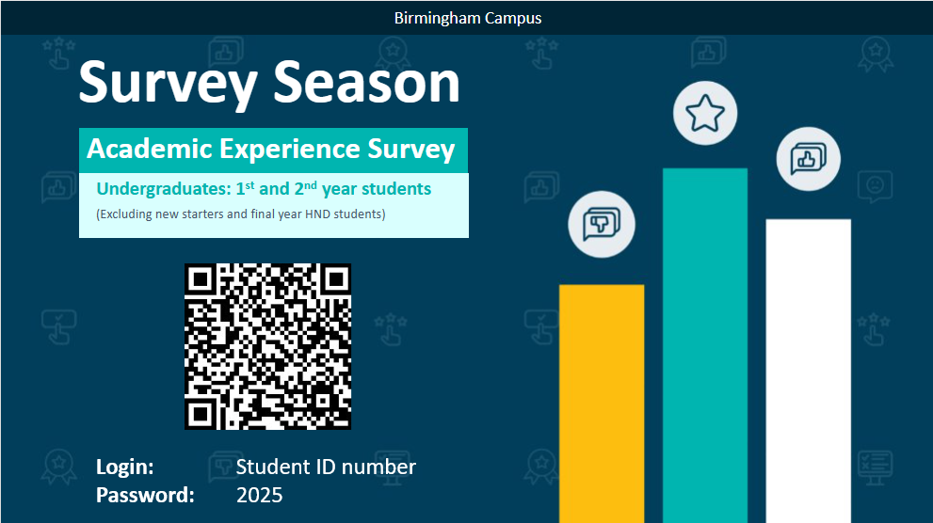
Please Spend 10 minutes to complete this survey
Notes:
Steps –
Scan the QR code (or use the link which you received via email)
Enter your student ID as the Username
The password is – 2025
Answer all questions providing as much details as you possibly can.

Slide 3
LCLM4006: Enterprise & Entrepreneurship
Recap of previous session….
We
Explored & explained what industry and competitors are.
Applied theory to practice by looking at the industry and competitors of your own business idea.

Slide 4
LCLM4006: Enterprise & Entrepreneurship
In today’s session….
We will:
Explore the different finance options for SMEs/Startups
Apply theory to practice by looking at your funding choices.
Work on your Cash Flow for your business idea.

Slide 5
LCLM4006: Enterprise & Entrepreneurship
Raising funding
One of the unique talents of entrepreneurs is finding the resources to launch their business ideas.
Funding means… MONEY and it is a resource that plays a crucial part for all entrepreneurial journeys.
Anyone might have a great business idea but…..without the necessary funding…it will remain a great idea only…….

Slide 6
LCLM4006: Enterprise & Entrepreneurship
Raising funding
There are many different types of funding/ finance available, especially in the UK.
And entrepreneurs can access these funding options both to start their business ideas or to grow their existing companies.

Slide 7
LCLM4006: Enterprise & Entrepreneurship
Raising funding
Government (national/local) backed loans or grants
Crowdfunding
Business loans (commercial Banks)
Family and friends
Angel investors
Venture capitalists
Personal funding

Slide 8
LCLM4006: Enterprise & Entrepreneurship
Government loan/grants
Government (national/local) backed loans or grants
Governments around the world, nationally or locally through the councils provide finance to startups or existing firms in form of loans or grants.
Government backed loans usually have much lower interest rates compare to the loans from commercial banks.
Grants are usually small amounts that startups do not need to pay back.
Notes:
Many governments provide small business grants, low-interest loans, or startup support programs.
Pros: Often come with lower interest rates or no repayment requirements (grants).
Cons: Competitive application process, strict eligibility criteria, and bureaucratic approval processes.
Examples: UK’s Start Up Loans, Small Business Administration (SBA) loans in the US, EU business grants.

Slide 9
LCLM4006: Enterprise & Entrepreneurship
Government-Backed Loans and Grants
Start Up Loans:
  The UK government offers unsecured personal loans ranging from £500 to £25,000 to start or grow your business.
  Successful applicants also receive up to 12 months of free mentoring.
  Government Loan Application
Finance and Support for Your Business:
  A comprehensive directory of government-backed financial support, including grants and loans, tailored to various business needs.
  Finance and Support

Slide 10
Crowdfunding
LCLM4006: Enterprise & Entrepreneurship
Crowdfunding allows small business owners or startups to sell shares in their companies in exchange for funding.
Through Crowdfunding anyone can make a micro investment in a new business that interests them.
Large numbers of people can invest small, affordable amounts into any existing firm or startup & can raise significant amounts.
Usually through online platforms that charge a fee
Notes:
Crowdfunding
Raising funds from a large number of people, usually via online platforms like Kickstarter, Indiegogo, or GoFundMe.
Pros: Engages potential customers early, no debt or equity loss if it's reward-based.
Cons: Requires strong marketing, may not always reach the target goal.

Slide 11
Crowdfunding Platforms
LCLM4006: Enterprise & Entrepreneurship
Crowd for Angels:
  A UK-based crowdfunding platform authorized by the Financial Conduct Authority (FCA), offering investment opportunities through shares, bonds, or tokens.
  Crowd-For-Angels
SyndicateRoom:
  An equity-based crowdfunding site that helps startups raise capital from angel investors and venture capitalists.
  Crowdfunding-Site
Notes:
Crowdfunding
Raising funds from a large number of people, usually via online platforms like Kickstarter, Indiegogo, or GoFundMe.
Pros: Engages potential customers early, no debt or equity loss if it's reward-based.
Cons: Requires strong marketing, may not always reach the target goal.

Slide 12
Business loans (Banks)
LCLM4006: Enterprise & Entrepreneurship
Business loans from commercial Banks can be a traditional route of entrepreneurial funding- but it is not always easy- a lot of paperwork.
Can be in a form of unsecured or secured business loans
The latter (secure business loan) will require collateral or a guarantor.
Notes:
Business Loans (Commercial Banks)
Traditional loans from banks, often requiring collateral and a good credit history.
Pros: Helps maintain full ownership of the business.
Cons: Strict eligibility requirements, potential high-interest rates, risk of debt.

Slide 13
Business Loans from Commercial Banks
LCLM4006: Enterprise & Entrepreneurship
Barclays Business Loans:
  Offers various financing options tailored to business needs.
Lloyds Bank Business Loans:
  Provides a range of business loans with flexible terms.
NatWest Business Loans:
  Features different loan options to support business growth.
Notes:
Business Loans (Commercial Banks)
Traditional loans from banks, often requiring collateral and a good credit history.
Pros: Helps maintain full ownership of the business.
Cons: Strict eligibility requirements, potential high-interest rates, risk of debt.

Slide 14
Family & Friends
LCLM4006: Enterprise & Entrepreneurship
Funding through family and friends.
Very common way of entrepreneurial funding in developing countries.
Requires strong family connections. It can be difficult to control the family dynamic at a later stage, but is a very straight forward funding option.
Example- Easyjet- Sir Stelios Haji-Ioannou secured a £5 million loan from his father.

Slide 15
Business Angels investors
LCLM4006: Enterprise & Entrepreneurship
Business angels are investors that invests their own money in a small business in exchange for a minority stake (usually between 10% and 25%).
Business angels will not offer only the investment, but also the mentoring and support to grow the business idea.
Business angel investors tend to be entrepreneurs or people with extensive experience in the business world.
Success or growth is not guarantee as a result of the investment offer.
Notes:
Family and Friends
Borrowing from close connections, often with flexible repayment terms.
Pros: Lower interest rates (or none), less paperwork.
Cons: Potential for personal conflicts if the business struggles to repay.

Slide 16
Angels investors Link
LCLM4006: Enterprise & Entrepreneurship
Business angels
UK Business Angels Association (UKBAA):
  The national trade association for angel and early-stage investment, offering resources to connect with potential investors.
Angels Den:
  An online investment platform that connects businesses with angel investors.
  Angel investors | British Business Bank

Slide 17
Venture capitalists
LCLM4006: Enterprise & Entrepreneurship
Venture Capitalists are investors that fund early-stage firms to help them grow.
Similarly, as the business angels they offer advice and strategic mentorship as well as funding.
They VC investment is often time limited as they expect the companies they fund to grow significantly and make a significant return on their investment.
Could raise millions and requires proof of concept.
Notes:
Venture Capitalists (VCs)
Professional firms that invest in high-growth startups for a significant share of equity.
Pros: Large funding amounts, strategic guidance, industry connections.
Cons: High expectations for growth, potential loss of control over decision-making.

Slide 18
Venture capitalists Link
LCLM4006: Enterprise & Entrepreneurship
British Private Equity & Venture Capital Association (BVCA):
  Provides information on venture capital firms operating in the UK.

Slide 19
Personal funding
LCLM4006: Enterprise & Entrepreneurship
Personal funding means funding raised by the individual entrepreneur.
Someone could have worked for several years and saved up a sum of money that is invested to their business idea.
Other examples:
Retired individuals can use their retirement funds to start their business ideas.
Individuals that been made redundant can use their redundancy pay to start their business ideas.
Notes:
Using personal savings, credit cards, or assets to fund the business.
Pros: Full control over the business, no need for repayment or equity sharing.
Cons: High financial risk, limited growth potential due to personal capital constraints.

Slide 20
Bootstrapping
LCLM4006: Enterprise & Entrepreneurship
Bootstrapping in the startup context refers to
  the process of launching and growing a business without external help or capital.
Bootstrapping.. means operating a company as economically as possible and cutting all unnecessary expenses.
Bootstrapping involves:
  hiring as few employees as possible
  leasing anything you can & being creative
  asking suppliers to allow longer payments terms & in some instances ask customers to pay in advance etc.

Slide 21
Raising Finance
LCLM4006: Enterprise & Entrepreneurship
Classroom discussion:
Reflecting on the different funding sources we learned, please choose two funding options that you would use to start your own business idea and tell the class why you selected these two.

Slide 22
Is not all about out money!
LCLM4006: Enterprise & Entrepreneurship
Let's look at the 25 UK entrepreneurs that started with very little money:
https://www.thisismoney.co.uk/money/smallbusiness/article-2809685/Top-25-self-entrepreneurs-started-small-sums-money.html

Slide 23
LCLM4006: Enterprise & Entrepreneurship
Entrepreneur case study- GymShark
Let's read about high grow company GymShark- this Young entrepreneur started from his garage!
https://www.thisisnotfinancialadvice.co.uk/p/from-garage-to-global-the-incredible
https://www.benfrancis.com/business/how-i-started-the-uks-fastest-growing-company/

Slide 24
Cash flow
LCLM4006: Enterprise & Entrepreneurship
To be successful entrepreneur you need to be able to control the finance of your company.
You need to present a 12-month cash flow forecast as a part of your assessments for this module.
A Cash Flow template is provided, please check in Moodle.
Everyone need to use this template and attached in your assignments.

Slide 25
Cash flow Practical activity 30 minutes
LCLM4006: Enterprise & Entrepreneurship
Let’s explore the Cash flow template from Moodle and try in the next 30 minutes to fill some of the costs or sales figures.

Slide 26

Do you have any ……
LCLM4006: Enterprise & Entrepreneurship

Slide 27

Next week…..
We will learn about
Assessment workshop

Slide 28
References
Barrow, Barrow, P., & Brown, R. (2012). The business plan workbook (7th ed.). Kogan Page.
Mariotti, S., & Glackin, C., (2017). Entrepreneurship: Starting and Operating A Small Business, 4th Edition, Pearson.

