Slide 1
Programme: BSc Health and Social Care
Module: Living with care : The Older Person
Module code: BMHP6009_BIRM
Student name: Oslava Chougleva
Student number: 2028217
Student name: Amina Bibi
Student Number:1807446
Lecturer: Joanne Davies
Assessment 1 – Debate Presentation

Slide 2

Euthanasia in the UK and Assisted Suicide
Source: Stock. adobe.2023

Slide 3

Definition of Euthanasia and Assisted Suicide
The deliberate taking of a person's life to stop their suffering is a practice that both euthanasia and assisted suicide share. Although the terms are frequently used together, they differ (NHS, 2020).
Euthanasia: intentionally takes another person's life to end their suffering ( RightToLifeUK, 2022).
It can either be done voluntarily or not.
Euthanasia is the act of one person—usually a doctor—putting their patient's life to death (Riisfeldt, 2023).
Assisted suicide: is intentionally assisting another person's suicide (BBC News, 2019).
Source: Duperrin.com, 2023

Slide 4

The law in the United Kingdom regarding Euthanasia and Assisted suicide
According to the Suicide Act of 1961, assisted suicide is against the law and is subject to a 14-year prison sentence. However, it is not illegal to attempt suicide.
The Coroners and Justice Act 2009 exempted bringing charges under section 2 of the 1961 act. if “the victim had reached a voluntary, clear, settled and informed decision to commit suicide, “ any person assisting was “wholly motivated by compassion” (Lewis, 2021)
‘Euthanasia is illegal and could be prosecuted as murder or manslaughter’ (British Medical Association, 2021).
International Law
Only fourteen countries globally (7% of all) allow assisted suicide and/or euthanasia ( RightToLifeUK, 2022).
Source:Pixabay.com, 2023

Slide 5

Anti-Euthanasia Arguments
Ethical and Practical Arguments
The NHS values improving lives, and everyone counts (Health Education England, 2017).
The value of suffering
Society’s respect for life is destroyed through euthanasia.
Accepting euthanasia reflects the understanding that individual lives—those of the sick and disabled—are less valuable than others.
Other people's rights, not simply the patient's, are impacted by euthanasia.
Euthanasia contradicts the desire to offer effective pain management and quality care for the terminally ill.
Euthanasia legislation internationally might weaken the dedication of medical professionals to preserving lives.
Euthanasia legislation will stop the development of novel therapies and cures for terminally sick people (BBC, 2014).
Religious arguments
A path of decline that leads to premature deaths and the killing of persons who are deemed undesirable begins with voluntary euthanasia.

Slide 6

End-of-life and palliative care facilities
Hospice care- End-of-life care and palliative care
Patients with terminal illnesses and a life expectancy of six months or fewer often receive hospice care (NHS Choices, 2019).
Although it can be provided in specialised hospice facilities, hospice care is frequently given to patients in their homes, nursing homes, or assisted living facilities (NHS Choices, 2019).
Hospice care focuses on pain control relief and spiritual and emotional support for the patient's family (NHS Choices, 2019).
Palliative care can significantly improve your quality of life and the quality of life of those who care for you if you have been diagnosed with a serious, chronic illness or a life-threatening condition (Kam, 2011).
The awareness of the human aspect of the illness is one of the benefits of palliative care (Kam, 2011).

Slide 7
The gap between the need and availability of end-of-life care
Financial limitations, a lack of end-of-life care infrastructure, and a shortage of terminally ill specialists
Lack of high-quality care
Doctors need more training and support to improve the quality of end-of-life care they can provide.
Hospice staff often have difficulty recognising the point at which a transition to a palliative care approach may be appropriate.
The well-being of families.
The availability and use of end-of-life care can be influenced by cultural attitudes, beliefs, and social norms surrounding death and dying.
(End of Life Care Fifth Report of Session 2014-15 Report, together with formal minutes relating to the report, 2015)

Slide 8

Legislation
The law
Both euthanasia and assisted suicide are illegal under English law.
Assisted suicide
According to the Suicide Act of 1961, assisted suicide is against the law and is subject to a 14-year prison sentence. It is not illegal to commit an attempted suicide
.Euthanasia
Euthanasia is either considered manslaughter or murder, depending on the circumstances. Life in prison is the maximum sentence.
Types of euthanasia
Euthanasia can be classified as:
voluntary euthanasia is when a person consciously decides to die and asks for help.
non-voluntary euthanasia –When an individual decides on someone else's behalf when they are incapable of giving their consent (for example, when they are in a coma), maybe because the terminally ill person has previously stated a wish for their life to be taken in such a situation.’(NHS, 2020).

Slide 9

Planning for end of life
Making a will: A will is essential to carry out your desires.
Power of attorney: You might need someone to decide or act on your behalf.
Living wills: It expresses the preference for a particular type of medical care or, in some circumstances, your refusal of a particular type of care (Age UK, n.d.)
Do not attempt cardiopulmonary resuscitation (DNACPR) form: Advance decision to refuse CPR (NHS, 2021).
Finance support: You might be entitled to submit a claim for bereavement benefits if your partner dies. (Age UK, n.d.)

Slide 10
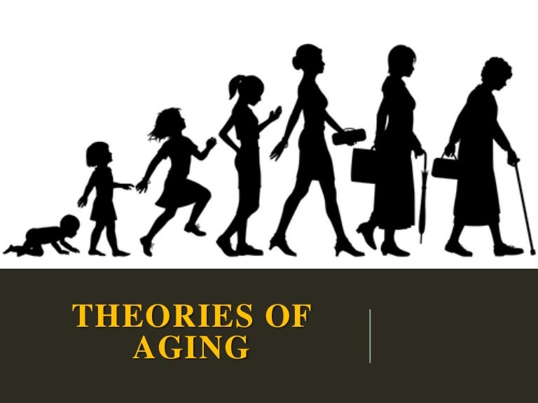
Disengagement Theory
According to the Disengagement Theory of Ageing, older people withdraw from relationships with others and society.
It is normal and appropriate. The theory states that society's reaction to the older person's disengagement is a common acceptance that the older person will soon pass away.
Society must prepare to carry on without them. As a result, the theory argues that older persons' withdrawal from society is normal and appropriate (Social Sci LibreTexts, 2018)
Activity Theory
According to the Activity Theory, People can maintain their sense of purpose, social relationships, and general mental and physical health by being involved and active.
Older persons can benefit from various activities, including volunteering, pursuing hobbies, picking up new skills, and exercising. These pursuits support positive ageing by fostering a sense of fulfilment, individual development, and social integration( Narushima , Liu and Diestelkamp , 2016)
Continuity Theory
According to Continuity Theory, people in their middle years and older adjust their lifestyles to continue engaging in the same hobbies, interacting with the same people, and holding the same ideas and values as they age.
They frequently keep these structures as they age and carry on with connections and activities that fit their pre-established patterns. In other words, people choose roles, activities, and behaviours suitable for their self-concept and personal identity to maintain continuity (Bell, 2013).

Slide 11
Conclusion
Conclusion: Euthanasia and assisted suicide involve intentionally ending a person's life to end their suffering; a third party carries out euthanasia, whereas assisted suicide is carried out by the person receiving the assistance—the Suicide Act of 1961 criminalises both methods in the UK.
Arguments against euthanasia on the value of life and worry about potential risks from overuse.
Palliative care facilities offer total support and symptom management to patients nearing the end of their lives. However, there is occasionally a gap between the need and availability of such care.
Planning for the end of life includes making decisions and arrangements for medical procedures and personal preferences. Ageing theories examine the biological, psychological, and social changes resulting from ageing.

Slide 12

Age UK. (n.d.) End-of-life planning. Available at: https://www.ageuk.org.uk/information-advice/money-legal/end-of-life-planning/ Accessed: 19 June 2023).
BBC (2014). BBC - Ethics - Euthanasia: Anti-euthanasia arguments. Available at: https://www.bbc.co.uk/ethics/euthanasia/against/against_1.shtml/ (Accessed: 6 June 2023).
BBC News (2019) What’s the difference between assisted suicide and euthanasia? Available at: https://www.bbc.co.uk/news/uk-47158287/ (Accessed:6 June 2023).
Bell, K .(2013) Continuity theory definition. Available at: https://sociologydictionary.org/continuity-theory/ (Accessed: 19 June 2023).
British Medical Association (2021) What is the law on physician-assisted dying in the UK? Available at: https://www.bma.org.uk/media/4400/bma-pad-map-and-uk-legislative-proposals-aug-2021.pdf/ / (Accessed: 6 June 2023).
CDN (2023) Theories of Ageing. Available at: https://cdn.slidesharecdn.com /( Accessed: 19 June 2023)
Duperrin (2023) Definition. Available at: https://www.duperrin.com/english/wp-content/uploads/2020/07/definition-scaled.jpg /(Accessed 6 June. 2023)
) House of Commons Health Committee(n,d) - Publications.Parliament. UK. Available at: https://publications.parliament.uk/pa/cm201415/cmselect/cmhealth/805/805.pdf (Accessed: 22 June 2023).
Source: Stock. adobe.2023)

Slide 13
Kam, K. (2011) When Is Palliative Care Appropriate? Available at: https://www.webmd.com/palliative-care/when-is-palliative-care-appropriate/ (Accessed:6 June 2023).
Lewis, P. (2021). Assisted Dying Bill. Available at: https://lordslibrary.parliament.uk/assisted-dying-bill-hl/ (Accessed:6 June 2023).
Narushima, M., Liu, J. and Diestelkamp, N. (2016). ‘ Lifelong learning in active ageing discourse: its conserving effect on wellbeing, health and vulnerability’, Ageing and Society, 38(4), pp.651–675. Available at: https://doi.org/10.1017/s0144686x16001136.
NHS (2020) Euthanasia and Assisted Suicide.NHS. Available at: https://www.nhs.uk/conditions/euthanasia-and-assisted-suicide/ (Accessed:6 June 2023)
NHS (2020 a) Euthanasia and Assisted Suicide. Available at: https://www.nhs.uk/conditions/euthanasia-and-assisted-suicide/ (Accessed:6 June 2023)
NHS (2021) Do not attempt cardiopulmonary resuscitation (DNACPR) decisions. Available at: https://www.nhs.uk/conditions/do-not-attempt-cardiopulmonary-resuscitation-dnacpr-decisions/ (Accessed: 19 June 2023).
NHS (2020) Choices. Available at: https://www.nhs.uk/conditions/euthanasia-and-assisted-suicide/ (Accessed: 19 June 2023)
RighttolifeUK (2022) Assisted suicide and euthanasia. Available at: https://righttolife.org.uk/know.ledgebase/assisted-suicide-and-euthanasia/ (Accessed 6 June 2023).
Riisfeldt, T.D. (2023) ‘Overcoming Conflicting Definitions of ‘Euthanasia, and of Assisted Suicide,’ Through a Value-Neutral Taxonomy of ‘End-Of-Life Practices’. Journal of Bioethical Inquiry. doi:https://doi.org/10.1007/s11673-023-10230-1.
Social Sci LibreTexts (2018) Disengagement Theory. Available at: https://socialsci.libretexts.org/Bookshelves/Sociology/ (Accessed: 19 June 2023)
Stock. adobe (2023) Euthanasia, Available at: https://stock.adobe.com/uk/search?k=euthanasia&asset_id=400233858 (Accessed: 05 June 2023).
Stock. adobe (2023) References, Available at: https://stock.adobe.com/uk/search?k=euthanasia&asset_id=400233858 (Accessed: 05 June 2023).

