Slide 1
Public Protection 1
Wynne Jones

Slide 2
Learning Outcomes
Following Completion of the Lectures Students Should be Able to:
Critically Assess the Impact of abuse upon victims
Understand how to evolve professional strategies to deal with the impact of personal attitudes and values upon the investigative process
Critically Review the links between Serious and Organised Crime Groups and public protection issues
Critically assess police strategies for dealing with public protection incidents.

Slide 3
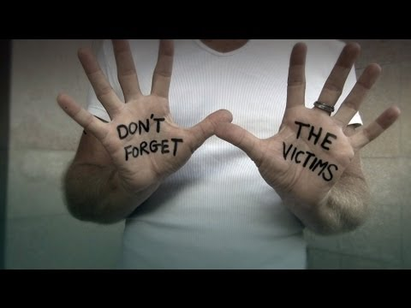
Defining a ‘Victim’
We might consider the definition of a ‘victim’ as being obvious.
We should however, examine some of the complexities around this contested and controversial aspect of victimology (the scientific study of crime victims).

Slide 4
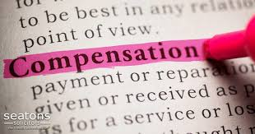
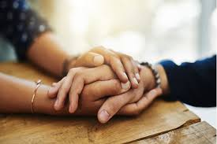
Popular view of Victimhood
A person who is entitled to some financial recompense as a result of what has happened to them?
Someone who seeks and deserves practical protection and the administration of Justice from the state?

Slide 5
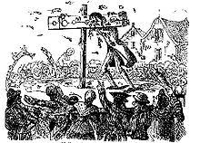
Historical Context
From the mid 1800’s victims were placed at the centre of the Criminal Justice System as offenders were subjected to public retribution either physically or by means of humiliation such as being placed in stocks and townsfolk throwing rubbish, dung or stones at them.

Slide 6
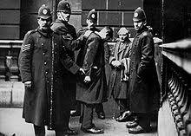
Police become Prosecutors
Throughout the 19th and early 20th Century the justice system developed the Police became the main prosecutors of crime on behalf of victims until by the mid 20th century victims had, largely disappeared from the courts.

Slide 7

The impacts of Victimisation
The impacts of crime may have financial or material effects but may also leave the victim with physical, behavioural and emotional harm
Given that the potential harm to victims is potentially substantial it might be argued that they should be placed at the centre of the Criminal Justice process

Slide 8
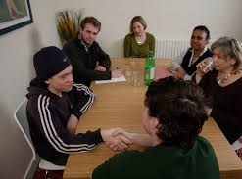
Re-centering victims of crime
Recently there have been calls for the re-centering of victims of crime throughout the criminal justice system through the introduction of restorative justice, the ‘Victims Commissioner and the Victims Strategy (2018)

Slide 9

Boundaries of Victimhood
Are the boundaries between the perception of and recognition for different types of victimhood equal?
If we think about victim responses to crime (you might have been one) they might differ across offence categories e.g. we would probably react differently to our car being damaged than we would if we had been physically assaulted.

Slide 10
Exercise - A hierarchy of Victims
Are Victims ‘Deserving’? ‘Undeserving’? ‘Ideal’ (Christie 1986)?
On the next slide you will be presented with a range of Victims on a scale of 1 – 5 where 1 is ‘none’ and 5 is ‘full’ rate your level of support for each victim, make o record of your score and your reasons for awarding that score.

Slide 11
Exercise - A hierarchy of Victims
A young child run over by a careless driver?
A man who stays with an abusive and violent partner?
A husband with a debilitating terminal disease who is given a lethal overdose by his wife?
A woman who gets so drunk she cannot remember getting into a taxi with a stranger who later attacks her?
A Heroin dealer beaten up by a rival?
A prisoner who suffers violence in prison?
An elderly person who has been overcharged £4000 by an unscrupulous tradesperson.

Slide 12
Debrief of Exercise
Were some of the examples easier to score than others?
Would your response have changed had the circumstances been slightly difference e.g. if the heroin supplier had been carrying out his or her dealing to fund a child’s healthcare?
Would the way you learned of the crime affect your view (heard it in a bar? Read on tabloid? Personal experience?)

Slide 13
United Nations on Victims
"Victims" means persons who, individually or collectively, have suffered harm, including physical or mental injury, emotional suffering, economic loss or substantial impairment of their fundamental rights, through acts or omissions that are in violation of criminal laws operative within Member States, including those laws proscribing criminal abuse of power.
A person may be considered a victim, under this Declaration, regardless of whether the perpetrator is identified, apprehended, prosecuted or convicted and regardless of the familial relationship between the perpetrator and the victim. The term "victim" also includes, where appropriate, the immediate family or dependants of the direct victim and persons who have suffered harm in intervening to assist victims in distress or to prevent victimization.

Slide 14

UN Definition
You will have noted that the UN definition of ‘Victim’ talks of ‘harm’ rather than ‘crime’ and also introduces the idea of the ‘secondary victim’ – the effects of the crime or abuse on immediate family members of the ‘primary’ victim.

Slide 15
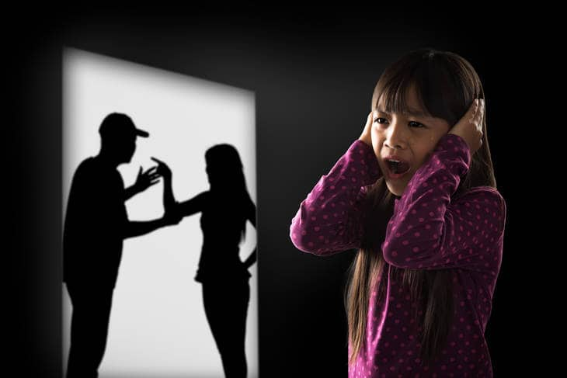
Distinctions between Victims and Offenders
Sometimes not as clear as we might think e.g.
Evidence suggests that many people who inflict domestic abuse upon partners themselves suffered domestic abuse,
This Photo by Unknown Author is licensed under CC BY-SA

Slide 16
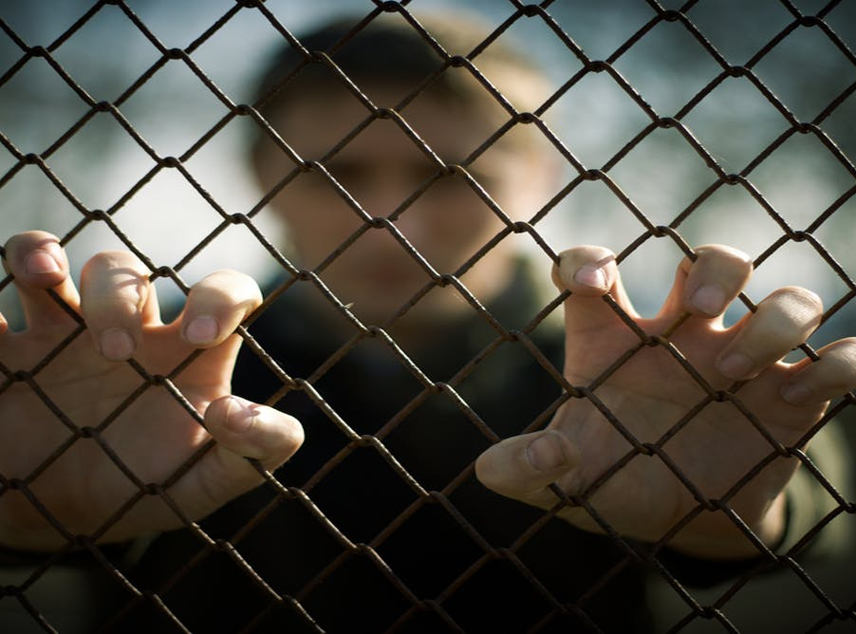
Distinctions between Victims and Offenders
Many young offenders who end up in young offender’s institutes also suffer from multiple forms of deprivation – 95% of imprisoned young people suffer from at least one form of mental illness. (ONS 1997)
This Photo by Unknown Author is licensed under CC BY-ND

Slide 17
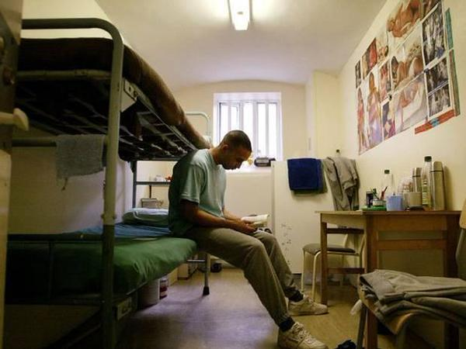
Distinctions between Victims and Offenders
25% of adult prisoners have an IQ of less than 80,
84% had experienced at least one Adverse Childhood Experience (ACE) compared with a Welsh average of 46%.
Nearly half of prisoners (46%) reported they had experienced four or more ACEs.
This Photo by Unknown Author is licensed under CC BY

Slide 18

Think about that…………..
Are these ‘offenders’ themselves ‘Victims’ of broader social exclusion and injustice??
This Photo by Unknown Author is licensed under CC BY-ND

Slide 19
Impact of Abuse on Victims

Slide 20
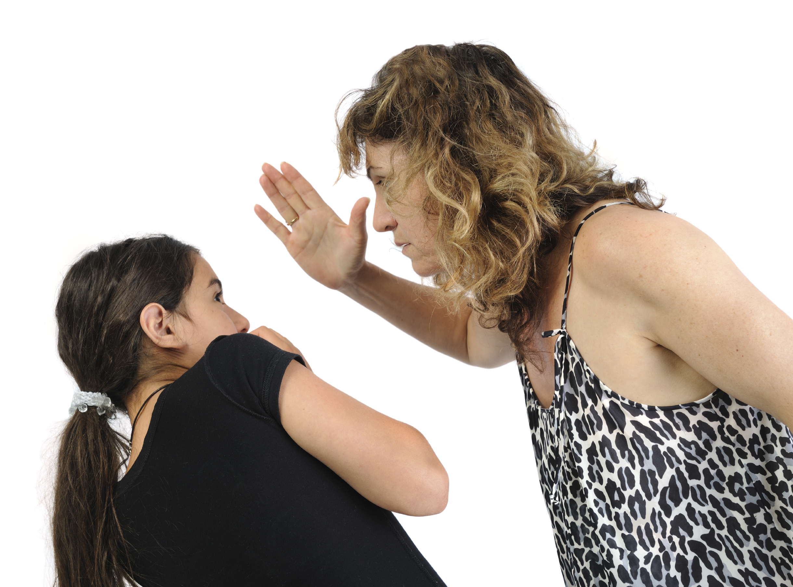
The Impact of Abuse on Victims
The impact of abuse is perhaps best thought of as a product of the perceived seriousness or intensity of these effects from the victim’s own standpoint.
This includes the meaning and significance of the abuse for the victim, whether or not it has resulted in a change of self-perception by which the victim comes to perceive himself or herself as a victim.
This Photo by Unknown Author is licensed under CC BY-SA

Slide 21
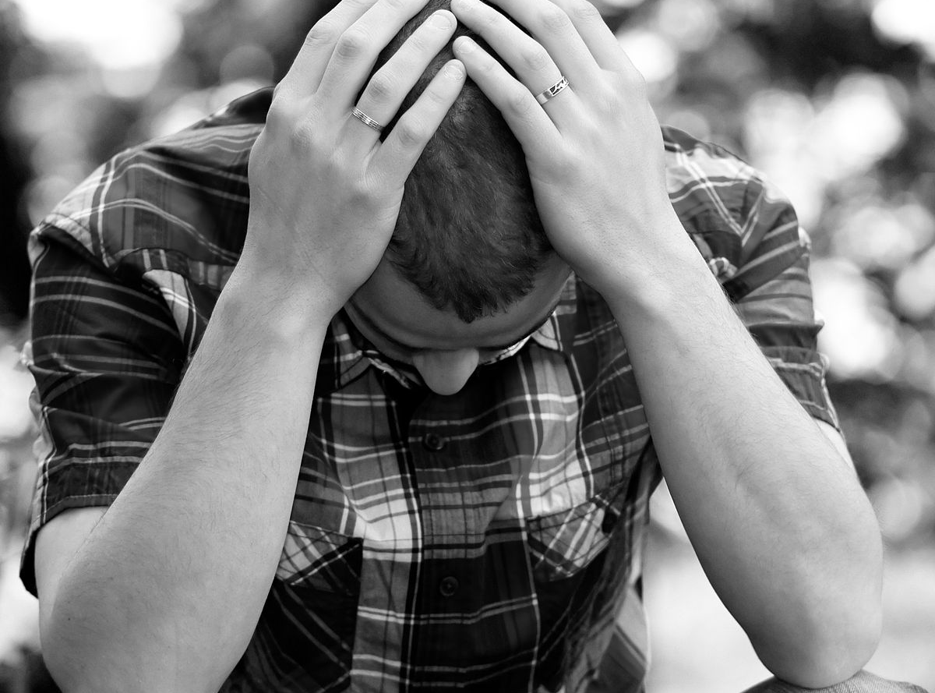
The Impact of Abuse on Victims
In terms of its duration the emotional impact is particularly intense at the outset, but that after a few days the initial fear, shock and anger gives way to a longer period of nervousness, anxiety, sleeplessness, depression, fear of a repeat attack and, often, self-blaming.
This Photo by Unknown Author is licensed under CC BY-SA

Slide 22
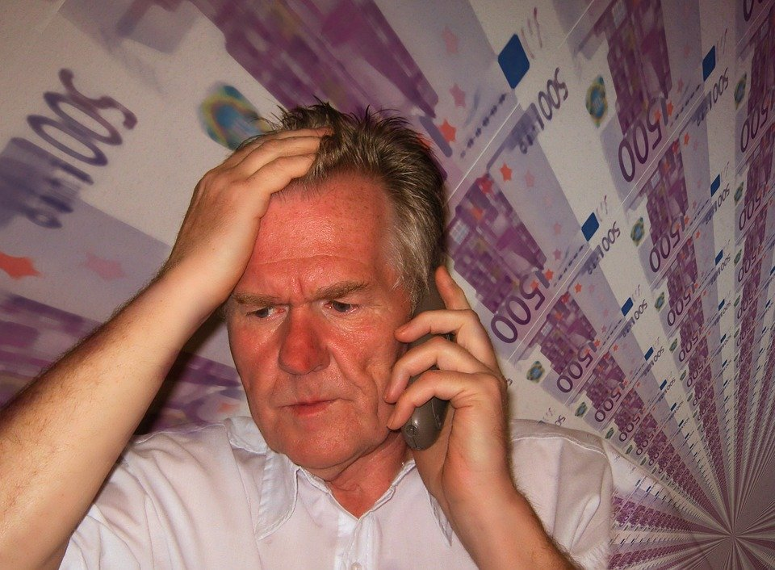
Short Term Impacts of Abuse
Mental Anguish
Shock, disbelief and denial
Anger, fear, frustration, confusion
Self-blame, guilt, grief

Slide 23
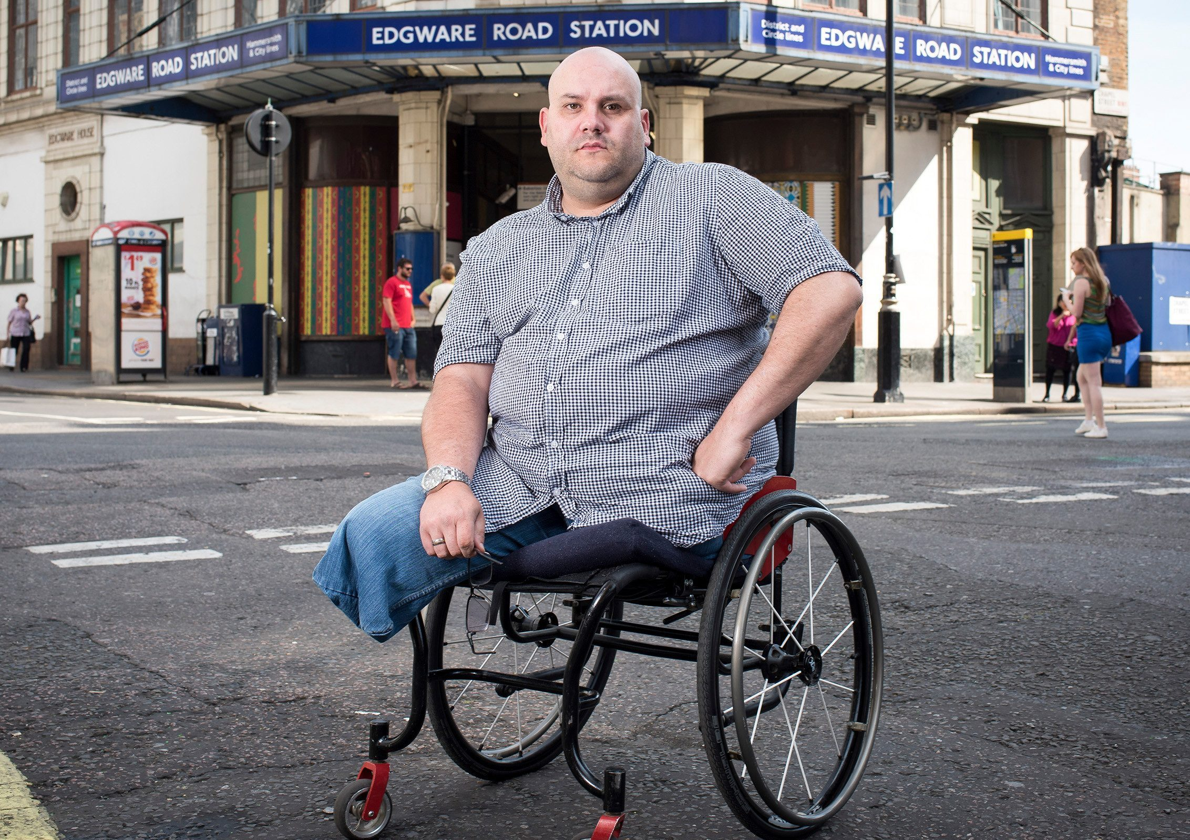
Long Term Impacts of Abuse
Following abuse some victims may develop long-term psychological problems, such as depression or anxiety attacks or Post Traumatic Stress Disorder.
(Dan Biddle the most injured survivor of the London Terror Attacks of 2005 leaving him with PTSD amongst other health issues – since he has suffered Hate Crime on account of his disability).
Notes:
Depending on the circumstances of the crime or the victim, some victims may suffer long after the event.

Slide 24
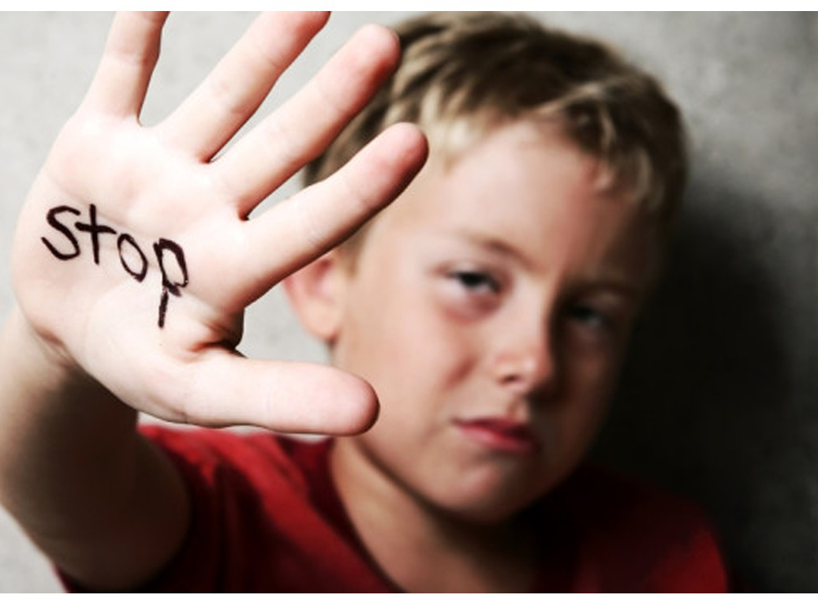
Long Term Impacts of Abuse
Abuse can lead to the victim feeling powerless and vulnerable.
As we know some abuse such as domestic violence, racially motivated crimes child abuse etc are often ‘ongoing’ offences and rarely ‘one off’s’ this for of abuse is particularly harmful to the victim.
This Photo by Unknown Author is licensed under CC BY-SA
Notes:
Depending on the circumstances of the crime or the victim, some victims may suffer long after the event.

Slide 25
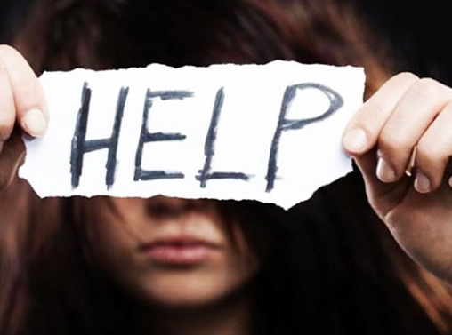
Long Term Impacts
Post Traumatic Stress Disorder (PTSD)
Flashbacks
Depression
Panic Attacks
Behavioral changes - Fear of going out (of re-victimisation)
Suicide
Multiple impacts on abuse victims life (e.g. employment, social, offending)
This Photo by Unknown Author is licensed under CC BY-SA-NC

Slide 26
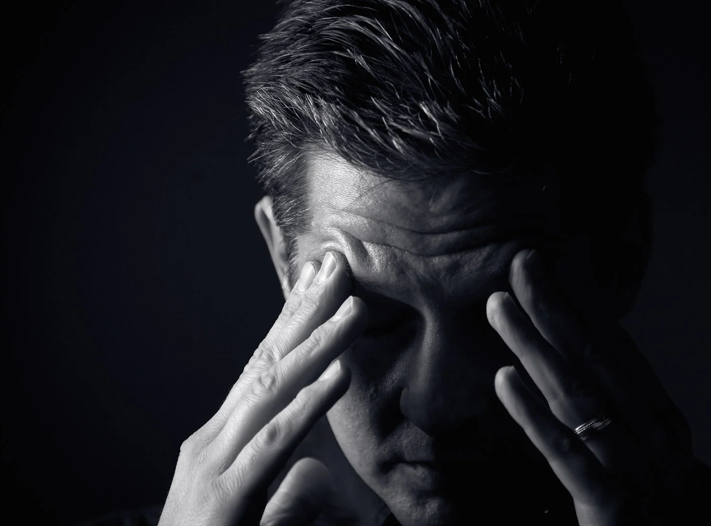
Depression and Anxiety
One person in eight will suffer from depression at some time in their lives,
Sufferers from depression are likely to experience low energy levels and de motivation,
Victims of abuse may experience feelings of guilt and have suicidal thoughts.

Slide 27
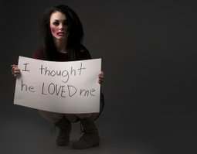
Trauma Bond
Trauma bond relates to the phenomena whereby a kind of relationship forms between the abuser and the victim.
The term was first coined by Dr. David Dutton a Canadian academic who researched domestic violence and child abuse extensively.
This Photo by Unknown Author is licensed under CC BY-SA

Slide 28
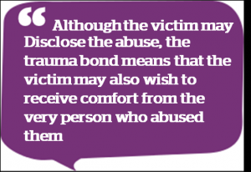
Traumatic Bonding
The development of strong emotional ties between two persons, with one person intermittently harassing, beating, threatening, abusing or intimidating the other.
This phenomenon is based on the existence of a power imbalance wherein the maltreated person perceives him or herself to be subjugated to be dominated by the other (Foote 1988)

Slide 29
Bibliography (All available via open source (online) or via UWTSD Library)
Benkert M. & Doyle T.P. (2009) Clericalism, Religious Duress and its Psychological Impact on Victims of Clergy Sexual Abuse.
Available at: https://link-springer-com.ezproxy.uwtsd.ac.uk/content/pdf/10.1007/s11089-008-0188-0.pdf Accessed 6th June 2020
HMSO (2018) Victims Strategy Available at: https://assets.publishing.service.gov.uk/government/uploads/system/uploads/attachment_data/file/746930/victim-strategy.pdf Accessed 10th June 2020
Jakobson S (2018) What is Trauma Bonding? Is It Keeping You In a Bad Relationship? Available at: https://www.harleytherapy.co.uk/counselling/what-is-trauma-bonding.htm Accessed on 10th June 2020
ONS (1997) Survey of Psychiatric Morbidity among Prisoners in England and Wales. Available at: https://www.herc.ox.ac.uk/downloads/health_datasets/browse-data-sets/ons-survey-of-psychiatric-morbidity-among-prisoners-in-england-and-wales Accessed 9th June 2020.
United Nations (1985) Declaration of Basic Principles of Justice for Victims of Crime and Abuse of Power. Available at: https://www.ohchr.org/en/professionalinterest/pages/victimsofcrimeandabuseofpower.aspx Accessed 6th June 2020.
Royal Society for Public Health (2019)
https://www.rsph.org.uk/our-work/resources/early-action-together-learning-network/resources/animation-and-films.html

