Slide 1
Starbucks
The companies approach to strategies, organisational management, teamwork and corporate social responsibility.

Slide 2
Objectives:
To discuss Starbucks approach to strategies
To critically analyse Starbucks approach to management
To discover how teamwork and grouping is used within Starbucks and measure this against theories of teamwork
To talk through what corporate social responsibility is and how Starbucks is supporting or not supporting this.

Slide 3
Introduction to Starbucks
1971 Seattle
1982 Howard Schultz
1983 Italian coffee culture
1987 Green aprons
1999 Takeover
Today
(Statista, 2023) (Starbucks, 2024)

Slide 4
Company Strategy- Goals and Objectives
Goal- Create a competitive edge against competitors to ensure consumers choose Starbucks
Objective 1- Curate a premium brand that is tough for a competitor to recreate. This includes selling premium products in a premium location with premium customer service.
Objective 2- Gain acquisitions of premium companies to diversify product portfolio. Such as Tea-vana (tea), Bay Breads (premium breads) and Evolution Fresh (juice).
Objective 3- Expand into developing markets in order to become more geographically accessible as a global brand.
(Geereddy, 2013)

Slide 5
Company Strategy- SWOT Analysis
Strengths- Strong brand recognition Global market position Quality of products Location of stores Knowledgable and capable employees Technological growth | Weaknesses- Expensive Products/ Paying premium Long term growth is diminished United States dependency Negative image of large corporations Clash of coffee cultures
Opportunities- Expansion into further global markets Expand product offerings Further expansion of goods into retail stores New distribution channels Business extension through horizontal diversification | Threats- Increased competition Changes in cost of coffee Increased market saturation in developing countries Developing countries economy Changing consumer tastes
(Geereddy, 2013)

Slide 6
Company Strategy- PEST Analysis
Political
Remain neutral in political issues due to previous mistakes.
Operation across many countries means following laws and legislations set by numerous governments.
Economic
Expand across global locations.
Backwards vertical integration to minimize costs.
Social
Ethos water acquisition in 2005 and a further investment of $12million.
Tailor to multiple cultures.
Technological
New 'Order and Pay' app that uses AI technology.
Available by external delivery services.
Offering healthier products due to demand.
Broadmix, Mixson (2021), Masko (2024), Talib (2020)

Slide 7
Organisational Management Approach
Starbucks offers its employees a mix of modern and traditional management structures.
Servant Leadership Theory-
Transformational Management-
Robert Greenleaf (1977), serve employees as a supporter and motivator to help upskill and provide adequate resources (Shonk, 2024).
'Ways of Being' training values (Schiemer, 2010)
James MacGregor Burns (1978) (Ugochukwu, 2024).
Howard Schultz used vision and leadership to ensure employees 'added value' to the organisation (Dimitrakaki, 2023).
Human Relations Approach-
Participative Management-
Elton Mayo (1933) (Two Teachers, 2023).
Positive Culture (Dimitrakaki, 2023)
Open Communication (Waqar, 2023)
Diversity and Inclusion (Starbucks, 2024)
Rensis Likert (1961) (Wang et al, 2022).
Employees are 'partners' (Schiemer, 2010)
Benefits for employees (Medium, 2023)

Slide 8
Teamwork within Starbucks
Tuckman's theory of team working (1965):
Forming
Storming
Norming
Performing
Adjourning
(FreshBooks, 2024), (Institute for Manufacturing, 2024)

Slide 9
Teamwork within Starbucks
Belbin team roles theory (1981):
Action Orientated Roles
Shaper
Implementer
Completer
People Orientated Roles
Co-ordinator
Resource Investigator
Cerebral Roles
Plant
Monitor Evaluator
Teamworker
Specialist
(FreshBooks, 2024), (Institute for Manufacturing, 2024)

Slide 10
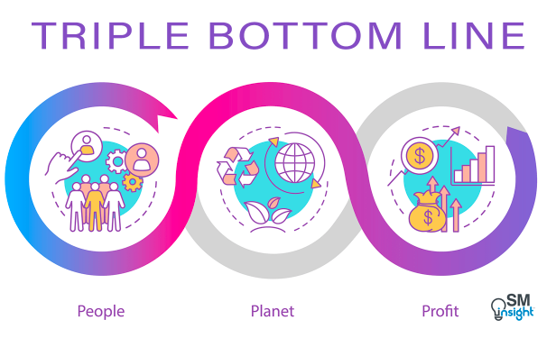
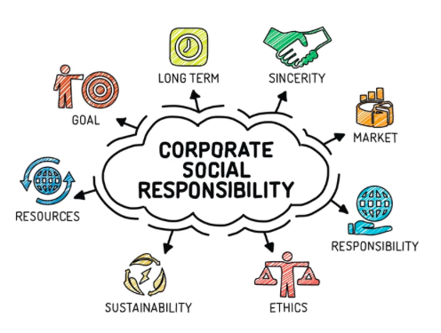
Corporate Social Responsibility
"...the idea that a business has a responsibility to the society that exists around it..." (Stobierski, 2021).
(Jurencius, 2024)
"The triple bottom line is a concept that states firms should commit to measuring their social and environmental impact- in addition to their financial performance- rather than solely focusing on generating profit," (Miller, 2020).
(Jackson, 2024)

Slide 11
Corporate Social Responsibility vs Starbucks
Starbucks invested $1 billion in wage increases, training and new equipment in 2022.
98% of coffee is ethically sourced
3500 stores have reduced usage of water, waste and carbon emissions by 10%.
100% score on DEI and HRCCEI
1000 stores in India by 2028
Investment into technology and various methods of payment.
Improved manufacturing techniques
(Birch, 2024)

Slide 12
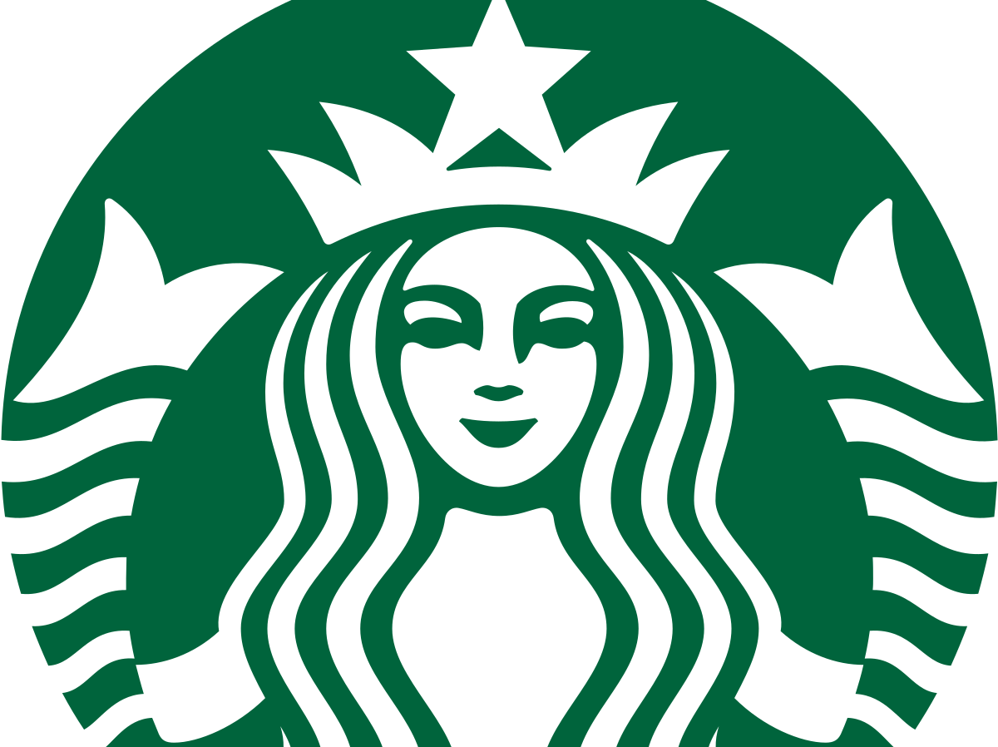
Overview
We can see from Starbucks company strategy, management approach, teamwork strategies and the dedication to ethical and environmental practices that Starbucks is not only going to be continually successful, but it also leads in challenging traditional stereotypes with a more modern and caring approach towards both consumers and employees.
(Wikipedia, 2024)

Slide 13
References
Birch, K. (2024). Starbucks: balancing sustainability goals with rapid growth. https://sustainabilitymag.com/sustainability/starbucks-balancing-sustainability-goals-with-rapid-growth​
​
Boardmix. (2024). PESTLE Analysis of Starbucks: A Comprehensive Guide to Brew Success. https://boardmix.com/analysis/pestle-analysis-of-starbucks/​
​
Dimitrakaki, I. (2023). Servant Leadership. Case Study Starbucks.
https://www.ijmh.org/wp-content/uploads/papers/v9i6/F1570029623.pdf​
​
Freshbooks. (2024). Tuckman's Theory: Five Stages of Team Development. https://www.freshbooks.com/hub/other/tuckmans-theory#:~:text=Tuckman's%20theory%20was%20first%20proposed,last%20until%20the%20project%20ends.​
​
Geereddy, N. (2013). Strategic analysis of Starbucks corporation.
ajol-file-journals_431_articles_74995_submission_proof_74995-5113-169771-1-10-20120320.pdf​
​
Jackson, R. (2024). Corporate Social Responsibility Image. [Online Image]. https://www.thegivingmachine.co.uk/blog/posts/corporate-social-responsibility-and-environmental-social-and-governance-a-simple-guide/​
​
Jurevicius, O. (2024). Triple Bottom Line Image. [Online Image). https://strategicmanagementinsight.com/tools/triple-bottom-line/​

Slide 14
Masko, J. (2024). Starbucks' political activism has backfired.
https://unherd.com/newsroom/starbucks-blm-and-palestine-activism-has-backfired/#:~:text=Like%20so%20many%20companies%2C%20the,over%20the%20war%20in%20Gaza.
Medium. (2023). Starbucks Career Benefits: A path to success.
https://starbuckspartnerhour.medium.com/starbucks-career-benefits-a-path-to-success-26998b323c80
Miller, K. (2020). The Triple Bottom Line: What It Is & Why It's Important.
https://online.hbs.edu/blog/post/what-is-the-triple-bottom-line
Mixson, E. (2021). How Starbucks Perfected the Art of the Cross-Chanel. https://www.intelligentautomation.network/transformation/articles/starbucks-digital-transformation#:~:text=Starbucks'%20%E2%80%9CDigital%20Flywheel%E2%80%9D&text=In%20addition%20to%20enabling%20Mobile,unique%20preferences%20and%20spending%20habits.
Roby, L. (2011). An analysis of Starbucks as a company and an international business. Starbucks as an International Business. https://digitalcommons.liberty.edu/cgi/viewcontent.cgi?article=1237&context=honors
Schiemer, B. (2010). What is Work? An Ethnography of Starbucks.
https://core.ac.uk/download/pdf/11590475.pdf
Shonk, K. (2024). Servant Leadership Theory. https://www.pon.harvard.edu/daily/leadership-skills-daily/servant-leadership-theory/#:~:text=Commitment%20to%20the%20growth%20of,the%20growth%20of%20each%20individual.%E2%80%9D
Starbucks. (2024). About Us.
https://www.starbucks.com/about-us/

Slide 15
Statistica. (2024). Number of Starbucks Stores worldwide from 2003 to 2024. https://www.statista.com/statistics/266465/number-of-starbucks-stores-worldwide/​
​
Stobierski, T. (2021). What is Corporate Social Responsibility? 4 Types. ​
https://online.hbs.edu/blog/post/types-of-corporate-social-responsibility​
​
Talib, F. (2020). Strategic analysis of Starbucks Coffee Company. Undergraduate Dissertation. 32-35. https://zaguan.unizar.es/record/101077/files/TAZ-TFG-2020-4193.pdf?version=1 ​
​
Two Teachers. (2023). Understanding Elton Mayo's Human Relations Theory: Unlocking Employee Motivation. https://www.twoteachers.co.uk/post/understanding-elton-mayo-s-human-relations-theory-unlocking-employee-motivation​
​
Ugochukwu, C. (2024). Transformational Leadership Theory: How to Inspire and Motivate. https://www.simplypsychology.org/what-is-transformational-leadership.html​
​
University of Cambridge. Belbin's Team Roles. ​
https://www.ifm.eng.cam.ac.uk/research/dmg/tools-and-techniques/belbins-team-roles/​
​
Wang, Q., Hou, H., & Li, Z. (2022). Participative leadership: a literature review and prospects for future research. Frontiers in Psychology. https://pmc.ncbi.nlm.nih.gov/articles/PMC9204162/#:~:text=The%20American%20scholar%20Likert%20(1961,et%20al.%2C%202018).​
​
Waqar, H. (2023). The Power of Effective Internal Comms: Lessons from Retail Industry Giants. https://www.sparrowconnected.com/blog/the-power-of-effective-internal-comms-lessons-from-retail-industry-giants#:~:text=Starbucks%20is%20renowned%20not%20only,directly%20with%20colleagues%20and%20management.​
​
Wikipedia. (2024). Starbucks Logo. [Online Image]. https://en.wikipedia.org/wiki/Starbucks

