Slide 1
Well-Being
The Here & Now

Slide 2
Homework
Definition of ‘Well-being’

Slide 3
Objective
Explore well-being in its current place, its theory and policy

Slide 4
Freedom
Health
Pleasure
(Austin, 2020)
Notes:
Ancient, classical and modern accounts regard these as universal component parts of well-being.
Three influential frameworks underpin wellbeing both politically and in policy at national and intergovernmental level
1) The International Bill of Human Rights (IBHR), involving the Universal Declaration of Human Rights (1984)
The International Covenant on Economic, Social and Cultural Rights (1966)
The International Covenant on Civil and Political Rights (1966)
IBHR is part of political and legal standards of well-being across the world.
Important to recognise the two separate concepts of well-being: subjective well-being which is aligned to personal perspectives and the greatest good an individual can achieve; objective well-being is aligned to political and institutional arenas and striving to meet their objectives. (Austin, 2020)

Slide 5
What are the determinants of happiness over the life course ?
Income only partial influence
Human relationships
Mental health
Child’s behaviour and emotional health
Mother’s mental health
School and significant teacher
(Clark et al, 2016)
Notes:
Money is only a small contributory factor in the happiness of the population over the life course
Human relationships are more important, especially personal partnerships
Mental health is the single most important factor and explains the variation in happiness across the population
Child’s behaviour and emotional health is best predictor of enjoyable adult life
Children are affected by parents mental health, especially the mother’s
Both school and significant teacher have an enduring impact upon the well-being of their students (Clark et al, 2016)

Slide 6
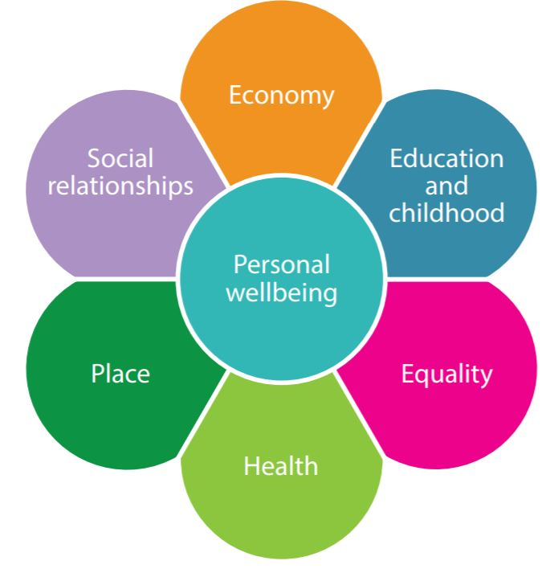
Well-being Framework
‘ Purpose to provide a balanced holistic picture of wellbeing and its determinants, giving decision makers and practitioners an invaluable overview of their communities’.
(whatworkswellbeing.org, 2017)
Notes:
Personal wellbeing (autonomy, happiness, life satisfaction, worthwhile, anxiety)
Economy ( unemployment, job quality, material deprivation)
Education and childhood ( child learning, adult learning, children’s wellbeing)
Equality ( WB equality)
Health ( health behaviour, overall health, mental health)
Place (green space, housing, democracy, local environment, crime & security, culture)
Social relations (close support, generalised trust, personal relationships, community cohesion, volunteering) (whatworkswellbeing.org, 2017)
In 2010 David Cameron launched @Measuring National Wellbeing Framework@ measuring the growth of the economy whilst equally wanting to improve standard of living/quality of life.
Wellbeing improves if individual able to satisfy own personal preferences and if policies allow people to increase their preferences without being reduced to reduced choices.
Largely policies create win/loss dynamic in first instance, however this is considered to change across lifetime with policy changes, so long as policies follow this criteria.
Gross Domestic Product (GDP) alone does not increase wellbeing, it impacts upon the natural environment and merely measures economic progression.
Moderns studies that persistent growth is inconsistent with finite resources, it puts pressure on non renewable resources and ecosystems.
Call to consider ‘prosperity’ without growth, emphasising how humans can flourish without impacting upon the universe.
The economist SEN proposed the ‘Capabilities Approach’, a theory to address this area of concern ( Dalziel et al, 2018)

Slide 7

The Organisation of Economic
Co-operation Development (OECD)
A framework measuring social progress amongst member states
Measures value of good life within certain domains of life
‘Second wave’ of political concern of well-being
(Austin, 2020)
Notes:
Refers to certain domains of life in identifying how well one is doing and being well. These include Health, work-life balance, education & skills, Social connections, Civic engagement and governance, Environmental quality, Personal security, Subjective well-being, Income and wealth, Jobs and earning, plus the future resources for well being, natural, economic, human, and social capital
Important influence on national initiatives (Austin,2020)

Slide 8
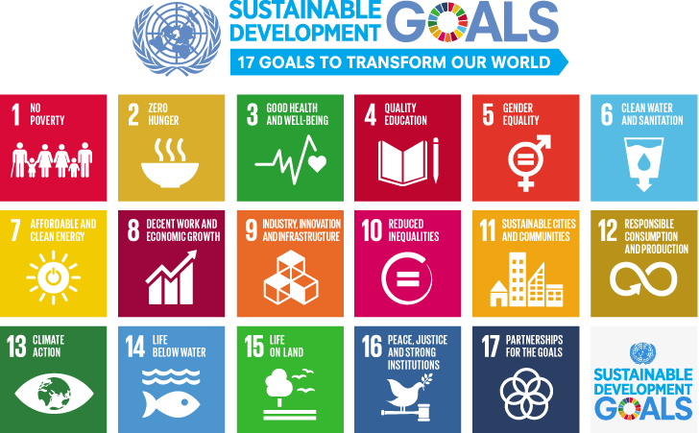
The United Nations’ Sustainable Development Goals (SDG’s)
Aspirational vision of well-being of global society
Individual and household level
In domains such as health, education and income
Structural consideration, and environmental considerations relating to the natural world
(Austin, 2020)
Notes:
Outlines 17 sustainable goals organised around three dimensions of economic, social and environmental sustainable development, whereby progress in these aspects of life are pursued in a holistic manner.
Underpins political backdrop of well-being across the world, and the SDG’s act as a guide for policy and action in nation states and intergovernmental organisations (Austin, 2019)

Slide 9
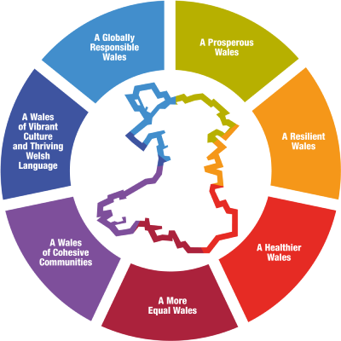
Well-being of Future Generations (Wales) Act 2015
(Welsh Government, 2021)
Notes:
Involves 7 specific wellbeing goals culminating from identified challenges in the future, climate change, poverty, health inequalities, jobs and growth.
Ultimately this manifests into child poverty, where families have inadequate economic resources, causing families an inability to engage in meaningful lives as they would chooses and also inhibits the child’s educational and cultural development, resulting in long term costs which further blight a country’s wellbeing.
For the benefit of our future generations it is recognised that as a nation we need to think about the long term impact of our decisions
This law advocates that all public bodies have a duty to uphold and act to ensure that the 7 well-being goals are worked towards achieving.
A prosperous Wales – innovative, low carbonised society using resources efficiently, bearing climate change in mind.
Developing a skilled and educated workforce in an economy which generates wealth and provides employment opportunities
A resilient Wales – maintaining and enhancing a natural environment of biodiversity safeguarding ecosystems that support social, economic and ecological resilience
A healthier Wales – where people’s physical and mental well-being is maximised with greater understanding awarded to choices and behaviours that will benefit future health.
A more equal Wales – that enables people to fulfil their potential irrespective of their background or circumstances
A cohesive community – Attractive, safe, viable and well connected communities.
A Wales of vibrant culture and Welsh language – the promotion of culture, heritage and Welsh Language, participation in the arts, sports and recreation.
A globally responsible Wales – in striving for social, economic, environmental and cultural improvements, considering the impact of doing so on global well-being.

Slide 10
Beyond GDP
‘The fundamental purpose of public policy is to protect and promote the well-being of citizens, it follows that the notion of poverty and deprivation go well beyond lack of income or consumption to include poor health status, low education and skills, weak social connections, the psychological costs of social exclusion, the exposure to risks and experience of vulnerability, and a sense of powerlessness.’
(OECD, 2014)
Watch a video delivered by Nicola Sturgeon (Scotland’s First Minister)
https://www.youtube.com/watch?v=gJzSWacrkKo
Notes:
Watch a video recorded of Nicola Sturgeon (Scotland’s First Minister) reflecting upon ‘what kind of society do we really want to be?
In Germany (2015) as part of the governments’ strategy ‘Living well in Germany’, citizens of Germany were being asked what matters to them in life, resulting in a reporting system being established which would act as an indicator of well-being, informing an action programme on how to improve well-being in Germany (The Federal Government 2023)
Two distinct differences in well-being: objective and subjective well-being. Objective well-being
Aspects of well-being relative to it being objective or subjective are acknowledged by different disciplinary approaches i.e. in economics traditional welfarist approaches regards wellbeing as
the amount of goods and services consumed.
Non-welfarist theories define wellbeing as ‘the capability’ of having the freedom to achieve these outcomes.
Sociologists believe the quality of life is not about human functioning ( good physical and mental health) but in combination with this and being satisfied with one’s own achievements as a social human being. The capability approach has been instrumental in measuring human development and is central to the majority of well-being and progress indicator initiatives worldwide.
All approaches advocate that human relationships underpin experiences of life and are shaped by the norms and values communicated through these relationships.
GDP has fundamentally been the main indicator of welfare and as a policy objective of most countries.
Wealth studies now show that economic growth (GDP) is not reflective of the higher well-being of people, as it does not reflect similar growth in household income, doesn’t reflect subjective well-being, mask inequalities in household economic resources/opportunities due to different characteristics, results in negative environmental impacts, the erosion of social cohesion and the increase in the prevalence of health conditions i.e. diabetes, mental health, hypertension.
A concept of human well-being which encapsulates institutions which are accountable and responsive and how they contribute towards development, combined with human voices are more likely to achieve development success.
Equally, underpinning the foundations of successful societies is how children are raised and educated, with care work instrumental in supporting flourishing children towards future development.
However, it is not purely health and education responsible for nurturing children, other departments and levels of government have a responsibility.
A recommendation for closer observation of child well-being when putting in place development policies would increase the chance of greater well-being in a country for the future and be sustainable. (OECD, 2014)
Rec

Slide 11
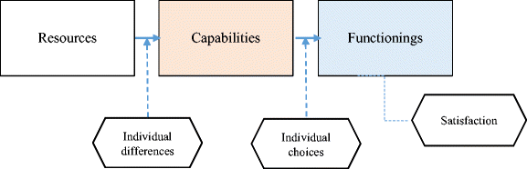
Capabilities Approach Theory
(Dalziel et al, 2018)
Notes:
SEN (the economist) proposed ‘capabilities approach theory’ which advocated how individuals have the right to influence facts that are relevant to their own lives.
This model places individuals at the centre of the model .
Resources reflect the set of rights/entitlements and commodities which are available to a person in a certain context.
Capabilities reflect the set of options one has available.
Functionings, reflect the set of ways of being/doing that a person puts into practice, what is possible and what is actually undertaken.
In focusing on capabilities, the emphasis is upon the conversion factors which help/hinder the transformation of resources into effective freedom to act.
Therefore, an appropriate public policy is one that guarantees the rights or goods and services, with appropriate conversion factors to enable an individual the capability to act.
Often researchers studying career pathways have merely looked at institutional and structural aspects related to the labour market, without enquiring into the institution of family life.
It is recommended that policies which allow for a greater set of possibilities for action when compared with the situation before the intervention was applied, would be the preferred choice.
SEN recommends that a holistic review of the internal and external factors surrounding agency to act is investigated, examining the contexts surrounding such action.
This addresses the conversion factors which mediate between the resources and the capabilities of individuals to act, what is available to use and what is actually used.
Conversion factors relate to social norms, cultural practices, personal skills and knowledge, and environmental (where one lives, infrastructure).
Time use choices influenced by cultural values, personal abilities and social capabilities are adopted in accordance with considered view of well-being.
Capabilities can be expanded by means of pursuing an education which will expose and enhance abilities, known as ‘human capital’.
Wellbeing within households and families with focus directed at child development.
Cultural capital enhances wellbeing by creating opportunities for individuals to express, develop, transform and pass on to the next generation their cultural inheritance.
Both sexes have equal capabilities for wellbeing, however significant time and financial cost is sacrificed predominantly by women to manage caregiving roles, exposing them to intimate violence.
This also accounts for the number of families growing up in low income families, where poor policy advice focusing on economic growth as opposed to wellbeing causes significant problems.
Cultural capital is acquired through investment in communities, i.e. historical sites, recreational places, environmental parks.
A group’s cultural vitality depends largely on the cultural capital being expressed within a household and family.
Research on cultural attitudes has exposed how the impact of work and family policies produce unequal opportunities for women in relation to wellbeing on account of biological differences which subject women to lower wages and lifetime losses on account of choosing to have a family.
Equitable access to services from all forms of capital is necessary for all citizens to have reasoned capabilities for leading lives of value.
Where vast numbers of the population experience restrictions in accessing services from a nation’s social capital provision, on account of particular characteristics, the capabilities of those individuals to achieve valued lives is reduced and their wellbeing restricted.
Hence, sacrifice on behalf of the dominant group to enable equitable access to other people, such as increasing the capabilities of more ethnic minority groups would raise economic productivity, aligned to social inclusion.
Employment enables all person to earn market income to purchase goods and services which enhance their lives in a manner which they value., offering social connections and helps to contribute to personal identities. Largely, those unemployed report lower values for happiness and life satisfaction.
Unemployment results in lower sense of wellbeing, psychological damage, loss of identity.
Even with social security support, 1 in 7 older aged adults are not in employment deemed high enough to pay for the essentials in life, with a strong gender disparity (gap) between men and women, with 1 in 4 women deemed to be not earning the real living wage, hence restricting their capabilities of wellbeing for themselves and their families.
Community engagement through coproduction of public services through local residents and local government officials which can develop regional capabilities of wellbeing to include regional economic development, and investment in natural capital, the ecosystem..
Attention drawn to the Nation State and its part in expanding capabilities whilst equally acting as a wise custodian of the market economy and welfare state. This requires an integrated and balanced approach to all economic and welfare policies..
Ensuring that the impact of economic growth is monitored for the wellbeing of the national population.
Intervention and participation from global intergovernmental organisations and agencies who collaborate to counteract the impacts of economic growth on human wellbeing, such as the UN in their drive to ensure more girls attend school than ever before, to ensure their wellbeing, an act of social Justice (Dalziel et al, 2018)

Slide 12
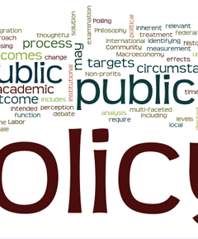
Relevance for Policy
Assessment of state of country
Measuring individual well-being
GDP inappropriate measurement indicator
New science of happiness
UK Measuring National Well-being Framework
The Capabilities Approach
Image: Stoodnt Inc.
(Austin, 2016)
Notes:
Evolved from joint statements from US Government and UK Government that the GDP evaluative system on the condition of the country was no longer appropriate.
Contemporary debate concerned for the negative impact global production was having on social and environmental aspects of life on account of economic growth.
Attention drawn to measuring wellbeing of a nation in particular psychological states, life satisfaction.
In current context economics and happiness literature relates concepts of wellbeing as either Benthamite-subjective (hedonic, individualistic), or Aristotelian-objective (eudaimonic, rationale).
When using GDP as measuring tool, wellbeing is largely concerned with ‘utility’ as the guiding principle.
Expanding on Kennedy’s speech it exposed how GDP failed to account for things that really matter to people, aligned to various forms of inequality, fails to account for inter/intra household inequalities of resources/power, excludes negative impact of economic growth i.e. health issues, impact on natural environment.
New Science of Happiness looked at the affective/emotional aspect (feelings of happiness) and cognitive/evaluative side (life satisfaction). Bentham outlook which emphasised the good of the individual and society, concerned with how to balance policy investment to achieve the greatest happiness for the greatest number of people.
Adopting this approach was seen as democratic, and non paternalistic, with emphasis on identifying which policy areas will generate largest increase in subjective wellbeing.
Some governments reported positive outcomes in health, material security, and social relationships.
Witnessed the introduction of the UK National Wellbeing Framework following David Cameron’s pursuit of quantifying the national reflection of wellbeing experienced by the nation, and explored which measures were to be included in an index of national wellbeing.
Subjective measures suggested however did not reflect the general value apportioned to these aspects of life for all individuals. Equally, adaptive preferences aligned to subjective wellbeing was seen as a vital flaw when reporting, as disadvantaged individuals, felt constrained by their circumstances to pursue alternative actions, accepted ‘their lot’ and resigned themselves to their present state of wellbeing.
Another concern that arose was how responsibility for subjective wellbeing was transferred from the collective onto the individual, diverting attention away from the very structures which cause well/illbeing, thus generating high levels of inequality.
Equally, subjective wellbeing and the impact of life events considered genetically influenced, such that subjective states generally revert back to usual ‘set points’, thus challenging the benefit that policy interventions offer, with policy constantly changing to keep ahead of hedonic adaptation.
Alternatively, objective wellbeing is a way of living and being that can be evaluated objectively. Relates to Rawl’s (the economist) who advocated the need for individuals to possess a prerequisite of goods before they are able to pursue life’s plans.
Resources are not seen as a means to an end, but as the tools by which someone can use to achieve greater things. This reflects the theory of Sen (the economist).
He advocated that individuals have different needs as each possess different abilities to transform goods into valued activities.
Some groups are discriminated against as they do not possess the abilities for example to use education to advance their occupations.
Objective wellbeing accounts i.e. OECD Measuring Wellbeing and Progress work programme, was used to measure economic and social progress evaluating domains such as health, material living standards, social connections, education, governance, environment and insecurity.
Largely objective wellbeing is concerned with the ability for individuals to flourish in these domains.
Aligned to the objective wellbeing concept evolves the ‘capabilities approach’ which focuses not only upon the resources but the freedom/agency for one to act to achieve wellbeing.
Supported by political and socio-economic environment which allows conversion of resources into outcomes.
Capabilities are considered universal, being nourished, sheltered, political voice, fulfilling work, positive relationships Without all of these people are not deemed as leading fulfilling lives.
From objective wellbeing perspective, considered paternalistic, the ability of an individual to judge for themselves what is good is undermined with their agency/autonomy to act restrained.
Capabilities Approach theorists advocate that this approach enables individuals to achieve valuable outcomes instead of objective normative targets.
Capabilities objective framework affords individuals the agency to plan own life, formulating own goals according to own context, creates space for the diversity of views regarding what constitutes wellbeing.
Assessment however is required of the social and material context in identifying what an individual is really able to be and do.
Capabilities Approach has been used in practical policy at grassroot level projects in developing countries to national level policy initiatives.
Used by UK Equalities and Human Rights Commission (EHRC) who monitor and protect equality and human rights in the UK with particular focus upon inequality.
This approach is deemed worthy of driving reform of Equality legislation at both national and local levels. (Austin, 2016)

Slide 13
A Recap
So to consolidate the learning please access the interactive Quizizz App
Via your device enter: joinmy quiz.com
Enter code: 678598

Slide 14
Questions &
Answers
Thankyou for listening

Slide 15
References
Austin, A (2016), On Well-being and Public Policy: Are We Capable of Questioning the Hegemony of Happiness? Social Indicators Research, Dordrecht Vol 127 Iss 1, [Online] Available at: https://www.proquest.com/docview/1777821191?pq-origsite=primo
Austin, A (2020). A Universal Declaration of Human Well-being, Switzerland, Springer International Publishing AG.
Brown, H, Abdallah,S, & Townsley, R (2017), Understanding local needs for wellbeing data, measures and indicators, [Online] Available at: https://whatworkswellbeing.org/wp-content/uploads/2020/02/understanding-wellbeing-locally-Nov-2017-links_0216388900.pdf
Boarini, R., A. Kolev and A. McGregor (2014), "Measuring Well-being and Progress in Countries at Different Stages of Development: Towards a More Universal Conceptual Framework", OECD Development Centre Working Papers, No. 325, OECD Publishing, Paris,[Online] Available at: https://doi.org/10.1787/5jxss4hv2d8n-en
Clark, A, Fleche, S, Layard, R, Powdthavee, N, & Ward, G (2016), Origins of happiness: Evidence and policy implications. [Online] Available at : https://www-jstor-org.ezproxy.uwtsd.ac.uk/stable/j.ctvd58t1t.5?seq=16
Dalziel, P, Saunders, C & Saunders J (2018), Wellbeing Economics: The Capabilities Approach to Prosperity. [Online]Available at: https://library.oapen.org/viewer/web/viewer.html?file=/bitstream/handle/20.500.12657/23025/1007136.pdf?sequence=1&isAllowed=y
Wallace, J (2019), Wellbeing and Devolution:Reframing the Role of Government in Scotland, Wales and Northern Ireland. International Publishing.
Welsh Government (2015), Well-being of Future Generations Act (Wales) Act 2015: the essentials, {online} Available at: https://www.gov.wales/well-being-future-generations-act-essentials-html

