Slide 1

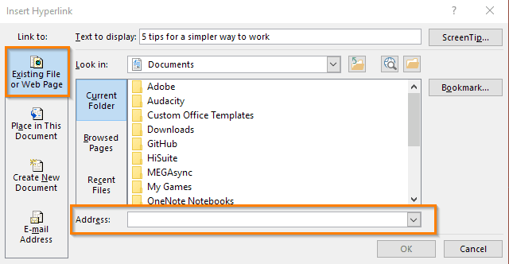
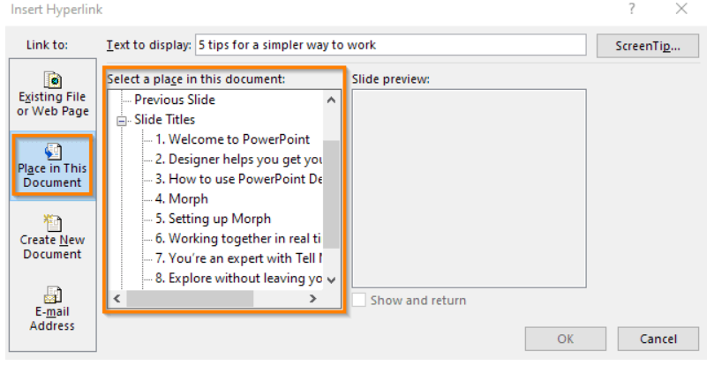
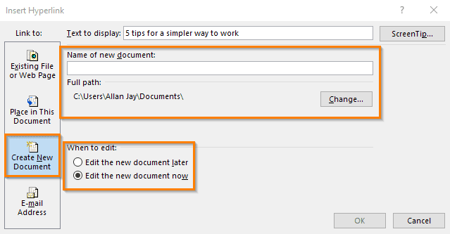
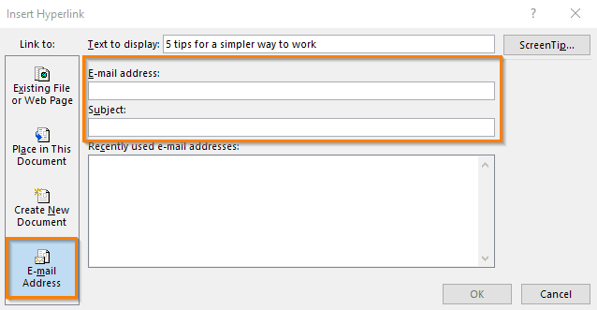
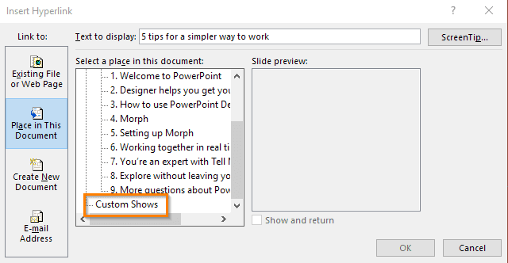

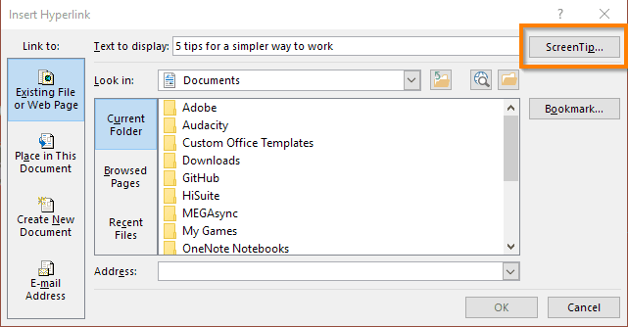
Introduction
How to insert hyperlinks into PowerPoint presentation
Student Name: Alexandru Florin Paun / Student ID: 2411677 / Group: 3
Lecturer Name: Suneth Warnakulasooriya
Contextual anchor objects
Whether you are using texts, shapes, or photos as anchors, it should provide a clue to the destination of the link.
This will prevent any confusion during the presentation.
For example, if you want to jump to a specific web site, you can use its name as an anchor text.
Macleod, C. M. (2020). Zeigarnik and von Restorff: The memory effects and the stories behind them. Memory & Cognition, 48 (6), 1073-1088. https://doi.org/10.3758/s13421-020-01033-5
Use screenshots instead of hyperlinking to a website
If you only want to show your audience a website, it is much more efficient to take a screenshot than using a hyperlink to redirect to the website.
It saves you a few clicks and minimizes issues such as a bad Internet connection.
Martin, F. (2008). Effects of practice in a linear and non-linear web-based learning environment. Educational Technology & Society, 14 (4), 81-93. https://www.jstor.org/stable/jeductechsoci.11.4.81
PowerPoint software (Microsoft, Redmond, WA) has become a popular tool for creating and displaying electronic presentations.
The “hyperlink” function in PowerPoint allows users to advance from one slide to another slide in the presentation when they click on a predetermined word, shape, or image, thereby allowing for a more dynamic and interactive experience than can be obtained with serial presentation of slides alone.
J.E. Barone et al.Some tips on slide-making and electronic presentation Curr Surg (2002)
Creating a Hyperlink
PowerPoint software (Microsoft) has become a popular tool for creating and displaying electronic presentations.
Such presentations typically consist of a series of “slides” that are presented in sequential order by a lecturer to the audience or are viewed in sequential order by an individual at a computer workstation.
C. Dodds PowerPoint presentations Curr Anesth Crit Care (2004)

