Slide 1

Digital Skills for Personal and Professional Growth
Name: Maimouna Sylla
ID Number: 2439953

Slide 2

QR code
Module Code: BMSW4008
Lecture Phillipa Fitzgerald
Deadline 01 December 2025

Slide 3
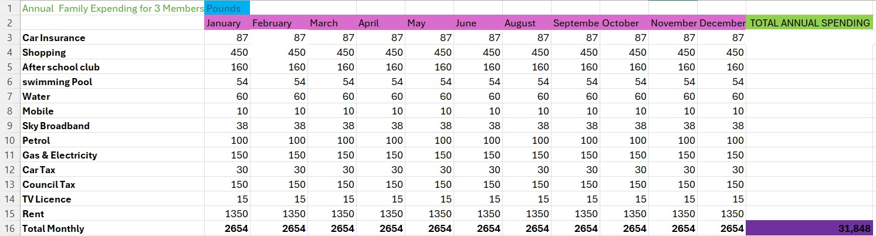
Excel personal details

Slide 4
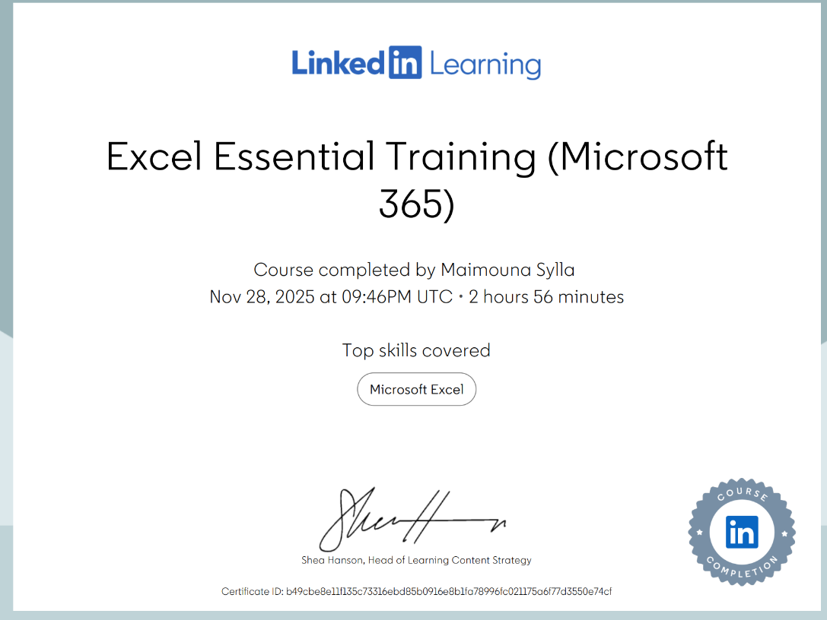

Certificate of completion Excel
Excel essential Training (Microsoft 365)

Slide 5

Reflection on Digital Skills and office 365 Learning
This Topic reflects on a journey to improve digital proficiency, focusing on practical application and continous growth in dynamic landscape of Office 365
ThePhoto by PhotoAuthor is licensed under CCYYSA.

Slide 6

Digital Skills Module Overview
Build essential digital academic in personal Development
2 Gain office 365 Proficiency
3 Apply Excel Skills Practically
4 Reflect and Plan Future Use
Identify current abilities and areas for improvement, develo confident using word, Excel, and powerPoint. Apply Excel tools to rea-word tasks and data. Reflect on leaning and how touse new skills moving forward.
ThePhoto by PhotoAuthor is licensed under CCYYSA.

Slide 7
Digital skills
Outlook & Task Management
Artificial Intelligence
Microsoft office 365
Areas for Improvement
Email features, inbox management
Calendar scheduling & Events
To do lists & planner overview
Beginner AI tools (ChatGPT,
Copilot)
AI in Word, Excel, PowerPoint

Slide 8
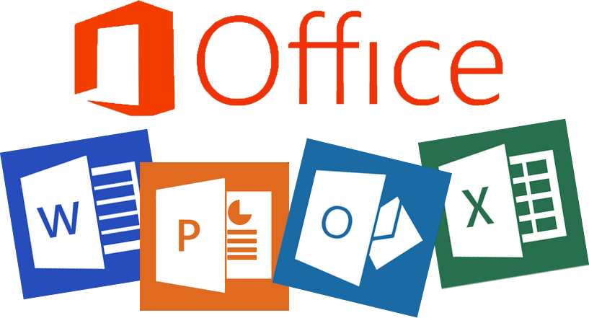
using Microsoft office tools for effectively
Microsoft Word Mastery
PowerPoint presentation Skills
Excel Data Management & Analysis
Purpose of the Essay, Key Use Cases Demonstrated, Key Insights Learned
Mastering Key Tools for the Modern Workplace
Integrating Data for impactfull Communication
ThePhoto by PhotoAuthor is licensed under CCYYSA.

Slide 9
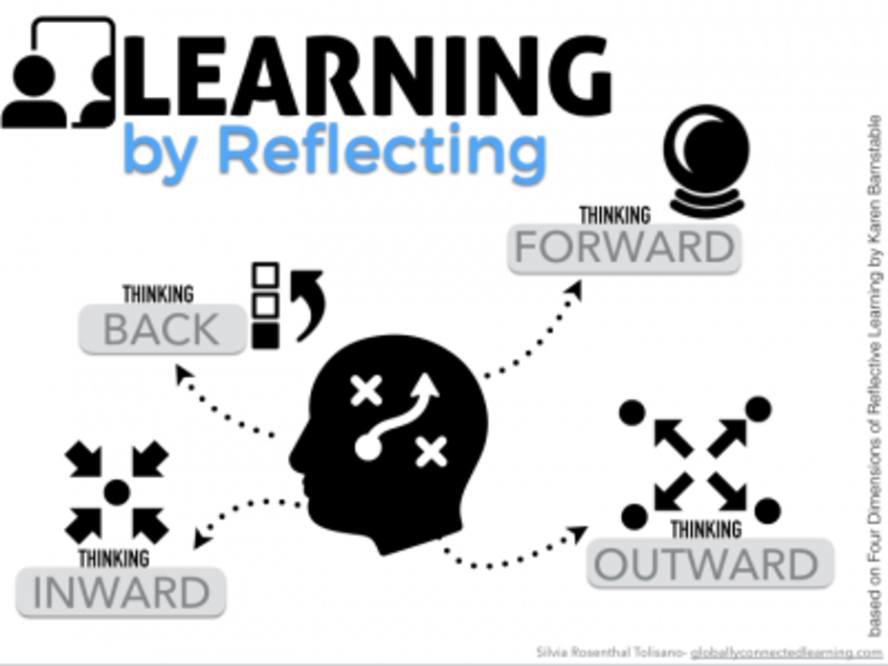
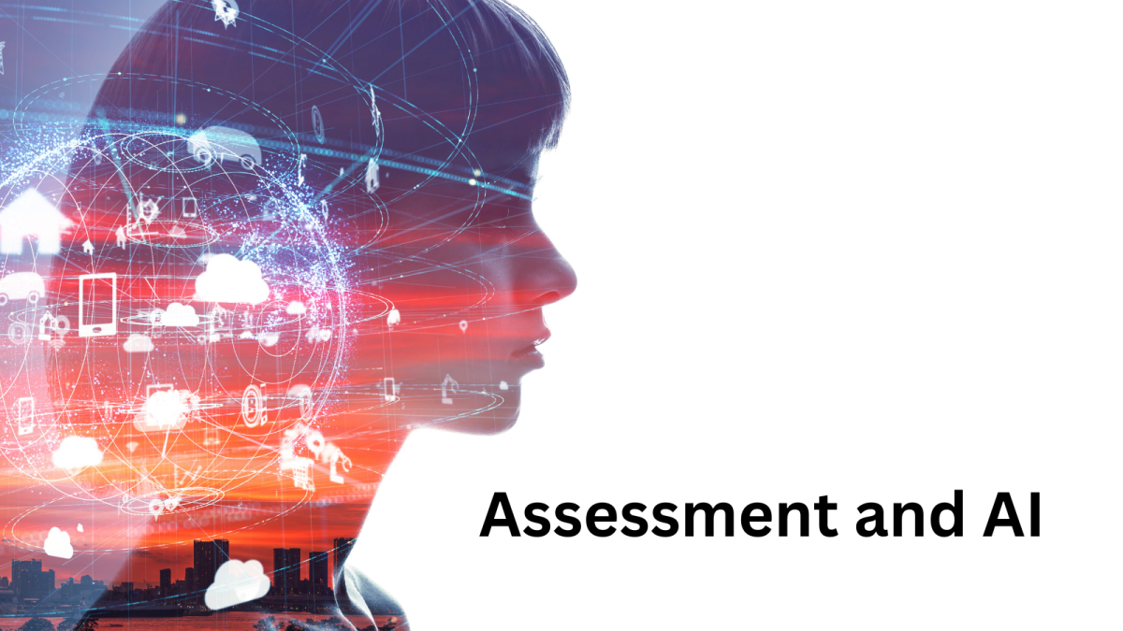
Integration & reflection
How Tasks connect:
A Journey from Baseline to Beginner to expert
Assessment Start evaluation of existing digital skills and identification of specific areas
Learning: Targeted study and certificate in office 365 appliction (Word, Excel PowerPoint)
Application: Practical development of aquired skills through tasks like the Excel essay and emmbedded spreadsheets.
Improved: advancement of digital leteracy, efficient document creation and confident tool usage.
ThePhoto by PhotoAuthor is licensed under CCYYSA.
ThePhoto by PhotoAuthor is licensed under CCYYSA.
ThePhoto by PhotoAuthor is licensed under CCYYSA.

Slide 10


Kelly, O., Hall, T. & Connolly, C. (2023) Digital Workplace Skills: Designing the Integrated Learning of Accounting and Microsoft Excel. Accounting, Finance & Governance Review. Available at: https://doi.org/10.52399/001c.77593
Csernoch, M., Kiss, J. T., Takács, V. & Máté, D. (2024) ‘Exploring Higher Education Competencies through Spreadsheet Self‑Assessment and Time’, arXiv. Available at: https://arxiv.org/abs/2409.12974
Holzberger, A. (2024) ‘A scaffolded learning approach to increasing student comfort with Microsoft Excel’, Journal of Marketing Analytics, 12, pp. 198–208.
Baltaci, S. (2023) ‘Workplace literacy skills — how information and digital literacy affect adoption of digital technology’, EPALE.
Lin, A. & Roan, L. (2022) ‘Impact of Digital Skills on Employability: Cross‑Sectional Analysis’, MDPI Economics.
References
ThePhoto by PhotoAuthor is licensed under CCYYSA.
ThePhoto by PhotoAuthor is licensed under CCYYSA.
ThePhoto by PhotoAuthor is licensed under CCYYSA.
ThePhoto by PhotoAuthor is licensed under CCYYSA.

